Slide 1
Capital Consortium Internal QC

Slide 2
FNS not conducting reviews for fiscal year October 2020 to September 2021. Our error rate remain the same.
  The Active Error Rate for Capital Consortium for FFY 2020 Food Share-October 2019 to February 2020 is currently at 13%
  This highest error rate among all the agencies in the State of Wisconsin
  The error rate for the State as a whole is 8.35%
  The error rate for the State is above the threshold of 6% that could result in corrective action

Slide 3
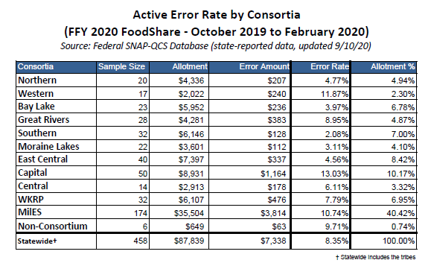
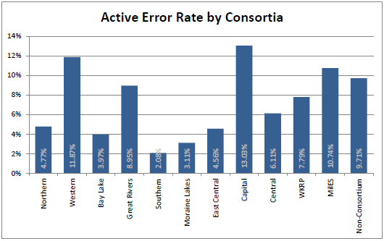

Slide 4
The most common errors in Capital remain the same
  Wages and Salaries, House Composition, Shelter Deduction
  Child Support Payments received from absent parent, Wages and Salaries, Summary page not generate
  Asset assessment, Shelter Deduction, and Child Support Payments received from absent parent
  Household Composition, SSI and/or State SSI Supplement, ABAWD FoodShare clock

Slide 5
A report as of December 2020 shows that about 30% of our cases have Earned Income
We need to achieved less than 10% error on targeted QC cases with Earned Income in order to be under the 6% overall error rate

Slide 6
Pre-Certification Project
  Focus on EI, CS, SUE, HH comp
  First run – workers sent cases open for FS that had EI and/or CS
  Second run – workers assigned EI project work had all work reviewed
  No confirmation until lead worker reviewed for accuracy
  Lead workers tracked results and shared findings with line worker/supervisor via email
  Results compiled by QC Project Lead (Antonio)

Slide 7
Pre-cert Final Results
Error Elements | Total Correct | Total Incorrect | Total Samples | Accuracy
Wages and Salaries | 1011 | 244 | 1255 | 80.56%
Child Support Payments Received from Absent Parent | 398 | 73 | 471 | 84.50%

Slide 8
Pros
Cons
Pre-cert allowed agency to maximize accuracy – benefits were not confirmed until the lead worker reviewed the case
Real-time correction – turnaround was same day/next day
Real-time teaching moments – immediate feedback while case is fresh
Immediate turnaround was resource intensive – significant time investment
  Approximately 15 minutes per case review, numbers submitted each day varied
Reviews were not truly random/staff had ability to know when review would happen
Due to pandemic, lack of EI docs to review

Slide 9
Change in Direction – Move to QC instead of Pre-Cert
  Testing new process at this time, start date September 7, 2021
  Reduced QC staff from 15 to 5 reviewers to improve consistency
  Using CWW Work Item Search to pull completed EI, EVFE, SEI documents
  Reviewing documents completed 7-10 days prior
  25 cases assigned each week
  Targeting 8 of the 25 cases for review of top error elements
  Emphasis on all 8 cases being unique workers

Slide 10
Results will be shared with you and your direct supervisor once a month by email
If you disagree with the review, let your direct supervisor know
Your direct supervisor will work with the QC team to resolve the issue
The QC team is responsible for fixing cases when necessary

Slide 11
Reminders
  We all are responsible for Quality Assurance
  It is the expectation that every time you run eligibility on the case that you check the budget and non-financial page results to ensure accuracy and take the proper steps to ensure the case is accurate if you find any discrepancies
  This should not be interpreted as doing a QC of the entire case
  If you find an error on a case, you should correct the case going forward. If the previous worker made an error, staff should notify his/her supervisor for follow up

Slide 12
Always follow the first contact resolution approach
First contact resolution at the Capital Consortium:
  Process all documents, SMRF, Renewals, Changes, and any other banner items
  Always collect Telephonic Signature during phone interactions
  Process all Discrepancies, and other work items
  Program adds
  Complete Baby and Person adds
  Complete RFA to set FS filing date if customer cannot stay on the phone to complete the full application interview
  New FS and HC request
  Complete missed intake and review appointments
  Complete FS interviews
  Check to see if a renewal is due soon for the case you are accessing. You may be able to take care of the renewal with the customer now and reduce repeat calls for the same case
  Sync reviews dates when possible
***The list above is not all inclusive. Workers need to look at the entire case, and use their critical thinking skills to determine what is needed on the case, so the caller will be satisfied and not need to call back again***.

Slide 13
Second Party Reviews
  State QC different from the active error rate
    Top Errors
      Citizenship/ID verification not on file
        Use data exchanges whenever possible
      Authorized Rep form not on file or the form is on file but not complete
        A complete Appoint, Change or Remove Authorized Representative form (F-10126) must be on file for an authorized representative designation to be valid-Section 1.2.31.
        If required information is missing on the form, including any of the signatures, the form will be considered incomplete, the witness cannot be the client or the authorize rep

Slide 14
OTX vs. 15. Delete
  Make sure you ask the right questions before deleting someone
  15 should be uncommon
  Delete if the person is not a tax dependent, OTX if they are

Slide 15
Your QC TEAM
Antonio Esterrich
Michele Chiuchiolo
Heidi Denure
Carol Sjoblom
Adam Chorlton
Kara Ponti
Alex Premo*
David Bernhardt
Jeremiah Cook*
Lisa Danowski*
Robyn Johnson
Tracy Kok
April Lee*
Patricia Porto-Sanchez
Amber Taylor*
HSEAQC@countyofdane.com
*QC Reviewer

