Slide 1
Errors on the Income Pages
Updated August 2019

Slide 2
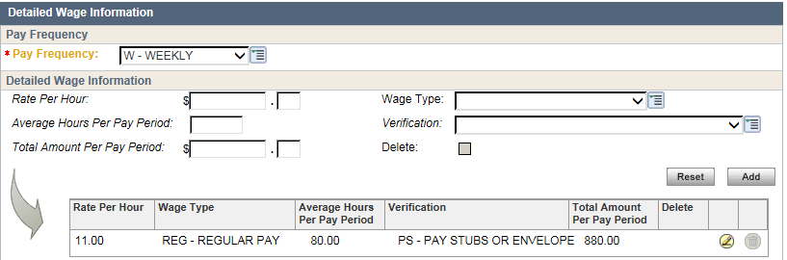
Common Error #1
Over-budgeting earned income
  Example - when you enter the bi-weekly hours, but enter the frequency as weekly

Slide 3

How does this error affect…
Our customers?
Our agency?

Slide 4

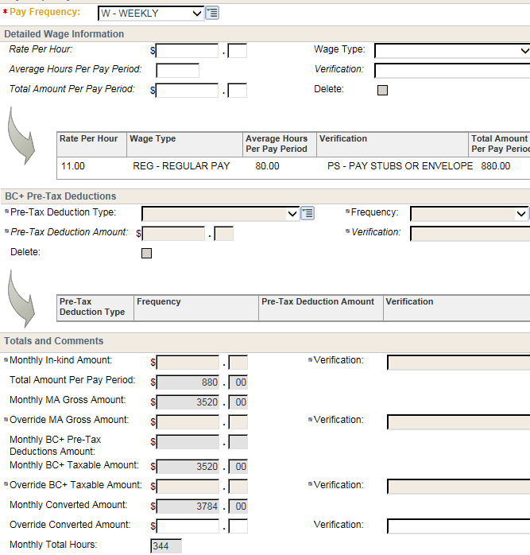



Compare your dynalist with the verification received (i.e. EVFE, Paystubs).
In this example, client works 40 hrs per week, and is paid biweekly.
$11 x 80 x 2.15 = $1892, NOT $3784
Review the EI Page

Slide 5
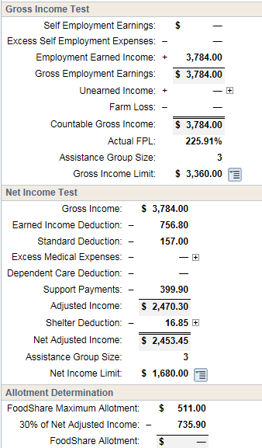
Review the Budget Page
You know this person works 40 hours per week, and is paid $11 per hour.
What do you expect to see on the budget page?
$11 x 80 x 2.15 = $1892

Slide 6
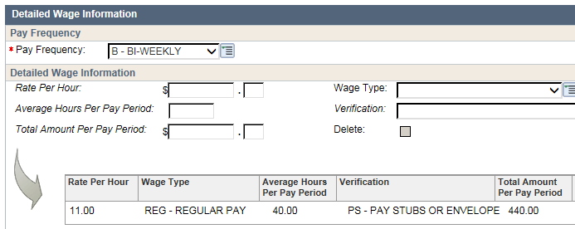
Common Error #2
Under-budgeting earned income
  Example - when you enter pay frequency as bi-weekly, but the client is paid weekly.

Slide 7
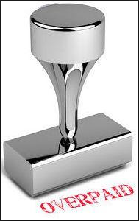
How does this error affect…
Our customers?
Our agency?

Slide 8
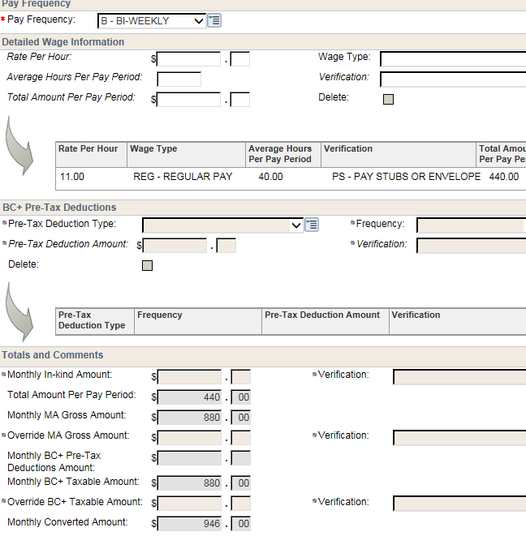

Compare your dynalist with the verification received (i.e. EVFE, Paystubs).
In this example, client works 40 hrs per week, and is paid weekly.
$11 x 40 x 4.3 = $1892, NOT $946

Slide 9
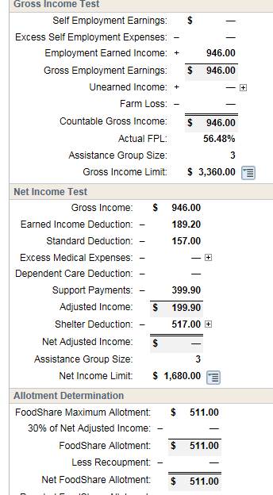
Review the Budget Page
You know this person works 40 hours per week, and is paid $11 per hour.
What do you expect to see on the budget page?

Slide 10
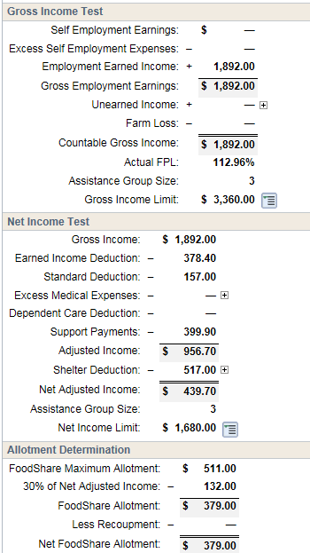
The correct budget page
In the first error, we denied this family’s FS, and they lost out on $379 per month
In the second error, client was overpaid $132 per month. If budgeted for 12 months, client overpayment would total $1584.

Slide 11
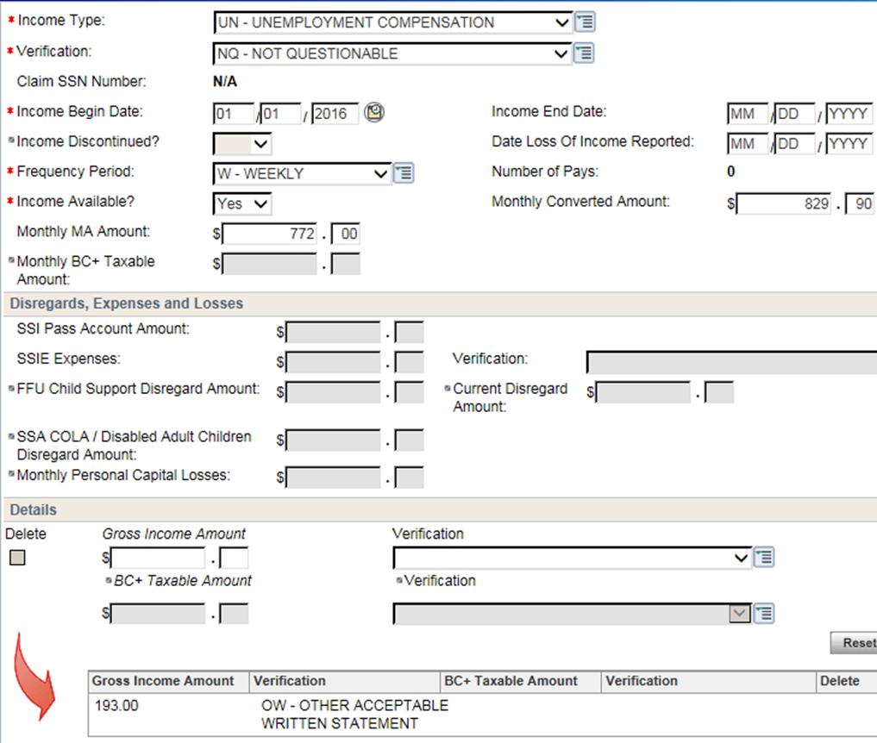


Be careful on UI pages as well!
Selecting Wrong Pay Frequency on UI page will have negative impact as well.
Remember, CWW will multiply what is in the dynalist by the frequency that you’ve entered.
Check your entries!!!

Slide 12
Review your entries
  Compare the frequency to the income per pay period – do your selections make sense?
Review the EI and UI pages
  Do they match your predictions?
  Right pay frequency selected?
Review the budget page
  Do income totals and allotment equal what you would expect?

