Slide 1
Let’s talk QC

Slide 2
Active Error Rate
An estimate of the proportion of cases with an error in the determination of eligibility or basis of issuance. This estimate will be expressed as a percentage of the completed active quality control reviews.

Slide 3
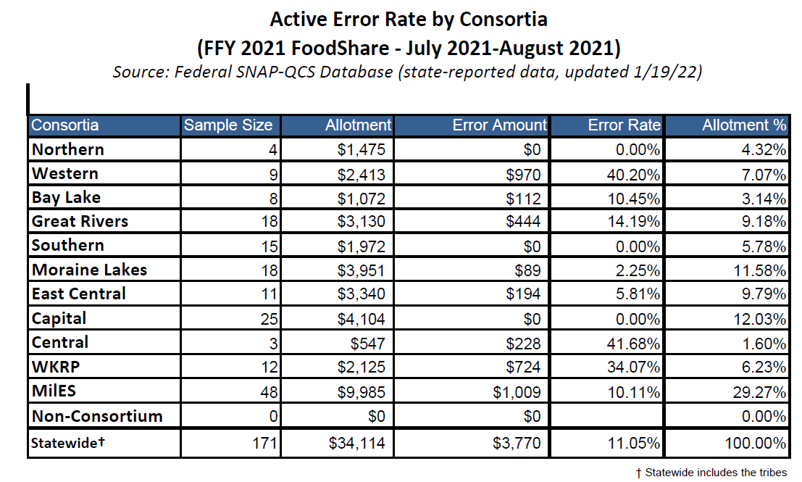

Slide 4
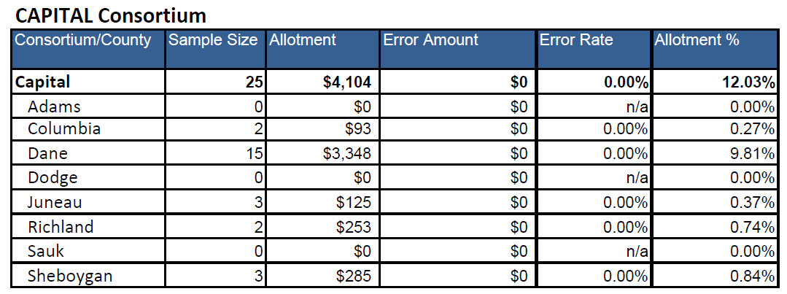

Slide 5
CAPER
(CAPERs), “case and procedural error rates” which measure whether the consortia properly denied, suspended, or terminated SNAP benefits to certain households and properly notified those households of its decision.

Slide 6
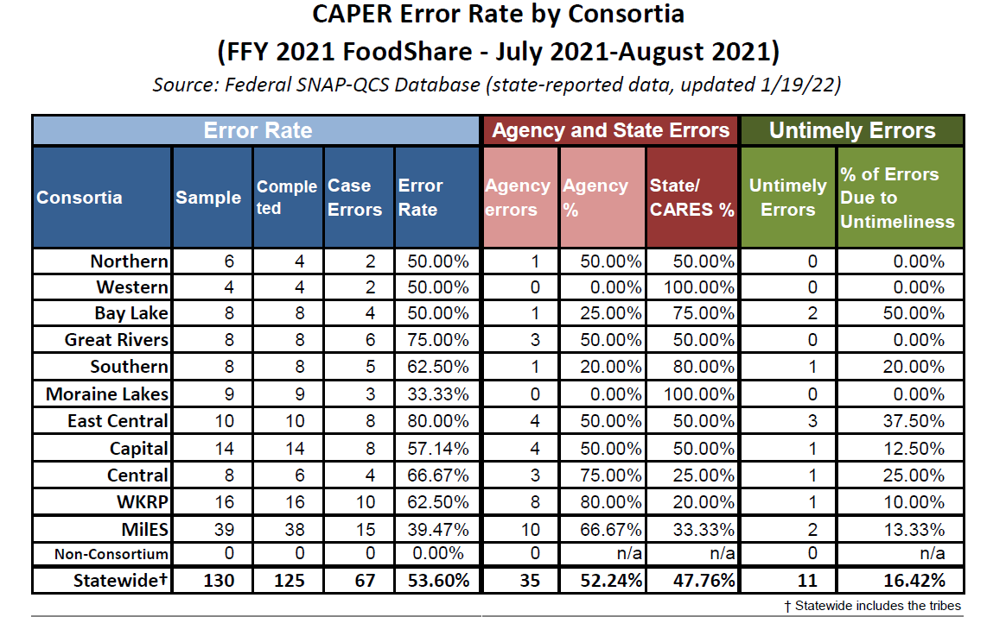

Slide 7
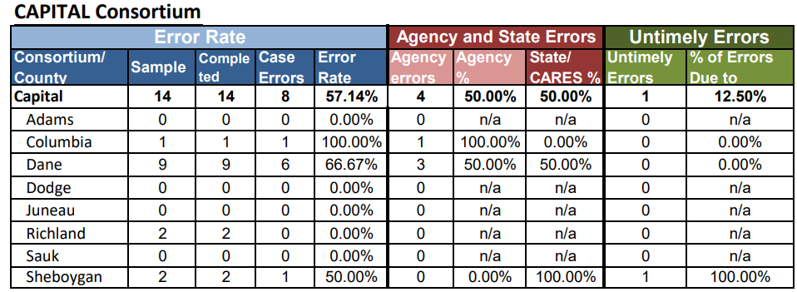

Slide 8
Second Party Reviews
Second party reviews provide an opportunity to informally evaluate and monitor policies and processes of the Income Maintenance (IM) programs. The goals of the second party review process are to:
  Establish baseline data so that program improvements can be measured,
  Identify areas for cost savings and program improvement,
  Maintain a focus of payment accuracy on IM programs,
  Minimize workload by combining both Healthcare and FS second party review process, and
  Provide an opportunity for agencies and the Bureau of Enrollment Management to work together to identify program improvement opportunities.

Slide 9
Goal of Targeted Reviews
The Healthcare and FS 2nd party review is a targeted review, focusing only on top error elements, not the entire eligibility circumstance for each program. Some errors may be missed in targeted reviews, however it is anticipated that targeted reviews will maximize the number of errors that can be identified and fixed without significantly increasing local agency workload.

Slide 10
SECOND PARTY REVIEWS
Second Party Review Error Elements (data based on 3 months, not monthly)
  Top 5 Statewide Page Error are Employment (30.17%), Current Demographics (11.98%), Permanent Demographics (6.20%), Representative Details (5.79%), and Confirmed Assistance Group Summary (4.13%).

Slide 11
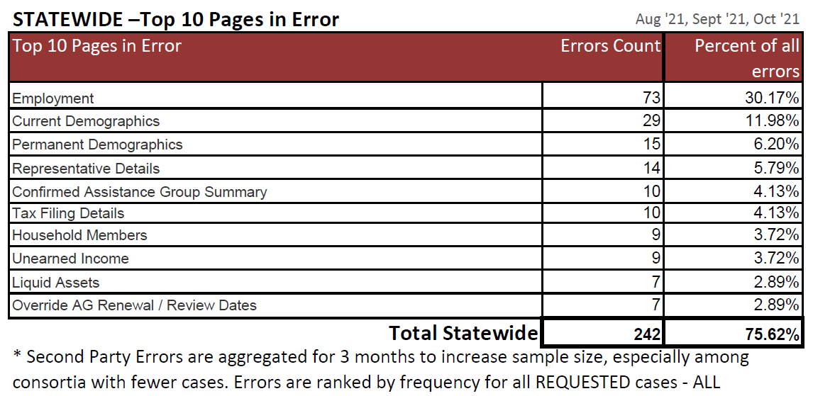

Slide 12
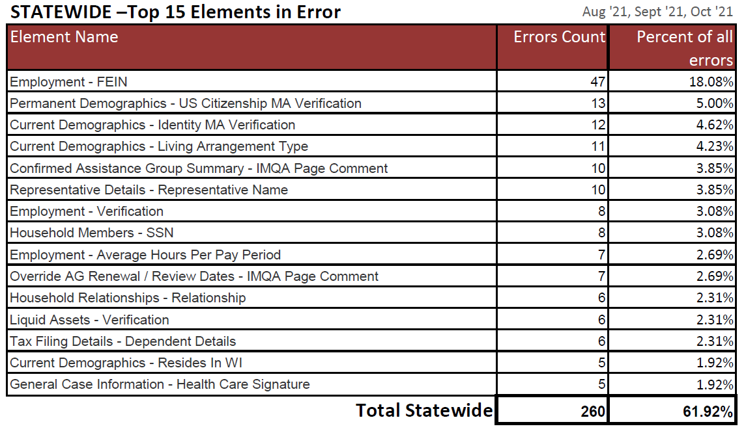

Slide 13
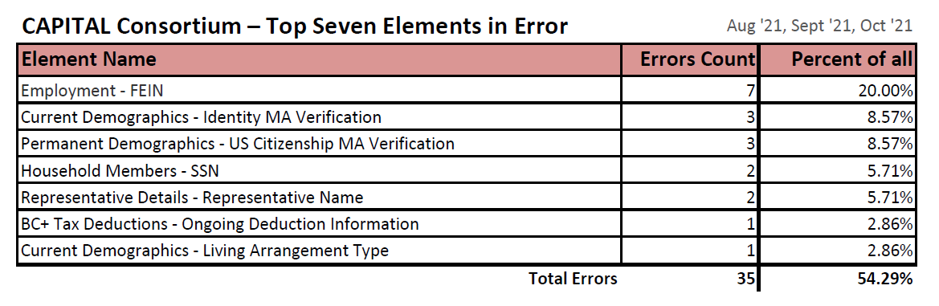

Slide 14
INTERNAL QC-IM
The internal QC process of IM is similar to the second party reviews but it is more targeted
The focus is on the most error prone area, Earned Income but we also look at Child Support, Shelter and Expenses, and Household composition
The goal is to reduce the errors on the Earned Income pages and elements, regardless of program, to reduce our overall error rate since this is the most error prone area
Cases are selected based on Earned Income documents that were processed recently
We pay attention to procedural errors as well as a preventive measure
Our internal error is not a reflection of our active error rate, or CAPERS

Slide 15
Internal Error Rates Results
 | Earned Income Correct | Household Composition | Shelter and Utility Expense | Child Support Income | Results | Time in minutes to complete the review
Sample Size | 296 | 295 | 249 | 47 | 296
Correct | 199 | 292 | 244 | 41 | 195 | 13.18
Incorrect | 97 | 3 | 5 | 4 | 101 | 21
Error rate | 32.77% | 1.02% | 2.01% | 8.51% | 34.12%
YTD as 02/15/2022

Slide 16
CHILD CARE QC (Dane Only)
2021 Wisconsin Shares Targeted Case Reviews
County | Quarter | Target Cases Reviewed | Cases wiwth Errors in Target Review | % of Error with Target Review | Incorrect Child Care Activity Code | Scheduled not entered
Dane | Q-1 | 8 | 0 | 0.00%
 | Q-2 | 7 | 1 | 14.29% |  | 1
 | Q-3 | 11 | 1 | 9.09% | 1
 | Q-4 | 12 | 1 | 8.33% | 1
Error treshold: 20%

Slide 17
Child Care QC Results

Slide 18
ERRORS
FIELD | ISSUE | RECOMMENDATION
DOB | Coded incorrectly | Make sure it is not NQ, and it matches the verification on file.
ID | Coded incorrectly | Once the system verifies the SSN, that is verification of ID-Use DE
EI | The verified hours do not match the schedule in case comments | Add up the hours when collecting the schedule. They must be the same as the employment hours verified
Authorization | The verified hours do not match the scheduled hours | Case comment any unpaid lunch or other breaks that would make the authorization higher than the verified hours
Travel Time | Calculating average, rounding up, and no comments supporting the travel time | Do not round up travel time and make sure that you document the rationale for the travel time allowed.

Slide 19
Approved Activity Schedule Must Correlate with Approved Activity Verified Hours aka 10 Hour Rule: CC HB 2.4.3.1
The worker should take into consideration:
  Unpaid lunch: one hour per eight-hour shift
  Other unpaid breaks: 30 minutes per eight-hour shift
  Unusual circumstances that may not be reflected in pay stubs

Slide 20
Unusual Circumstances Not Reflected In Paystubs
    Child was ill and the parent missed work
    Parent was ill and had fewer work hours
    Parent or child had medical/dental appointment and missed work
    Vacation
    Parent was sent home early due to low workload
    Parent was called into work due to increased workload
    The employer closed the business due to holiday, weather, or other

Slide 21

Ask The Parent
If the discrepancy can be resolved or reduced to 10 or fewer hours through a conversation with the parent, the worker must enter case comments and accept the parent’s schedule

Slide 22
MAKE SURE WE USE THE
TEMPLATE FOR CHANGES
COLLECT THE FOLLOWING INFORMATION
  Name of the new employer
  Date new employment/activity started
  New work schedule
  Does the new work schedule correlate with the hours they reported?
  What are the new daycare needs?
  Is there a change in travel time need?
  Date old employment/activity ended.
  If the new job is not verified, place them into an APPROVED ACTIVITY SEARCH PERIOD(ACTS) the month following the loss of employment

Slide 23
Travel Time
CC Handbook 2.4.3.10
Document the rationale for the amount of or lack of travel time need in case comments
More than one hour per day must be verified
Use the maximum amount of daily travel time needed
CC Handbook 2.4.1
Travel time details must be documented in case comments in CWW, CSAW, or both systems
Agency practice is to document in the template in CWW case comments
Required by the system in CSAW travel time comment box

Slide 24
Questions?

