Slide 1
Qc Reminders
FEINs and the connection to Reasonable Compatibility and Access to Insurance

Slide 2
FEIN Numbers
Federal Employer Identification Number
Think of this like an SSN for employers
No FEIN or Wrong FEIN? Effects accuracy and/or effectiveness of….
  Reasonable Compatibility
  Access to Health Insurance
  SWICA matches (False-Positives)

Slide 3
FEIN Numbers continued
Best practice for locating FEINs…
  Use Employment Data Exchanges
    New Hire Matches
    Quarterly Earnings Data
    FDSH
    Search option on the Employer page in CWW
Pulling FEIN from the Data Exchanges is preferred to using the CWW Search

Slide 4
FEIN Numbers continued
What if a FEIN cannot be found?
  This should be rare for client’s that hold traditional employment
  Attempting phone contact with Employer is an option
  If cannot locate a FEIN, case comment!
    New job with no matches, client has not provided an SSN, etc.

Slide 5
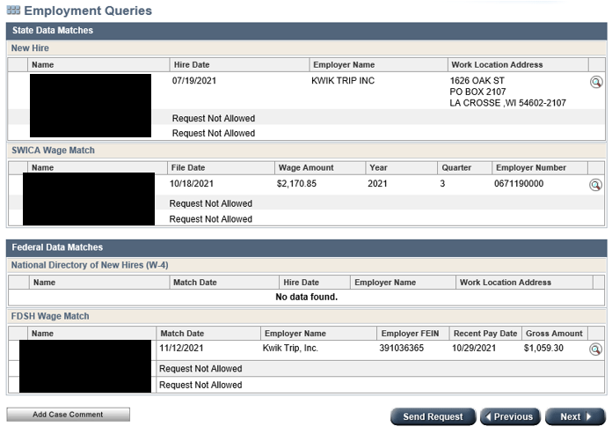
This case has at least three options for pulling the FEIN.
Using FEINs from the Employment Queries is best practice.

Slide 6
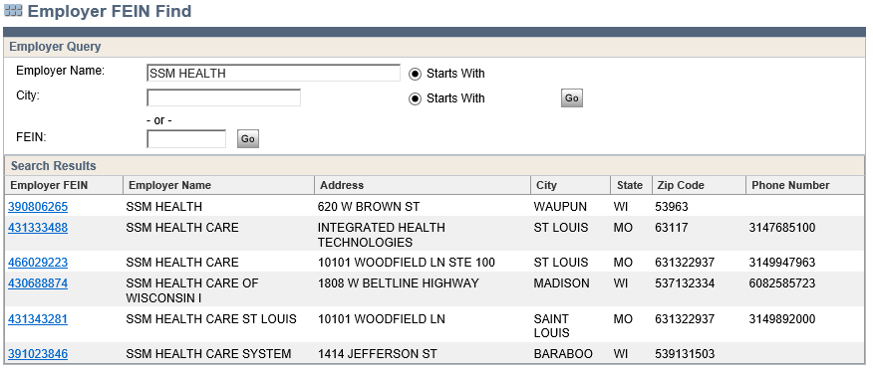
Notice six different FEINs are returned when using the Search option from the Employment page…use only as a last resort.

Slide 7
Reasonable compatibility
BadgerCare Plus Eligibility Handbook Section 9.12
Process Help 10.3.5.4 Reasonable Compatibility Results
This is a HC only process
No FEIN or wrong FEIN and process will not work
Important to understand as it can save time
  If RC is met, case can potentially pass HC without verification from client

Slide 8
Reasonable compatibility continued
The reasonable compatibility test will apply to the following:
  BadgerCare Plus based on MAGI rules, except BCP deductibles
  Family Planning Only Services (FPOS) based on MAGI rules
  Elderly, Blind or Disabled Medicaid (EBD MA), except deductibles
  Medicaid Purchase Plan (MAPP)
  Medicare Savings Program (QMB/SLMB)
Health Care Programs not included are:
  Unmet Medicaid deductibles
  Home and Community Based Waivers (HCBW)
  Institutional Medicaid

Slide 9
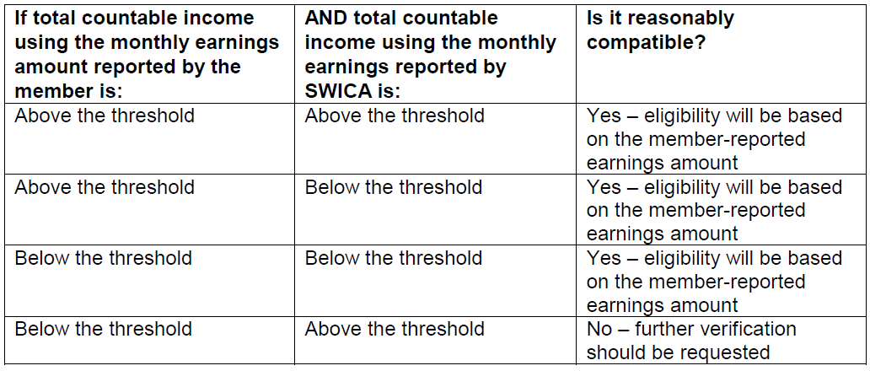
Reasonable compatibility continued

Slide 10
Reasonable compatibility continued
Simplest way to define RC?
  CWW take the client’s reported employment income then compares it to the available employment income on the SWICA or FDSH data.
Keys to a successful RC run:
  FEIN
  Use the client’s self-declared earnings
  No client report or unclear report? Enter $0.00 in the Overrides and pend
    Using anything else, such as $1.00 or $0.01 could result in RC passing
    Never use SWICA or FDSH data as an income estimate – will go to RC as well.

Slide 11
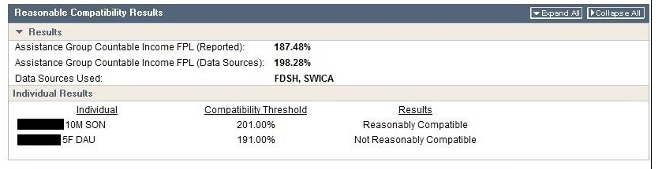
Reasonable compatibility continued
More reminders….
  if RC passes, ?, NV, Q?, QV will have no negative effect on the HC benefit determination.
  RC results are found on the HC Budget pages

Slide 12
Employer Verification of Health Insurance (EVHI)
Process Help 44.3.6
BC+ Handbook Chapter 7
Accurate FEIN needed for this process to work.
DHS maintains a database of HI access information based on FEIN
No FEIN or wrong FEIN can lead to incorrect benefit determination

Slide 13
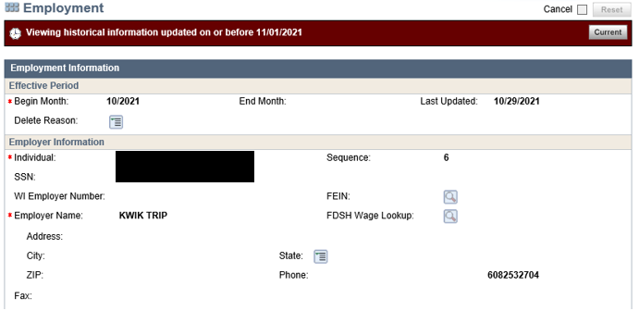

Slide 14
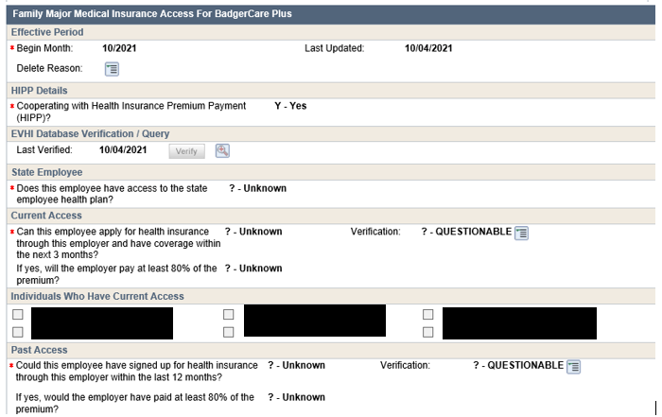
No FEIN entered, leading to “? – Unknown” populating in the HI Access section of the Employment page.

Slide 15
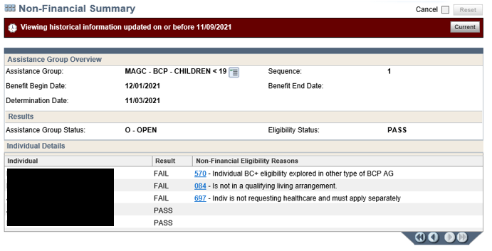

Slide 16
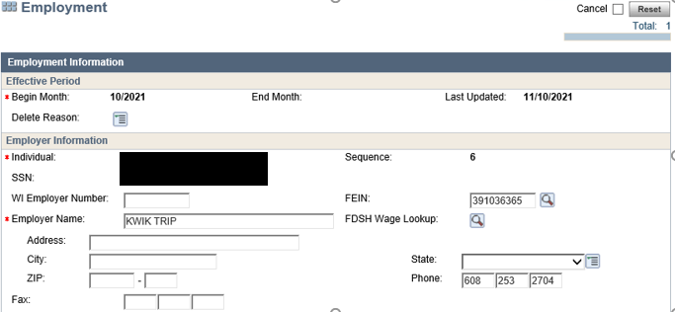

Slide 17
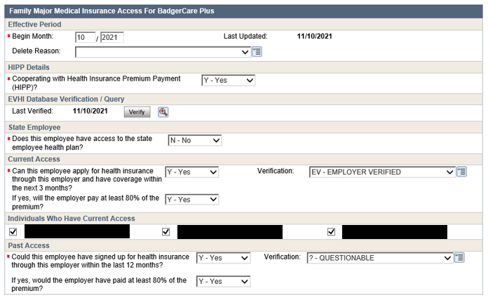
FEIN is now entered and EVHI Database populates HI Access information.

Slide 18
