Slide 1
Trauma Informed Care Foundation Session
Capital Consortium
Notes:
Welcome to the TIC journey we about to embark on our consortium community.

Slide 2
Triggers
If you need to leave, stand up, take a walk.
Notes:
We will be discussing topics that are very sensitive and may trigger very powerful emotions. If you need to leave, stand up, or take a walk, it is perfectly fine. Check with your supervisor for resources available in your county.

Slide 3
Building a Resilient and Trauma Informed Consortium Community (RTIC)
RTIC is a journey………..
This will take some time
There will be bumps along the way
Everyone will learn differently and at different paces
We will get there together
Notes:
We are on this together but each person is also on an individual Journey based on personal experience, ACES, and knowledge of TIC.

Slide 4
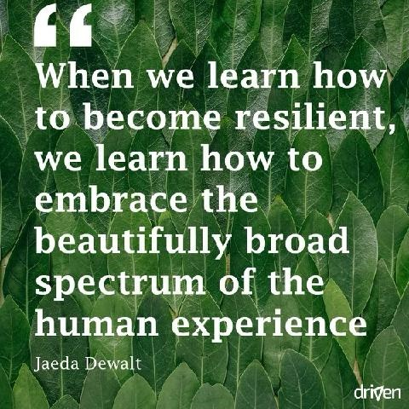
Notes:
Resiliency is going to be our recurring theme. I would like to share this quote: “when we learn how to be become resilient, we learn how to embrace the beautifully broad spectrum of the human experience”.

Slide 5
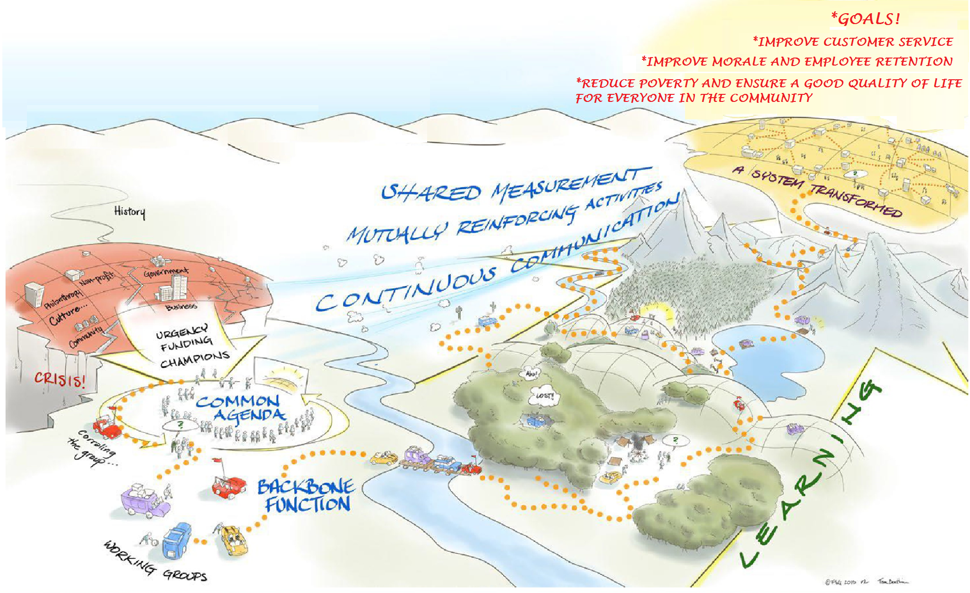
Notes:
A resilient and trauma informed consortium community is a continuum. It would change over time and some people and partners would find themselves at different stages of the process. However, it very important to have a strong foundation. This picture shows the complexity of a system pull apart by competing priorities. After reaching a common agenda and developing a strong foundation and working groups, a system can be transform and work towards achieving its common goals.

Slide 6
Common language
-Adverse Childhood Experiences:
-Trauma-Informed Care:
-Resilience
Notes:
ACEs are an accumulation of adverse experiences in childhood that produce toxic stress. The more ACE situations a child encounters (abuse, neglect, household challenges), the higher the risk to experience negative health and well-being outcomes as an adult.
-An approach/perspective shift that promotes recovery and well-being by recognizing ACE symptoms and the role trauma has played in someone’s life.
-The ability to thrive, adapt and cope despite tough and stressful times. ACEs are common but do not have to represent a lifelong risk factor. By fostering resilience, we can reduce risk and help people recover from ACEs when the right supports are in place.

Slide 7
Common language continued…
Consortium Community: Caring for yourselves, each other and clients we serve.
Collective Impact: The commitment of a group of important actors from different sectors to a common agenda for solving a specific social problem.
Tools of civility: It’s not what you say. It’s how you say it. Intentionally and sincerely invite diverse perspectives. Seek participation; take responsibility; include yourself! Use common language; avoid jargon.
Notes:
What is common language and why do we care?
Consortium community means all counties working together towards a common goal. Caring for yourselves, each other, and the clients we serve…in not a specific order…
Collective impact: We interact with different agencies, groups and clients that have an impact on the work we do
Tools of civility-we would use the tools of civility as a guideline of principles that would guide communications going forward. Including but not limited to: emails, meetings, and CCA.

Slide 8
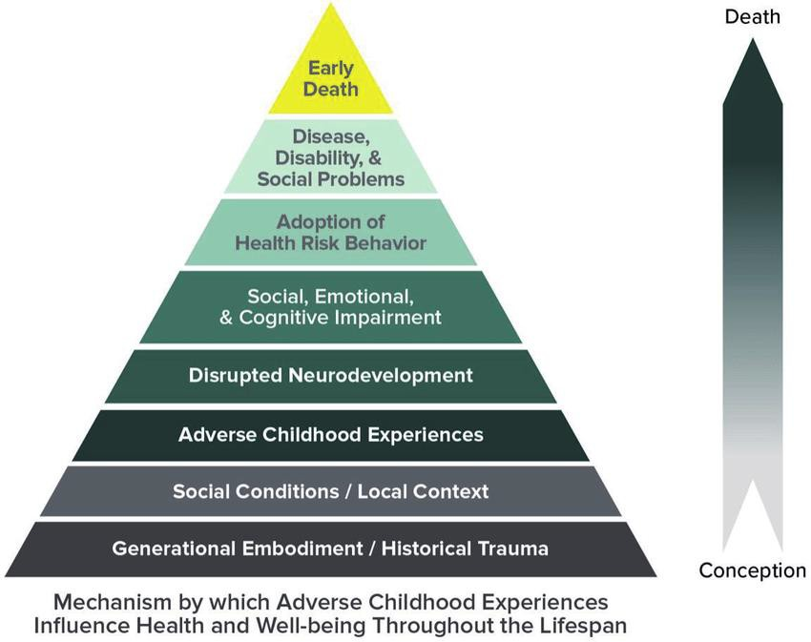
Resilient and Trauma Informed Community process
Notes:
We would like to talk a bit more about ACEs. The pyramid is a visualization of how ACEs can impact a person. Not everyone will have the outcomes in this path, but some will. Overall, the data shows that the higher your ACE score, the higher risk you are for many poor health outcomes. We will be diving into ACE education more down the road. If you would like more information, it is available on the CDC website https://www.cdc.gov/violenceprevention/aces/index.html. There are also a lot of good resources on the State of WI DHS website https://www.dhs.wisconsin.gov/resilient/index.htm.

Slide 9
ACE scores in the population
ACE score info from Kasier study:
67% of the population with at least 1 ACE score
16% had a score of 4 or more
ACE score info from Capital survey
88% had at least 1 ACE score
24% had an ACE score of 4 or more
Notes:
The published study shows ACEs are common through out the population in every demographic. There are 10 questions, and scores range from 0-10. We also asked some in our Capital Consortium Community to check their ACE scores, and this is what we found…..There is a common misconception, to think that these are issues that are limited to people in certain demographics, or socioeconomic status, but the research shows they are prevalent everywhere.

Slide 10
We are more than our ACE score…
“Adverse childhood experiences (ACEs) are the single greatest unaddressed public health threat facing our nation today.”
- Dr. Robert Block, the former President of the American Academy of Pediatrics
ACEs and trauma….
Notes:
Are not limited to 10; these are just broad categories. Other things can cause childhood trauma, but these are the questions used in the original study.
Are not an identity. ACEs are not who you are, it is a health risk indicator, like many other things.
Should not be a source of shame.
Do not have to be a lifelong risk factor. These can be overcome, and not all people will have the same outcomes from similar ACEs.

Slide 11
How to determine your ACE score
https://www.acesaware.org/wp-content/uploads/2020/02/ACE-Questionnaire-for-Adults-Identified-English.pdf
Use a Chrome Browser
Notes:
If you would like to know what your ACE score is, you can look at the pdf of the questionnaire on this website. Add the total responses for which you answer yes for your ACE score.

Slide 12
Say that again….We are more than our ACE score…what can help?
Resilience…
“Is not something you’re born with. It’s something that gets built over time.” (Dr. Jack Shonkoff)
Notes:
*can be developed at any stage of the lifetime.
*creates protective factors that serve a child into adulthood.
*creates a buffer against toxic stress.
*can grow from a single positive relationship.
We will talk a lot more about resilience, and building resilience.

Slide 13

IM ROLE~ Trauma has a ripple effect on a community.
So can resilience
While your individual actions alone may not transform the entire community, your actions can have rippling effects well beyond what you can imagine….
Notes:
It is not solely your responsibility to transform the community, this takes everyone working collectively
It can be hard to see how ESS can impact the community to help people prevent ACEs, and build resilience. We are not social workers, nurses, teachers or doctors, and do not have that same direct contact, but we do have a role.

Slide 14
Example from IM
Luke calls CCA to apply for MA only:
Situation A: ESS opens MA only, and doesn’t ask about FS or discuss 211.
Situation B: ESS asks if they want to see if they qualify for FS too, and they qualify for $200. ESS also tells them about 211 and the community resources it can help with.
The next week, Luke gets an unexpected high energy bill.
Notes:
Here is a situation we have all seen, and all of us have probably done what is in both situations at some point.

Slide 15
More on situation a: Ripple effect of Trauma
ESS opens MA only, and doesn’t ask about FS or discuss 211.
Notes:
In this situation Luke didn’t get $200 FS, or know about 211. Luke chooses to pay the energy bill because they are already behind, and will get cut off if they don’t pay.
They have to cut $200 from their groceries, gas, and other bills so they and their child go hungry for a day.
Going hungry is one of the questions on the ACE test, and is a trauma that can lead to long term health risks.
The child gets in a fight at school because of his hunger, and the parent has to leave work to pick the child up, therefore losing income.
On the way back to work Luke runs out of gas and has no money to fill the tank, losing additional work hours and more income as well as putting their job at risk.
This is the ripple effect of what can happen to a family w/out resources, and what can help with using the First contact resolution approach while on the phones. Did the ESS do anything wrong here- no. Is it the ESS fault that all these outcomes occurred- no. There are a huge number of factors that went into this situation, and the ESS had little to no control over any of them. We just want to show an extreme example of how big things can ripple out from little things.

Slide 16
More on situation b:
Situation B: They apply for and get $200 of FS, and the ESS tells them about 211.
Notes:
They are able to move money from their food budget to pay for some of their energy bill.
They make up the difference in the groceries with the $200 from FS, and they Call 211 and find a food pantry in their neighborhood that helps them get enough food to get through the week.
211 also tells them about another energy assistance program in their community to pay off the energy bill.
The family is able to maintain nutrition for everyone avoiding trauma to the child. The knowledge of other resources helps the person to build resilience and maintain the child’s health. This helps keeps the child out of possible referrals to DCF, juvenile justice, etc. The family is able to maintain their bills. Again, ripple effect.

Slide 17
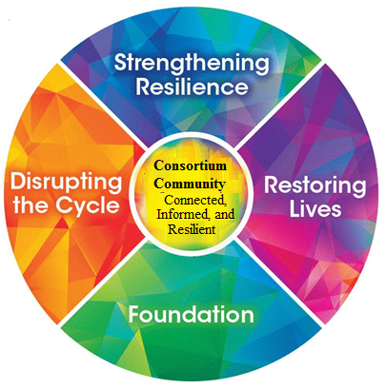
Resilient and Trauma-Informed Community
Kaleidoscope Model of Change
Notes:
Why a Kaleidoscope? Did you have one when you were a kid? Depending on how you turned the scope, it changed what you saw. The process of Trauma informed care is to give us the tools to change our perspective on what we see. Everyone has a story, some trauma-- that explains they way we react to a situation. Many feel that they have been beat up by life’s circumstances, but there is hope in healing. By introducing a model of trauma informed care staff and customers work together in framework of wellness to improve our outcomes, to build morale and over satisfaction in your job and life. Rotate that kaleidoscope, change your perspective– instead of saying or thinking, what’s wrong with you/them? Change that to what happened to you?

Slide 18

Foundation ~Establish shared knowledge and understanding to support trauma-informed values, actions, and systems
Realization that we are all in this together. More than 50% of us would report at least one adverse childhood trauma while growing up.
Notes:
Foundation- As Adam showed earlier– we are all have trauma, and it has shaped us to choose the job we did, to live the way we live. Today’s training is setting our foundation--- our beginning as a consortium community. We are finding the common ground on which to build this new perspective we are hoping that you take this journey together --- we all start from the same point and grow from there.

Slide 19
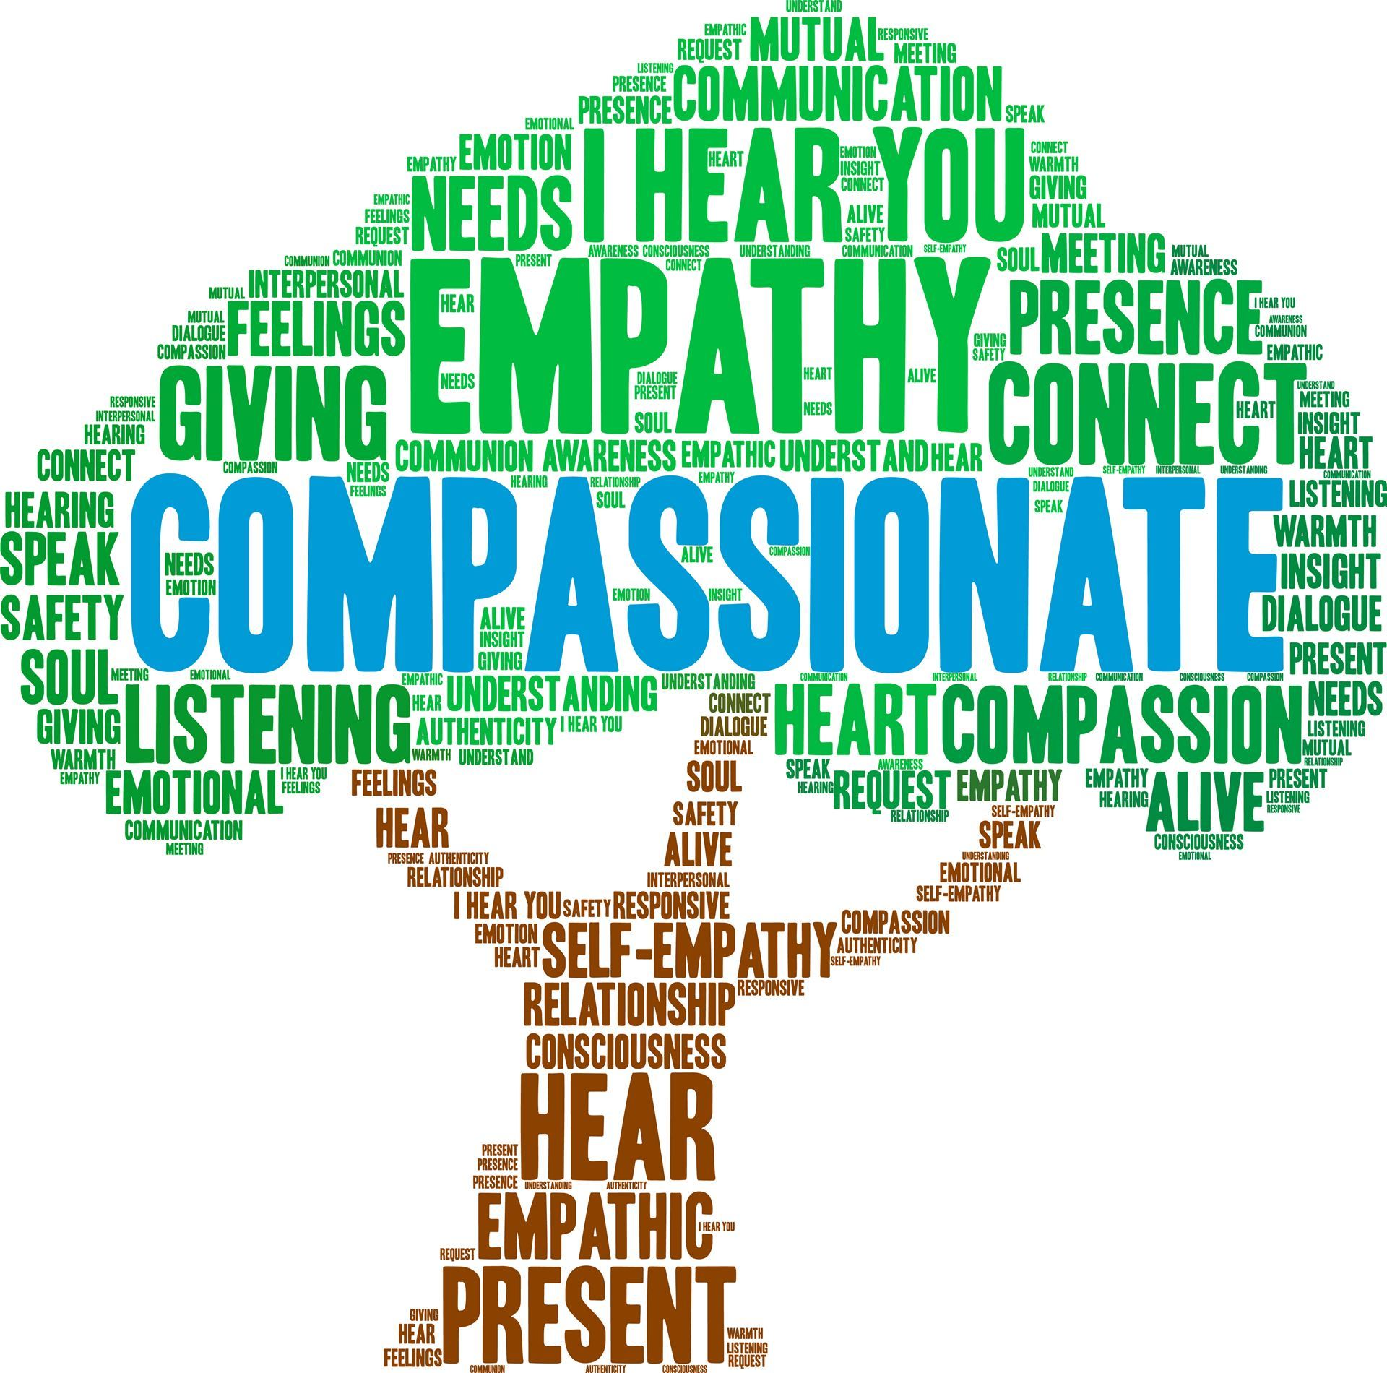
Disrupting the Cycle~Be aware of how our interactions influence the life of our Consortium Community and how our behaviors contribute to the cycle of past trauma
Shifting our perspective
Having empathy and understanding on how trauma impacts lives well after it has occurred.
Notes:
Disrupting the Cycle-Believe the best in others. Take moment to remember that some people haven’t had nurturing life models- shift your perspective. Turn the kaleidoscope. Empathy is simple word for a complex idea. How can we build our empathy? Listen, really listen to those who are talking to you, take into account their non-verbal cues (their tone), smile at people, use the person’s name, be curious about others differing beliefs- ask questions, give true and honest recognition. What can we do in our work? Making sure people are getting the correct benefits, providing resources/referrals, being kind, being aware of what others might be experiencing.
.

Slide 20
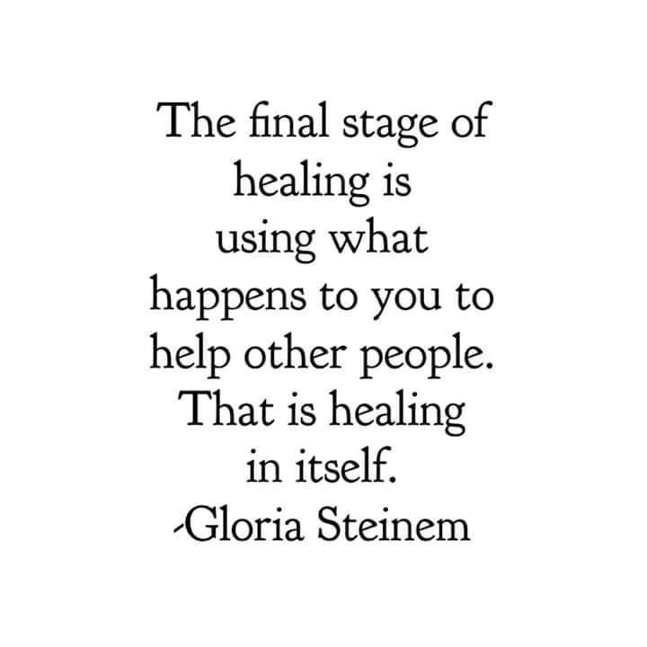
Restoring Lives~Embrace accessible and effective supports that promote healing and recovery
“This is treatable. This is beatable. The single most important thing we need today is to look this problem in the face and say, ‘this is real and this is all of us.’ ”
- Dr. Nadine Burke Harris
Notes:
Restoring Lives- using our common language… an understanding of how trauma impacts us all, physically, emotionally, psychologically--- will help us heal and grow.
Learning how to manage difficulties by learning about why we think they way we do and focusing on moving forward. Recovery is active, daily and practical, finding what works for you ---- willing and wanting to change, embracing the change and putting this knowledge into action.

Slide 21
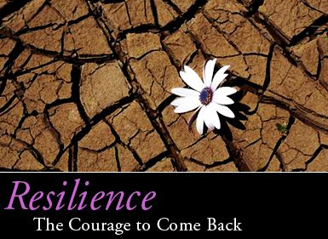
Strengthening Resilience~Resilience is the ability to bounce back and thrive despite past experience
“Resilience is based on compassion for ourselves as well as compassion for others”
~Sharon Salzberg
Notes:
Strengthening Resilience- read the quote--- components that make up resiliency are competence, confidence, connection, character, contribution, coping and control. We must start with ourselves --- who are we most hard on, others or ourselves? this doesn't mean that you wont experience grief, anxiety or distress, it means you have the coping skills to handle these difficulties. Reframe your thoughts – be positive, seek support, focus on what you can control, and manage stress with healthy behaviors.

Slide 22
How to build resilience~ self care
Building your mental Strength takes practice, but each time you engage your core, shifting to a new perspective becomes easier.
Pause. The next time there’s something in your life that’s frustrating you, Pause.
Think. Ask yourself, Where is this feeling stemming from? What other perspectives can I explore?
Act. Identify the perspective that’ll allow you to have the impact you want and go for it.
Notes:
Building Resilience as a community begins with our own self care. If we practice, eventually shifting to a new perspective will follow.
When frustrations arise, PAUSE and acknowledge the feelings, then THINK about where the thoughts are coming from and then
ask yourself what other perspectives could be explored. We are then able to ACT by applying the perspective that will allow you the impact you want.

Slide 23
What can I do?
Remember that we are all in this together, WI DHS has a website (Resilient Wisconsin) and you can sign up for the monthly news letter.
  https://www.dhs.wisconsin.gov/resilient/index.htm
  Why is it important? Self-care encourages you to maintain a healthy relationship with yourself so that you can transmit the good feelings to others. You cannot give to others what you don't have yourself. While some may misconstrue self-care as selfish, it's far from that.
Notes:
So you may ask yourself, “What can I do?”
If you are interested in learning more, Resilient Wisconsin has a newsletter you may want to sign up for. It is a wonderful resource packed with useful information.
It is important to point out that self care is not selfish! Our good relationship with ourselves will allow good feelings to spill over into our consortium community.

Slide 24
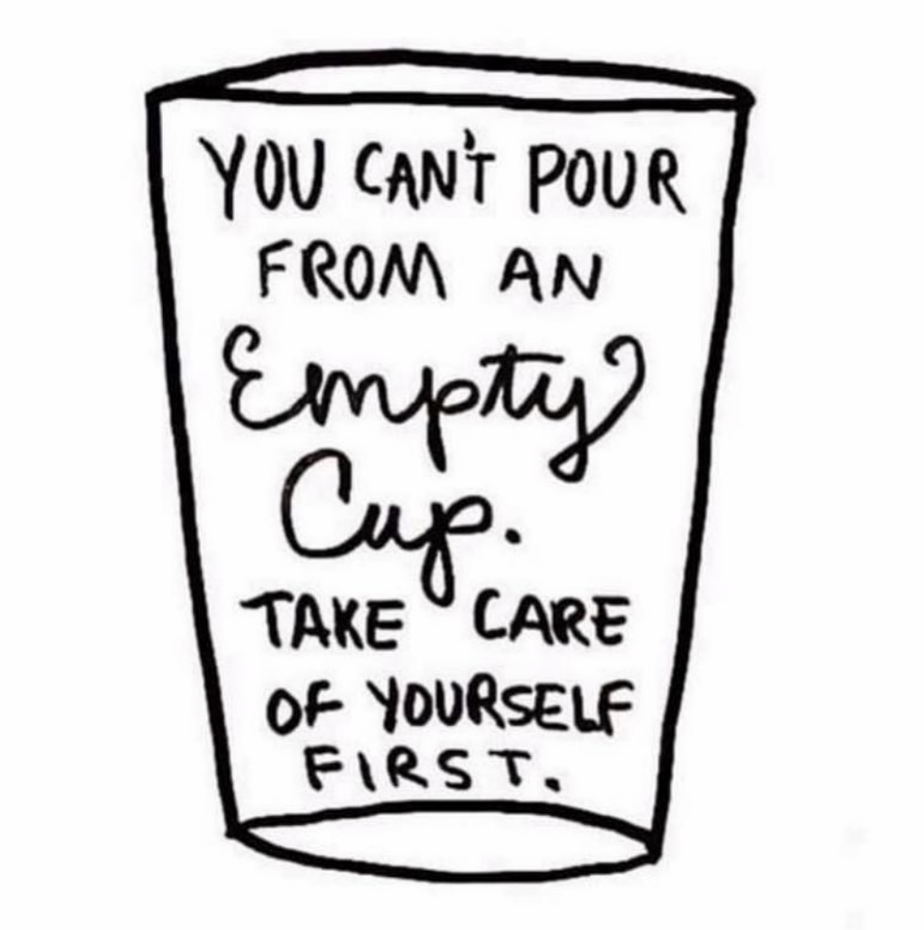
CARING FOR YOURSELF IN THE FACE OF DIFFICULT WORK
Our work can be overwhelming. Our challenge is to maintain our resilience so that we can keep doing the work with care, energy and compassion.
A few things to do each day
1. Get enough sleep.
2. Get enough to eat.
3. Do some exercise.
4. Stay hydrated
5. Do something pleasurable.
6. Focus on what you did well.
7. Be open to learn from mistakes.
8. Share a private joke.
9. Meditate or relax.
10. Support a colleague.
Notes:
What we all do is really hard work! So what can we do to be sure we continue to build resilience?
We have built a list of 10 things to strive for each day.
#7 We should not feel bad about a mistake made, instead we focus on learning. Learning and growing is positive!
#10 Lift each other up whenever you have the opportunity to do so. It is just as fun to give kudos as it is to receive it!

Slide 25

Notes:
Take a little time each day to visit your peaceful place. Let’s pause for just a bit to think about what our peaceful place might be…
Would anyone like to share what their peaceful place is?

Slide 26
Activity time
Self care activity
Calendar activity done at TIC 101 with Scott and Donna
Notes:
We are going to do a calendar activity with the calendars you were all sent ahead of time.

Slide 27

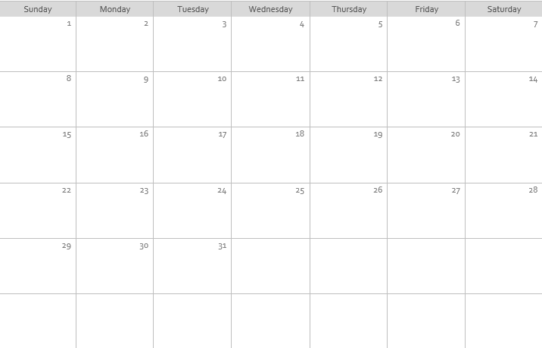
Notes:
You were sent a calendar previously and you were asked to fill it in with your daily and weekly activities that you both like to do and need to do in your lives. For example, your job, taking the kids to school, or mowing the lawn. I’m guessing it has begun to fill up nicely.

Slide 28

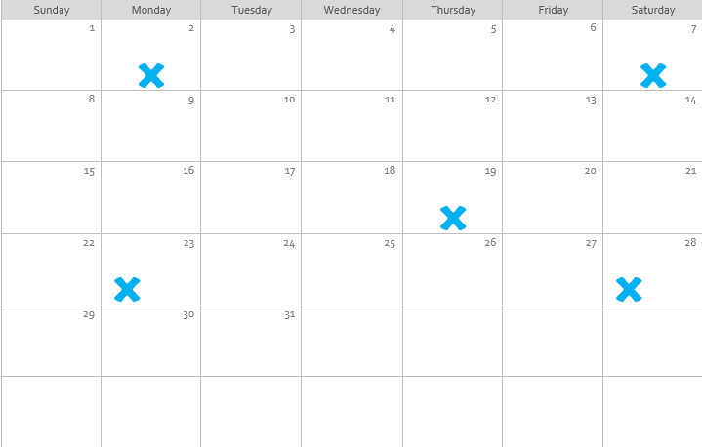
Notes:
What would you have to give up if you lost a few days each month to sickness, chronic pain, depression or a major life crisis?
This is a tough question, but just take one minute and cross things off the list you just made. What would you give up if you just couldn’t do it all?

Slide 29
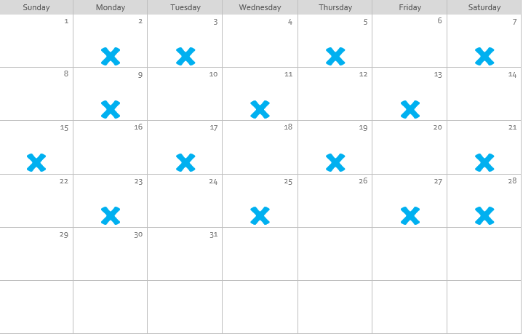
Notes:
I’m going to make it a little tougher now. As you can see you are loosing more days. Take a minute and answer this question:
What would change about your job, your relationships or your home life if you lost many days each month to sickness, chronic pain, depression or a life challenge?

Slide 30
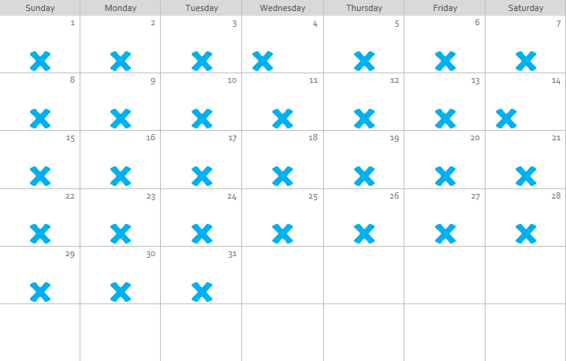
Notes:
Imagine for a moment that sickness, chronic pain, depression or some other life challenge interrupted your daily life every day of the month.
Let’s reflect on that for a minute…….
What kind of help would you need in your life every day?
How might we, as a society, provide the kinds of support to our neighbors, family members or friends that will allow them to participate in the community and family life even if they are struggling with health and other ACE-related challenges?

Slide 31
“If you lose your why, you lose your way.”
Framework Mission:
Promote resilience through a collectively engaged, trauma-informed consortium community to improve the physical, mental, social, emotional and spiritual well-being of ourselves, each other and clients we serve.
Notes:
If you lose your why, you loose your way. Question for you: tell me in the chat the reason you got into this field. (read through comments).
Thank you!
We do hard work! - emotionally as well as mentally.
It is important for each of us to remember why we choose the work we do.
Write it on a post it and when you have a difficult time, pause and think about all the good you are doing.

Slide 32
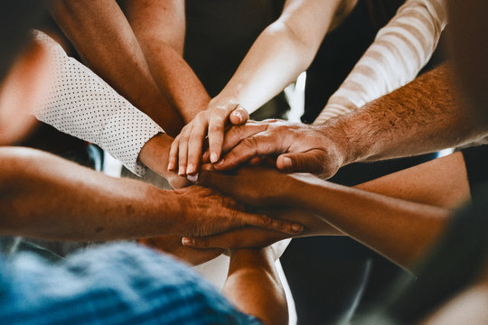
Our Consortium Community~Connected, informed, and Resilient
Notes:
This is our goal:
Our Consortium Community-Connected, Healthy, and Resilient.

Slide 33
Everyone has a role in rtic
• Education
• Nursing Homes
• Youth Serving Organizations
• Homeless Shelters
• Human Service Departments
• Elected Officials
• Healthcare
• Faith-based
• Law Enforcement
• Neighborhood Associations
• Business
• Media
• Mental Health Providers
• Parents
• Concerned citizen
• Civic Volunteer
Notes:
In our journey, we tried to think about who plays a role in RTIC:
use the chat feature for this next question:
Who is part of our Consortium Community?
Human Services, school, parents, homeless shelters, nursing homes, child care centers.
In order for us to be CONNECTED, INFORMED and RESILIENT, we all must work together.

Slide 34
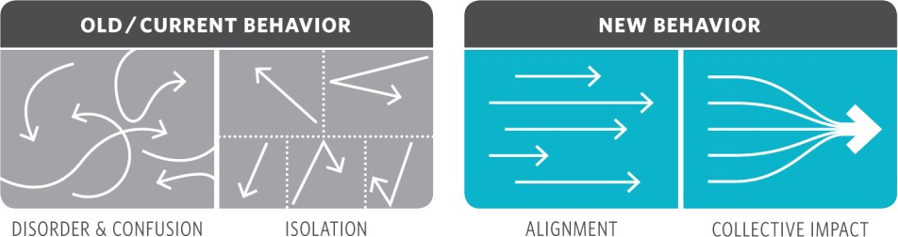
Mobilizing a Trauma-Informed consortium Community through Collective Impact
Notes:
Which brings me to our next slide:
The first picture: this is when our consortium community is fragmented. We don’t talk to one another, our goals don’t align.
The result is disorder, confusion, isolation. It is hard to thrive as an individual and as a community in this type of environment.
The second picture shows a VISION of our consortium community, when our goals align. Our collective impact can be strong when we work together as a community to achieve social change.
“Achieve social change”. It sounds like too big of a goal and I am just one person… this is where we use tools we discussed earlier: shift perspective. Share common ground. CONNECTED, INFORMED and RESILIENT, WE CAN as a Consortium Community.

Slide 35

Tools of civility: It’s not what you say. It’s how you say it. http://civilityproject.onmason.com/tools-of-civility/
Notes:
Tools of Civility is tool that has been used by many different organizations including Waupaca County and Columbia County HHS. This tool comes from the Speak your Peace, The Civility Project. In Columbia County this poster is hung in every office, conference room, and break room and explained to all new hires on their first day. When this was introduced Columbia HHS, not everyone was at the same level of understanding and not everyone bought into it. However the longer it is used, the more impact it has when interacting with each other. It is a visual that is a constant reminder of our common language and common ground. This also sets the stage for what often times are difficult conversations, and our ground rules for becoming a positive community. Columbia County ES, has each of these slides printed and laminated and multiple times through out the year, reviews them, and has staff read these aloud before staff meetings. As we go through these slides, please feel free to put examples of how you may have used these tools in the past or how you will use these tools going forward.

Slide 36

Notes:
Be aware and attend to the world and the people around you. Be informed about what is occurring in our community, focus on the issue-on what the person is saying and consider the whole picture, strive for objectivity, no judgements, open your mind to new perspectives.

Slide 37

Notes:
Focus on others in order to better understand their point of view. Seek to understand and hear what is said, ask effective questions, respect the person and his/her view through your words and body language, give thoughtful attention and avoid distractions.

Slide 38

Notes:
Welcome all groups of citizens working for the greater good of the community- Intentionally and sincerely invite diverse perspectives, seek participation, take responsibility, use common language and avoid jargon

Slide 39

Notes:
What a slide! I use this one quite often. If anyone knows me, they know, that I will respond with, “lets go to the source and talk to them”. What does this mean? Just as the poster says, Don’t gossip and don’t accept when others choose to do so. Go to the source for the facts; validate the information, communicate with respect and positive intent, own what you say and be accountable. Model this behavior, set a good example, and honor those that are not present, and do not judge.

Slide 40

Notes:
Honor other people and their opinions, especially in the midst of a disagreement-Value the person, appreciate his/her contributions, experiences, passion, culture, norms and values, use questions to clarify. Value all ideas that are brought to the table and demonstrate positive body language.

Slide 41

Notes:
Look for opportunities to agree; don’t contradict just to do so. Rise above your emotions and focus on the issue, build relationships and make a connection, work towards a mutual trust. Columbia County used this slide to set boundaries for Staff Meetings. We call them Team Agreements. We came up with them as a team and review them before every staff meeting. Some examples of our agreements are: Look for my good intentions, even if you disagree please don’t make me wrong, only speak of those present in the room, raise your hand when you want to speak. Columbia has several more, and these are some examples of setting boundaries and common ground.

Slide 42

Notes:
Be Sincere; apologize and forgive-Take responsibility for your actions and words, accept an apology, practice forgiveness and let go of the past.

Slide 43

Notes:
Be Mindful of the words you choose. This can be tough. I call it communication with compassion. Address conflict with the intent of resolution. When disagreeing, stick to the issues and don’t make it a personal attack. Learn from others’ perspectives and feedback.

Slide 44

Notes:
Practice accountability in language and actions. Take ownership, use “I” statements, don’t shift responsibility and blame onto others, be trustworthy, and tell the truth

Slide 45
Speaking your peace
Notes:
Communication is key and often times can be difficult. When communicating or providing feedback, keep these Tools of Civility in mind.

Slide 46
Summarize what we need to know and where we are going
Capital
Consortium
Notes:
This presentation is just a start of many other types of RTIC training we will be providing. Everyone’s feedback and participation is important. Our next steps are to continue partnering with LaCrosse/Gunderson Health, and WI DHS. You will see upcoming invitations to follow up presentations. As you can see we have many tools to use to start seeking our common ground and communication. I would like to challenge you all to be brave, and use the chat function to let us know how you have used any of these tools in the past, or what is one take away you are going to start using today and why?

