Slide 1
ABAWD Training

Slide 2
Types of ABAWD
Non-ABAWD
ABAWD

Slide 3
Non- ABAWD
An individual who is not an ABAWD, or has a reported exemption.
They are not subject to TLBs (Time-Limited Benefits), and do not need to meet the ABAWD work requirement.

Slide 4
Non-ABAWD
1. Under age 18 or over 64
2. Residing in a Food Unit with a child under 14
3. Pregnant
4. Determined unfit for employment
5. Receiving UC or has applied for UC

Slide 5
Non-ABAWD
6. Student of higher education that is an eligible student for FS
7. Primary caregiver of a dependent child under 6 or an incapacitated person
8. Complying with W2 program requirements

Slide 6
Non-ABAWD
9. Is not a work registrant due to working over 30 hours/week or earning 935.25/month

Slide 7
Age
13 year olds: They are Non-ABAWDs until the month after they turn 13.
64 year olds: They are Non-ABAWDs as of the month in which they turn 64.

Slide 8
True or False
A client must be related to a child under the age of 13 residing in the same food unit to qualify as a non-ABAWD.
FALSE

Slide 9
Residing in a Food Unit with a child under 13
Individuals who reside with and are included in the same food unit as a child under age 13 are non-ABAWDs, even if that child is ineligible for FoodShare. Relationship to the minor is not relevant.

Slide 10
True or False
The correct code on the pregnancy page verification field is CC-Collateral Contact.
TRUE

Slide 11
Pregnancy
We do not need to verify that a person is pregnant to make them a Non-ABAWD unless the report is deemed questionable.
If the verification code is NQ or ? on the Pregnancy Verification field, they will be an ABAWD and will be referred to FSET until the pregnancy marked as verified
When a pregnancy is reported update pregnancy using CC-Collateral contact as the verification code with the date it was reported.

Slide 12
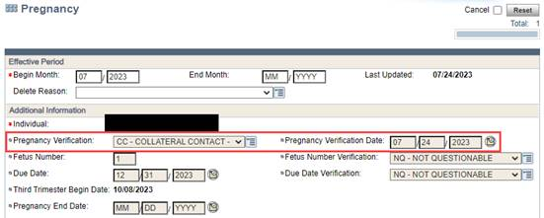
Pregnancy

Slide 13
Determined unfit for employment
1) Disabled- The person must have a disability that is verified to update the top portion of the disability page. If they do not have a verified disability they would be evaluated for Unfit to work instead.
They may be getting SSI/SSDI, or have a disability determination from DDB.
They may also be approved for presumptive disability, MAPP disability, VA disabled, or Railroad Retirement Board disabled.

Slide 14
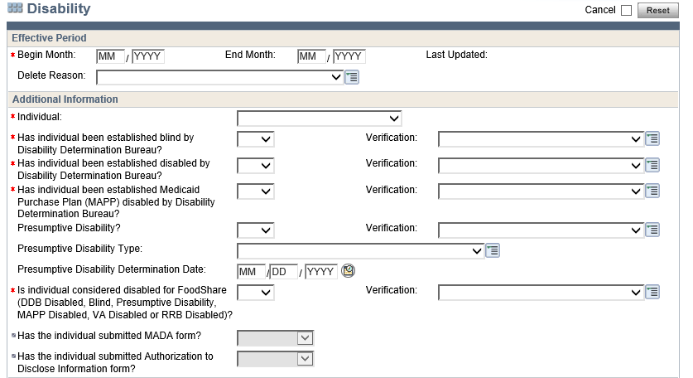
Determined unfit for employment

Slide 15
TRUE OR FALSE
An IM agency worker may make the determination that a client is mentally or physically unable to work.
TRUE

Slide 16
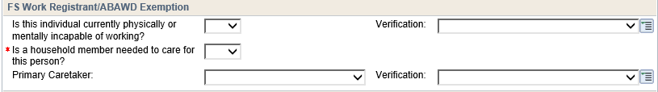
Determined unfit for employment
2) Receiving temporary or permanent disability benefits. Ex: workman’s comp
3) Mentally or physically unable to work, as determined by the IM agency.
4) Displaying mental instability, combativeness, or other mental health issues (IM or FSET worker can exempt)
All of these are entered at the bottom of the disability page in the ABAWD exemption section. Verification is not required.

Slide 17
Determined unfit for employment
5) Chronically Homeless
Chronic homelessness includes members who are in a temporary housing situation, such as transitional living arrangements and shelters. It also includes members staying temporarily (up to 90 days) at another person’s residence.

Slide 18
Determined unfit for employment
This is to be entered on the ABAWD exemption page.

Slide 19
TRUE OR FALSE
An individual is not exempt from TLBs any month they were incarcerated.
FALSE

Slide 20
Incarceration
Use the IC code on the FS clock to exempt any months in which an ABAWD was unable to meet the work requirement due to being incarcerated.
ESS workers will have to determine when the person was incarcerated, and make a judgement call about if that incarceration prevented the person from being able to meet the work requirement.

Slide 21
Receiving UC or has applied for UC
UIB data exchange must show they are receiving UC, or the UC is in pending/disputed status.
The UC page must only be entered with 0 income if they are in pending/disputed status. The UC page must be end dated if UC has ended.
Out of State UC or application for it must be verified.

Slide 22
Student of higher education that is an eligible student for FS
If a person is a student of higher education at least half time, and that person meets the criteria as an eligible student for FS, then that person is a Non-ABAWD.
If they are in higher Education less than half time, they are not tested for student eligibility for FS, and are an ABAWD.
In order be exempt for higher education we do not to verify school enrollment.

Slide 23
Enrolled at least half time in high school
There is no maximum high school age in regard to the FS ABAWD policy.
The individual must be enrolled in and attending high school at least half time. Online high school is treated the same as physically attending high school.
Participation in HSED and GED programs is not an exemption.

Slide 24
Primary caregiver of an incapacitated person
If there is no information known to the agency, about the incapacitated individual that the FS member is caring for, the IM agency does not need verification of the individual’s incapacitation or to verify that they are the primary caregiver unless questionable.
There is no minimum time commitment for caring for an incapacitated person, as long as the FS member is the primary caregiver.

Slide 25
Primary caregiver of an incapacitated person
A person who is paid for working as an attendant for a disabled person would not be exempt due to caring for an incapacitated individual because this is their source of employment.
These hours will be counted on towards the 80 hours/month on the employment page.
Primary caretaker does not mean you are babysitting for a child. If Mom is working 60 hours/week and Uncle Pete babysits the 3 year old child, he is not the primary caretaker.
Uncle Pete’s baby sitting can be seen as work (volunteer if not paid, in-kind if he receives something other than money) and those hours can count toward meeting the work requirement.

Slide 26
TRUE OR FALSE
An individual working 15 hours a week and earning more than $935.25 per month qualifies as a non-ABAWD
TRUE

Slide 27
Making $935.25/month
They will be a Non-ABAWD if they are working over 30 hours/week, or if they earn more than $935.25/month regardless of the number of hours they work.
(ABAWDs still meet the work requirement by working 80 hours/month)
Use the override hours on the EI page to increase the monthly hours to 80 if working less than 80 but earning $935.25
Notes:
30x7.25x4.3= 935.25

Slide 28
W2
If they are participating in W2 they will be a Non-ABAWD.
If they are participating in another allowable work program over 80 hours/month they will be considered an ABAWD meeting the work requirement.

Slide 29
Meeting the ABAWD work requirement
An ABAWD is considered to be meeting the ABAWD work requirement if one of the following applies:
1) Working a minimum of 80 hours per month
2) Participating and complying with an allowable work program at least 80 hours per month: FSET, Refugee employment and training, Children First, WIOA, Refugee cash assistance, programs under section 236 of the trade act.

Slide 30
TRUE OR FALSE
ABAWDs cannot combine hours from multiple activity sources to meet the work requirement.
FALSE

Slide 31
Meeting the ABAWD work requirement
3) Both working and participating in an allowable work program for a total of 80 hours per month
4) Participating and complying with the requirements of a workfare program(Workfare is through FSET, and the FSET worker will let you know if they are enrolled in that program)

Slide 32
TRUE OR FALSE
An ABAWD participating in volunteer work for at least 80hrs per month is not considered meeting the work requirement
FALSE

Slide 33
TRUE OR FALSE
If a participant is receiving regular pay plus other shift pay, the system will correctly determine the amount of hours.
FALSE

Slide 34
3.17.1.8 ABAWD Definition of Working
1) Work in exchange for money
2) Work in exchange for goods or services (“in kind”)
3) Unpaid work (i.e. volunteer work, community service)
4) Self-employed at any wage
5) Any combination of the above

Slide 35
ABAWD
ABAWDs who do not meet the work requirement will only be allowed to receive up to 3 full months of time-limited benefits in a 36-month time period (fixed clock Jan 2025-Dec 2027)
The questions pertaining to FS ABAWD status must be asked at every renewal or application interview.

Slide 36
TRUE OR FALSE
FSET is an allowable work program
TRUE

Slide 37
TRUE OR FALSE
There is no limit for the amount of hours the IM/FSET worker can grant for good cause to participants.
TRUE

Slide 38
FSET Participation
ABAWDs subject to time-limited benefits may choose to meet the work requirement by participating in FSET.
An ABAWD enrolled in FSET must participate in qualifying activities in order to meet the work requirement and maintain ongoing FS eligibility.
FSET agencies will enter participation information in the FSET tool.
IM and FSET workers can apply up to a combined total of 80 good cause hours toward a member’s TLB month. If the member meets the work requirement, with the addition of the 80 hours, the member’s TLB month is removed

Slide 39
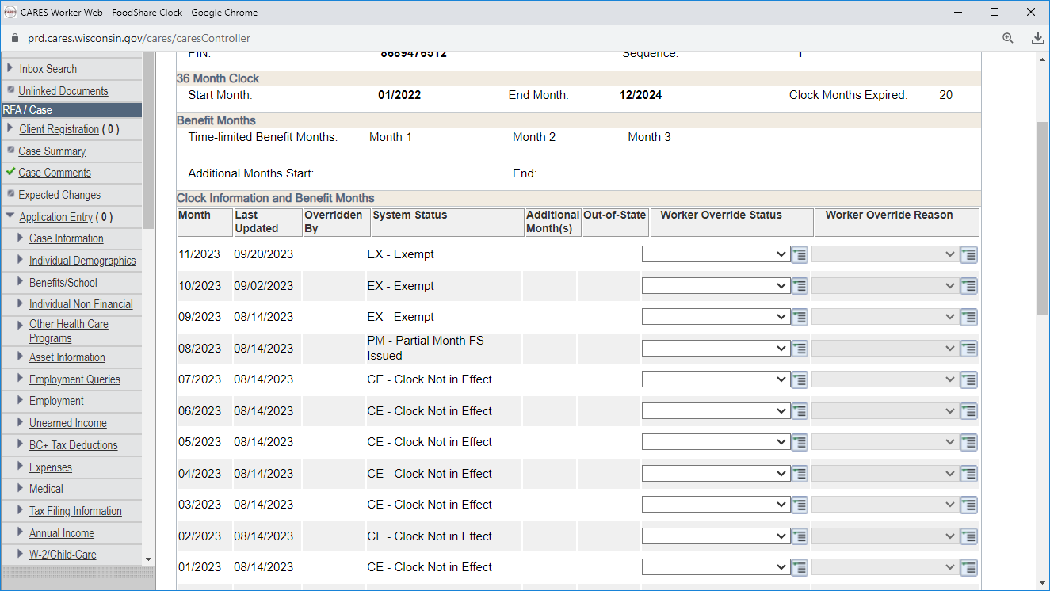
FSET Participation Enter ‘good cause’ under the Worker Override Reason

Slide 40
Good Cause
Any circumstance that is beyond the member’s control and resulted in the member missing work, such as:
Work activity was cancelled
Discrimination
Family issues
Illness or personal health reasons
Inclement weather
Legal issues
Lack of transportation
Unreasonable job demands
Unanticipated emergency
(IM workers may request verification of the good cause hours only if it is questionable. For good cause regarding illness do not include anything regarding medical diagnosis or treatment in your case comments)

Slide 41
Reporting Requirements
ABAWDs are only required to report if their work hours drop below 80 hours per month by the 10th of the month following the month in which the change occurred.
ABAWDs are not required to report other changes in ABAWD status or a change in exemption.

Slide 42
Verification of Temporary Exceptions
Effective 08/14/23 ABAWD exemptions are not required to be verified unless it’s questionable

Slide 43
FEEDBACK!
Here is a link to a survey on this training:
https://s.zoom.us/m/bZEE2h2oh
Thank you!!

