Slide 1
ACCESS 101
Jeremiah Cook
Updated 01/02/20

Slide 2
Agenda
ACCESS.wisconsin.gov
  What is ACCESS?
  Tools in ACCESS
    Am I Eligible?
    Apply for Benefits
    MyACCESS (Login to Account or Create an Account)
    Renew Benefits
Best Practices
Resources

Slide 3
What is ACCESS?
ACCESS is a website where people can:
  Complete a screening to see if they may be eligible for public assistance benefits.
  Apply for benefits
  Manage their benefits.
A person can apply for the following programs using ACCESS:
  Health Care (BadgerCare Plus or Medicaid)
  FoodShare
  Child Care
  Family Planning Only Services

Slide 4
ACCESS
Welcome Screen

Slide 5
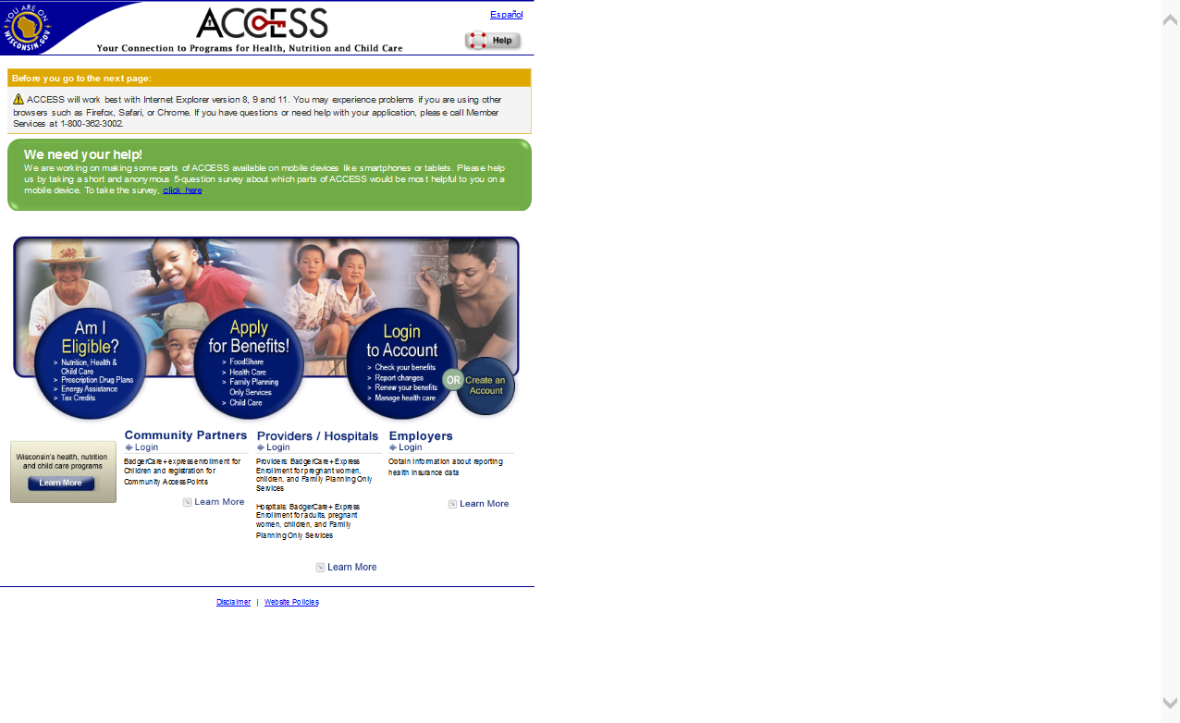
ACCESS Welcome Screen
Figure 1: ACCESS Welcome Screen

Slide 6
ACCESS Welcome Screen
Each ACCESS page is available in Spanish by clicking the “Español” link at the top of the page.
When using ACCESS, an applicant can get help by clicking on the “Help” button in the upper right-hand corner of the screen. This explains more about what a question is asking and what information the applicant should provide.

Slide 7
ACCESS Welcome Screen
The ACCESS home page contains four buttons to select from to go to different parts of ACCESS:
  Am I Eligible? – by selecting this button, the applicant can find out what benefits he or she might be able to get (no login needed).
  Apply for Benefits – by selecting this button, the applicant can apply for Child Care, FoodShare, Health Care, or Family Planning Only Services (login needed).

Slide 8
ACCESS Welcome Screen
  Login to Account – by selecting this button, the applicant can check benefits, renew benefits, report changes, and perform other functions.
  Create an Account – by selecting this button, the applicant can link an existing case by creating a new ACCESS account.
To avoid errors when using ACCESS, applicants should not use the Forward, Back, or Stop buttons on their browser. Instead, they should click on the ACCESS icons and links to move from page to page.

Slide 9
ACCESS Welcome Screen
Red asterisks indicate that the information being requested is required from the applicant.
  ACCESS will not let the applicant move beyond the current page until all fields with a red asterisk are completed.
  If the applicant clicks Next without answering all of the required questions, ACCESS will display an error message directing the applicant to answer the missed questions.

Slide 10
Am I Eligible?
Screening Tool

Slide 11
Am I Eligible?
Figure 2: Link to “Am I Eligible?” Screening Tool

Slide 12
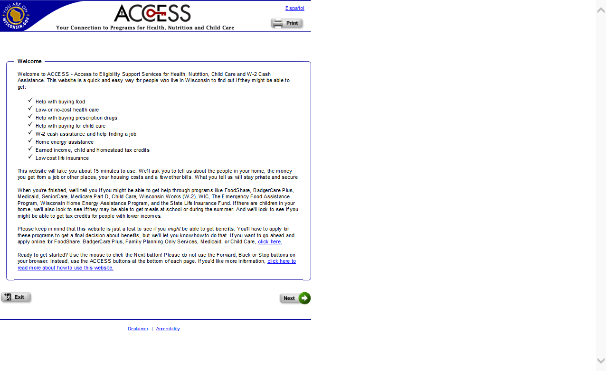
Am I Eligible?
Figure 3: “Am I Eligible?” Welcome Screen

Slide 13
Am I Eligible?
The Am I Eligible? screening tool in ACCESS helps applicants determine what programs they might be eligible for before they apply.
The screening results provide a list of programs that the applicant may be eligible for. Some of these programs can be applied for in ACCESS, while others require other enrollment methods.

Slide 14
Am I Eligible?
Applicants fill out basic information including:
  Information about the people in their home
  Their access to health insurance
  Their employment/income
  Their expenses (child care, housing, utilities, etc.)
  Their assets (only if the applicant indicates that he or she is disabled)

Slide 15
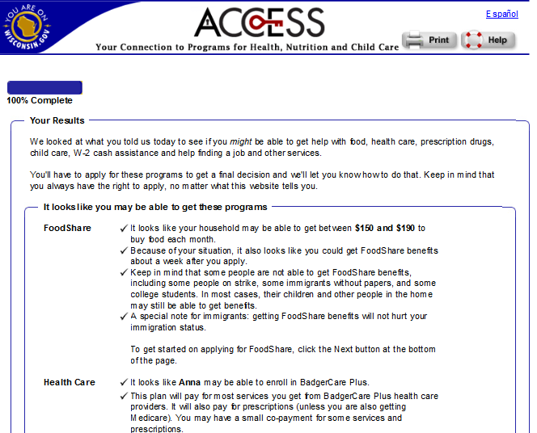
Am I Eligible?
Figure 4: “Am I Eligible?” Results Page

Slide 16
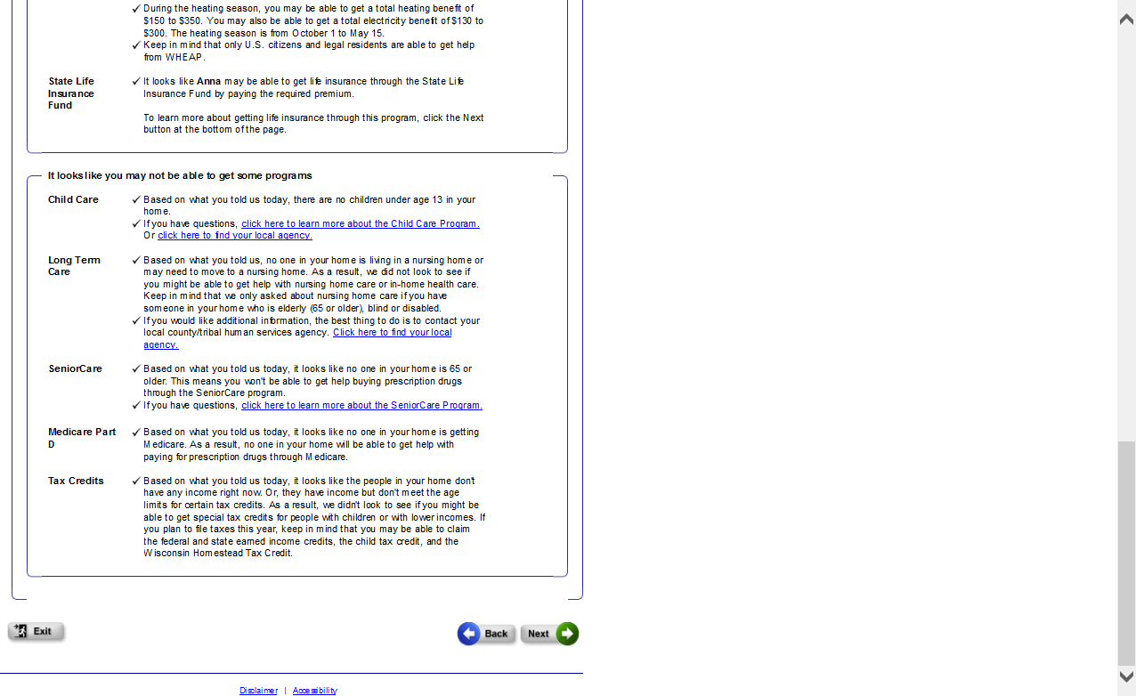
Am I Eligible?
Figure 5: “Am I Eligible?” Results Page (cont.)

Slide 17
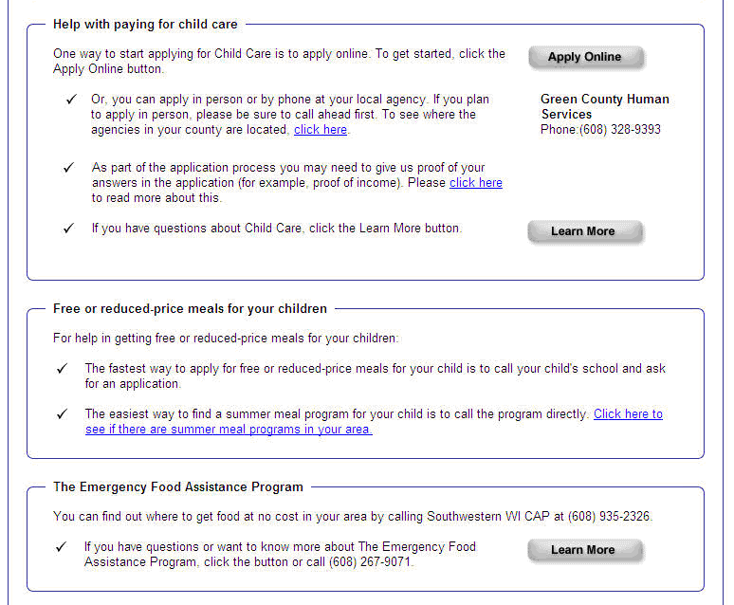
Am I Eligible? – Next Steps Page
Figure 6: “Am I Eligible?” Next Steps Page

Slide 18
Apply for Benefits!
Feature in ACCESS

Slide 19
Apply for Benefits!
Figure 7: Link to “Apply for Benefits!”

Slide 20
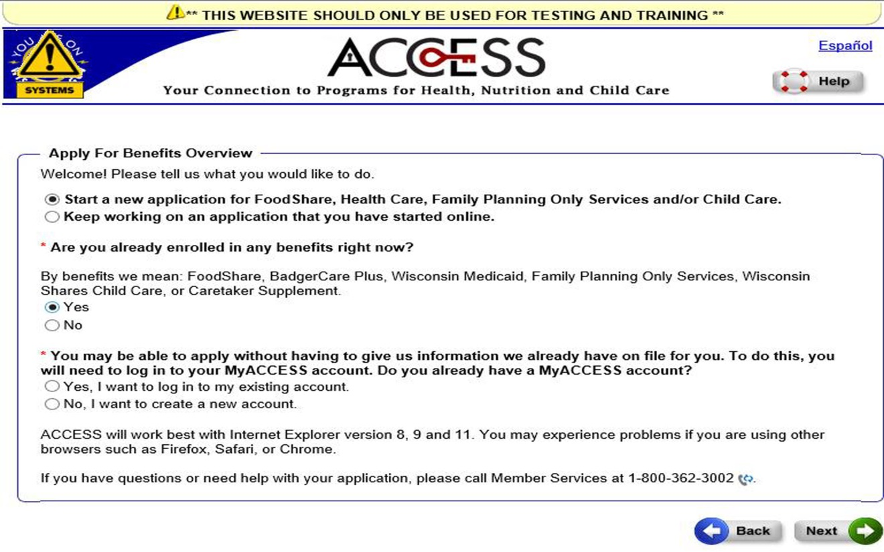
Apply for Benefits!
Figure 8: “Apply for Benefits!” Overview Page

Slide 21
Apply for Benefits – Add a Program for an Existing Member
On the Apply for Benefits Overview page, ACCESS asks if the applicant is already enrolled in any benefits. If the applicant says “Yes,” then he or she will be directed to the streamlined Add a Program version of Apply for Benefits.
Add a Program makes it easier and faster for an existing member to request an additional program in ACCESS.

Slide 22
Apply for Benefits – Add a Program for an Existing Member
To use the Add a Program feature in ACCESS, the existing member must log in to his or her authenticated MyACCESS account.
Details about creating and authenticating a MyACCESS account are covered later in this training.
If the member does not have an authenticated account or is not receiving benefits, he or she will be directed to the regular ACCESS Apply for Benefits application.

Slide 23
Apply for Benefits – Add a Program for an Existing Member
Add a Program closely resembles ACCESS Renew My Benefits and will automatically fill in information about the member based on what is available from the program(s) in which the member is currently enrolled.
The member will be given a chance to review and update any information on the application before submitting.

Slide 24
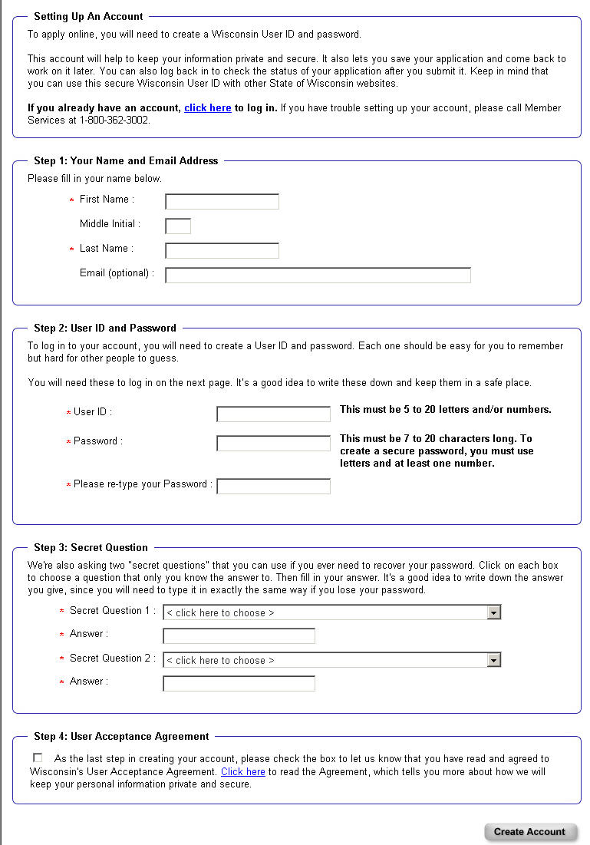
Apply For Benefits – Create an Account for a New Applicant
Figure 9: “Apply for Benefits” Create an Account Page

Slide 25
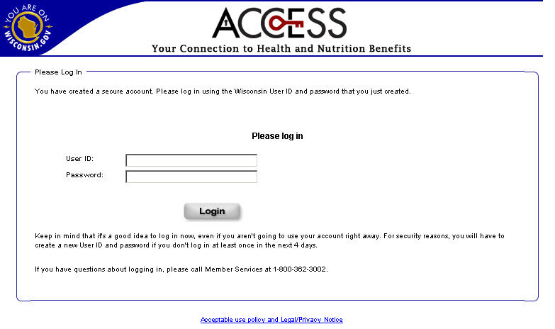
Apply For Benefits – Log in to Activate Account
Figure 10: “Apply for Benefits” Login Page

Slide 26
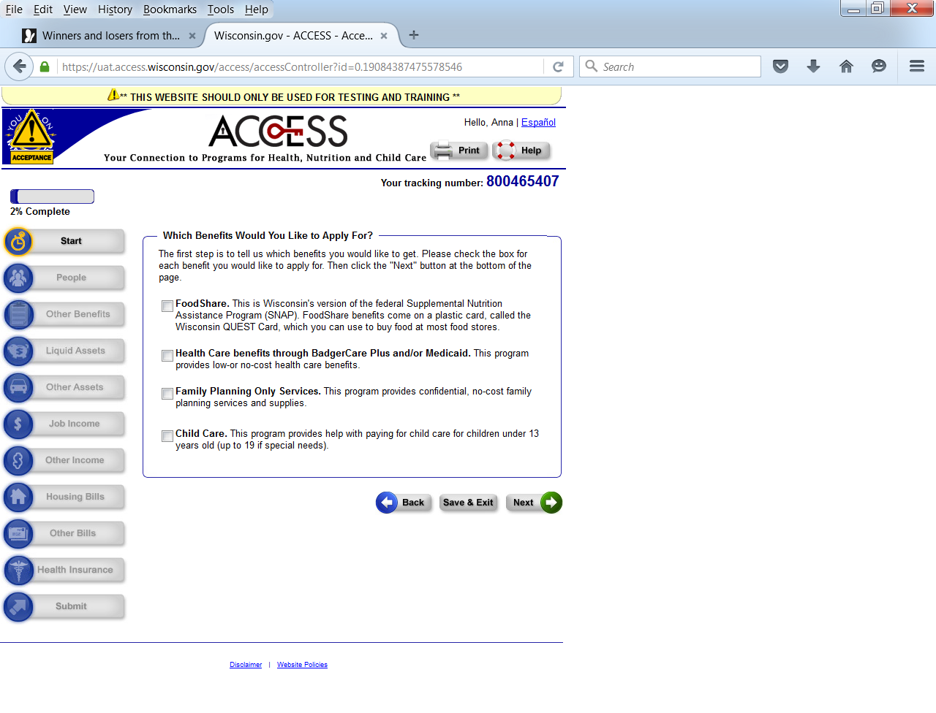
Apply For Benefits – Navigation
Figure 11: “Apply for Benefits!”

Slide 27
Apply for Benefits –
Real-Time Eligibility
Comparing information provided by the applicant to a number of prescreening criteria allows ACCESS to make an initial assessment of the application’s potential for real-time eligibility processing.
With real-time eligibility processing, the applicant may be able to get a faster, or even immediate, determination about his or her application.

Slide 28
Apply for Benefits –
Real-Time Eligibility
If an application is potentially eligible for real-time eligibility, a new page will appear describing some of the information required to get a faster determination.
For those who pass the prescreening criteria (about 10 percent of applicants), real-time eligibility can help provide faster access to needed health care coverage.

Slide 29
Apply for Benefits –
Real-Time Eligibility
Through real-time eligibility, certain individuals may be able to find out right away if they are eligible for BadgerCare Plus and/or Family Planning Only Services. Or, if an applicant is not eligible, his or her application will be transferred to the federal Health Insurance Marketplace right away.
The applicant’s information is verified using online data exchanges.

Slide 30
Apply for Benefits –
Real-Time Eligibility
The applicant can receive an eligibility determination less than three minutes after submitting his or her health care application.
The applicant will immediately be able to view the results and, if eligible, print a temporary ForwardHealth identification card.
The applicant’s official notice of decision will be issued electronically or by mail the next business day.

Slide 31
Apply for Benefits –
Real-Time Eligibility
To potentially get an answer about his or her application right away, the applicant will need to:
  Complete the entire application before signing and submitting.
  Provide Social Security numbers for everyone whom ACCESS asks about.
  Provide complete information about immigration status for anyone who is not a U.S. citizen.

Slide 32
Apply for Benefits –
Real-Time Eligibility
  Provide the Federal Employer Identification Number (FEIN) for any jobs listed on the application.

Slide 33

Apply For Benefits – Help Text
An applicant using ACCESS can get help from any screen by clicking on the Help button in the upper right-hand corner of the screen.
The Help button will open a new page that explains more about what ACCESS is asking and how to answer the questions.

Slide 34
Apply For Benefits – Completing the Application
You can help the applicant to:
Select which programs he or she wants to apply for. (ACCESS will only ask the questions needed for the programs the applicant is applying for.)
Enter the basic demographic information – name, address, etc.
Enter citizenship and additional demographic information.
Note: Social Security numbers (SSNs) are not required but help expedite processing of the application. The applicant must provide SSNs for everyone in his or her household to get a real-time eligibility determination.

Slide 35
Apply For Benefits – Completing the Application
Enter the number of people in the home. Based on this answer, the applicant will be asked to enter demographic information about each person in the home. The applicant will also be asked how he or she is related to each person on the application.

Slide 36
Apply For Benefits – Completing the Application
  Review Summary pages after each section. Summary pages provide an opportunity for the applicant to change incorrect information or remove individuals from the application.
Answer non-financial questions (disability, drug felony, school enrollment, etc.; if applying for Child Care, the applicant should enter the information about the approved activity).

Slide 37
Apply For Benefits – Completing the Application
If someone on the application is working, enter information about the employment.
If there are other sources of income, answer questions about the type and amount of income.
Answer questions about the type and amount of bills (housing, utility, child support, dependent care, medical bills, etc.).
  Note: You should talk through the Rights and Responsibilities with the applicant.

Slide 38
Apply For Benefits – Completing the Application
If applying for FoodShare or Child Care, select either phone or face-to-face interview.
Sign the application – the applicant must sign the application himself or herself.
Submit the application, print the application summary (if desired), and write down the tracking number.

Slide 39
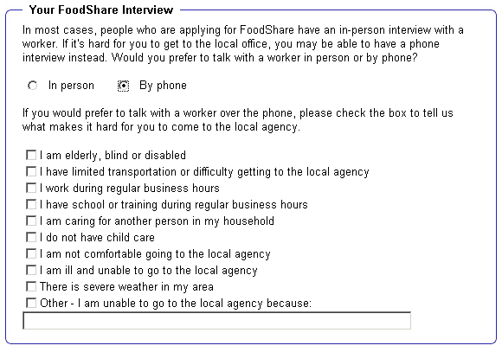
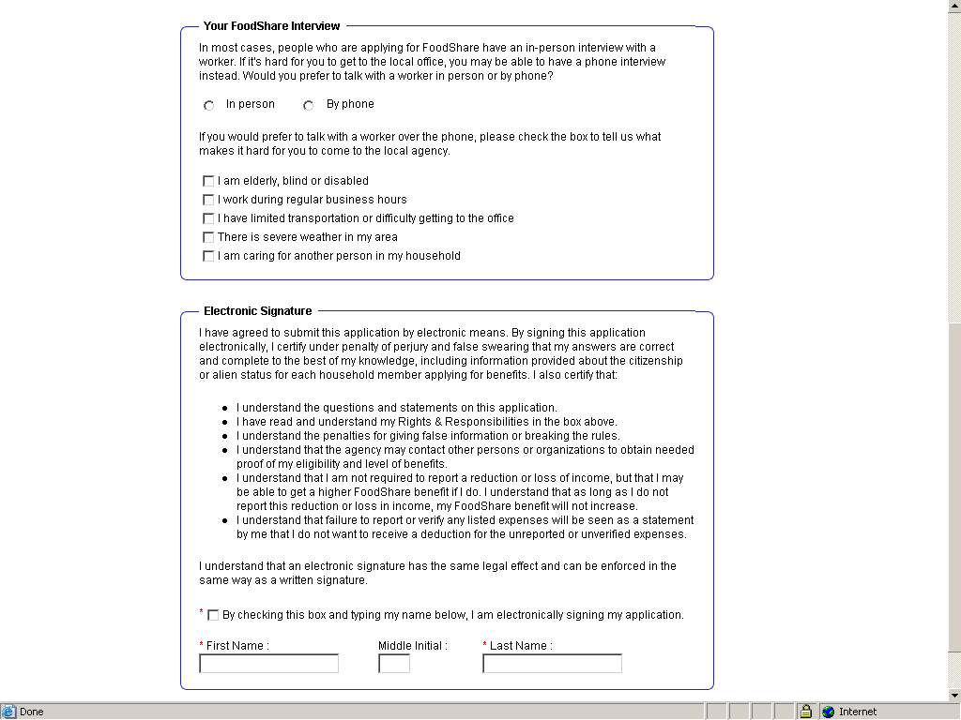
Apply For Benefits – FoodShare Interview
The box MUST be checked by the applicant and
the applicant MUST type in his or her own name!
Figure 12: “Apply for Benefits!” FoodShare Interview Page

Slide 40
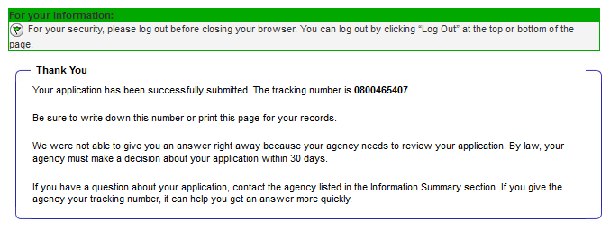
Apply For Benefits – Next Steps
Figure 13: “Apply for Benefits!” Submission Confirmation

Slide 41
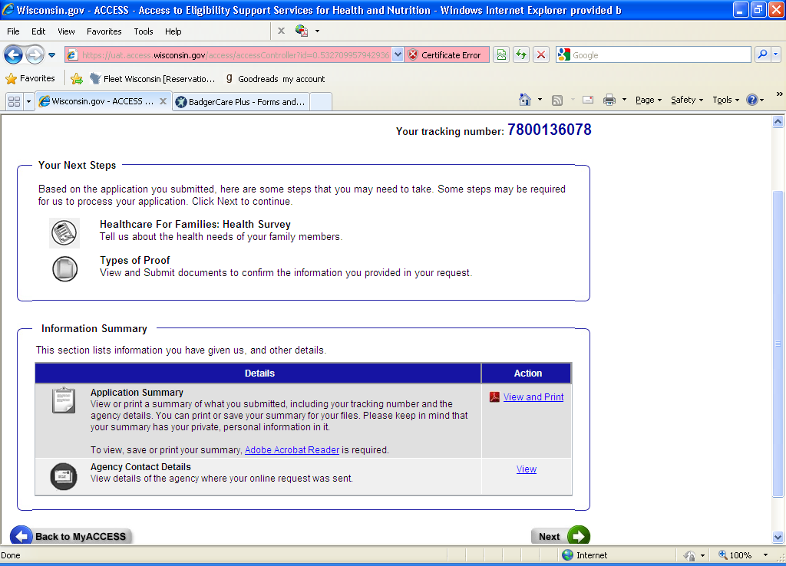
Apply For Benefits – Next Steps

Slide 42
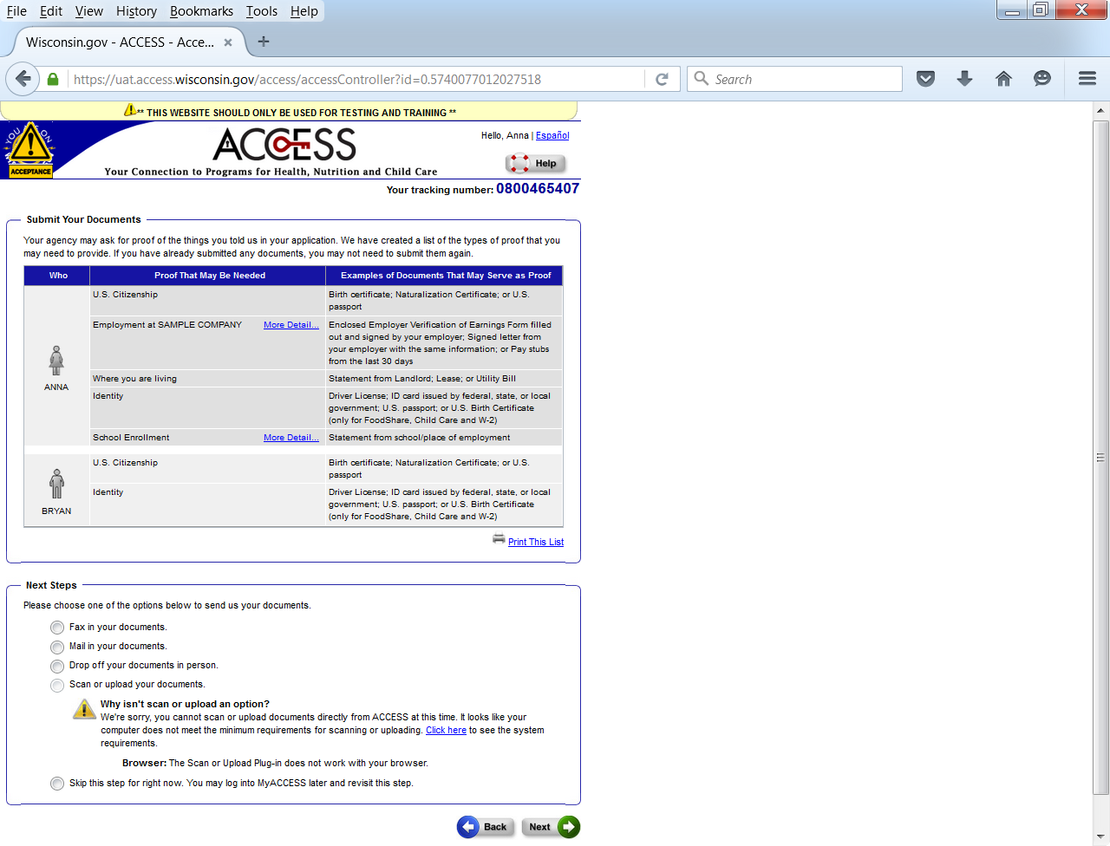
Apply For Benefits – Next Steps

Slide 43
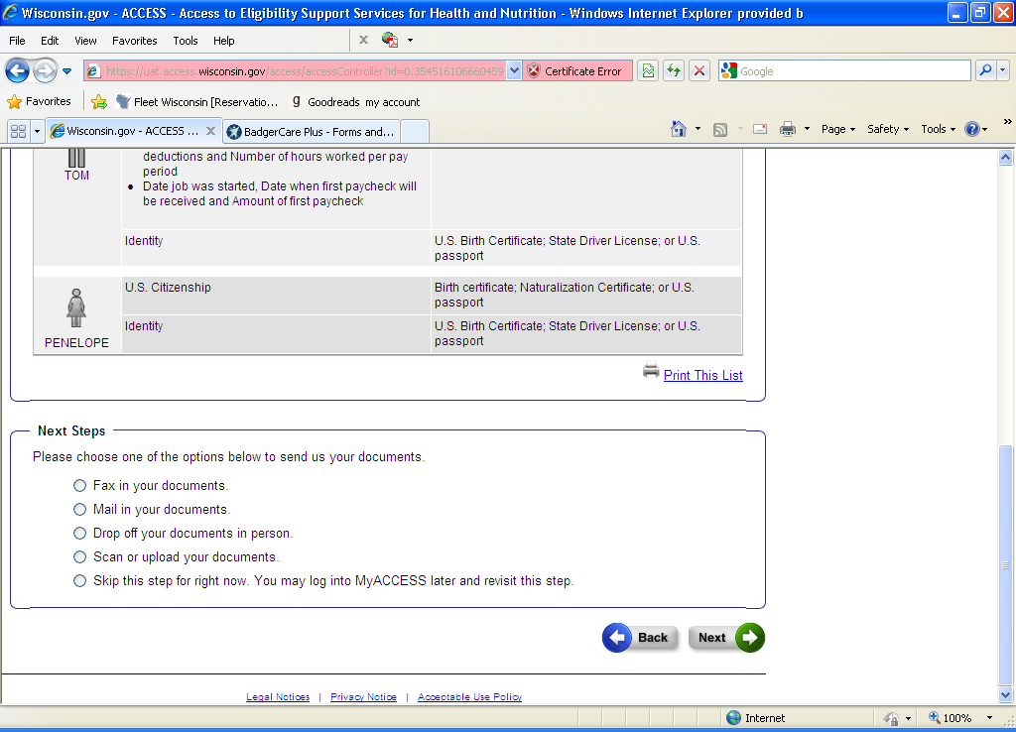
Apply For Benefits – Next Steps

Slide 44
Apply For Benefits – Training
As you prepare to assist applicants, practice completing an application on the ACCESS Training Site.
Visit https://trn.access.wisconsin.gov/.
Make sure the yellow triangle labeled “Training!” is in the upper left-hand corner of the screen (this is the indicator that you are in the training environment).

Slide 45
MyACCESS
Login to Account or Create an Account

Slide 46
MyACCESS
Before the applicant can view ongoing benefit details, complete a change report, or perform other functions, the permanent MyACCESS account needs to be activated.
After completing the ACCESS application, the applicant will get notices in the mail with his or her case number in the upper right-hand corner of each notice.

Slide 47
MyACCESS
Using the “Create an Account” or “Login to Account” buttons on the ACCESS home page, the applicant can manage his or her benefits, complete reviews, submit change reports, and request benefits statements.
After clicking one of these buttons, the applicant must submit his or her SSN, date of birth, and case number (or ForwardHealth or QUEST card number). This will link the applicant’s ACCESS account login with his or her actual case.

Slide 48
MyACCESS

Slide 49
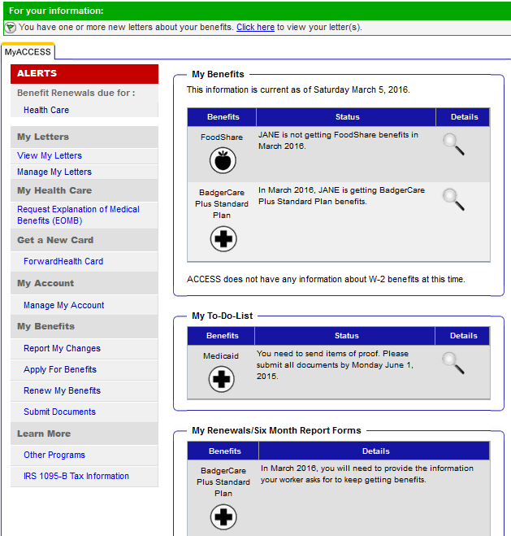
MyACCESS – Manage Benefits

Slide 50
My ACCESS – Completing Renewals Online

Slide 51
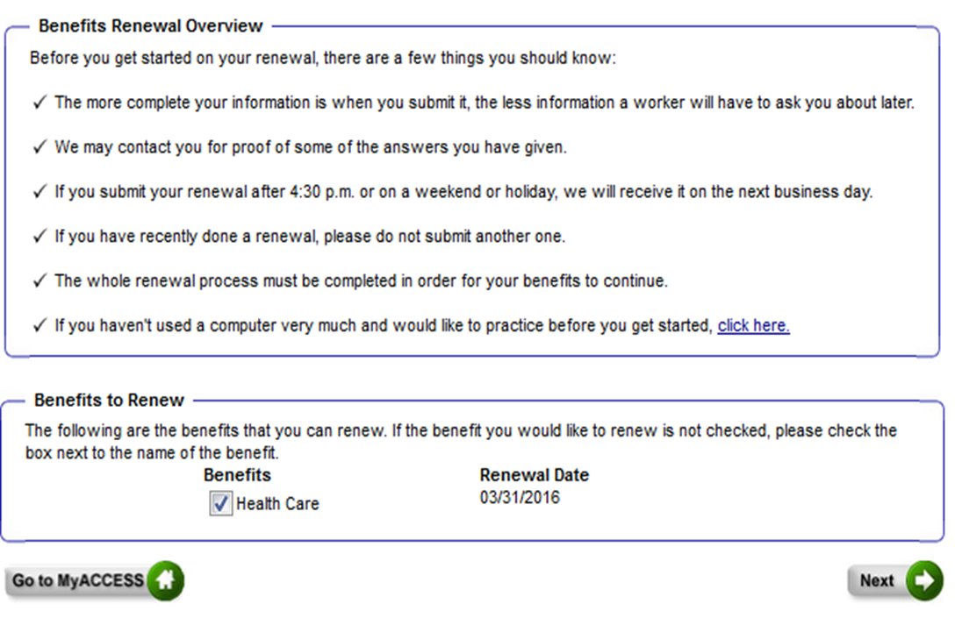
MyACCESS – Completing Renewals Online

Slide 52
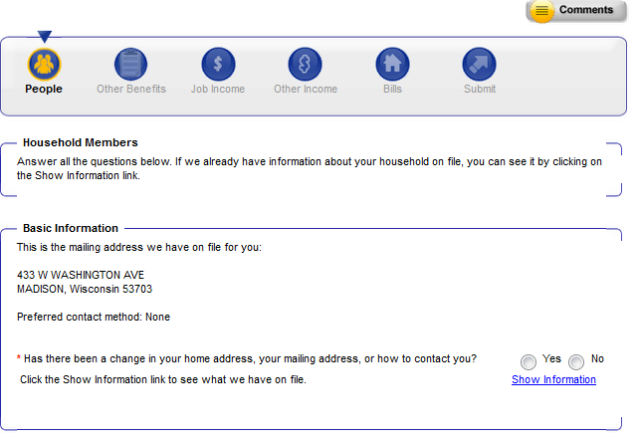
MyACCESS – Completing Renewals Online

Slide 53
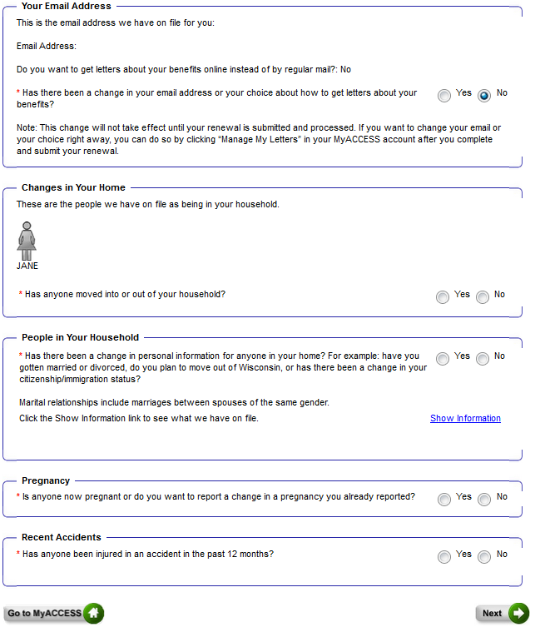
MYACCESS – Completing Renewals Online

Slide 54
MyACCESS – Completing Renewals Online

Slide 55
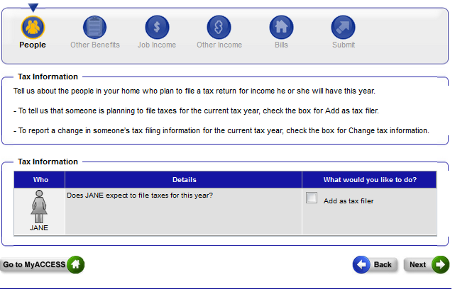
MyACCESS – Completing Renewals Online

Slide 56
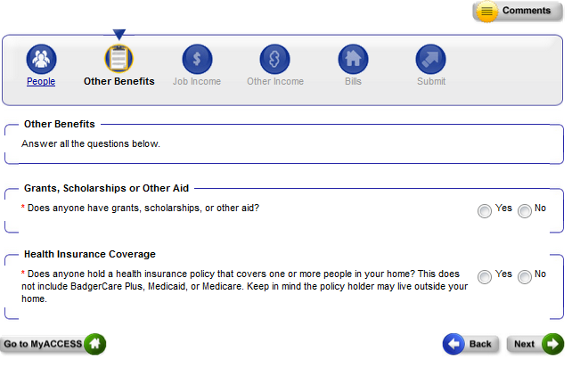
Completing Renewals Online –
Other Benefits

Slide 57
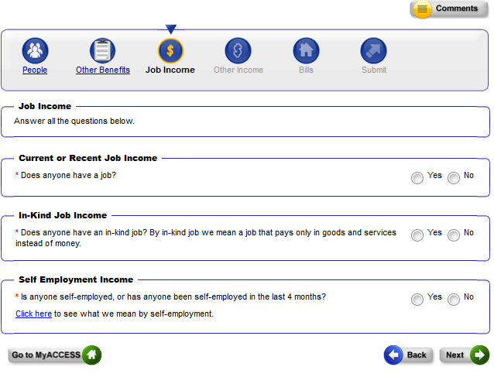
Completing Renewals Online

Slide 58
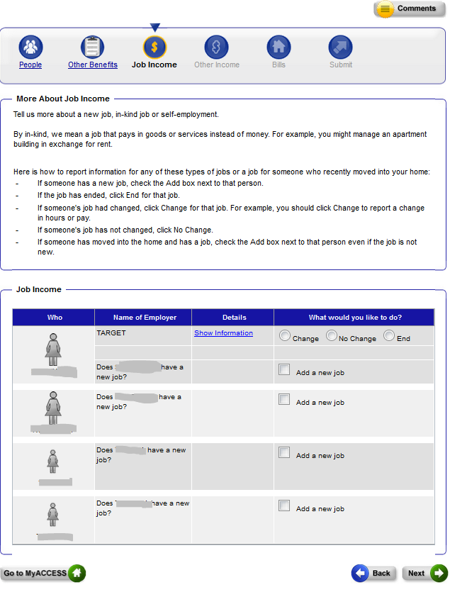
Completing Renewals Online

Slide 59
Completing Renewals Online

Slide 60
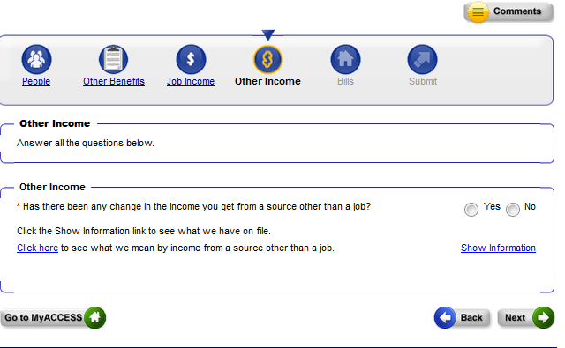
Completing Renewals Online

Slide 61
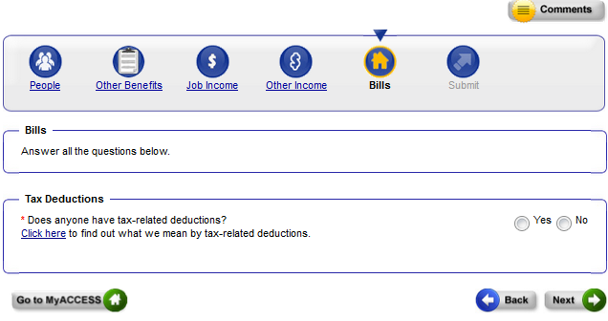
Completing Renewals Online

Slide 62
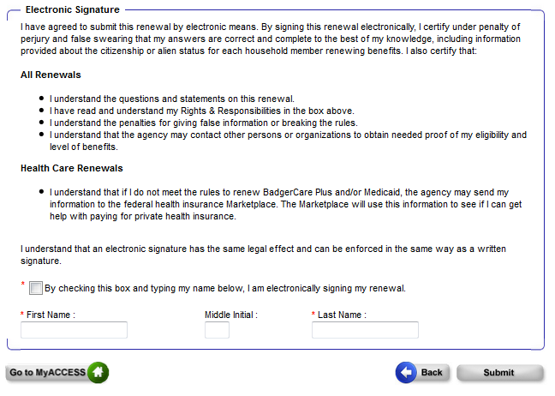
Completing Renewals Online

Slide 63
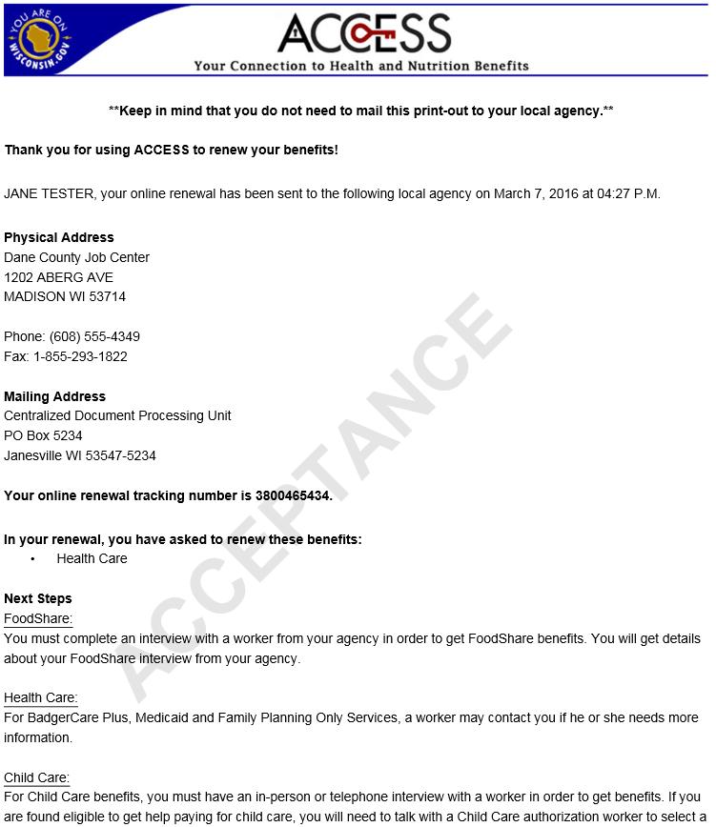
Renewal Summary Page

Slide 64
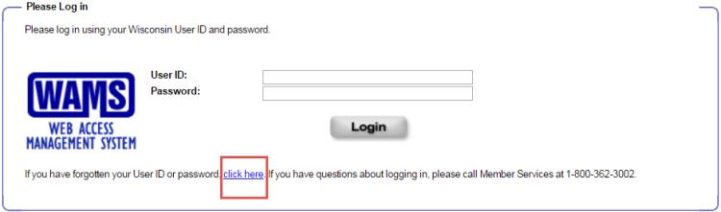
ACCOUNT RECOVERY
People who cannot remember the user ID or password for their MyACCESS account should click the click here link at the bottom of the ACCESS login page.

Slide 65
Account Recovery
The Access Account Recovery Setup page will be displayed. People should enter their user ID to recover their password or their ACCESS tracking number to recover their user ID and click Continue.

Slide 66
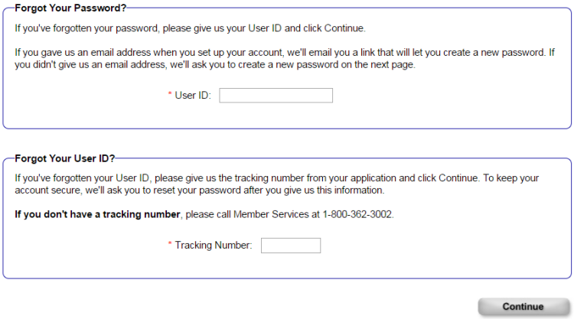
Account Recovery

Slide 67
Account Recovery
The ACCESS Account Recovery page will be displayed if an email address was not provided when people created their MyACCESS account. For privacy and security, all three sections need to be completed before an account can be recovered. Click Continue after completing all three sections.

Slide 68
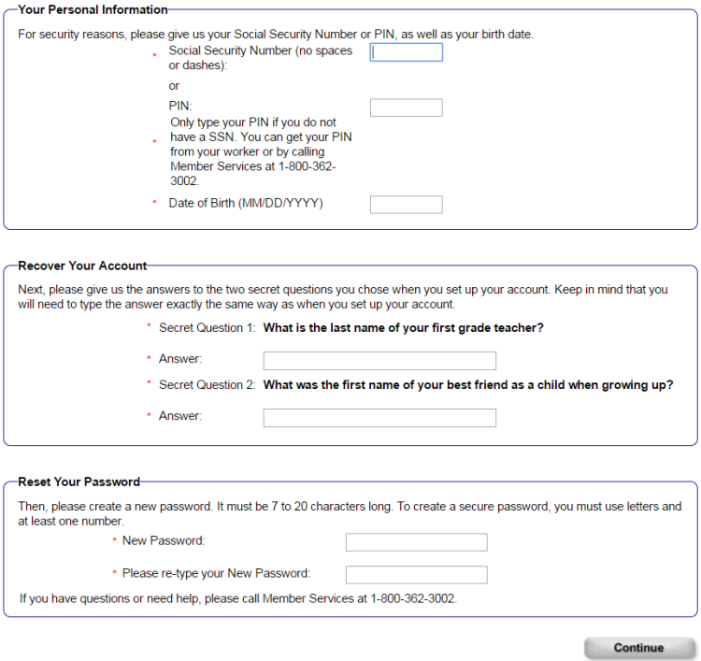
Account recovery

Slide 69
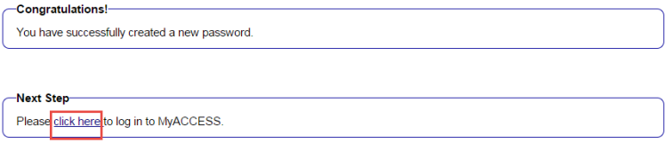
Account Recovery
If the recovery is successful, the Congratulations page will be displayed. Click the link here to go to the ACCESS login page.

Slide 70
Account Recovery
If an email address was provided as part of creating a person's MyACCESS account, the account recovery process occurs through the Web Access Management System (WAMS) instead of ACCESS. The following page will be displayed after people click Continue on the Access Account Recovery Setup page. Follow the steps on the page to recover the account.

Slide 71
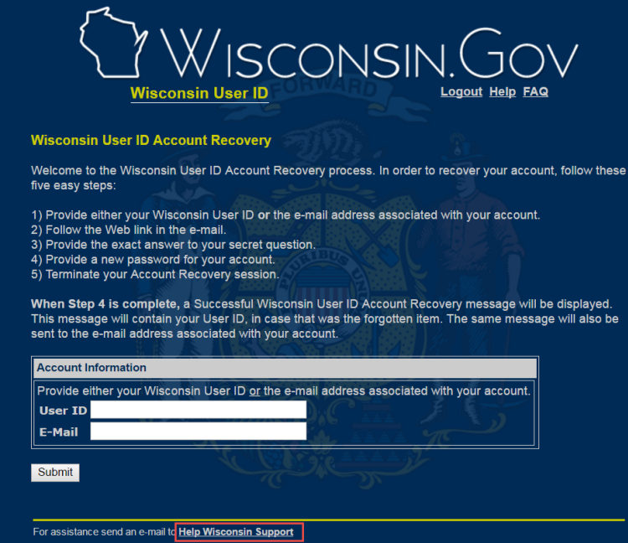
Account Recovery

Slide 72
ACCESS Best Practices

Slide 73
ACCESS Best Practices
Help applicants write down and remember their login name and password.
Always make note of the application tracking number (upper right-hand corner of the screen).
Assist applicants with submitting their verifications whenever possible, preferably at time of application submission.
For detailed screenshots and explanations for each ACCESS screen, go to: www.emhandbooks.wi.gov/ah/.

Slide 74
Resources

Slide 75
Resources
ACCESS Handbook
  http://www.emhandbooks.wi.gov/ah
ForwardHealth Portal
  dhs.wisconsin.gov/forwardhealth
BadgerCare Plus website
  https://www.dhs.wisconsin.gov/badgercareplus/member-info.htm
  Enrollment and Benefits Handbook
  dhs.wisconsin.gov/em/impubs/pubs/p-00079.pdf
ACCESS - Training website
  https://trn.access.wisconsin.gov/

