Slide 1

BadgerCare Plus Overview
October, 2020

Slide 2
Useful Desk Aids
Your trainer should have printed copies of these desk aids from this Power Point for you.
Desk aids referenced within this Power Point:
Flow chart in BCPH 2.3.3
BC+ Chart on capital-im.com website, under Desk Aids
Type of Income chart on website
Tax Deductions desk aid on website
Late Verifications desk aid on website
You may wish to print these desk aids out. You may wish to save paper and just know where to find them when you need them. Both ways work. ☺

Slide 3
What is BadgerCare Plus?
Health insurance for…..
Low income adults
Pregnant women
Children
Former foster care youth
3 Month Backdate possible

Slide 4
How do I apply for BC+?
In person
ACCESS website
Mail in paper application
Phone
Capital Consortium: 1-888-794-5556
Adams, Columbia, Dane, Dodge, Juneau, Richland, Sauk and Sheboygan Counties
****Note – if someone requested FS on same application as HC, we need to process HC, even if applicant didn’t follow through on FS part

Slide 5
Non-Financial Eligibility
Be a Wisconsin resident (Ch 3)
Be a US citizen or qualified immigrant (Ch 4)
Verify citizenship status and identity (Ch 4.1)
Cooperate with Child Support Agency (Ch 5)
Cooperate with Third Party Liability (TPL) (Ch 5.2)
Provide SSN when required (Ch 9)
Meet access / coverage requirements (Ch 7)

Slide 6
Forming the BC+ Assistance Group
Your reading will get very detailed about how these groups are formed.
It gets complicated. Don’t be afraid to ask questions.
Don’t be surprised if you are confused. That’s normal.
When you find the following desk aid, print it out.
Tax rules
Relationship Rules

Slide 7
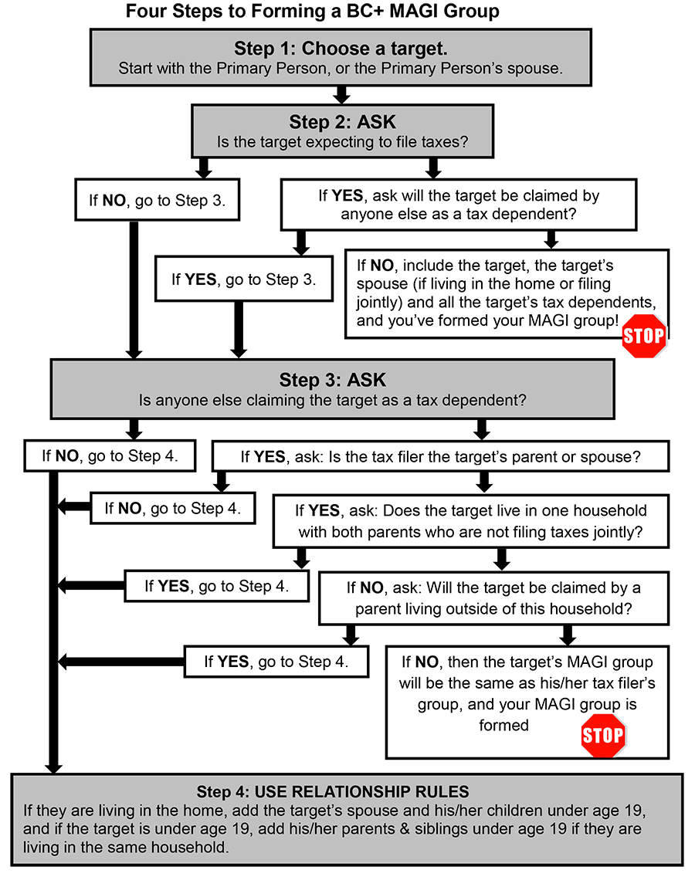
Four Steps to Forming a BC+ AG
In the BC+ manual 2.3.3

Slide 8
Financial Eligibility
No asset limit
Income limits
Adults – 100%
Premiums for Childless Adults over 50% See 44.2
Children – 300%
Premiums over 201%
Pregnant women – 300%*
FPOS (family planning only services) – 300%*
*will also see this referred to as 306% see 16.1.1
All group members’ taxable income is counted
Notes:
The income limits under MAGI rules listed above include the following income disregards.
Children, pregnant women and individuals eligible under Family Planning Only Services will be allowed an income disregard equal to 5% of the FPL in addition to a conversion factor adjustment equal to 1% of the FPL. While the income limit remains 300% FPL, CWW will actually test against an income limit of 306% FPL once the income disregard and conversion factor are included.
Parents, caretakers and childless adults already have the income disregard included in the income limit of 100% FPL. CWW will test against an income limit of 100% FPL.
Note: Other effective income limits for children under MAGI Modified Adjusted Gross Income. MAGI rules are used to determine BC+ eligibility for new applicants beginning in 2014 and for existing members as of March 31, 2014 or their next regularly scheduled renewal, whichever is later. MAGI rules are based on tax relationships and family relationships, and they consider taxable income and whether children and tax dependents are required to file. rules will also reflect the addition of the 6% disregard with the exception that the income thresholds for children’s premiums will only be increased by 1%.

Slide 9
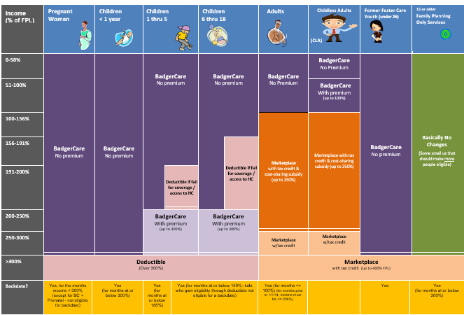
Available on the capital consortium website

Slide 10
Income
Counted Income
Disregarded Income
Earned income, cash tips
Disability pay
Educational aid
Unemployment Compensation
Work study
Capital gains / losses
Adoption assistance
AmeriCorps Vista
Child / Family support
Earned income of a minor
Foster Care / Kinship Care
SSI
Veteran’s benefits
W-2
Worker’s Comp

Slide 11
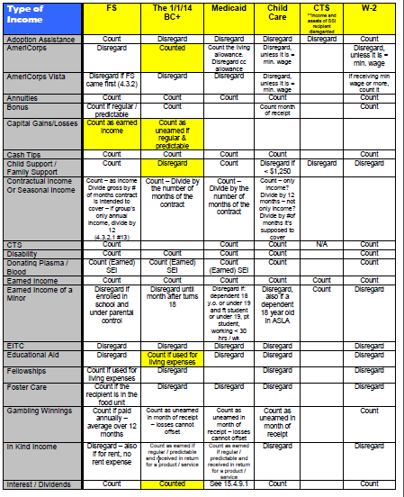
Available on the capital consortium website

Slide 12

BC+ Deductions
Pre-Tax Deductions
Taken out of paycheck, pre-tax
Health insurance premiums
Health savings account
Retirement contributions
Parking and transit costs
Child care savings account contributions
Group life insurance premiums

Slide 13
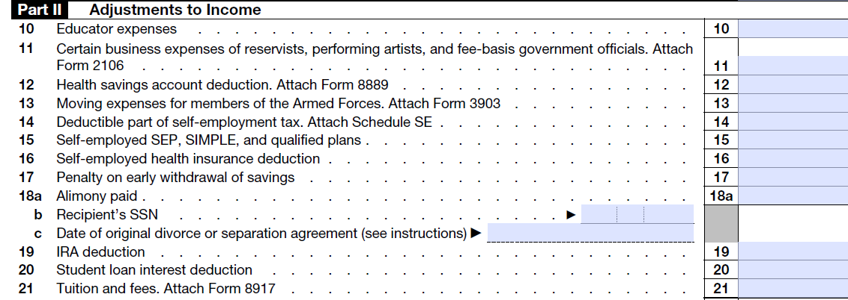
BC+ Deductions
Deductions
Schedule 1, 1040 of taxes
Student loan interest
Higher education expenses
Self-employment tax deduction
Spousal support, alimony or maintenance
Teachers’ tax-deductible expenses
Self-employed SEP, Simple or Qualified Plan contributions
Others

Slide 14
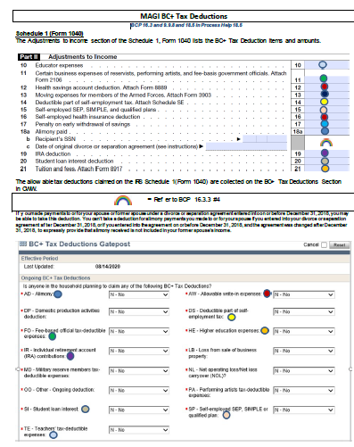
Desk Aid to Help
Available on the consortium website

Slide 15
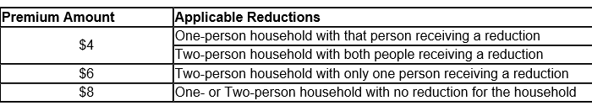
Premiums
19.2.1 Children's Premiums using MAGI Rules
The minimum monthly premium amount for children is $10 per person
The maximum monthly premium for a child is $97.53
44.2 Premiums for Childless Adults
44.3 Treatment Needs Question for Childless Adults-**Required**
44.4 BadgerCare Plus Health Survey for Childless Adults-**Optional**

Slide 16
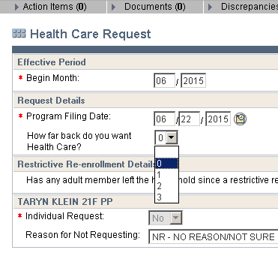
Backdating
HC can be backdated up to 3 months prior to filing date
Tell CWW how far back to look on the HC Request page
Make sure all pages contain eligibility information for those backdated months, if backdate request to 03/2015, ALL begin months in CWW need to be entered as 03/2015
.

Slide 17
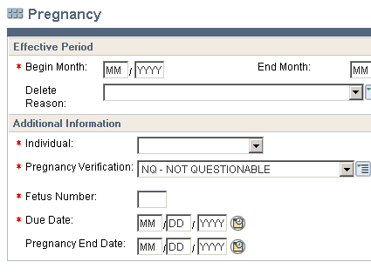
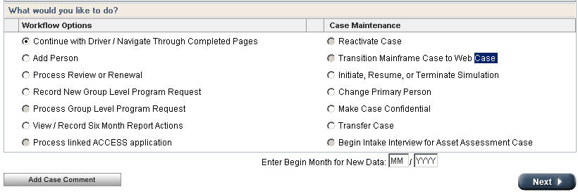
Example
Actual income must be verified for each backdated month
Make sure you enter the correct begin month for each application
And, if the backdate request is due to a pregnancy, put the pregnancy begin date in the begin month field

Slide 18
Renewals
ACCESS Renewals
Customer completes renewal on ACCESS
Phone Renewals
Customer calls in and completes renewal on the phone – telephonic signature required
Administrative Renewals
An automatic renewal for cases that meet certain criteria listed in 26.1.3
PPRF
Agency sends out Pre-Printed Review Form to customer ahead of time for their review
Customer returns PPRF with any necessary changes
In Person
Customer may choose to have in person appointment

Slide 19
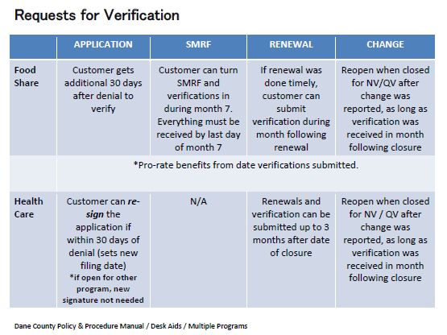
Available on the capital consortium website

Slide 20
Reasonable Compatibility
Health Care Only
In some situations, applicants are not required to verify their income.
This is because what they reported to us AND the income that is available in data exchanges both are under the income limit
If member reports income over the income limit, that income will be used, regardless of what the outcome would be if DE was used

Slide 21
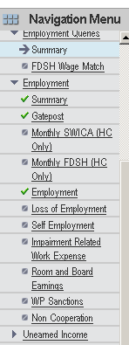
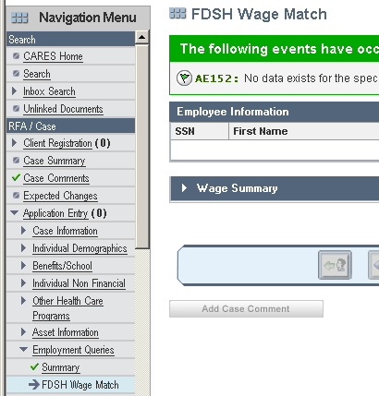
Which FDSH to use?
Don’t use this one
Use this one

Slide 22
Self Employment
Business Type | Federal Forms
Sole Proprietor | 1040 | Schedule (C, E, or F)
Partnership | 1040 and 1065 | Schedule (C, E, or F) | K-1
Corporation | 1040 and 1120 |  | K-1
S Corporation | 1040 and 1120S |  | K-1
SEIRF (Self Employment Income Report Form) | For anyone self employed, who has a new business or who has reported a valid significant change in their business

Slide 23
Deductibles Chapter 17
Who can get one?
What is it?
Children under 19 with income over 306% FPL
Children with income over 156%FPL denied due to access to health insurance
Pregnant women with income over 306% FPL
If the household incurs expenses that equal that amount, or pre-pays their deductible, they can get BadgerCare coverage

Slide 24
Extensions Chapter 18
Adult caretaker / pregnant woman can enter extension due to increase in income (earned, spousal support or both)
Children, step-children and NLRR children of the parent / caretaker will also enter the extension
Childless adults are not eligible for extensions

Slide 25
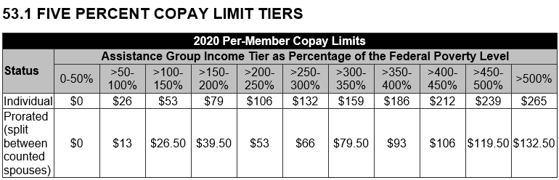
Copays (5% Cost Share Limit) Chapter 38.8
Applies to members eligible for BCP, SSI Medicaid, and most EBD Medicaid programs.
Members may not pay more than 5% of their household income for monthly premiums and copays for BCP or Medicaid card services.
A copay limit will be set on a monthly basis.

Slide 26
Copay Exemptions
38.2.2 Copay Exempt Populations
Children under age 19
Children in foster care
Children in adoption assistance
American Indians or Alaskan Native Tribal members
Former Foster Care Youth
Pregnant Women
38.2.3 Copay Exempt Programs
MAPP
Seniorcare
Family Planning Only Services
Institutional Medicaid
Katie Beckett
Wisconsin Well Woman Medicaid

Slide 27
Gap Filling
Chapter 16.9
Due to differences between the eligibility rules used by the Federally Facilitated Marketplace (FFM) and the eligibility rules used when counting income for BadgerCare Plus, the Marketplace may find someone to be at or below 100% of the FPL based on his or her annual income, while BadgerCare Plus may find someone to be above 100% of the FPL based on his or her current monthly income.
Because of this difference in eligibility rules, these customers must have eligibility for BadgerCare Plus determined based on their expected annual income under a process called "gap filling."

Slide 28
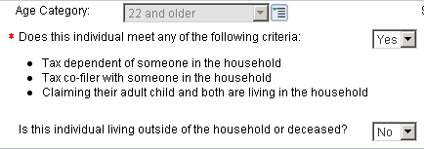
BC+ in CWW
Household Members
Does this individual meet any of the following criteria:
Tax dependent of someone in the hh
Tax co-filer with someone in the hh
Claiming their adult child and both are living in the hh
Is this individual living outside of the hh or deceased?

Slide 29
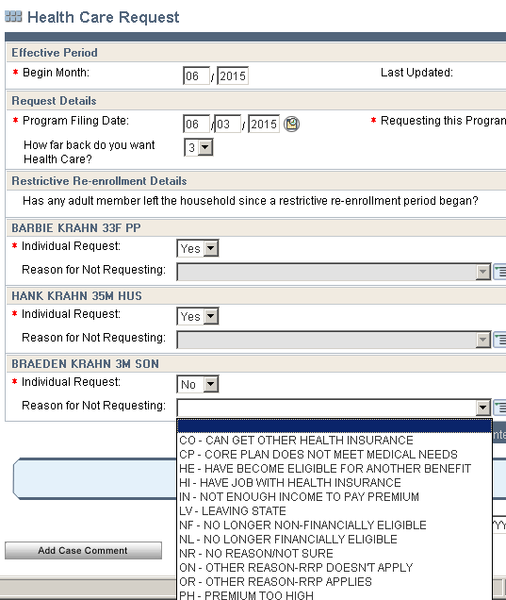
Health Care Request
Filing Date vs How far back do you want HC?
If HC request for an individual is no, must select reason

Slide 30
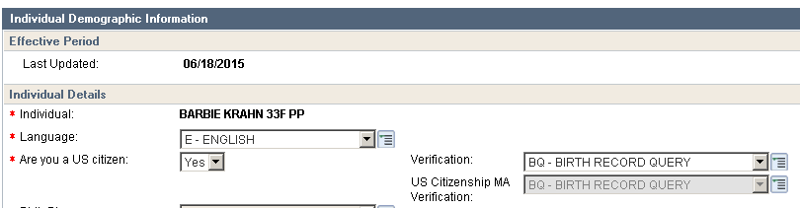
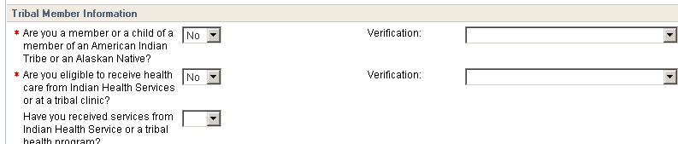
BC+ in CWW
Permanent Demographics Page
Citizenship
Tribal member
,

Slide 31
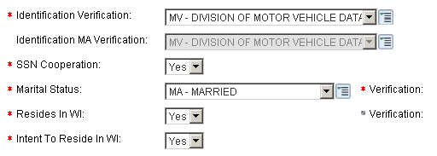
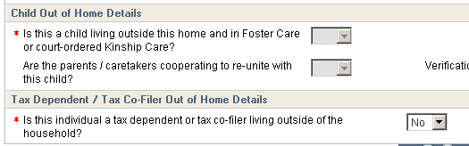
Current Demographics
Identification Verification
Intent to Reside in WI
Child Out of Home
Tax Dependent / Tax Co-Filer Out of Home

Slide 32
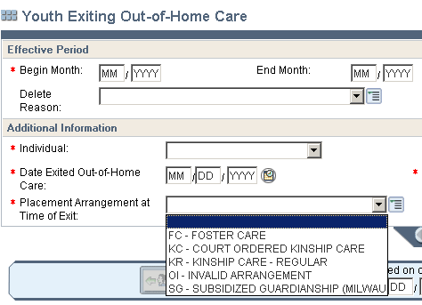
Youth Exiting Out-of-Home Care aka Former Foster Care Youths
Youths who were in foster care, subsidized guardianships or court-ordered Kinship Care on 18th birthday qualify for BC+ until 26 years old
See 11.2

Slide 33
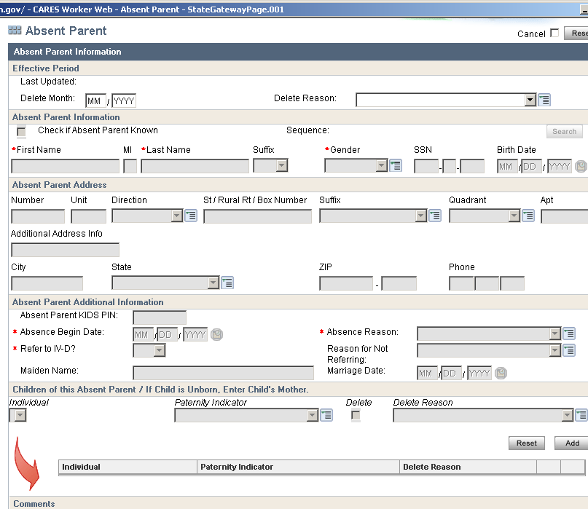
Absent Parent Page
Complete one for each absent parent
Scheduled by information entered on Household Relationships page.
If child is missing a “FTR – Legal Father” or “MTR – Mother” in the hh
Unmarried pregnant woman

Slide 34
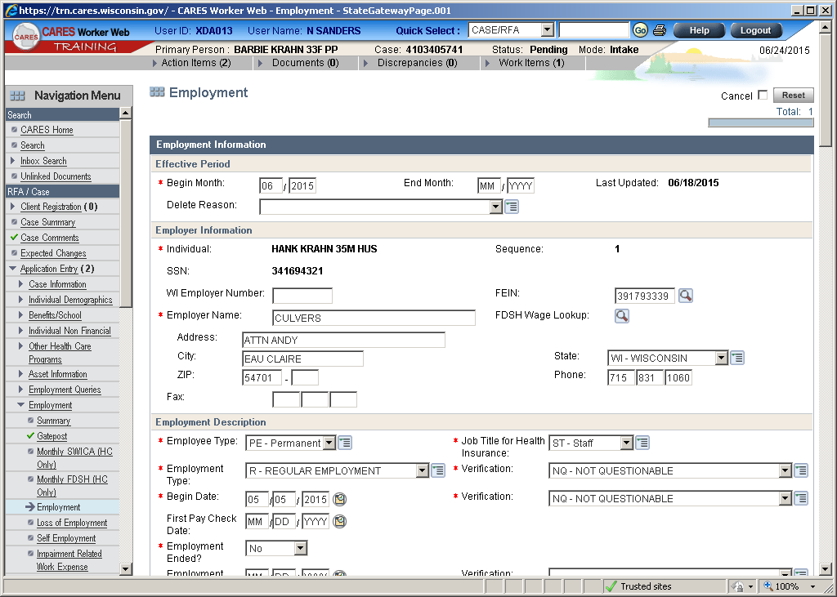
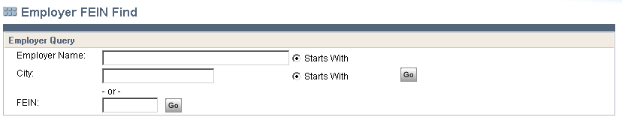
Employment Page
Click on magnifying glass next to FEIN
Enter employer name (don’t have to do the long entire official name) and click go
If you copied the FEIN from the Employment Queries page, enter it here and click go

Slide 35
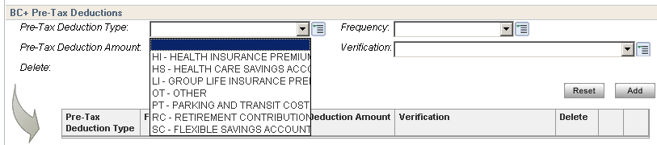
Employment Page continued
BC+ Pre-Tax Deductions
Deductions found on paystubs, taken out of customer’s paycheck, pre-tax

Slide 36
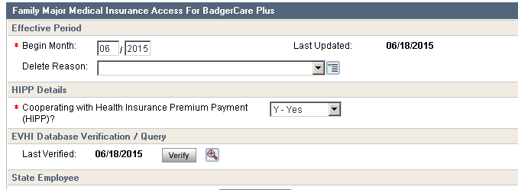
Employment Page cont.
Click the Verify button
Make sure you’ve entered FEIN above

Slide 37
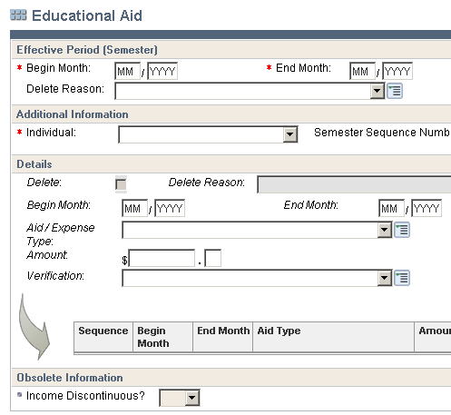
Educational Aid
Begin month and end month refer to the semester begin and end months (generally August – December and January - May)
This page collects both educational aid income and expenses
You will have to add text listing what verification is needed

Slide 38
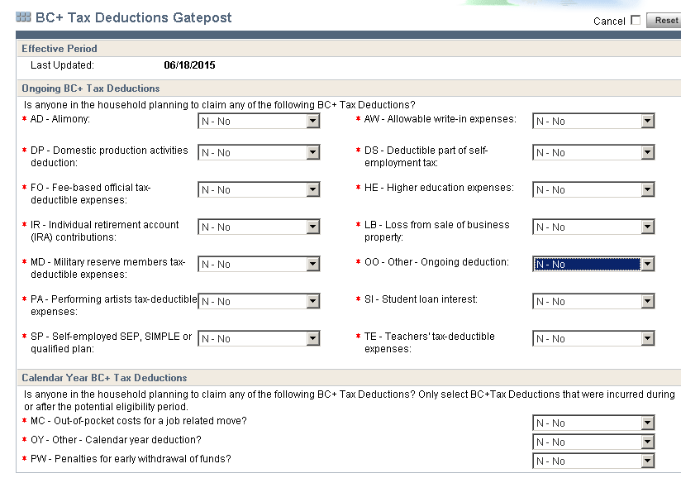
BC+ Tax Deductions
Should be pretty uncommon
Need verification
Can be found on tax form 1040

Slide 39
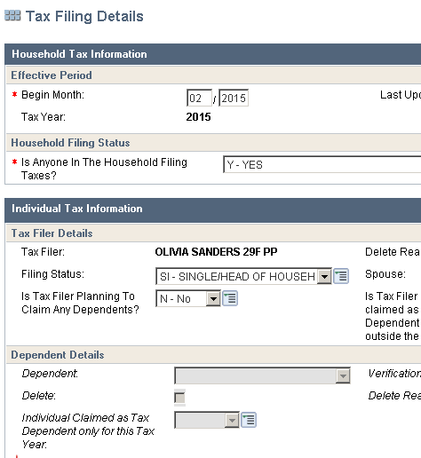
Tax Filing Details
This is for how they expect to file at the end of current year
Individual Claimed as Tax Dependent only for this Tax Year – be accurate

Slide 40
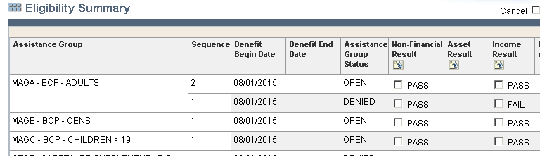
Eligibility Summary
Manually click on the Non-Financial and the Income Result boxes
Make sure everyone you think should be passing is passing
Make sure your budget is correct

Slide 41


