Slide 1
BadgerCare Plus
**BCP Test Group
**Tax Filing vs Relationship Rules
**Assistance Groups
**Participation Status Codes
**Group Examples/Exercises

Slide 2


BCP Test Group
**The BCP Test Group is formed using either tax filing rules or relationship rules.

Slide 3
Tax Filing Rules
Tax Filing=An individual’s “tax” household
If an individual is a tax filer and is not also a tax dependent, the BCP Test Group contains themselves, the spouse (if living in the same home, or if filing taxes jointly) and any tax dependents he or she expects to claim, including those who are deceased or living outside the home
A tax dependent’s BCP test group will be the same as his or her tax filer’s group unless meeting 1 of these 3 exemptions:
He or she is being claimed as a tax dependent by someone who is not his or her parent.
•He or she lives in one household with both parents who are not filing taxes jointly.
•He or she is being claimed as a tax dependent by a parent living outside the household

Slide 4
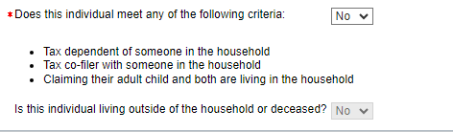
OTX: Out of the Home Tax Dependents/Tax Co-filers
Household Members Page
Current Demographics Page

Slide 5
Relationship Rules
Relationship=Physical household or family relationships
If any of the exceptions are met, or if an individual is not a tax filer or a tax dependent, relationship rules are used to determine the BCP Test Group.
Under relationship rules, only include individuals who are living in the home with the target.

Slide 6
2.3.3 MAGI Flowchart

Slide 7
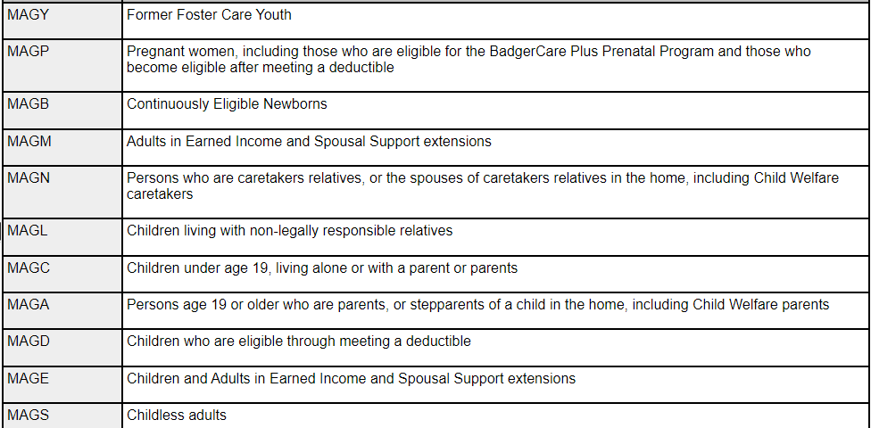
BCP Assistance Groups **Once the test group is determined, then the BCP assistance groups can get formed

Slide 8
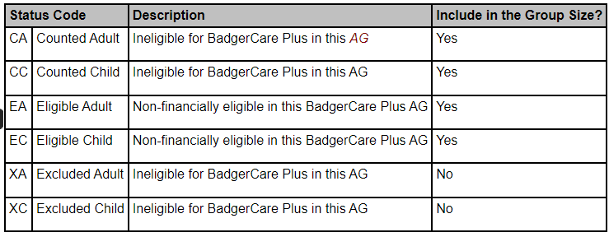
BCP Participation Status Codes **Each individual in the assistance group will need to be given a participation status code.

Slide 9
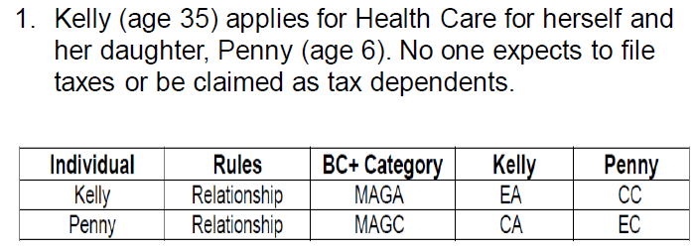
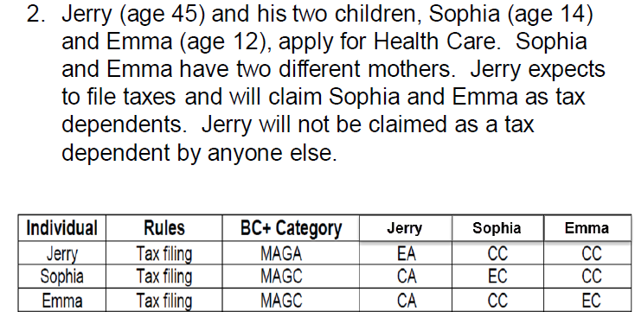
BCP Group Examples

Slide 10
BCP Group Exercises •Who is requesting HC? •What is their assistance group (e.g. MAGC)? •What is the participation status code for each individual (e.g. EC, EA, CC, CA)? •Which rule? Tax Filing or Relationship Rule?

Slide 11

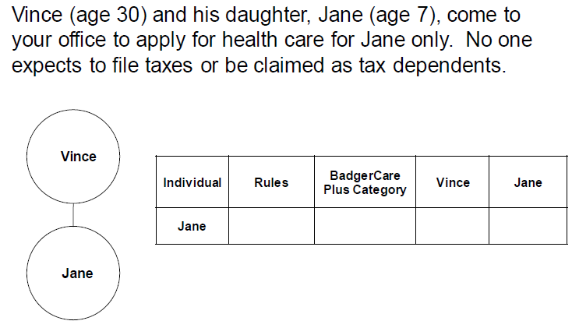
Exercise #1

Slide 12
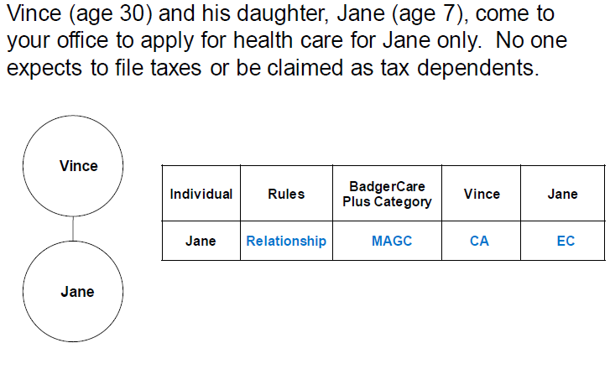
Exercise #1 Answer

Slide 13
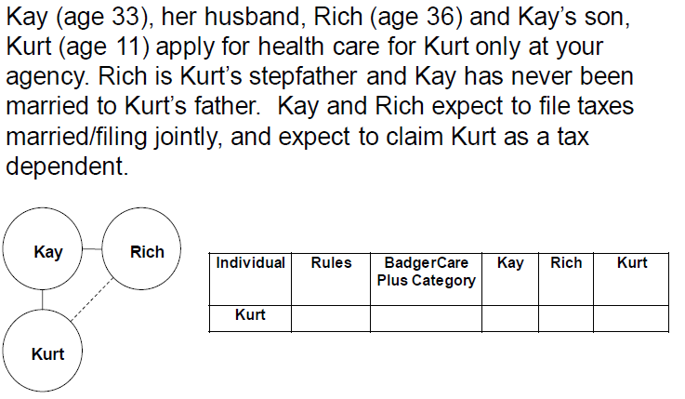
Exercise #2

Slide 14
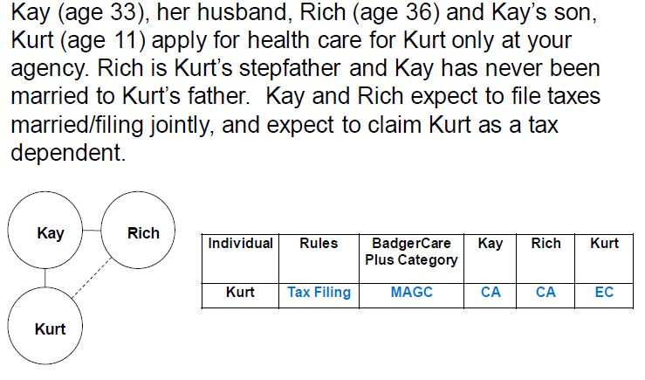
Exercise #2 Answer

Slide 15
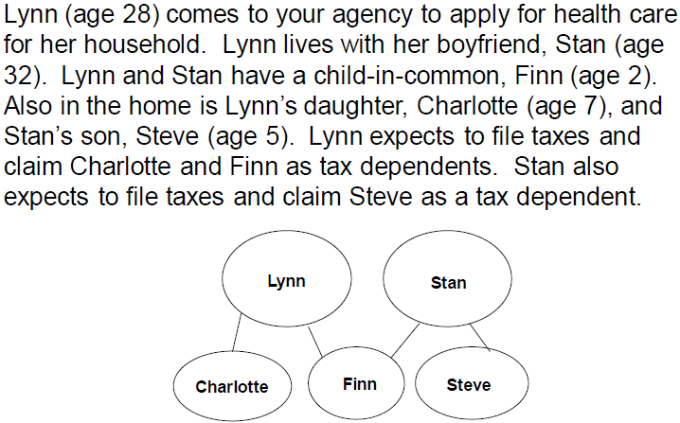
Exercise #3

Slide 16
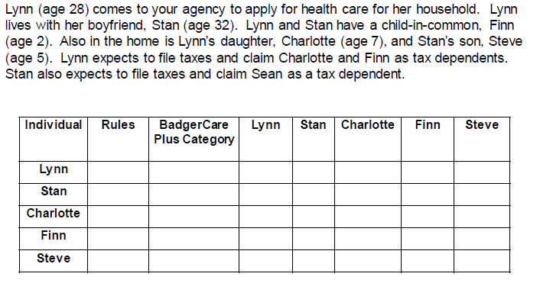
Exercise #3

Slide 17
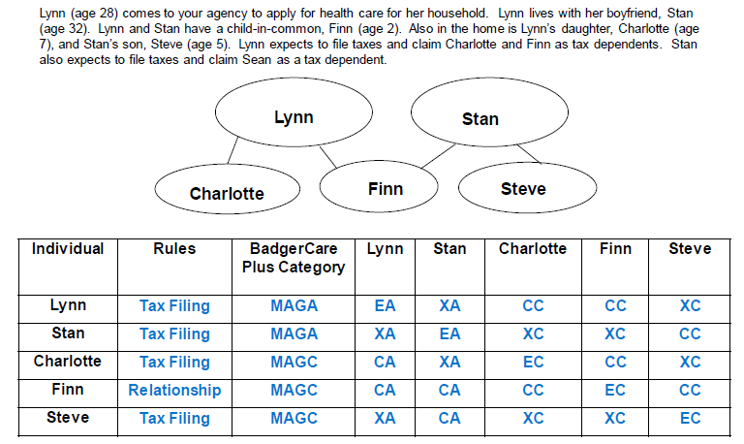
Exercise #3 Answer

Slide 18
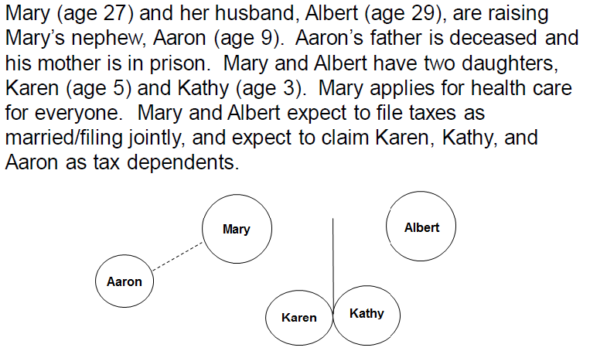
Exercise #4

Slide 19
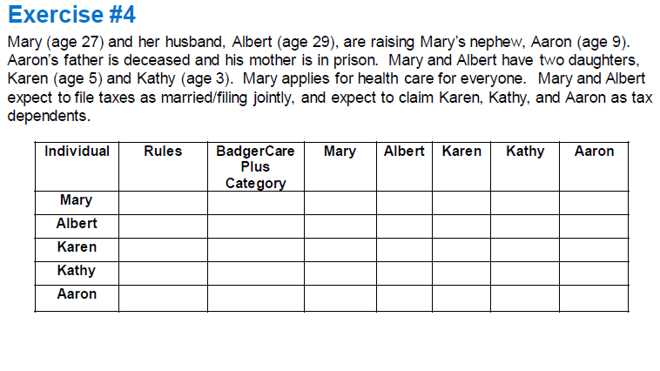
Exercise #4

Slide 20
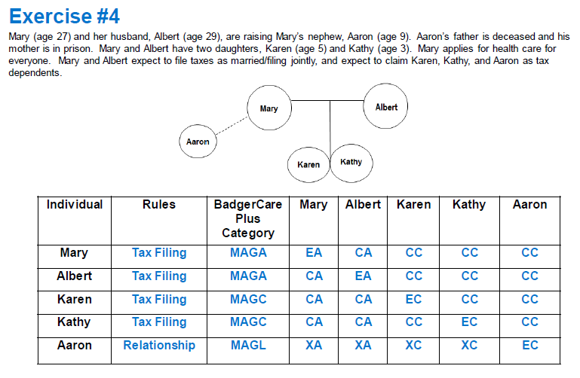
Exercise #4 Answer

Slide 21
Tips **Children living with their parent(s) AND being claimed as a tax dependent will have their parent’s income counted **If the dependent child's income is under the threshold, only the parent’s income will count, if over the threshold, then both the dependent child’s AND the parent’s income will count (**check SWICA/FDSH/CWW employment page to determine estimate of annual income of the dependent child and complete this section on the TFI page)

Slide 22

Continued… **Children NOT living with their parent(s) BUT being claimed as a tax dependent will be tested under Relationship Rules (will not need to have their parent’s income counted) ** Under relationship rules, only include individuals who are living in the home with the target

Slide 23

Questions?

Slide 24

Cites: BCP 2.3, 2.5, 2.6 & 2.7

