Slide 1

CARES MAINFRAME
June 2021

Slide 2

Table of contents
PAGE
3 –CARES
5–CARES Homepage
7 –CMWA/CMVM
8 -Alerts
10 –Function Keys
11 –Screen Help
12 –Pound Signs/Hashtags
14 –Printer Maintenance
15 –W2 Payment History
16 –Benefit Recovery
20 –LIHEAP Query
21 –DXIU
22-DXRU
23-DXUS
24-DXQW
25-DXQE
26-CARES Mainframe screen codes

Slide 3
Table of contents
PAGE
3 –CARES
4 –CARES Homepage
7 –CMWA/CMVM
8 -Alerts
10 –Function Keys
11 –Screen Help
12 –Pound Signs/Hashtags
14 –Printer Maintenance
15 –W2 Payment History
16 –Benefit Recovery
20 –LIHEAP Query
21 –DXIU
22-DXRU
23-DXSU
24-ACMP
25-CPRG
26-CPRB
27-DXQR
28-DXQC
29-CARES Mainframe screen codes

Slide 4
cares
Before the advent of the CARES worker web, Wisconsin economic support specialists processed benefits through what is now called the CARES mainframe. It is sometimes referred to as Host On Demand, or HOD. Many workers call it the Dark Side.
The original CARES is a menu driven system. One can go to the main page, MNMS and, working through the sub-menus, find the screen one wants. Most of the screens are now only available to query. We will look at the screens which you will need to use, and some which you may find helpful.

Slide 5
CARES
Client Assistance for Re-employment and Economic Support System.
When one signs into CARES, one will see the mainframe version of the broadcast message screen. Hitting enter will take one to the next screen.

Slide 6
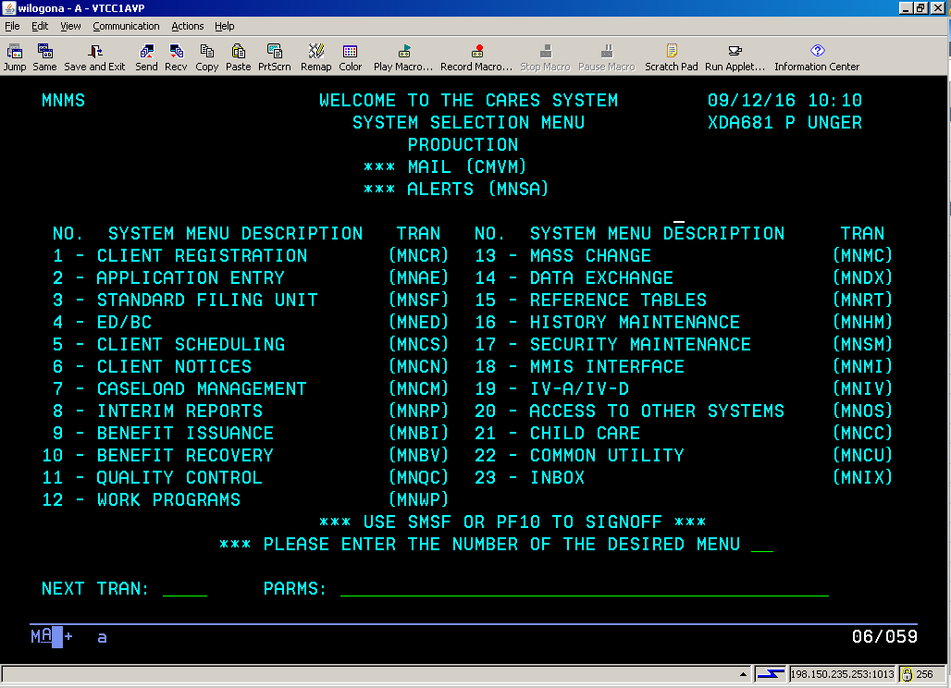
CARES Homepage

Slide 7
This is essentially the homepage for the mainframe. At the bottom of the screen are lines marked NEXT TRAN: (transaction) and PARMS: (parameters). All screens in the mainframe have a four letter tran (transaction) code that the worker can enter to go directly to the desired screen (one screen in the mainframe includes a number in the tran code). The worker will need to enter the parm (parameter) code for the case or individual s/he is accessing. The parm may the case number, pin or SSN. The individual menus will tell you what to use and in what order.

Slide 8
There are two items at the top of the page marked by asterisks: CMVM and CMWA.
CMVM was a means of e-mailing another worker prior to the widespread usage of the internet. If you notice that line at the top of your page, type CMVM in your tran line with nothing in your parms line.
MNSA are your alerts. Most will show up in the worker web under Action Items. Entering tran CMWA allows you to see all Action Items for your caseload, as opposed to limiting it by type of alert.

Slide 9
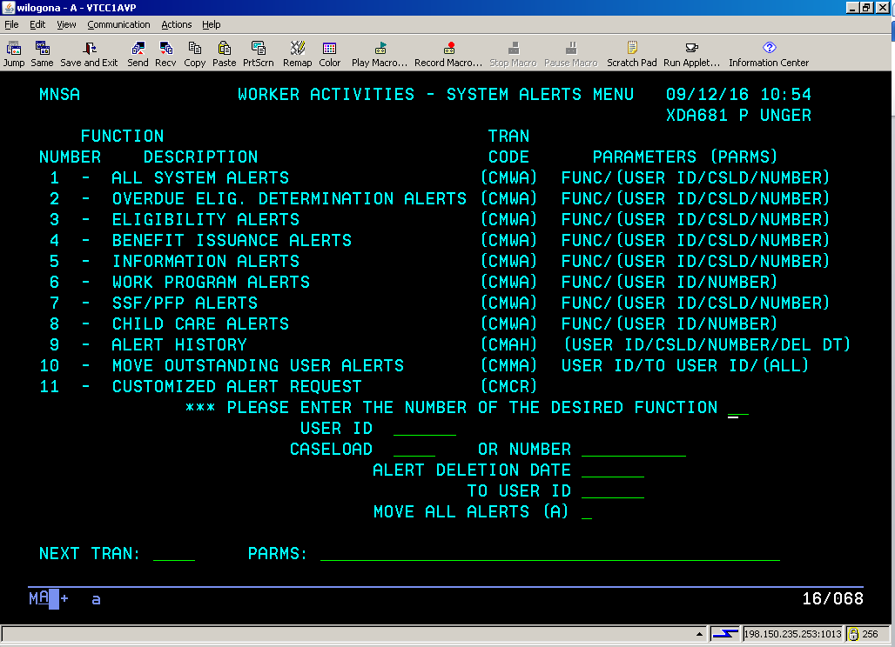
If you enter MNSA, you will see a menu.

Slide 10
The worker can enter the function number from the column on the left in the ***PLEASE ENTER THE NUMBER OF THE DESIRED FUNCTION line if one intends to winnow one’s alerts to a certain type. An entry of 1 will show all alerts. The important function here is 9. If you accidentally delete an alert and want to go back and find it, enter 9 in the desired function line, your XDA number (or X__ number if you are in another county) and alert deletion date. You can further limit the search by adding the case number or pin if you know it.
A reminder to all. It is important to check your alerts and process them timely. Failure to do so can lead to a benefit error if discovered by the State or Federal Quality Assurance process. It is also important to remember that not all alerts that appear in the mainframe also appear on the individual case screens in the worker web. You the worker are responsible for all alerts in both systems.

Slide 11
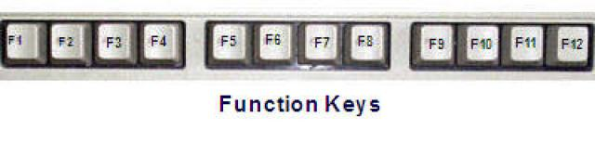
There are also a number of screen related F keys that appear on individual screens. Some will have values higher than F12. To use them, subtract 12 from the number. That will leave you with a value on your keyboard. Hit the shift key and the F key with the value you came up with. In other words, if CARES says to hit F14 to print, subtracting 12 will leave you with F2. Hit shift and F2 at the same time to print.

Slide 12
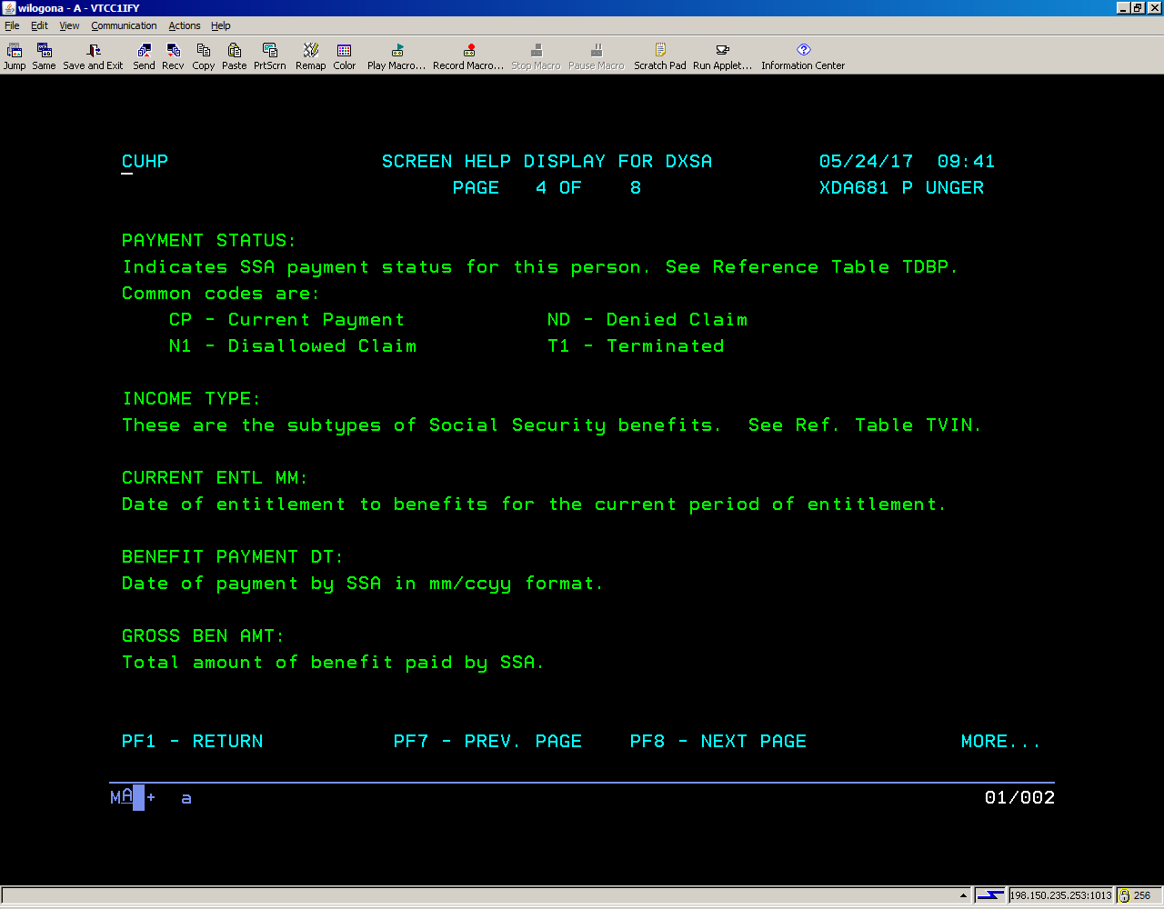
Most CARES Mainframe screens have a help screen. One can access it by using the F1 key. These screens will provide you with codes to complete the screens. They will also give you reference tables for the various codes on the screens. You can find it by entering RTDT in the tran line and the table ID in the parms.

Slide 13
############################
Another mainframe aid is the pound sign (or hashtag). If you are on a screen that requires the entry of a code, and are uncertain of the correct code, enter the pound sign and hit enter. CARES will take you to a list of available screens. The worker can hit enter to move through the possible choices until s/he finds the code of choice. Type the code in the ENTER SELECTION VALUE field and hit enter, and you will return to your screen with the code in place. If you wish to return without entering a code, press F2.

Slide 14
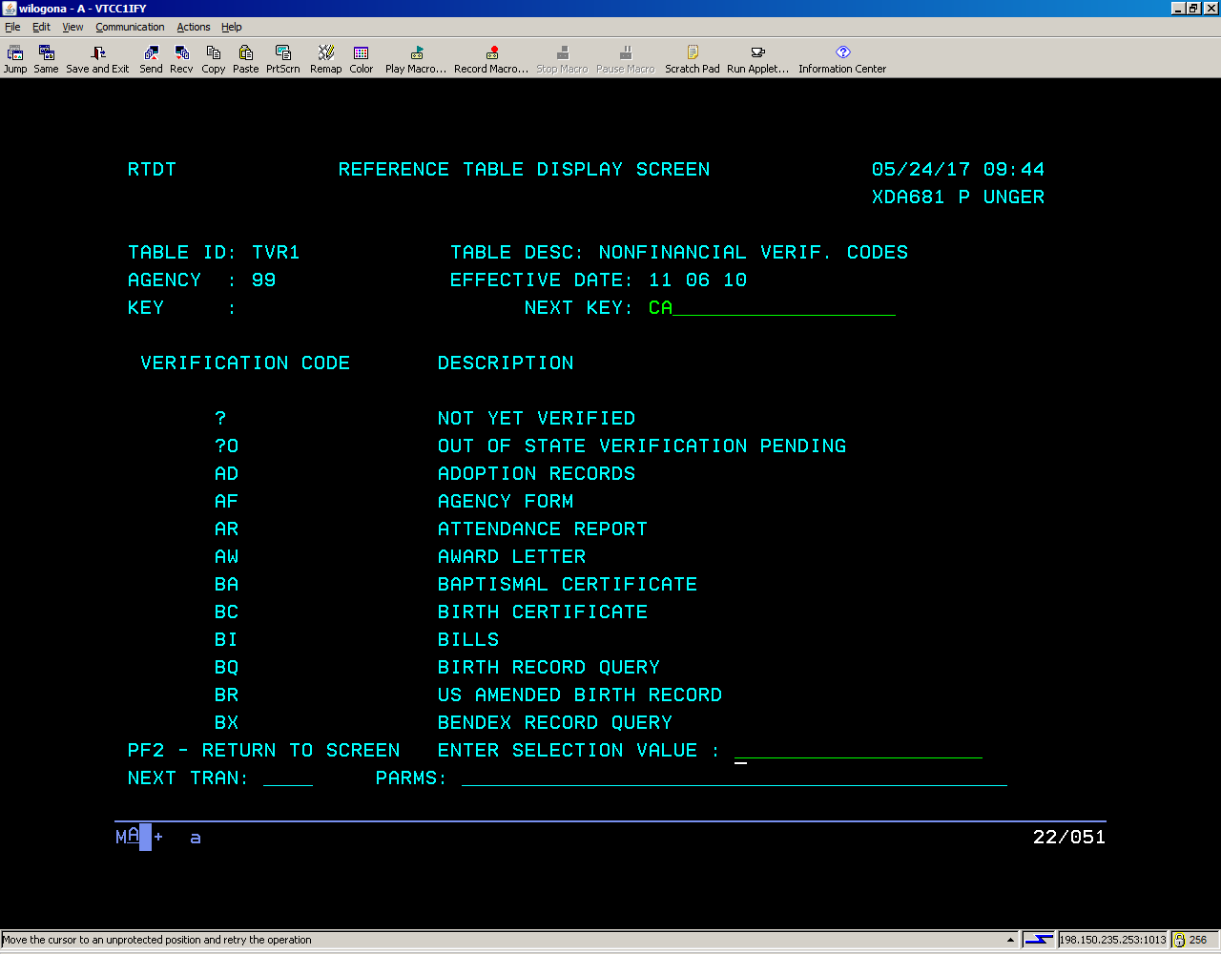

Slide 15
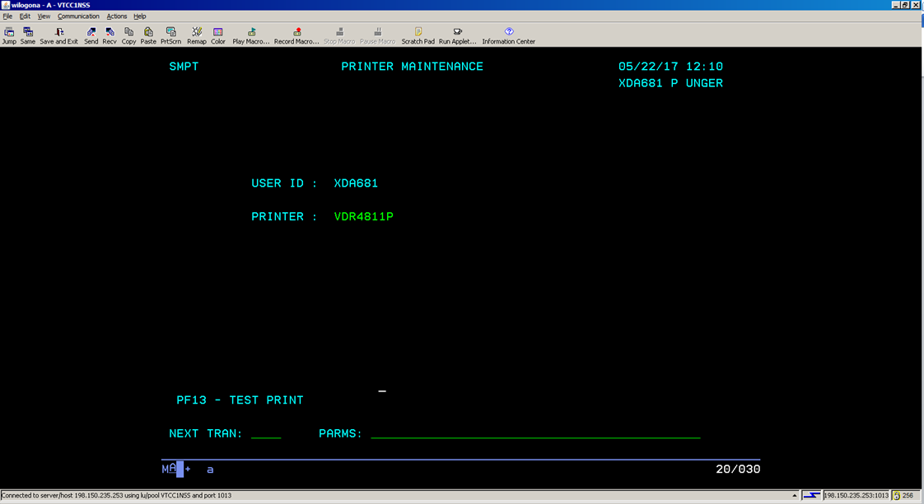
Certain screens will allow you to print letters, new or historical. We will discuss those screens later. To set up the printing for those screens, one will need to go to screen SMPT. The worker will be able to enter the printer ID in the printer line. Here at Dane County, we have labels on all of the printers with the ID. You will want to use the code beginning with VDR.

Slide 16
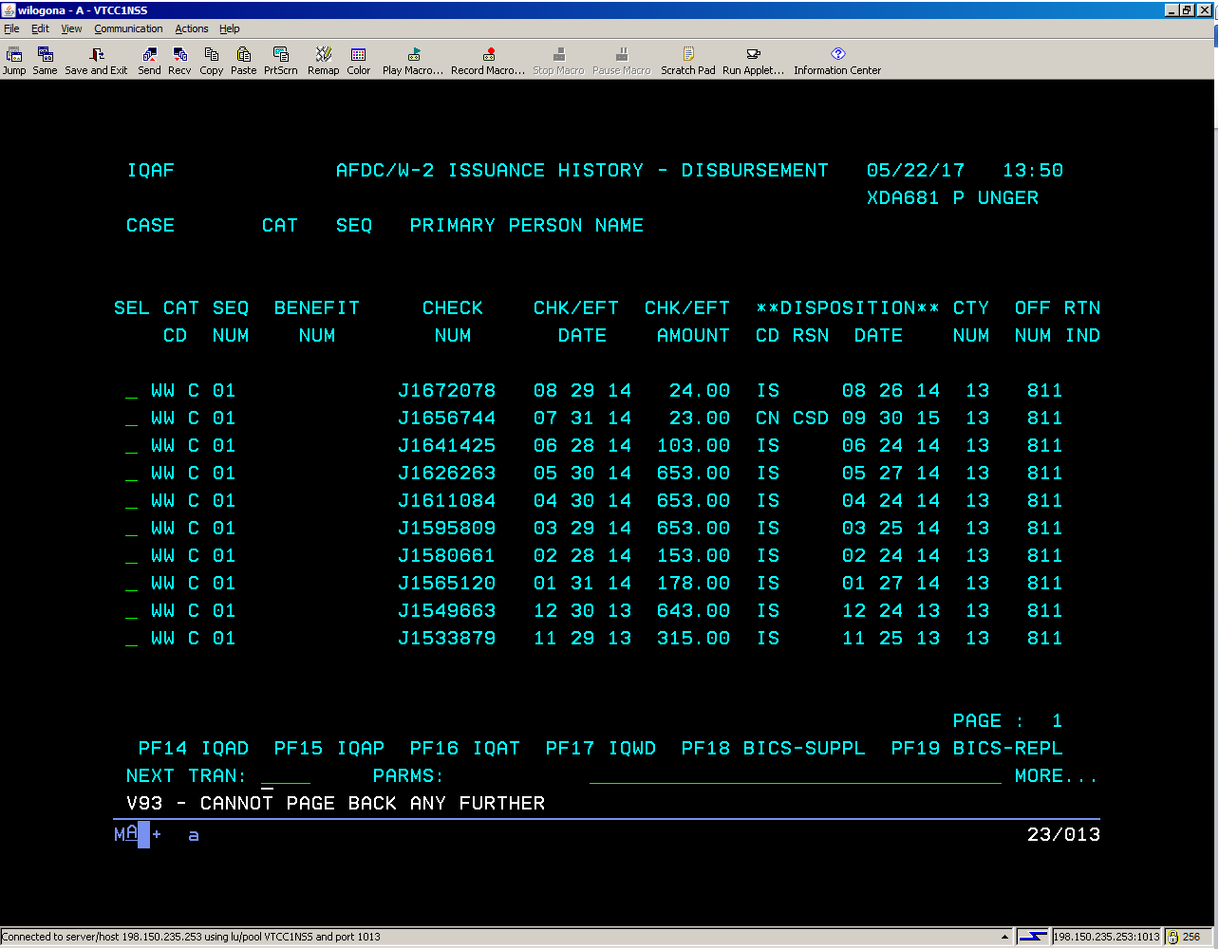
Workers are able to see the W2 payment history in the mainframe. Use tran code IQAF with the case number.

Slide 17
Benefit recovery is still housed in the mainframe.
Workers may receive phone calls regarding dunning notices, recouped benefits, and notices of overpayment.
Line workers may give the basic details regarding the overpayments by finding the information in the mainframe.
Monthly recoupments can be found on the budget screens in the worker web.
More difficult questions can be passed on to the respective overpayment units.
BENEFIT RECOVERY

Slide 18
Screen BVCA will show you the overpayment history for a case. The original overpayment numbers and the outstanding balances can be seen, along with the dates of the overpayment.

Slide 19
The same is true for screen BVCI, except it gives the worker overpayment information based on a pin number. One example of when this is important is when someone had been an adult on a different case with an overpayment.

Slide 20
Comments about the overpayment can be seen on screen BVCC, using the claim number as the parm. The claim number can be found on either screen BVCA or BVCI. Information should also be available in general case comments. The top of the screen will also tell you what type of error occurred.

Slide 21
Finally, screen DXLI will show the worker if someone has received the Low Income Energy Assistance Program in the past two years. Enter DXLI with the social security number to see the information.

Slide 22
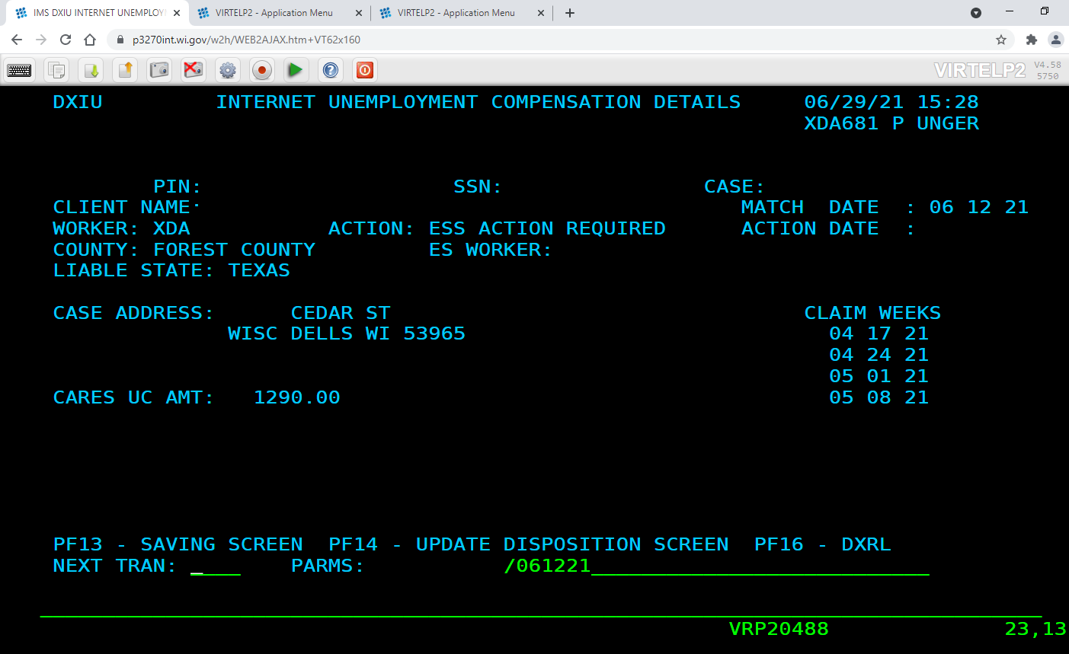
INTERNET UCB DATA - SEE DXIU

Slide 23
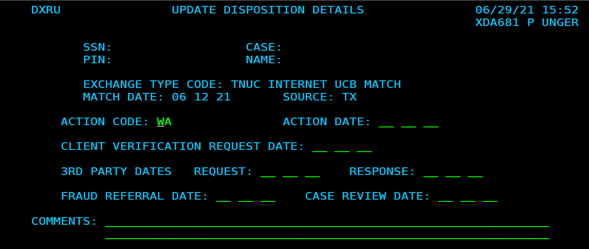
The previous page is the first of the Interstate Unemployment screens. It will show you the state where the client filed and the weeks that s/he claimed. Hit F14 and you will see this next. Choose the appropriate Action Code. Remember to enter # to your options. Enter an action date, and if you used CL, the client verification request date, or if you used TP, the 3rd party dates. Add comments and hit enter when complete…

Slide 24
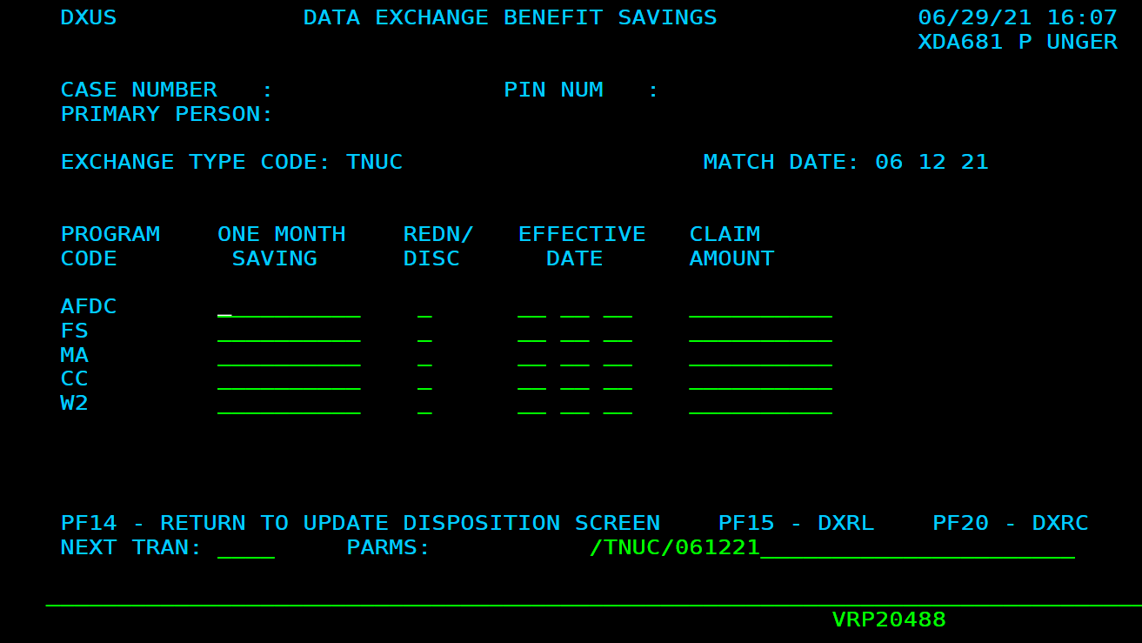
This page used to be attached to all of the discrepancies that we receive, when we processed them in the mainframe. Here, you can enter the results of the report that you received. Under one month saving, you would enter the amount that was saved if you closed a case or reduced beneftis. Claim amount would be where you entered an overpayment total.

Slide 25
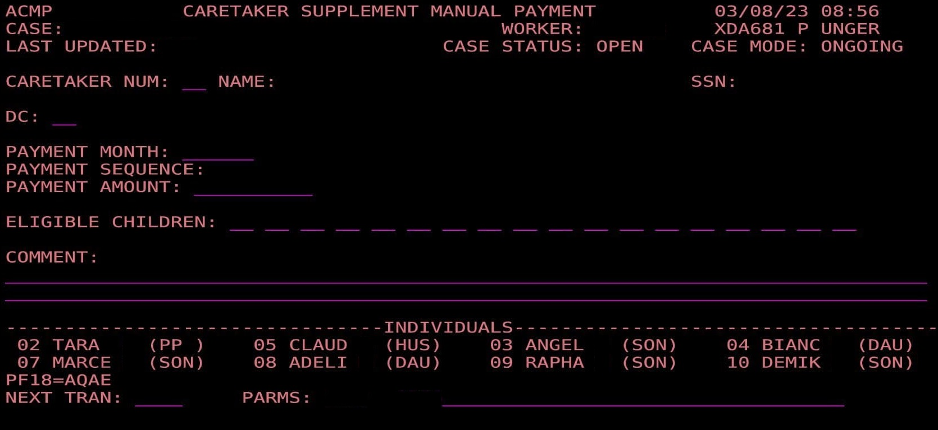
This page must be completed when one is issuing a retroactive CTS payment. All individuals have line numbers, displayed near the bottom of the page. Enter a number for the caretaker (CTS recipient) and line(s) for the children being added. Payment amount is the amount that you are adding, not the month’s total. The DC line is used if you need to delete the page.

Slide 26
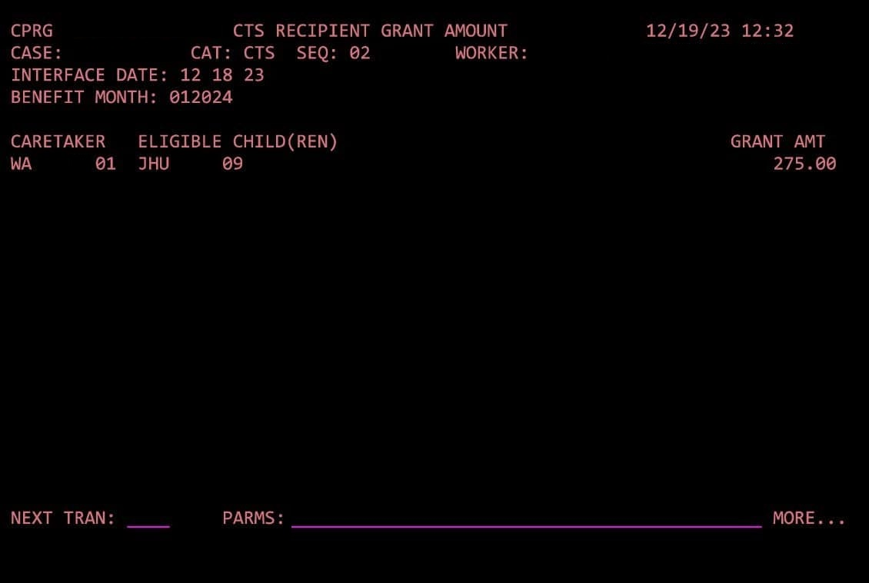
CPRG is an information page showing the current CTS payment. It is not accessible through a menu.

Slide 27
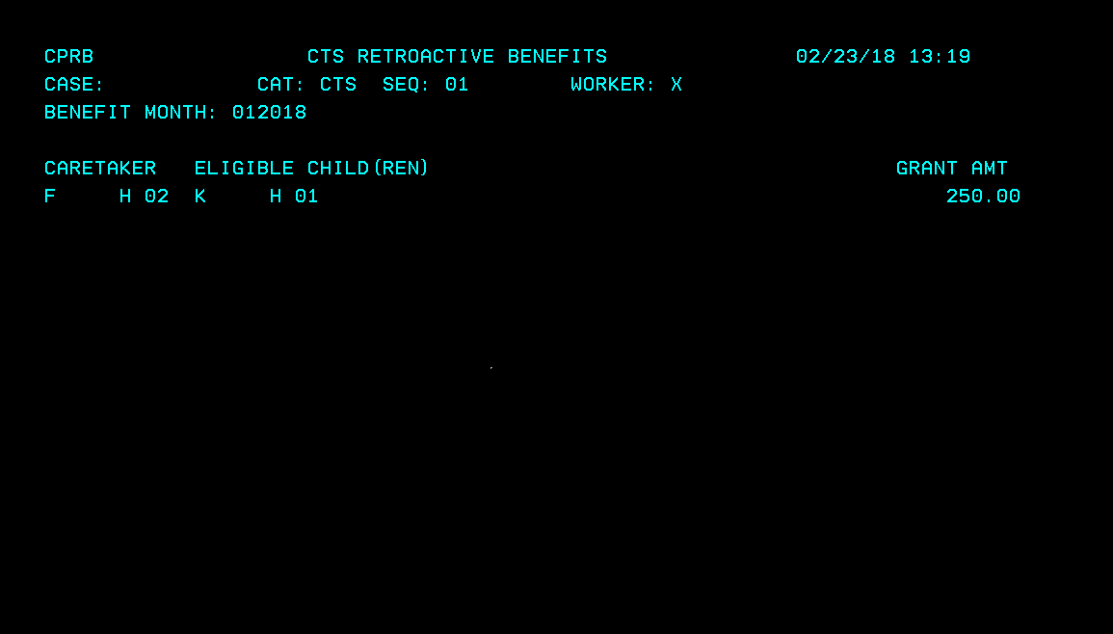
CPRB is an informational page intended to show retro payments that are waiting to be issued.

Slide 28
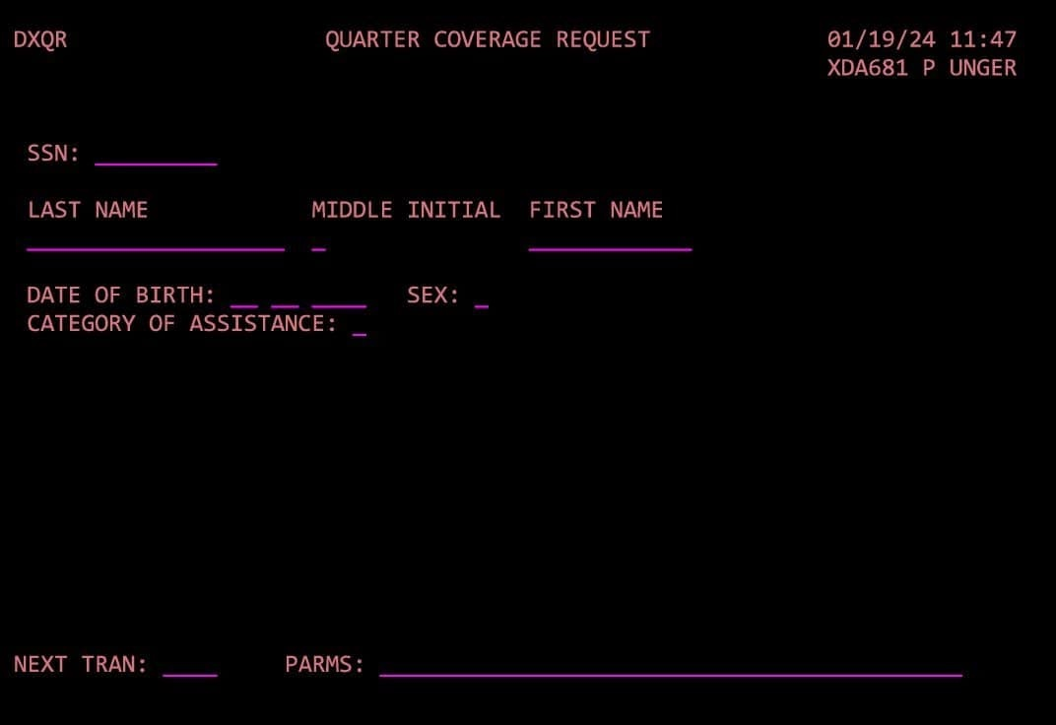
Verifying work quarters: use Mainframe page DXQR. Enter the SSN, the name, date of birth, gender and category of assistance, which can be found by entering a # in the field.

Slide 29
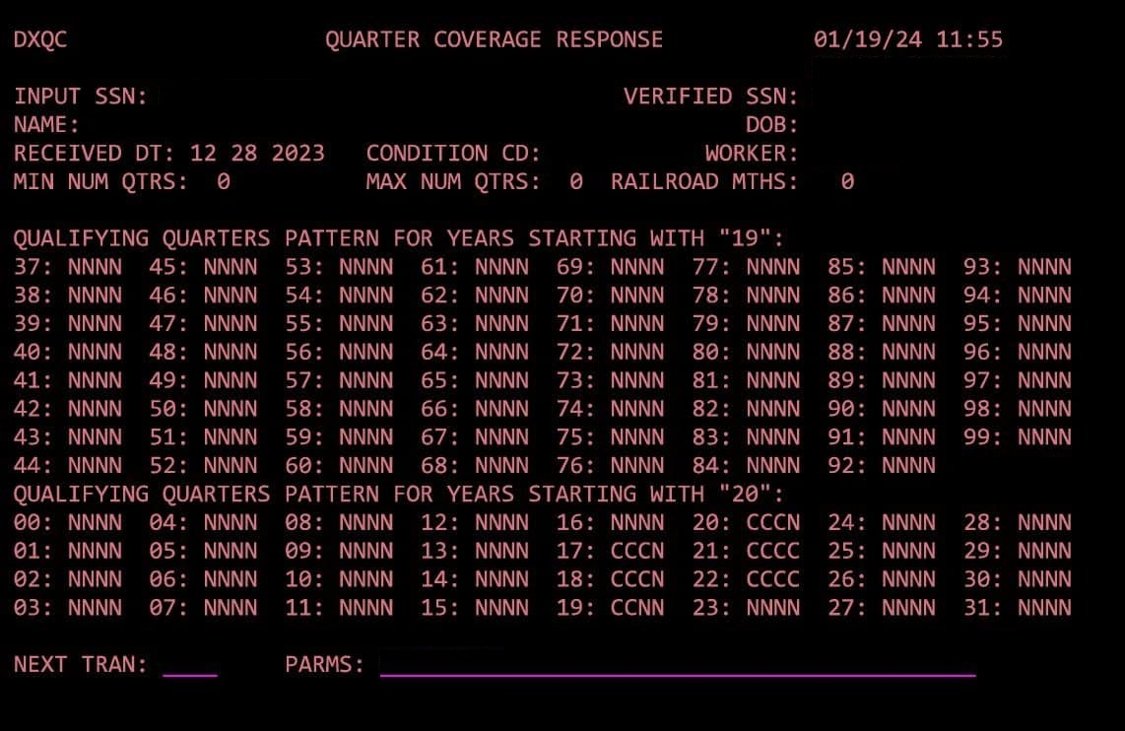
These are the results you will receive. Any quarters marked with a C are qualifying work quarters.

Slide 30
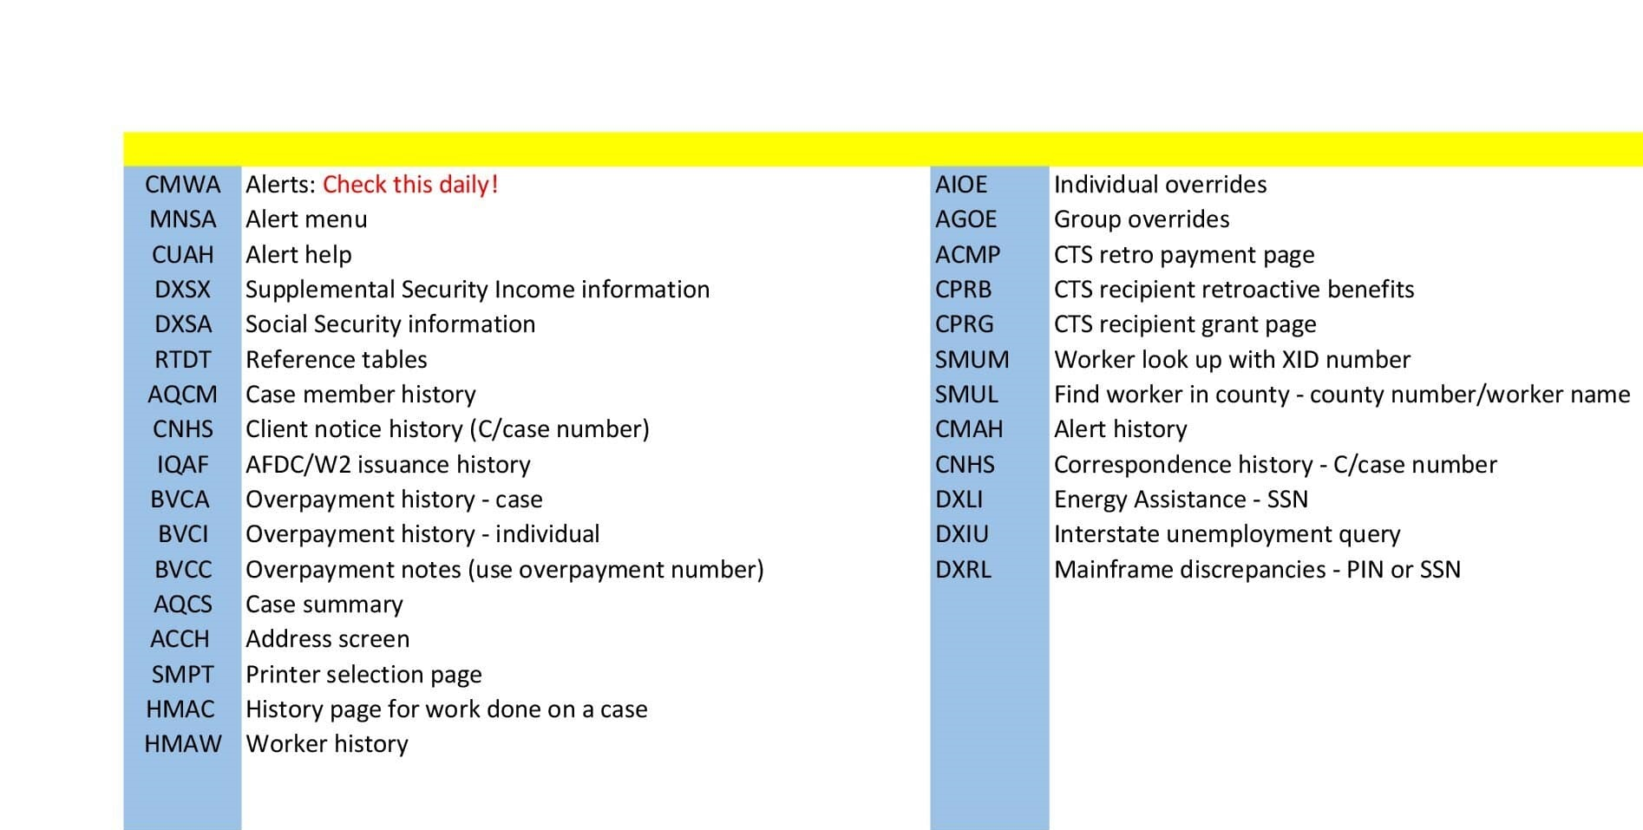
MAINFRAME TRAN CODES

