Slide 1
Divestment Training
Last revised 03/12/18

Slide 2
TABLE OF CONTENTS
Terms 3
Golden Rule 6
Sources of Divestment 8
Identifying a Divestment 17
Exceptions 20
Undue Hardship 26
Penalty Begin Date 30
Card Coverable Services 35

Slide 3
SOME IMPORTANT TERMS
Long Term Care– Medicaid for persons residing in an institution (Nursing Home, CBRF, AFH, hospital) over 30 days, or persons who have applied or been functionally screened for Community Waivers
Community Waivers – Programs that enable elderly, blind or disabled people to live in community settings rather than in hospitals or nursing homes

Slide 4
Look Back Period – This is the amount of time we are allowed to investigate into the financial history of a client applying for long term care in order to determine if a divestment was made. This includes looking at past bank transactions, sale or transfer of property, and the creation of trusts and annuities anytime in the last 60 months.

Slide 5
WHAT IS A DIVESTMENT?
Divestment is the transfer of income, non-exempt assets, and homestead property which belong to an institutionalized person or their spouse, or both.
Divestment also includes any action taken by a person to avoid receiving income or assets they are entitled to.
We will cover more on what specifically constitutes a divestment in later chapters.

Slide 6
GOLDEN RULE OF DIVESTMENTS
DIVESTMENT RULES ONLY APPLY FOR LONG TERM CARE CASES.
In other words, there can only be a divestment if the client is institutionalized (in a hospital or nursing home) or applying for community waivers.

Slide 7
What cases do divestments not apply?
MAPP
NS deductibles, met or unmet
MS
QMB, SLMB or SLMB+
LTC cases where the divestment occurred more than 5 years ago.
For any of these cases, a divestment page should not be built.

Slide 8
How do I find a divestment?
This is not an easy question to answer, but here are some red flags indicating a possible divestment on the proceeding slides.

Slide 9
1) Section 11 of the EBD Medicaid Application
The most obvious and first place to search is the application itself. Section 11 of the EBD MA application directly asks the client if they have given away or transferred any income or resources or sold for less than fair market value in the last five years. If they answer yes to any of these questions, a possible divestment has occurred.

Slide 10
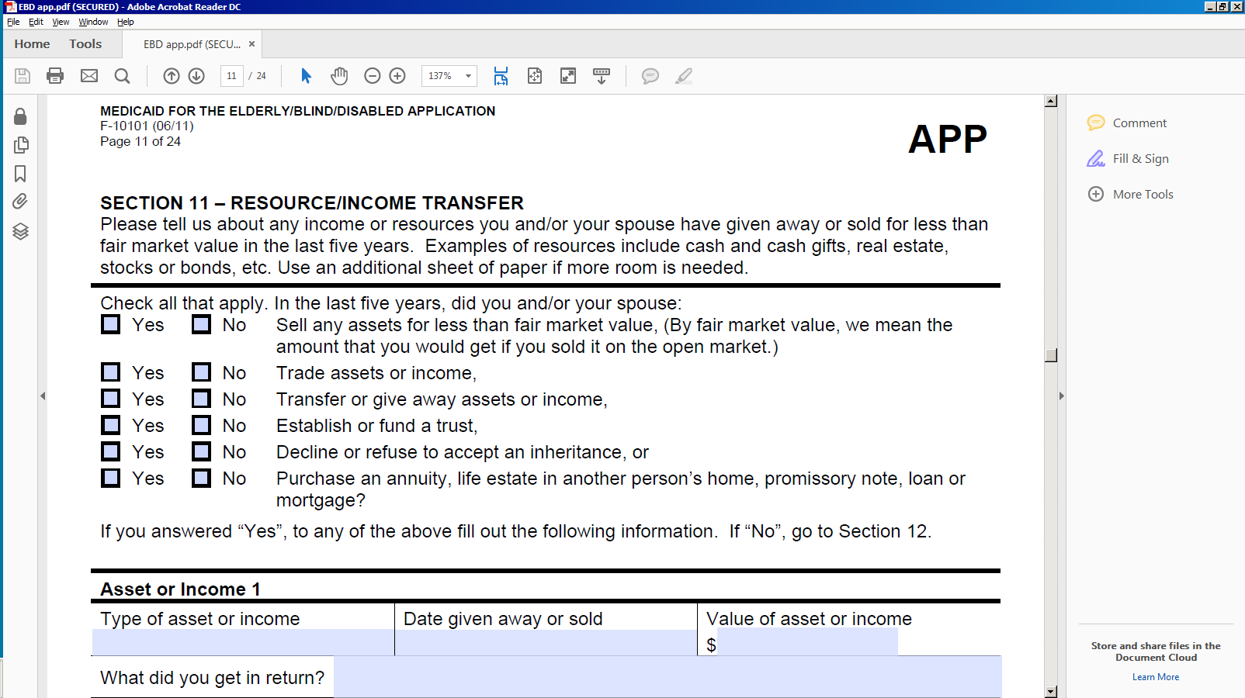
(a picture of section 11, pg 11 on the EBD application)

Slide 11
2) There are transfers to or from accounts not listed on the app.
Check the bank transaction records carefully. If there are any transfers to account numbers you have no record of, request records of these accounts from the client. If the accounts do not belong to the client or their spouse, then a possible divestment has occurred unless the client received something in fair compensation for the money transferred.

Slide 12
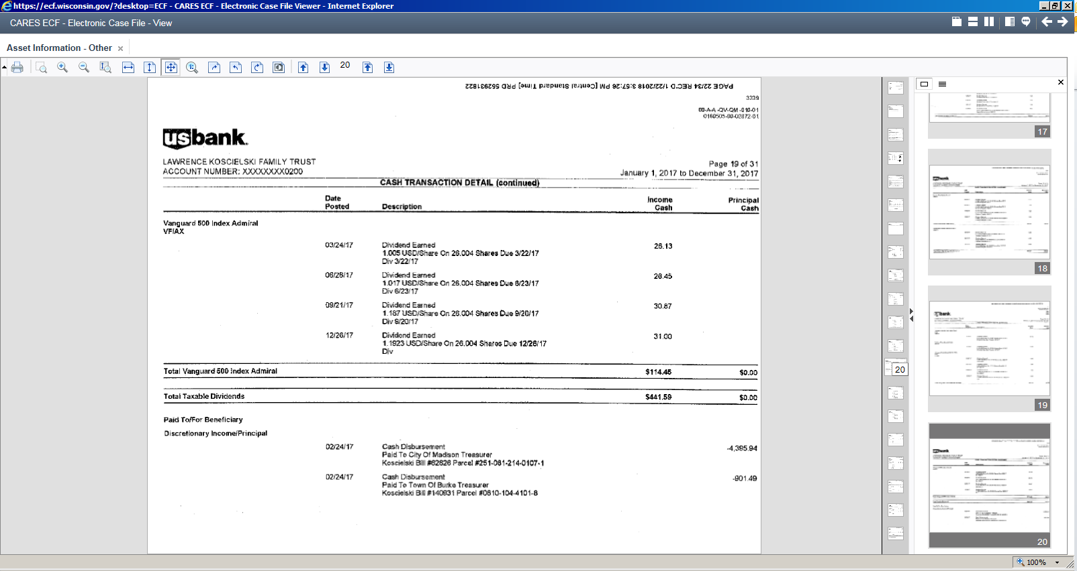
An example of a bank statement where we should request clarification on what this expense was for

Slide 13
3) Quitclaim Deeds
A Quitclaim Deed is a transfer of property. If the grantor in a quitclaim deed does not receive fair market value for the property, it is a divestment, unless the transfer occurred more than 5 years in the past.
Note that the official date of the transfer is considered to be the date the deed was signed and notarized, not the date the transfer was recorded in the Register of Deeds.

Slide 14
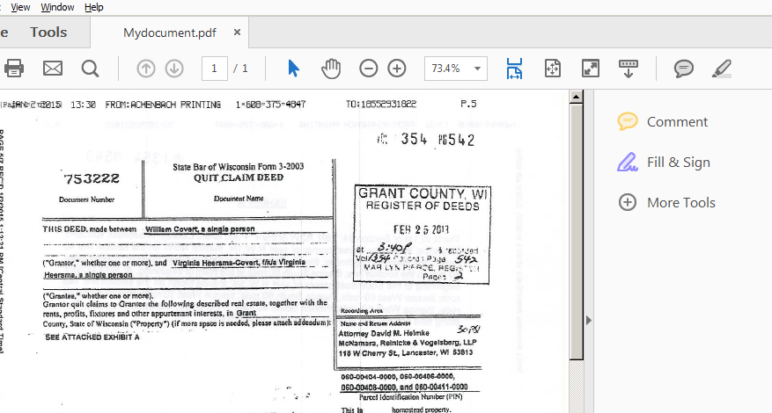
Example of a Quitclaim Deed

Slide 15
4) Life Estates
A life estate is created when a property holder transfers ownership of the property to someone else and retains the right to live on the property and the income from it. Life estates are not counted as an available asset.
If the property holder transferred the property to the remainder person for less than fair market value, a divestment has occurred.

Slide 16
Calculating the divested amount of a life estate
The divested amount is the property’s fair market value at the time of transfer minus the life estate value.
To find the life estate value, multiply the fair market value of the property by the number from the table 39.1 in the M.E.H. that corresponds to the age of the life estate holder at the time the property was transferred.

Slide 17
How do I know if a transfer or withdrawal is a divestment?
The first step is to attempt to get clarification from the client or their authorized representative on how the money was spent or where the asset was transferred.

Slide 18
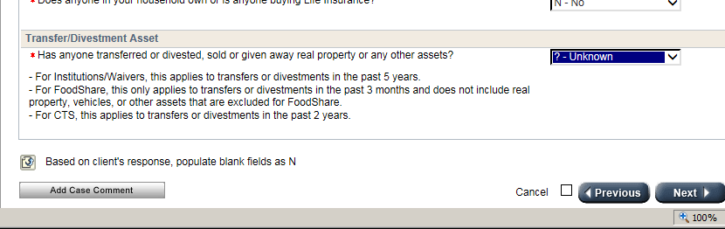
Give the client an opportunity to verify that the expenditure or transfer was not a divestment.
Pend the case in CWW on the Asset Gatepost page under the Transfer/Divestment tab:

Slide 19
Be clear on what the potential divestment is.
Leave a note for the client on the verification checklist and in case comments what the potential divestment is and what proof may be needed.

Slide 20
Check Exceptions
While there is no all-inclusive list of exceptions, the following slides show ones we see more commonly.

Slide 21
1) The client or couple had an established pattern of charitable giving or gifting.
If the client or couple can show a history of charitable giving or gifting to family members, the value of which does not exceed 15% of the individual’s or couple’s annual gross income per year, the total amounts gifted will not be considered a divestment.

Slide 22
2) Homestead property exemptions
The institutionalized person can divest homestead property to his or her spouse.
They may also divest homestead property to a child who meets at least one of the following:
-Is younger than 21 years old
-Is blind or permanently disabled
-Has been residing in the institutionalized person’s home for at least two years immediately prior to the person moving to an institution. A notarized statement that the client was able to remain in their home because of the care provided by the child.

Slide 23
3) The community spouse divests assets more than 5 years after the institutionalized spouse was determined eligible.
Note that while this is not a divestment for the institutionalized spouse, the community spouse may have a divestment if they later apply themselves for LTC Medicaid.

Slide 24
4) Gambling losses
Gambling losses at a casino, racetrack, or in some other type of regulated gambling is not divestment
It is a divestment if the client makes personal bets with friends or relatives or has losses from unregulated gambling.

Slide 25
5) The agency determines that the denial of eligibility would result in Undue Hardship.
Undue hardship occurs if denial or termination of an applicant’s or member’s eligibility for coverage of LTC service would deprive the person of any of the following:
  Medical care
  Food
  Clothing
  Shelter, or other necessities of life

Slide 26
Undue Hardship Procedure
If an applicant or member is denied LTC services as a result of one of the situations listed in the last slide, IM workers are required to manually send the applicant or member the following:
  Undue Hardship letter (F- 10187)
  Undue Hardship Waiver Request (F-10193)
  These forms must be mailed the same day that CWW or the IM worker mails the negative NOD.

Slide 27
Required Undue Hardship Documentation
Must include a statement signed by the applicant or member (or authorized representative) which describes whether the divested assets are recoverable, and what steps have been taken to recover the divested assets.
Proof that an undue hardship would exist if eligibility is terminated or denied, such as proof of involuntary discharge or other proof that the client will be deprived of life necessities if the divestment penalty is applied.

Slide 28
Bed Hold Payments and Notifications
When an undue hardship waiver request is received by the IM agency from an institutionalized individual, the agency will send the institution the Undue Hardship Bed Hold Notice (F-10189).
The notice informs the institution that a bed hold payment will be made on the client’s behalf for the period of time while the IM agency is making a decision about the hardship waiver request.

Slide 29
Determination of undue hardship process time frame
Give the member or applicant 10 calendar days after a request for verification is mailed. If the verification is not submitted within 10 calendar days after the request is submitted, deny the undue hardship request and notify the applicant or member by sending a negative NOD.
The deadline may be extended another 10 days if the individual requests extra time.
A decision to approve or deny undue hardship must be made within 30 calendar days after receipt of the undue hardship form.

Slide 30
Penalty begin date for a divestment -- Applicants
For divestments that occurred on or after 01/01/09, the penalty begin date for an applicant begins on the date all of the following have occurred:
  The person applies for LTC Medicaid
  The person enters an institution or meets the appropriate LOC and functional screening criteria.
  The person meets all other Medicaid nonfinancial and financial eligibility requirements.

Slide 31
An example of a divestment
Robert Baratheon applies for LTC Medicaid (waivers in this case) on 12/20/17. His wife, Cerce, transferred a life insurance policy to her daughter on 12/6/17 with a cash value of $9890.25. Robert has a functional screening on 01/19/18 and is found functionally eligible for waivers on 01/19/18. All verifications are received late on 02/1/18. The start date of the penalty period will be 02/01/18. The penalty end date will be 03/07/18.

Slide 32
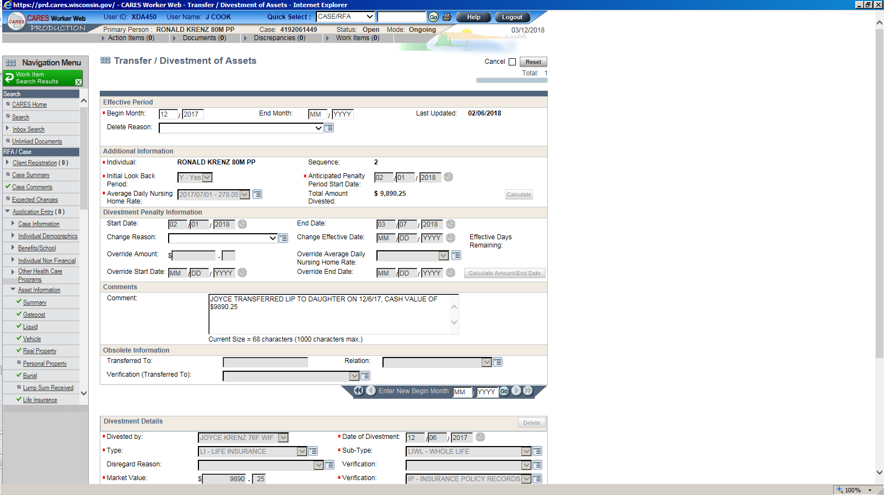
The divestment penalty screen from our example

Slide 33
Penalty begin date for Members
The member’s penalty begin date begins on the month after timely notice is given.

Slide 34
An example of a divestment for a member
Example: Leto was determined eligible for institutional Medicaid on 03/01/17. On 07/02/17, he sold his home and gave the proceeds to his son, Paul. The divestment was reported 07/12/17 and was entered 07/16/17. The penalty begin date would be 08/01/17. If the divestment was not entered until after adverse action for August, the penalty begin date would be 09/01/17.

Slide 35
Card coverable services
A person who is under a divestment penalty period may still be eligible for card coverable services if they meet all eligibility criteria. (See MEH 17.15)
Card services are all the Medicaid-covered services except routine, day-to-day health care services that are provided to Medicaid members by a nursing home that are reimbursed within the daily care rate.
For a listing of Medicaid coverage see MEH 21.1

Slide 36
Life after divestment – Do they need to reapply?
Since clients are usually eligible for card coverable services during a divestment penalty period, they do not need to reapply for LTC Medicaid once the divestment penalty ends.
Note that you will still need to carry out reviews for card coverable services at appropriate intervals during the divestment penalty period.

Slide 37
QUESTIONS?

