Slide 1
EBD for Family Workers

Slide 2

Overview
This presentation will provide tips and reminders regarding how to process cases with an EBD individual.

Slide 3

Contents
FS Renewals
Medical Expenses
Medicaid Renewals
  - Categorically Needy
  - MAPP
  - MPA
  - LTC
Assets
General Reminders

Slide 4
FS Renewal

Slide 5
For FoodShare, a food unit member is considered elderly at age or older
Under certain specific circumstances an individual and his or her spouse who are both elderly and/or disabled may be a separate food unit even if they are living and eating with others. See FSHB 5.2.1
60

Slide 6



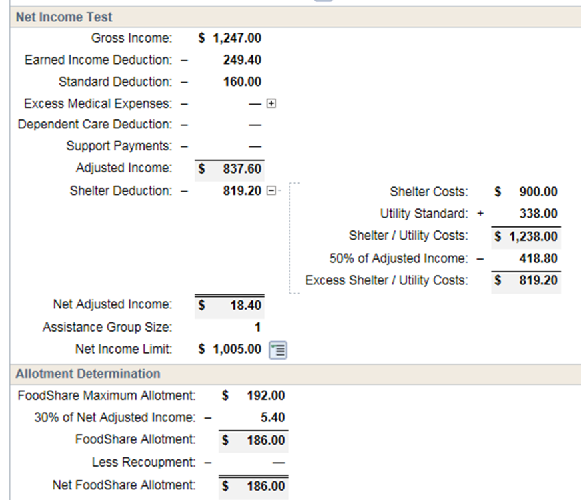
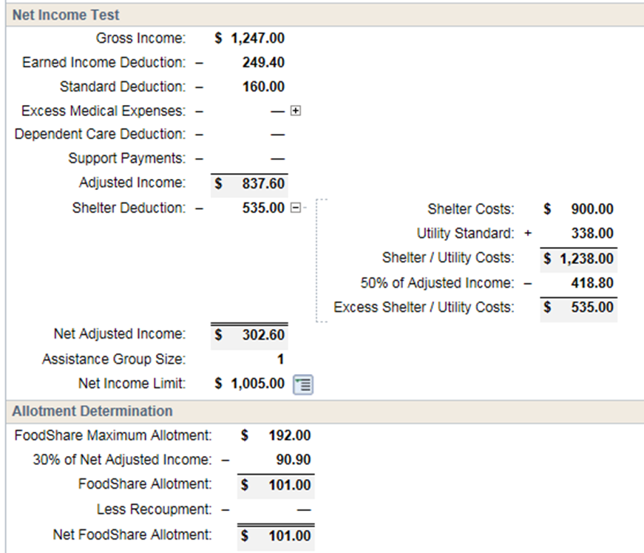
Shelter and utility deduction
  - Food units that include elderly, blind, or disabled individuals have no shelter cap
  - Ask for shelter and utility amounts
EBD
NON-EBD
No shelter cap
Shelter cap
Lower allotment

Slide 7

Medical expenses can increase FS allotments
  - Medical expenses incurred by elderly, blind, or disabled food unit members can be used
  Over the counter medications (OTC) approved by medical professional
  Medical equipment/supplies approved by medical professional
  Mileage to medical appointments
  Service animal expenses
  Medical insurance premiums
  Medical , vision, dental bills
  - Expense needs to be verified

Slide 8
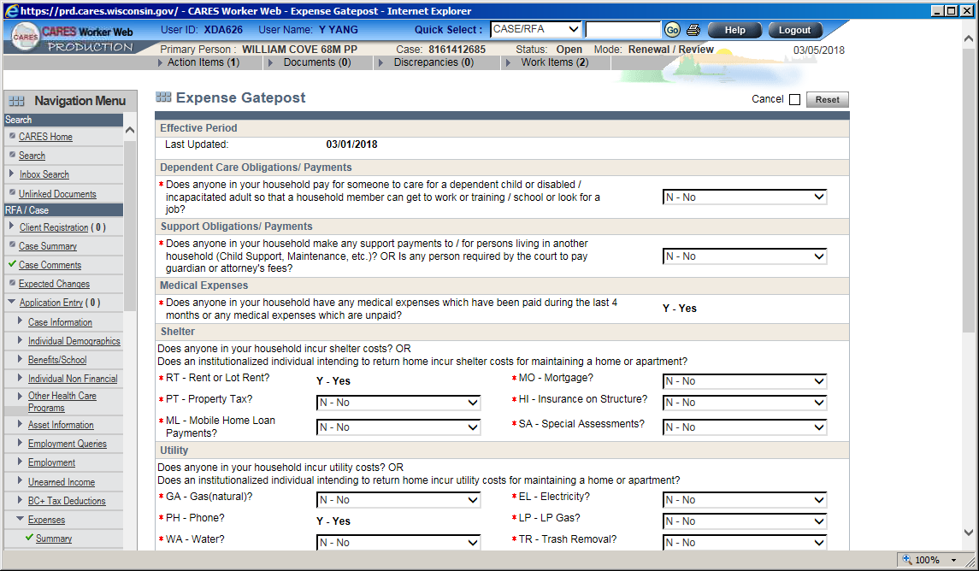
During a renewal, if there is an EBD individual, ask about their medical expenses

Slide 9
Medical Expenses

Slide 10

Changes during the certification period must be verified if:
  - New source of expense
  - Changed by more than $25
  - If questionable
During SMRF
  - Changes in expenses are not required to be reported. If reported, follow policy above

Slide 11

During Renewal
  - New source of expense must be verified
  - Changes in TOTAL recurring medical expenses of more than $25 since last verified must be verified

Slide 12
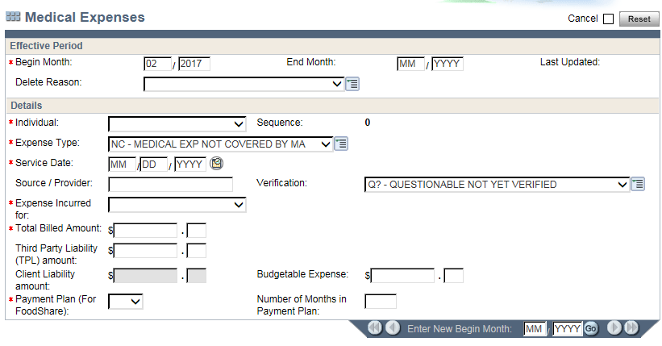
Add medical expenses sequence for each expense
Expense amount used in FS budgets

Slide 13
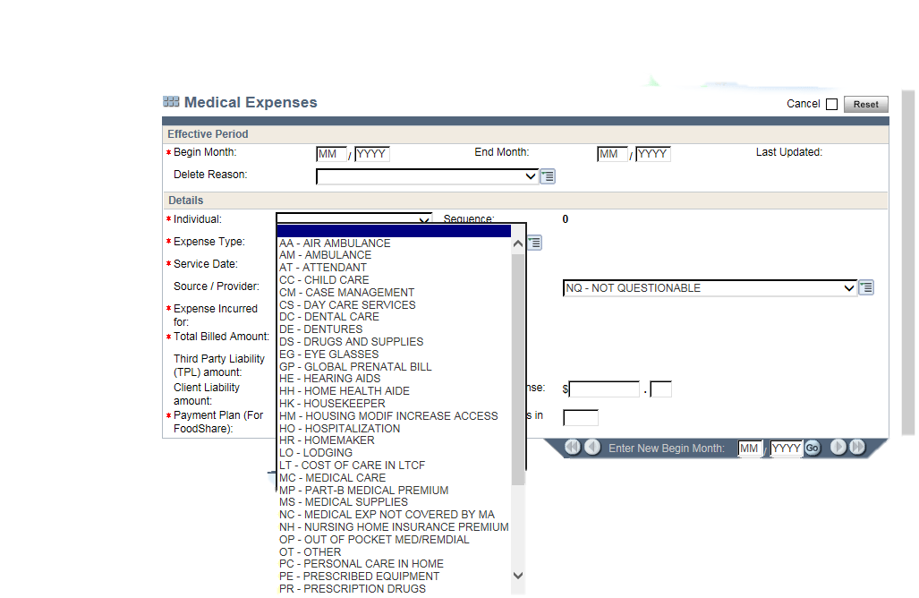
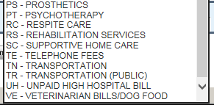
Common medical expense codes
When in doubt, use OT-OTHER

Slide 14
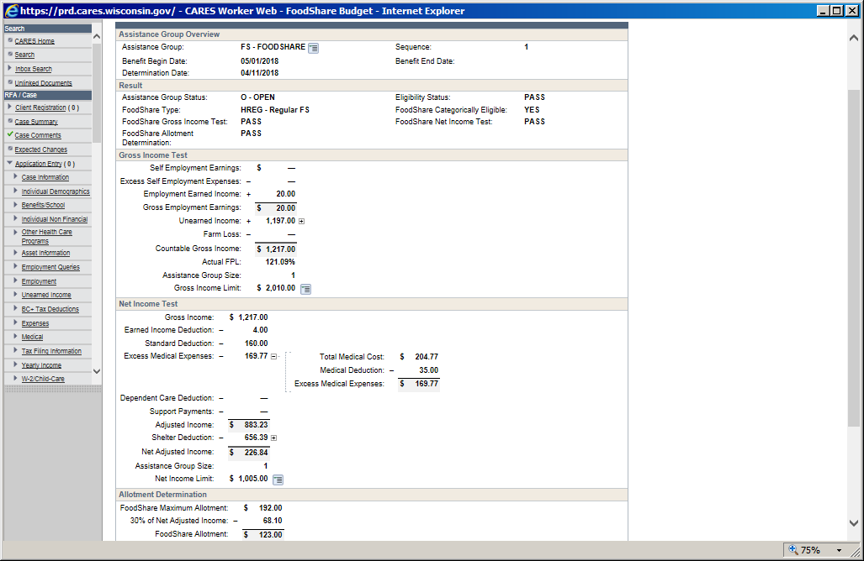
Check your budgets
Includes all budgetable FS expenses on the Medical Expense pages and health care premiums amounts on the Medical Coverage pages
CWW will automatically deduct the $35 medical deduction from the total.

Slide 15
MA renewals

Slide 16
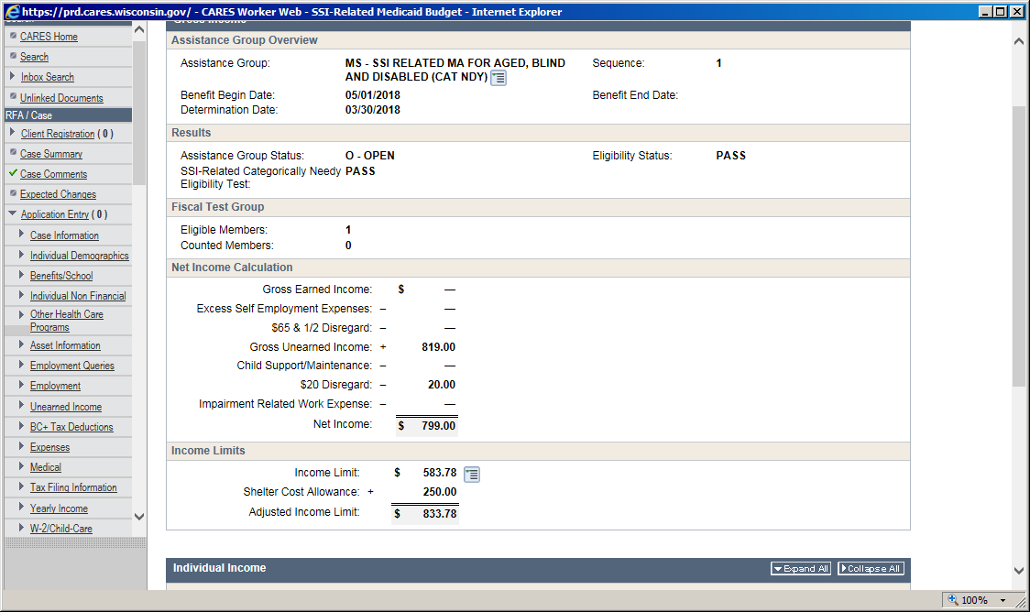
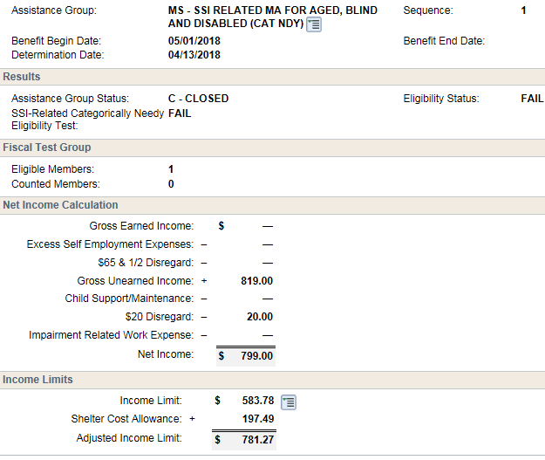



Utilities
Do not zero or enter $1 for utilities if member is open for Categorically Needy Medicaid (MS) program
Shelter allowance decreased after changing utilities to $1, terminating MS eligibility

Slide 17
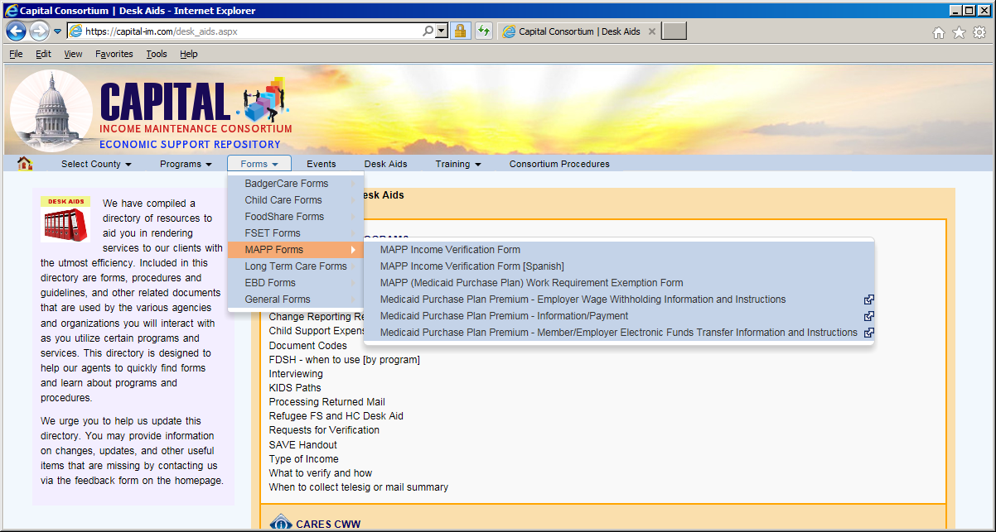
MAPP
Must be disabled
Must be working
  - Employer, need paystubs
  - In-kind work (form on the website)

Slide 18
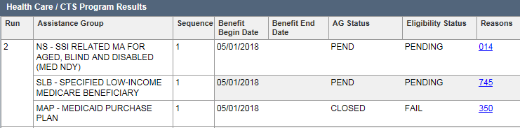
When a MAPP case is pending:
  - NS will pend
  - MAPP will fail for reason code 350 (Target may be eligible for another category of MA)
  -Try to remember NOT to confirm the 350 MAPP denial, it causes member confusion and generates a phone call

Slide 19
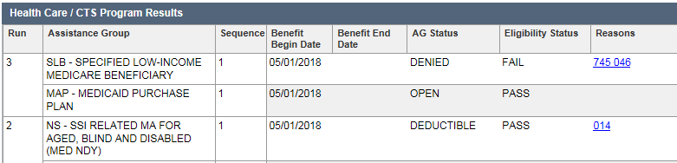
Once verifications are turned in and if all eligibility requirements are met MAPP will open

Slide 20
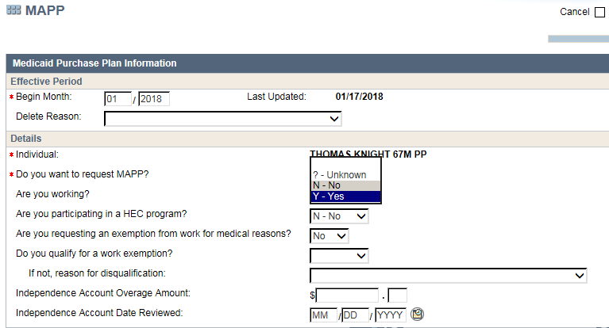
If MAPP recipient is no longer working, update the MAPP page
Do not forget to update the Earned Income page too!

Slide 21
If MAPP recipient is no longer working, the member has until the last day of the next calendar month to become eligible again.
Do not terminate eligibility until one full calendar month has passed since employment ended.
Example: On 4/4, Jacob reports that he lost his job. Jacob can remain eligible for MAPP until 5/31. As of June 1st Jacob will no longer be eligible.

Slide 22
Medicare Premium Assistance Programs
QMB
Qualified Medicare Beneficiary
100% of FPL
Pays Medicare Part A & B, Medicare deductibles, copays, and coinsurance
*Cannot be backdated*
SLMB+
Specified Low Income Medicare Beneficiary Plus
120 % FPL, but less than 135% FPL
Pays Medicare Part B
*Cannot be enrolled in full benefit Medicaid program, FPOS, or TB*
SLMB
Specified Low Income Medicare Beneficiary
100% FPL, but less than 120% FPL
Pays Medicare Part B

Slide 23
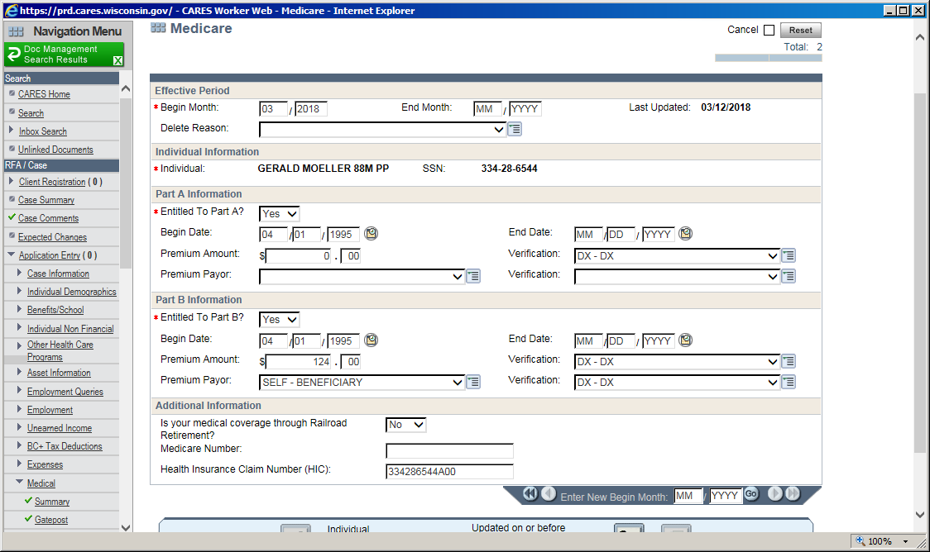
Medicare B premium or private health insurance premiums are allowable medical expenses
Do not add “OT” unearned income page for the Medicare Part B premium amounts
CWW knows to include the Medicare premium in the budget for the appropriate programs, such as FoodShare.

Slide 24
3 month delay with SSA when establishing or losing MPA eligibility
The member will always get an extra month of premium paid by the State for the month after the termination month due to premium being paid in advance
Example: Jill’s MPA renewal is due by January 31. Jill does not complete her renewal. SSA will not deduct Jill’s Medicare premium from her SSA benefits until May. In May SSA will deduct 3 month (March, April, May) worth of Medicare premiums.
When Jill reinstates her MPA program it will take another 3 months before the program is back in place. SSA will refund her any premiums the State pays.

Slide 25
LTC Renewals
MIS (Nursing Home)
Community Waiver
***Please transfer to EBD queue***

Slide 26
Assets

Slide 27
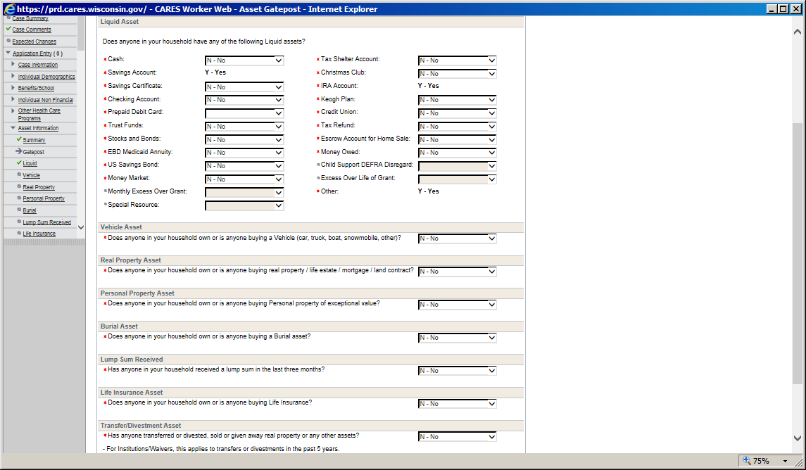
If an EBD individual is applying/ renewing EBD Medicaid, DO NOT SKIP the assets.
Review the asset gatepost with the member
Ask if there are any new assets

Slide 28
Assets to Pend At Renewal
Pend all available assets, including but not limited to:
Checking
Savings
CD accounts
Stocks/bonds
Whole life insurance with face values $1500 or greater
  NOTE: Credit Unions require members to have a savings account to be a member

Slide 29
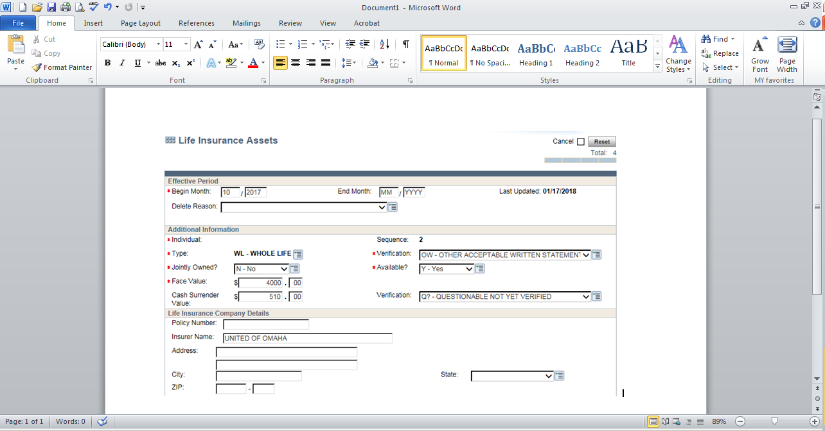
Life Insurance
If a whole life insurance policy has a face amount of $1500 or greater, pend for current cash value
If there are multiple whole life insurance policies, add the face values together, if face value is greater than $1500, pend for all cash values
If any new life insurance policy is reported, add and pend

Slide 30
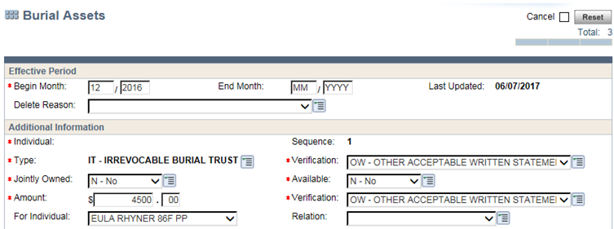
Burial Assets
Do not pend already exempt burial assets
If new burial assets are reported, add and pend for verification
Not sure if exempt? Review last year’s case comments for clarification

Slide 31
Vehicle Assets
Update vehicle assets
If there is only one vehicle, it is exempt. Do not pend for values
If member reports more than one vehicle and vehicle verification is not in ECF, pend for verification of vehicles
Fair market values of vehicles can be verified via NADA or Kelly Blue Book
  - mileage is not used in determining fair market values

Slide 32
Asset Verification
Bank statement
  Match account number to bank account sequence
  Statement should be the most recent bank statement, unless backdating applies
  Enter balance after deducting any income received in the corresponding month

Slide 33

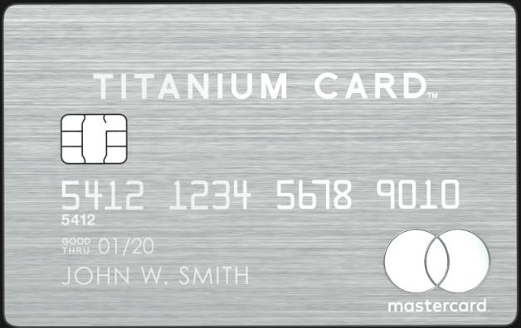
Pre-paid debit card
  - Member can request statement from pre-paid card provider
  - ATM balance receipt
  Note: ATM receipt must match member debit card number. ATM receipt does not verify ownership of the card. Copy of the card should be obtained. Members may be hesitant in providing copy of their ATM card, card number should be blacked out leaving the last 4 digits for verification purposes.

Slide 34

Real property
  -Property look up is available for all Capital Consortium Counties, the links can be found on the Consortium website
  - Link provides property tax amounts and ownership details

Slide 35
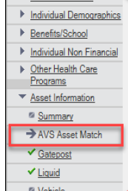
Asset Verification System (AVS)
Accessible in the “Asset Information section” of the navigation menu
During the 45-day renewal period, the AVS Asset Match page will be scheduled as part of the health care renewal driver flow if any health care programs that use AVS to verify assets are open on the case

Slide 36
Depending on whether a request has been made and responses have been returned, workers may see the following sections on the AVS Asset Match page:
• AVS Asset Match Request
• Liquid Asset Case Information
• AVS Asset Match Response
• Initiate AVS Asset Match Request

Slide 37

The “AVS Asset Match Request” section displays AVS requests that have been initiated within the last 40 calendar days for each person on the case

Slide 38
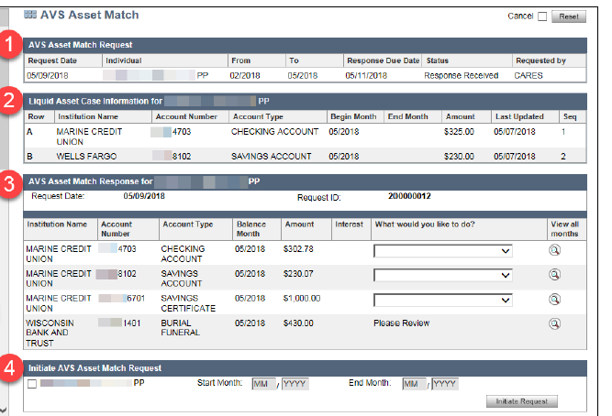

Slide 39
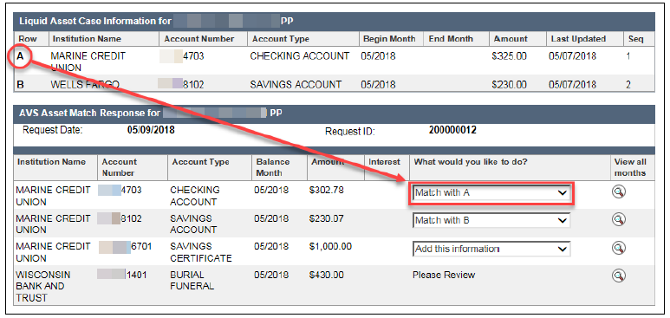
Workers will have the option to add, match, or not add any asset information returned by AVS

Slide 40

Initiate AVS
The “Initiate AVS Request” section will allow workers to manually initiate an AVS request

Slide 41
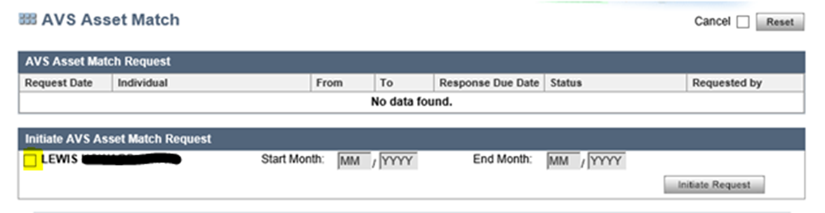
Initiate AVS request for:
Applications
Program Adds
At renewal, if AVS has failed to initiate prior to renewal month

Slide 42
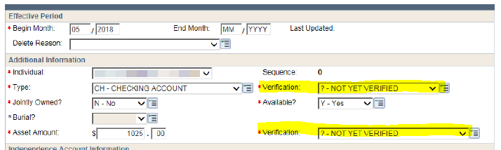
AVS-Verification Checklist
When initially processing an asset, use ? to request verification

Slide 43
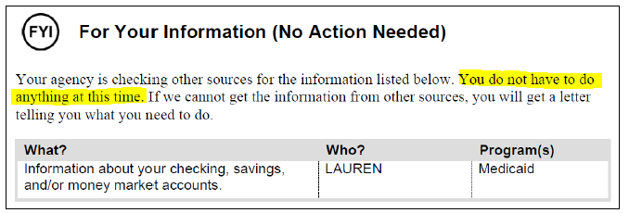
For certain liquid asset types, known as “AVS liquid assets,” the ? verification code will result in the asset being added to the For Your Information (No Action Needed) section of the Verification Checklist

Slide 44
AVS Alerts
Initial AVS Response (545): 10 days after the AVS request was sent, workers will receive an alert indicating that the initial AVS response is available for processing
Workers should go to the AVS Asset Match page right away to complete the asset verification process
(Note that this alert will be set even if AVS has not yet returned any data)

Slide 45
Workers must update the ? pending verification code to Q? if AVS does not return verification of the asset after 10 days
Verification Checklist will be mailed notifying the applicant or member that he or she is required to provide verification of this asset
If needed, workers should extend the verification due date to ensure that the applicant or member has 10 days to provide any required verification

Slide 46
Additional AVS Response (546): 30 days after the AVS request if any additional asset information has come in from AVS since the initial AVS response. Workers should go to the AVS Asset Match page to process the responses.
VS Request Failed – Incorrect VCL Sent (547): The AVS request failed, workers must request verification from the applicant or member. Workers should update the verification fields for the asset type and amount to Q? and sending a new Verification Checklist.

Slide 47
Net Gross Discrepancies
DX auto-populates unearned income pages with the Social Security net income amounts
Reasons for Net Gross Discrepancies:
- Over payment
- Supplemental insurance premiums are deducted
- Prescription plan insurance premiums are deducted
- Taxes
- Child Support

Slide 48
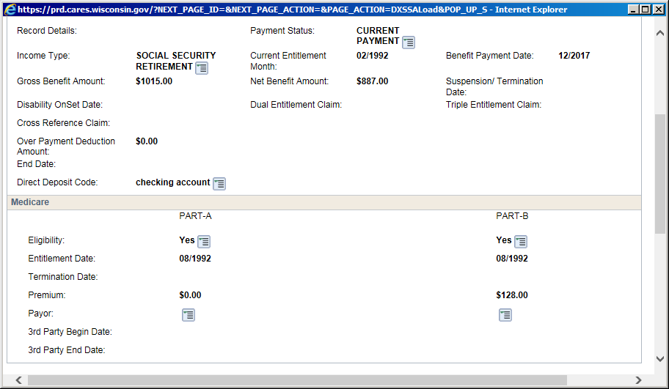
Use SOLQ to figure out the difference between the gross and net income amounts
$1015 - $887 = $128
Medicare B premium
***No other action needed, all income is accounted for***

Slide 49
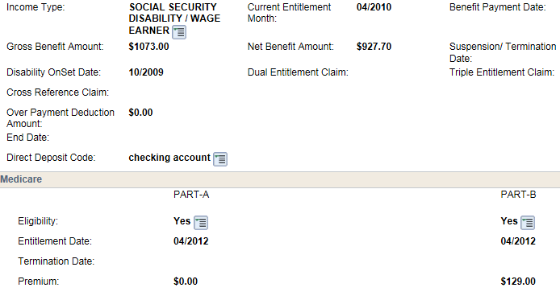
Use SOLQ to figure out the difference between the gross and net income amounts
$1073 - $927.70 = $145.30
$145.30 - $129 (Medicare B premium) = $16.30
Medicare B premium
Add OT-OTHER unearned income page for $16.30

Slide 50
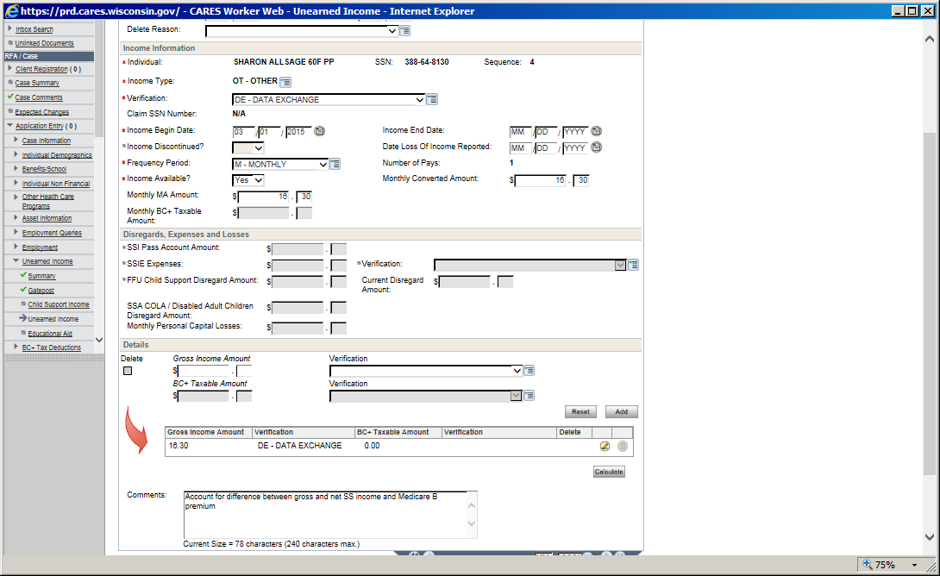
Add OT-OTHER unearned income page for $16.30

Slide 51
If $16.30 is an overpayment deduction it is disregarded income, do not add “Other” unearned income page
You may be able to verify if there is a SSA overpayment using DE

Slide 52

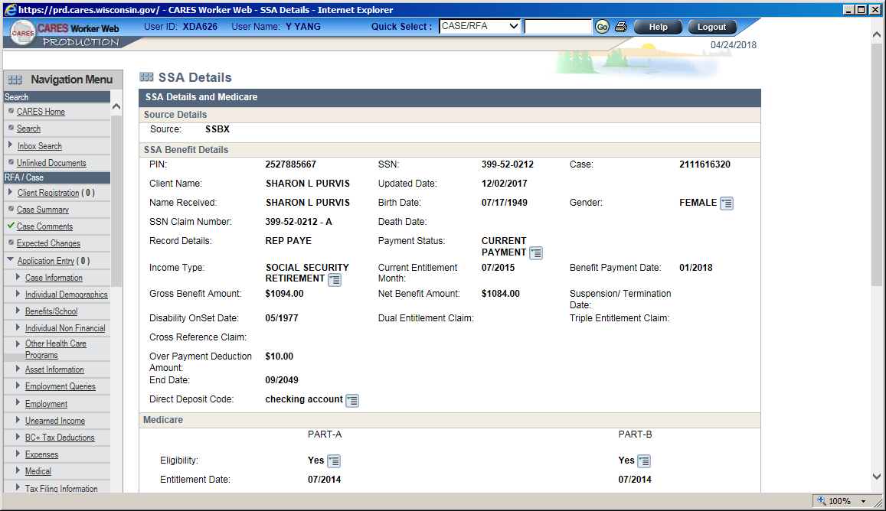

Using HOD
- Trans: DXSA
- Parms: SSN/PIN
- F8 to view OP info
Using CWW
- Data Exchange
- SOLQ Search
- Click Previous Source to view OP info

Slide 53
If $16.30 is deducted to pay for prescription premium or health insurance premium, it must be verified before it can be allowed as a medical expense for FS/HC
Pend for verification if unable to verify using DE

Slide 54
Do It or Transfer It
Do It
- FS renewal for SSI case
- FS renewal for SSI Waiver cases
- Case has open BC+ category
- CTS cases
- If you start it, finish it
Transfer It
- LTC renewal
- Open for LTC
- Complicated EBD questions - MAPP related questions
- Disability questions
- FS case w/ EBD MA renewal due

Slide 55
Reminders

Slide 56
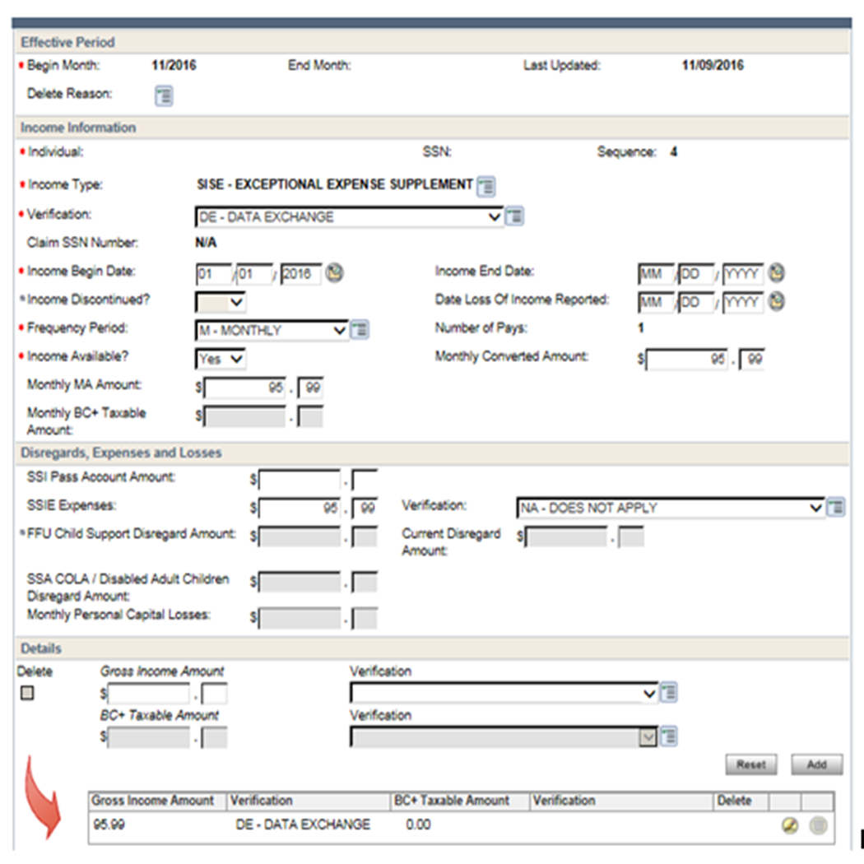
SSI-E
SSI-E income is disregarded income for FoodShare.
The SSIE Expenses section of the page must be completed.

Slide 57

Turning 65
- If member is turning 65 and MAGS is closing
- Member must be tested for EBD programs
- Asset test MUST be completed, do not confirm EBD programs open

Slide 58

Becomes entitled to Medicare
- If childless adult becomes entitled to Medicare A and B, MAGS will close
- Member must be tested for EBD programs
- Asset test MUST be completed first, do not confirm Medicare Premium Assistance open

Slide 59
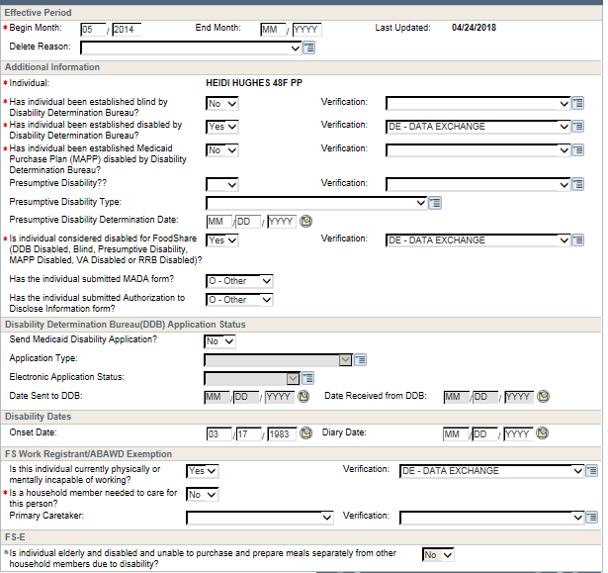
Disability page
If member is receiving SSDI or SSI benefits, he/she is considered disabled, add the disability page

Slide 60
Applying for disability decision
Not open for MA program
- Complete a telephonic signature for HC
- Complete Disability page, enter ?
- Send out MADA and ADDD forms
- Review asset information, pend for verification of all reported assets
- Pend for unverified income
- Review medical expenses
- Review shelter expenses
Already open for MA program
- Complete Disability Page, enter ?
- Send out MADA and ADDD forms
-Review asset information, pend for verification of all reported assets
- Review income information, pend if appropriate
- Review medical expenses
- Review shelter expenses

Slide 61
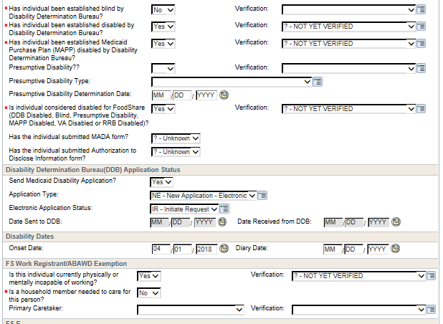

Slide 62

Questions???
Questions later?
***Please see your lead or supervisor***

