Slide 1

Educational Aid

Slide 2

Alerts
113 Educational Aid Expires
Reminder that the semester has ended
Workers must run the case to update the budget
We CANNOT assume that the client is enrolled for a new semester or receiving financial aid

Slide 3
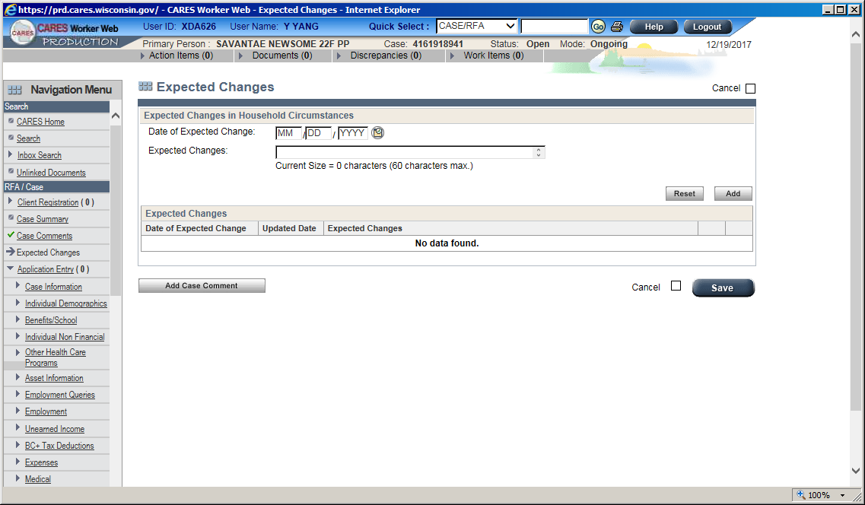

Alerts
Expected change
It is the member’s responsibility to report changes in student financial aid, do not pend for the next semester’s financial aid
Do not add

Slide 4

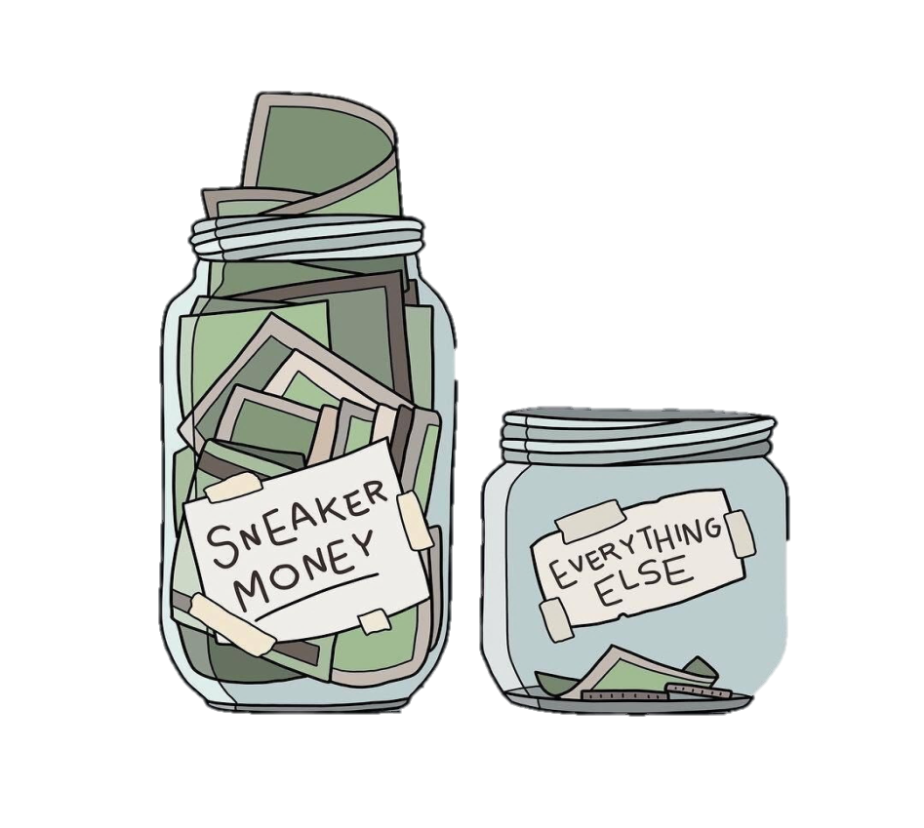

Slide 5



Slide 6
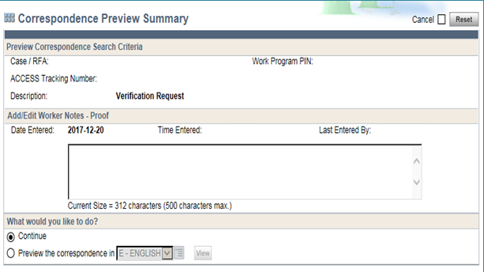
Verification
If multiple income and expenses types are pending for verification, only the most recently added displays on the verification checklist
Add additional comments!
List specific verification items needed.

Slide 7


Verification
Award/Grant letters
offered vs. accepted
estimates vs. actual
expected disbursement dates
Tuition statements
Receipts
Critical thinking
***They are all different***

Slide 8
MATC
Students can view and print their financial aid letter for the school year from their account in the Student Center
The financial aid letter is available as soon as it is awarded —time frame varies depending on when the student turns in their paperwork
The tuition statement can be requested from the Student Financial office, it is an itemized statement that is e-mailed to the student
Book expenses, there is an ESTIMATED budget available to students based on their classes
***Is not a true expense amount as students can purchase/rent/loan/borrow their books***

Slide 9
UW
Students can view and print their financial aid letter for the school year from their account in the MyUW Student Center
Go to “View Financial Aid", located in the Finances section
Click on the active aid year
On the next screen, click on Printable Version and they will be given a breakdown of financial aid information

Slide 10



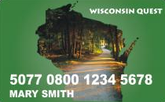
Reminders
A fulltime student is considered a FT student during summer.
#overpayment: A fulltime student applies for FS in the summer and does not meet the criteria in FSHB 3.15.1 and we approve FoodShare for the student.

Slide 11

Are there any questions?

