Slide 1
The FoodShare Clock
What is it and how does it work?
Process Help 71.5

Slide 2
ABAWDs
All Able Bodied Adults without Dependents (ABAWDs) ages 18-52 must meet the FoodShare work requirement or have an exemption each month, or a TLB (time limited benefit) will be applied
The FoodShare clock is where the client’s monthly status is tracked
3 TLBs are allowed before losing eligibility for FoodShare

Slide 3
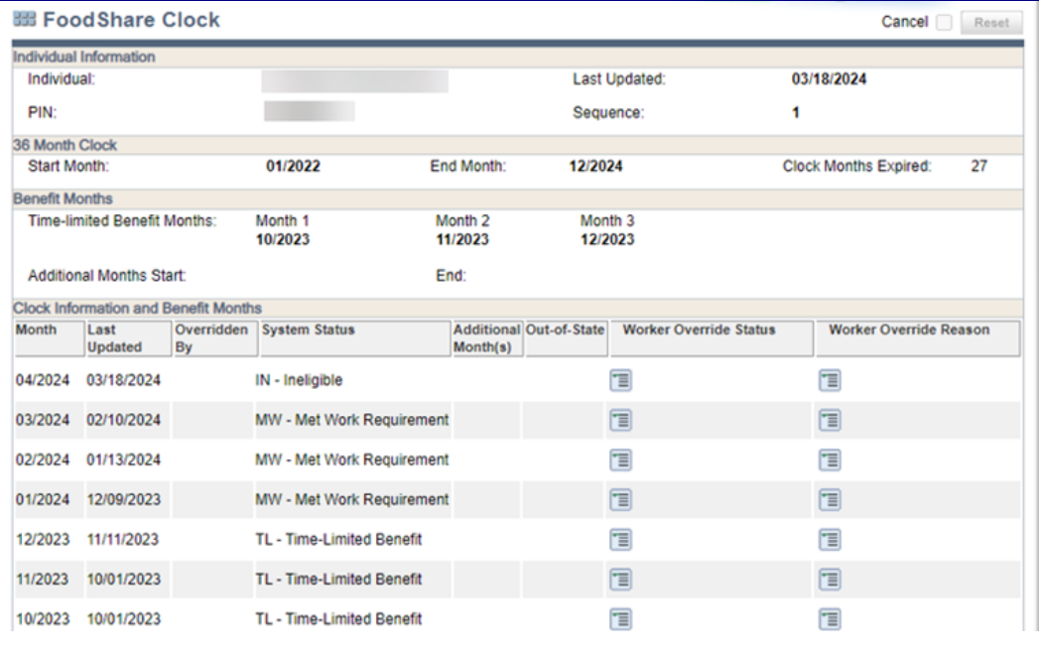

Slide 4
When do Changes to the FS Clock Occur?
Eligibility is run and confirmed by a worker for the recurring or current month.
A batch run on the second Saturday of the month
A batch run on adverse action
Eligibility is run and confirmed in the adverse action batch run.
The TLB months and other system statuses may frequently change due to changes in FoodShare eligibility, ABAWD status, and FSET participation.

Slide 5
What can workers do with the FS clock?
Adjust the start month
Delete it
Establish a new one
All of the above
None of the above

Slide 6
True or False?
The FS clock is for 3 years, but is not fixed. Everyone has their own clock timeframe based on when they began receiving FS
Countable months received in another state are countable months for our clients in WI if received in the current 3 year clock period
Exemptions and good cause can only be applied to TLB months, not ineligible months

Slide 7
What will the clock do?
Since ABAWDs are ages 18-52, what will the FS clock do if a client turns 53 during the 3 year fixed clock period?
Delete itself
Fill in all remaining months with EX (exempt) immediately
Populate to EX each month going through the rest of the fixed clock period
Populate each month to TB (to be determined)

Slide 8
When do we override the clock?
AE-Agency Error
EV-Exemption Verified
FE-Discretionary Exemption
FH-Fair Hearing
IC-Incarceration
LV-Late Verification
OS-Out of State Information Received
WA-Waiver ABAWD Area
MT-Met 30 Day Work Requirement
GC-Good Cause Verified
Process Help 71.5.3

Slide 9
Override Scenario #1
Jack calls to apply for FoodShare in March. After discussing ABAWD policy with Jack, the worker determines that he does not meet the work requirement or have an exemption at that time. The worker explains that he exhausted his 3 TLBs last year in August, September, and October. Jack informs the worker that he was incarcerated from July-December of last year.
Should anything be done with the clock?

Slide 10
Jack’s incarceration during the TLB months is an exemption and is not questionable
The FS Clock page is adjusted to reflect Incarcerated for all 3 TLB months, August, September, and October. Jack may be eligible for FS from the application date ongoing if meeting all other eligibility requirements

Slide 11
Override Scenario #2
Samantha’s Unemployment Compensation (UC) page was incorrectly left with no end date even though she was no longer receiving UC. At the next renewal, the worker noticed the person had been exempted incorrectly.
Is this an overpayment? What should be done with the clock?

Slide 12
There is no overpayment and no adjustment to the clock for the previous months due to agency error
ABAWD status should be re-determined going forward

Slide 13
FS Clock Automated for Three Additional Months
When does the clock display AM-Additional Month status?
The member incurs 3 TLBs, no longer eligible for FS
The member meets the work requirement. The clock displays status of MW-Met Work Requirement
The member stops meeting the work requirement
Anytime CWW builds clock status of AM for a month, the next two months automatically display the same status
Process Help 71.5.3.1

Slide 14
3 Additional Months:
A Second Chance
Callie received TLBs for the months of October, November, and December
On January 2nd, she started working at Kwik Trip
On March 30th, her employment was terminated
Because Callie had started meeting the work requirement and regained FS eligibility after her 3 TLBs, she was given a “second chance” and allowed 3 additional months, April-June

Slide 15
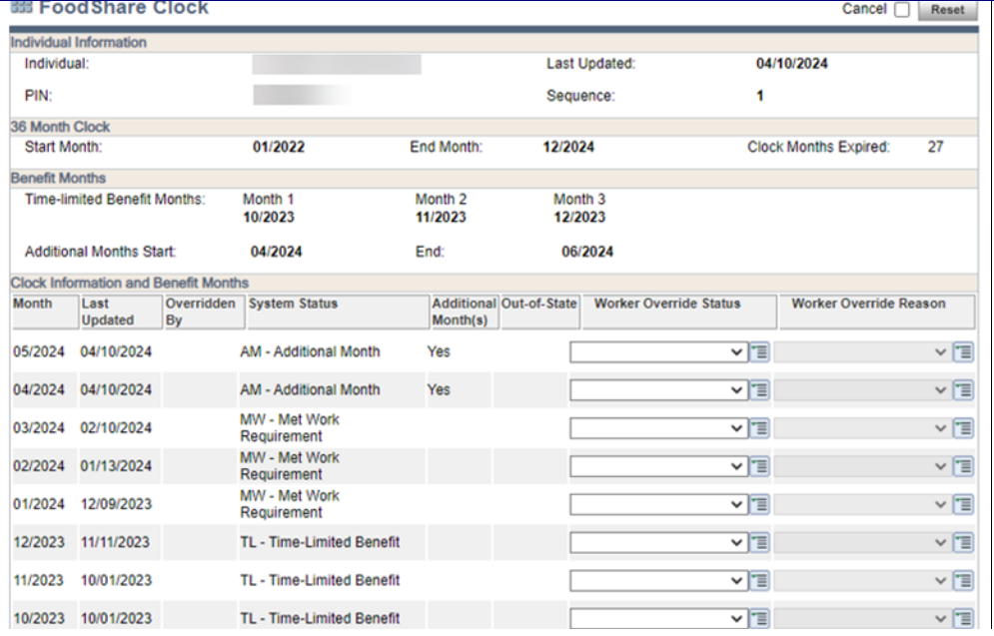

Slide 16
What happens when running with dates?
The FS clock is updated when running for the current month or later if FS is confirmed
The clock is not updated if:
FS cannot be confirmed
Additional months have begun
FS is run with dates prior to the current month
The worker will need to override status to Exempt for the appropriate months
Process Help 71.5.4

Slide 17
Running with Dates Scenario #1
Stella’s FoodShare renewal is due December 31, 2023. She completed it and was then subject to ABAWD policy. She received a TLB in September 2024. A second TLB was issued at adverse action for December 2024. During her December renewal interview, Stella reports that she has an exemption due to participating in outpatient alcohol treatment since December 10, 2024.
What should be done with the clock?

Slide 18
The worker must run with December dates to update the December status on the FS clock from Time-Limited Benefit (TLB) to Exempt

Slide 19
Running with Dates Scenario #2
Jackson applies for FoodShare on June 18 and is an ABAWD. He reports receiving out of state unemployment on August 24. We are not able to verify the out of state income, so verification is needed. Verification is received on September 2.
When is Jackson exempt?
September 1st
August 1st
October 1st

Slide 20
Running with Dates Scenario #2
What actions are needed to update the FS clock?
The worker runs eligibility and confirms ongoing for October to exempt October and ongoing months, then runs with a September 1 date and confirms FS, and the September TLB is changed to Exempt status
The worker must manually override August status to Exempt, since this is a past month

Slide 21
Running with Dates Scenario #3
Marge was issued her first TLB for the month of February. She met the work requirement and was not issued a second TLB until October. On October 20th, Marge reports that she became pregnant during October. The worker does not find this questionable, so no verification is needed
What should be done with the clock?

Slide 22
The exemption is effective in October, forward.
The FS Clock page is adjusted to reflect Exempt for the month of December when running eligibility and confirming. Eligibility is run with dates to remove the TLBs for October and November. Even though she reported October 20th, the exemption is applied beginning October 1st.

