Slide 1

Fair Hearings
June 21, 2018

Slide 2
Table of contents
1 - What is a fair hearing
3 - Hearings serve to…
5 - Conference
8 - How do I know that I have a Fair Hearing?
13 - First Step
15 - Second Step
18 - Enclosures
20 - Adding documents
25 - Appeal notice
29 – Hearing notice
32 – The hearing
35 – The decision
37 - Letterhead

Slide 3
What Is A Fair Hearing?
When an applicant or member disagrees with an agency's action (on his/her request for benefits, amount of benefits, overpayment or termination), an agreement is often reached through an adjustment of the benefit or explanation of the program rules by the agency. However, if no agreement is reached, the applicant/member may request an administrative review by the Division of Hearings and Appeals ( DHA The Division of Hearings and Appeals ) through the fair hearing process.
1

Slide 4
Hearings are conducted by DHA for BC+, MA (and all MA subprograms), CTS, FS, RAP, CC, and SeniorCare ap-plicants/recipients and for CC pro-viders. Administrative Disqualification Hearings (ADH) are also conducted by DHA, but only at agency request.
2

Slide 5
Hearings serve to:
Interpret the program to dissatisfied clients.
Bring the applicant/member, the agency and state authorities into discussion for a better understanding of problems.
Resolve factual disputes.
Clarify policies and their application in relation to laws and regulations.
Review policies in program administration and reveal those which require clarification or revision.
Promptly remedy unfair treatment, mistaken or arbitrary action and negligence.
3

Slide 6
The hearing process isn't intended to be a substitute for responsible administration. Neither good nor bad administration is necessarily reflected in the number of hearings involving any one agency. For example, an applicant/member may request a hearing as a protest against a requirement which isn't within the agency's power to adjust.
4

Slide 7
Conference
It is suggested that we offer an agency conference. An Agency Conference is a meeting between the client/CC provider and agency representatives to:
Resolve the matter at issue,
Explain the proposed action or inaction,
Permit the client and any representative to present information about the hearing request and to request information from the agency.
Offer the client an agency conference at his/her request.
5

Slide 8
A conference does not affect the client's right to a hearing or the time limit for completing a hearing. Advise the client that to have a conference is his/her choice and doesn't delay or replace the hearing. A hearing may be requested and held without a conference. The worker responsible for the agency's action may attend the conference.
The conference may lead to the informal resolution of the dispute. However, a hearing must still be held if one was requested, unless the client voluntarily withdraws the hearing request in writing to DHA, and DHA has notified us that they have received the withdrawal.
6

Slide 9
The client may withdraw the hearing request at any point in the process. They are sent a withdrawal form after they file their initial request. There is also one available under documents on the Appeal Information page, which we will look at later.
7

Slide 10
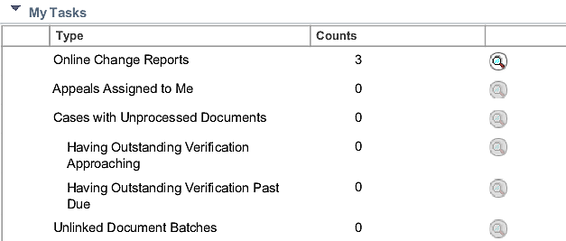
How Do I Know That I Have A Fair Hearing?
On your homepage, in the “My Tasks,” there is a line that says Appeals assigned to me. There will be a number there that will tell you how many, or if, you have any appeals.
8

Slide 11
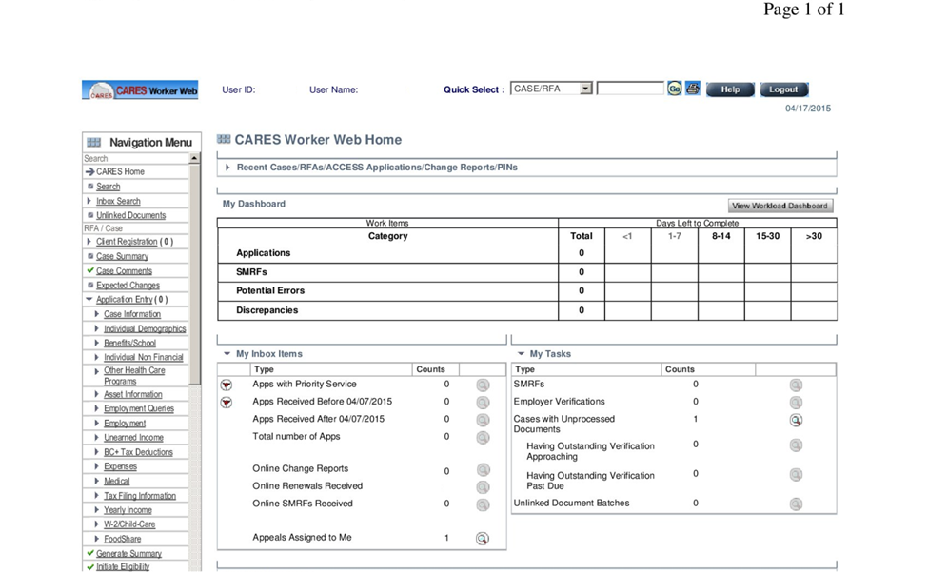
If you click the magnifying glass, CARES will take you to the Appeal Information page.
9

Slide 12
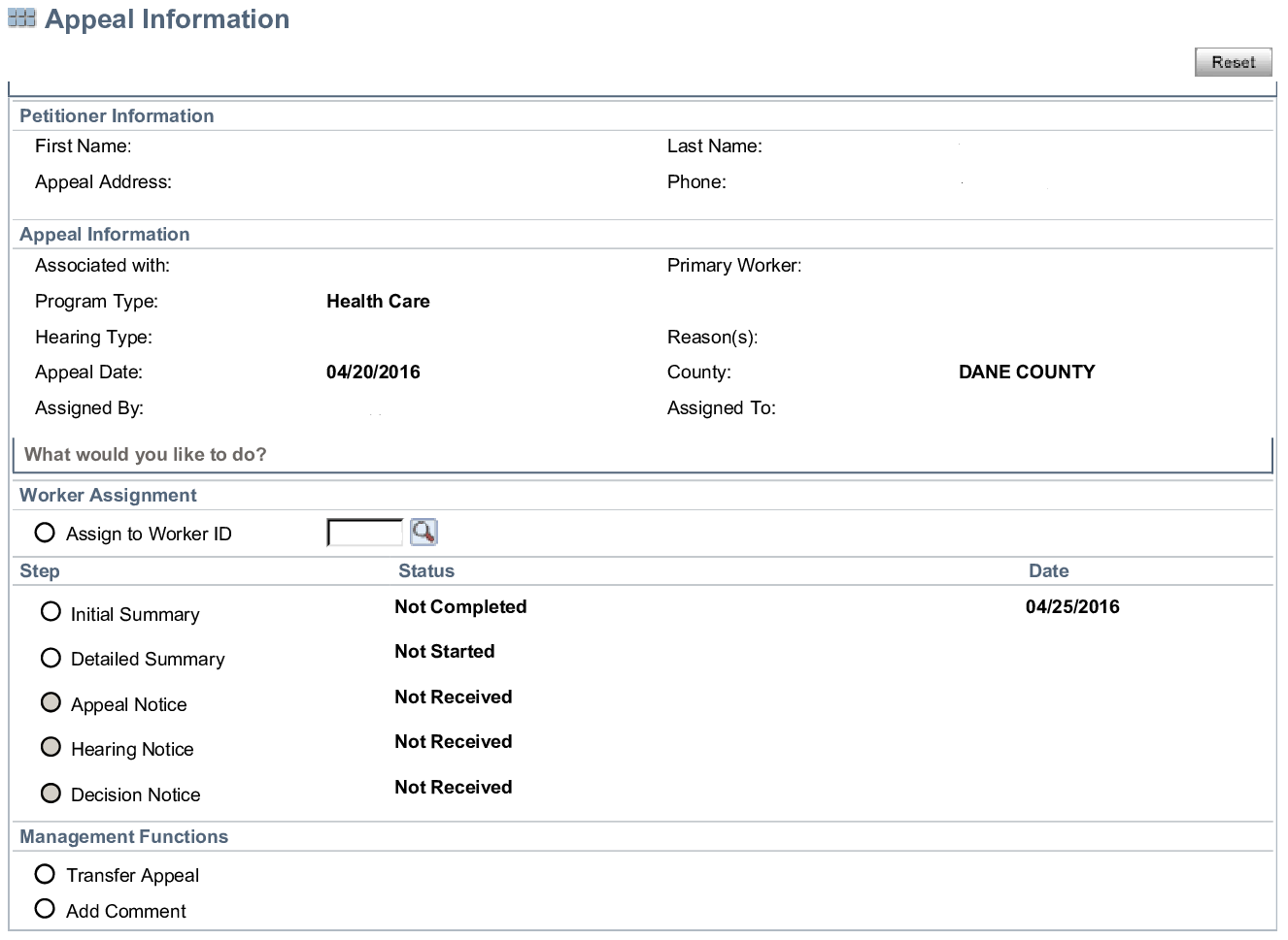
10

Slide 13
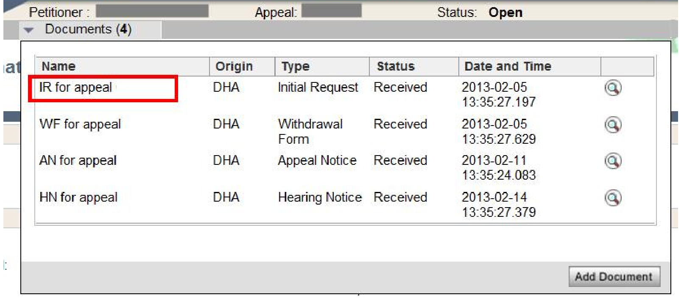
At the top of the page the worker will see Documents with a number after that. Click on that and the above drop down will appear. Click on IR and the request for the hearing will appear, informing you of what is being appealed.
11

Slide 14
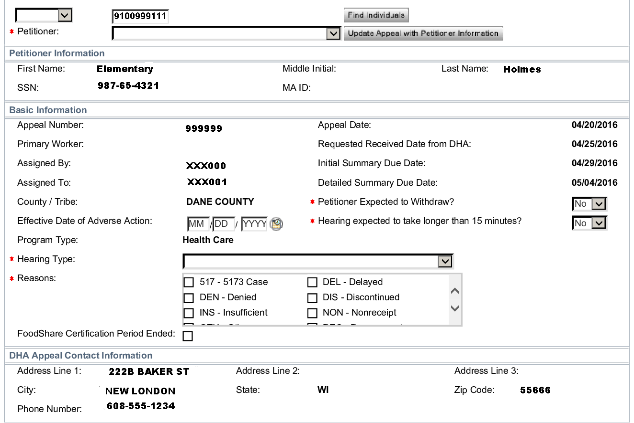
12

Slide 15
First Step
Upon receipt of the hearing, the worker has five days to complete the initial summary.
Page 10 has the appeal information screen. On that screen, click initial summary, and the screen on page 12 will appear. The items, such as name and address will appear on the page.
Click the drop down above petitioner and select case.
13

Slide 16
Then click “Find Individuals” and “Update Appeal With Petitioner Information.” CARES will then update the screen.
Then tab down to the “Effective Date of Adverse Action.” This should be the date of the event that they are appealing, i.e., the date benefits were reduced or denied, or the date of the application.
Then Select the “Hearing Type” from the drop-down menu and “Reason” code from the list.
14

Slide 17
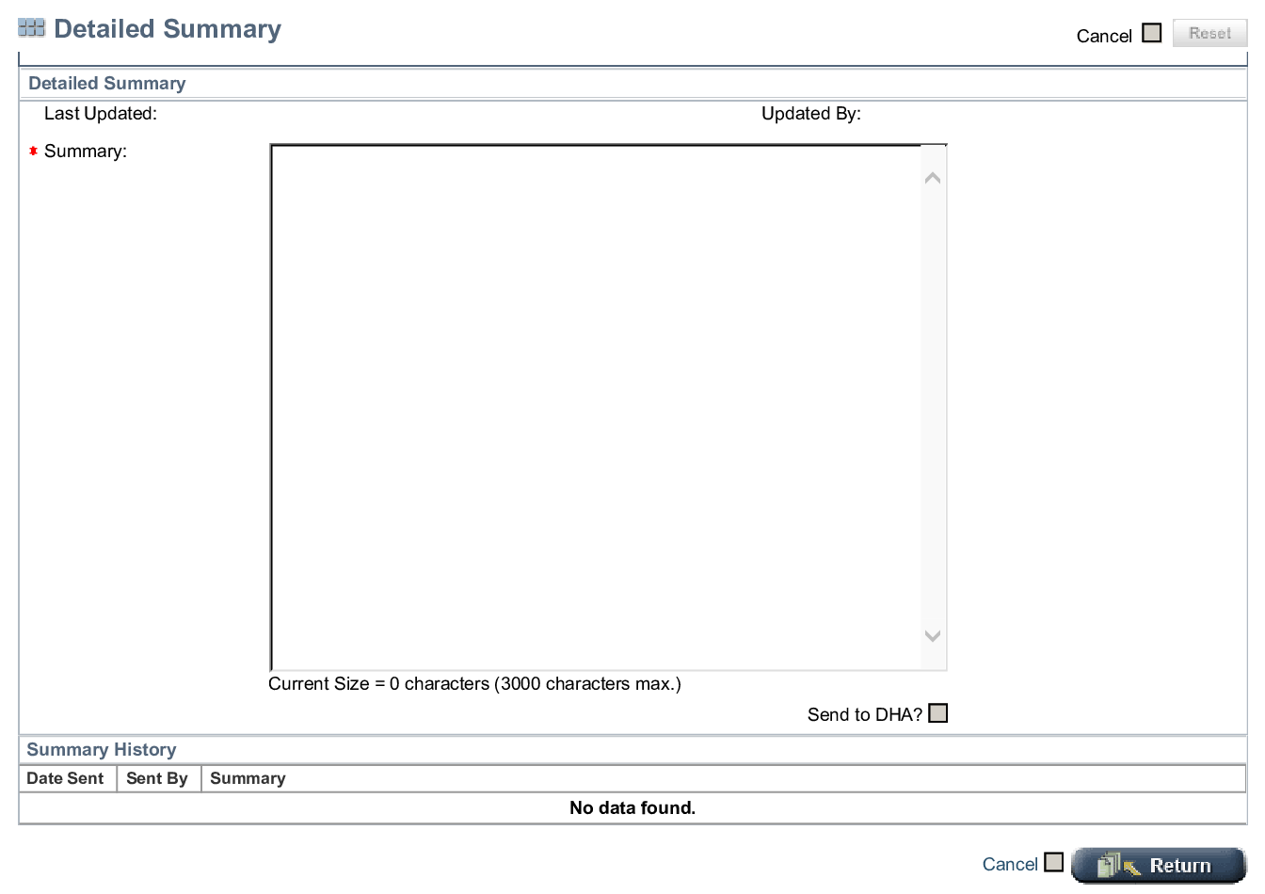
Second Step
15

Slide 18
16
The hearing summary must be completed within ten days of receiving the hearing request.
In it, one describes the agency actions that have led to the appeal.
This is a professional letter. Please check your grammar and spelling before submitting it.
You can leave the page uncompleted and return, and CARES will save your letter.
Once “Send to DHA?” is clicked, the text will drop down into the Summary History section.

Slide 19
17
Once sent, one can not edit the information. Additions can be entered, however.
Copy and paste a copy of the text to county letterhead. Address it like a business letter (date at the top, Hearings and Appeals address, To Whom It May Concern, CC: client, Enc:, etc).
Send a copy of the letter to the client along with any enclosures which you attached to the file, list them under Enc:.

Slide 20
enclosures
When submitting the summary, the worker should attach any relevant attachments to help make their case.
It is a good practice to always attach the Notice of Decision(s) that informed the client of the action that they are appealing.
If income is the issue, attach the verification we received.
A verification request may be useful if it is a question of a denial/closure for unsubmitted proof.
At a recent meeting with two hearing officers, we were advised to avoid attempting to use too much evidence.
They also stated that we should avoid hearsay, and that they consider case comments to be hearsay.
18

Slide 21

It may be a good idea to have the case comments handy, without submitting them, in case their content may assist.
It may be a better idea to have the worker in question available to testify if those comments are critical.
There may also be other pieces of information which you may not want to submit but have available.
19

Slide 22
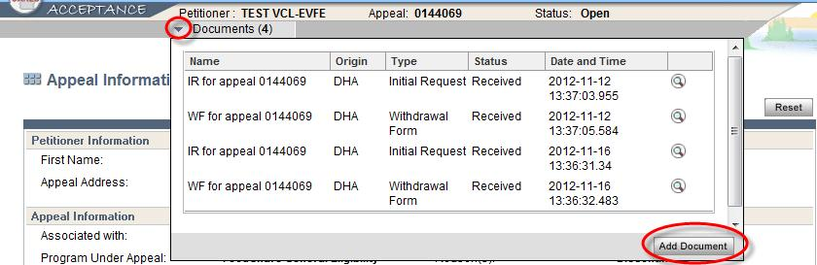
Adding documents
To add a document, click the documents drop down.
Click add document.
20

Slide 23
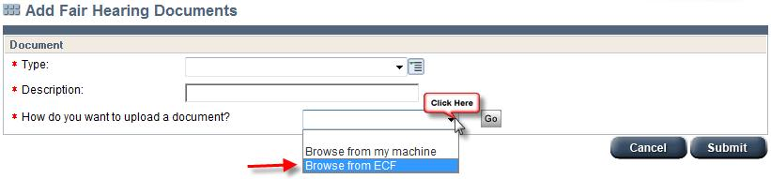
After clicking the Add Document button, CARES will take you to this screen. Hit the “How do you want to upload a document?” line and you will see the dropdown shown above. You will also need to select a type of document. Most frequently, it will be Exhibit/General. Then enter a description that will make it easily identifiable (dd/mm/yyyy Notice of Decision, e.g.). Once you do so, CARES will show you ECF, such as below.
21

Slide 24
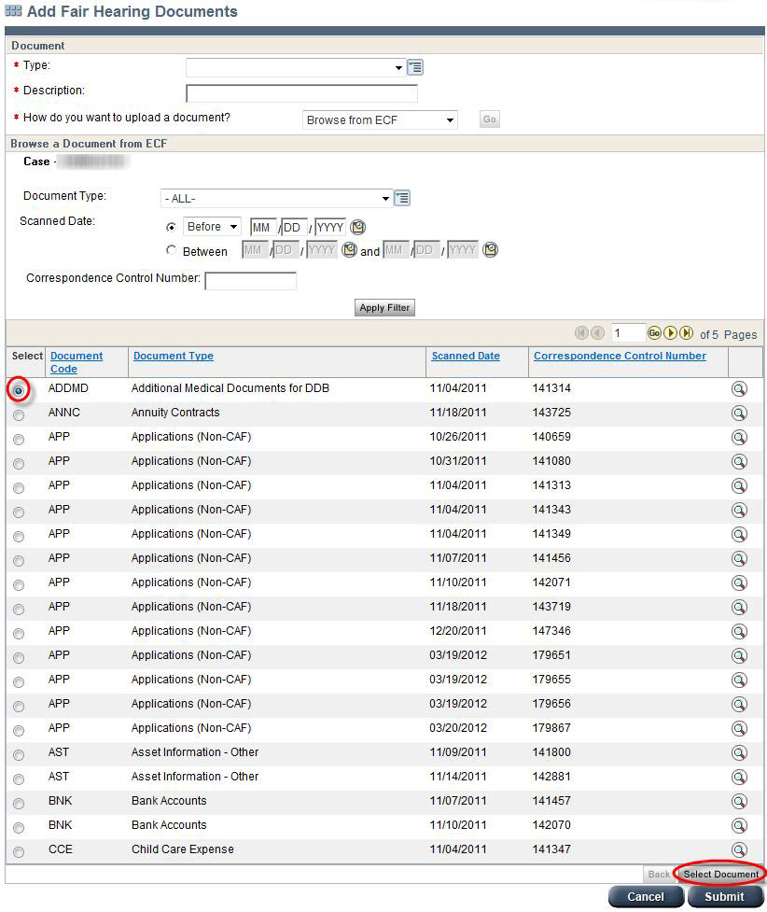
22

Slide 25
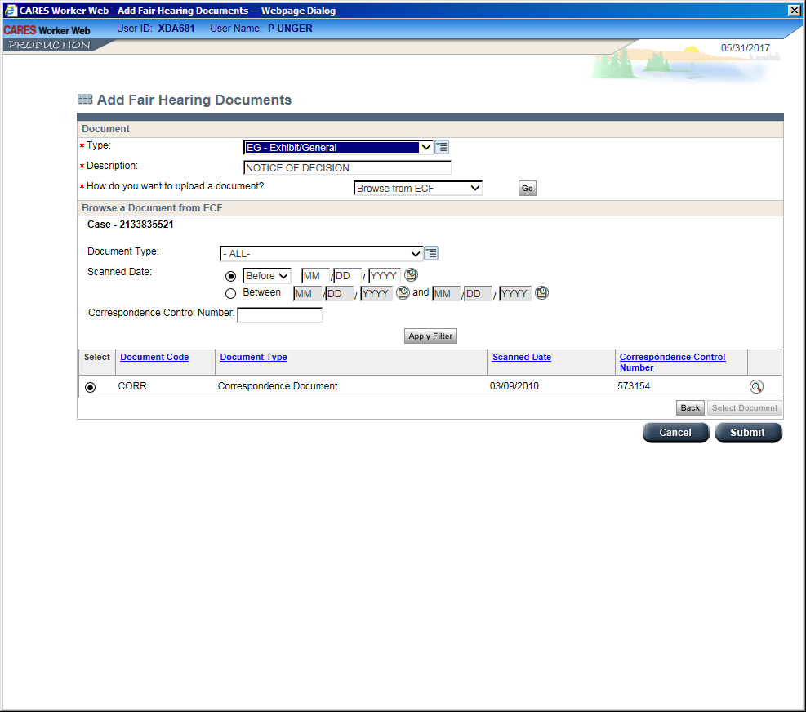
Click on the radio button for the document that you want and then hit Select document. CARES will take you to this screen. Hit submit.
23

Slide 26
You are also able to save documents to your computer and add them by selecting Browse From My Machine. The computer will then take you to your personal files, where you will presumably have saved the document(s) that you want.
Methods of saving to your computer will vary. One suggestion is to print a document as a PDF.
24

Slide 27
25
APPEAL NOTICE
Within a few days of receiving your hearing notice, you receive another document on the Appeal Information screen: AN.
This is the Appeal Notice. It will tell you if you need to reinstate benefits for the client.
This has a strict ten day time line. It is important that observe that deadline.
Hearings and Appeals will contact your supervisor if you do not.
You will not always have to restore benefits. Read the notice closely.

Slide 28
26
Restoring benefits may involve an auxiliary, a 3070, reopening the case, etc.
After you have taken the action ordered, you will need to complete the Appeal Notice section of the Appeal Information screen.
Enter the date the action was taken.
If the county wins the hearing, the client will be responsible to repay the benefits. If the county loses, we do not recoup.

Slide 29
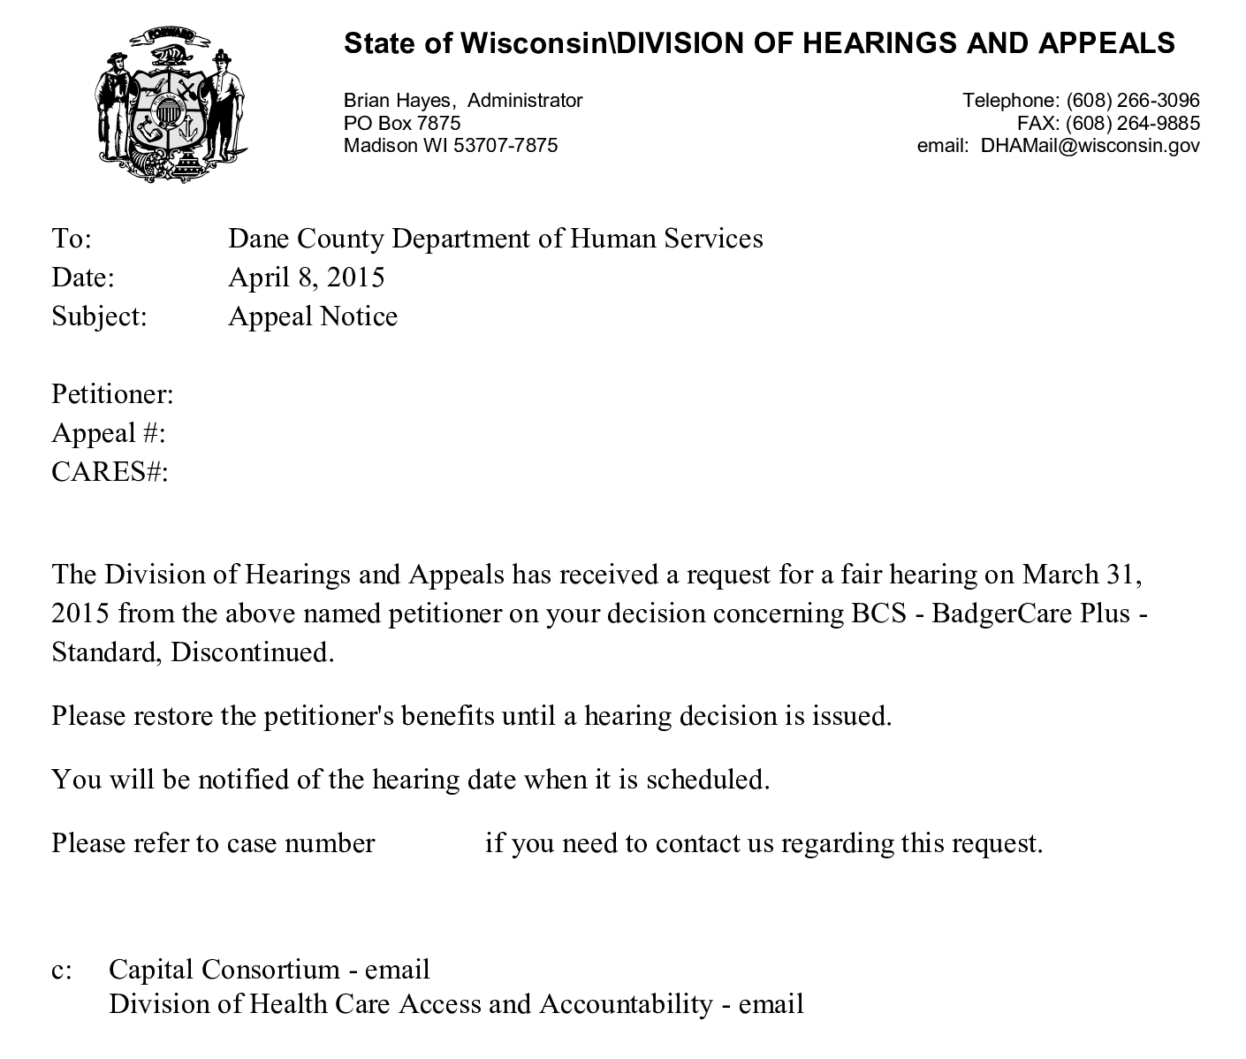
27

Slide 30
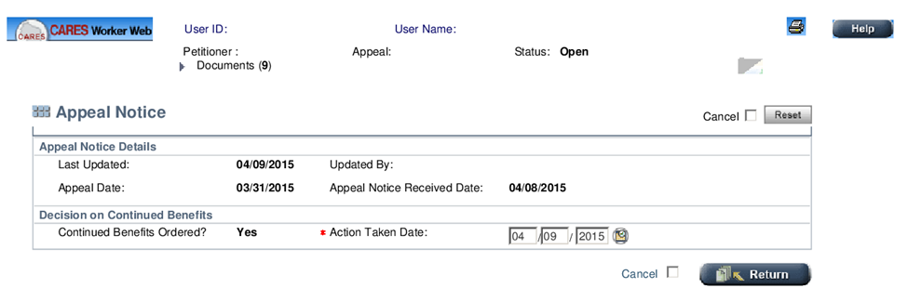
28

Slide 31
29
Hearing notice
At some point after all of this is completed, you will receive an e-mail informing you that the hearing has been scheduled. Here in Dane County, that e-mail typically comes from one of our clerical staff. A copy of the appointment letter goes to the client and will be available in the documents section of the Appeal Information screen.
You will then need to complete the Hearing Notice screen with the worker’s information and the phone number of the hearing room.

Slide 32
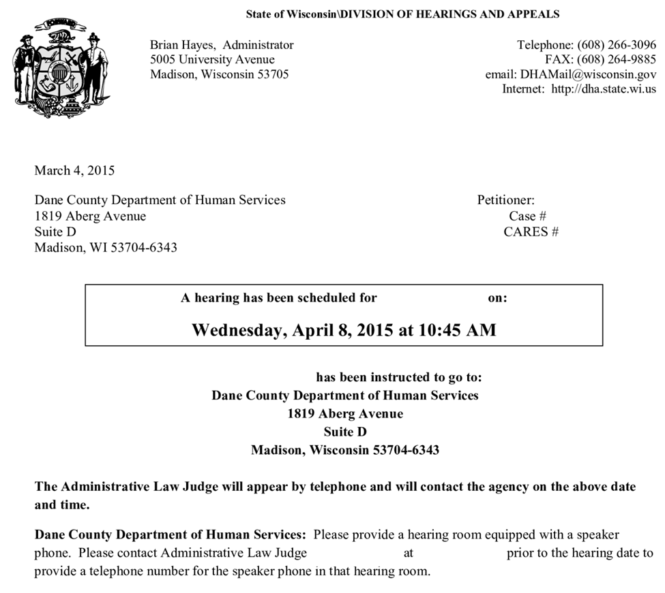
30

Slide 33
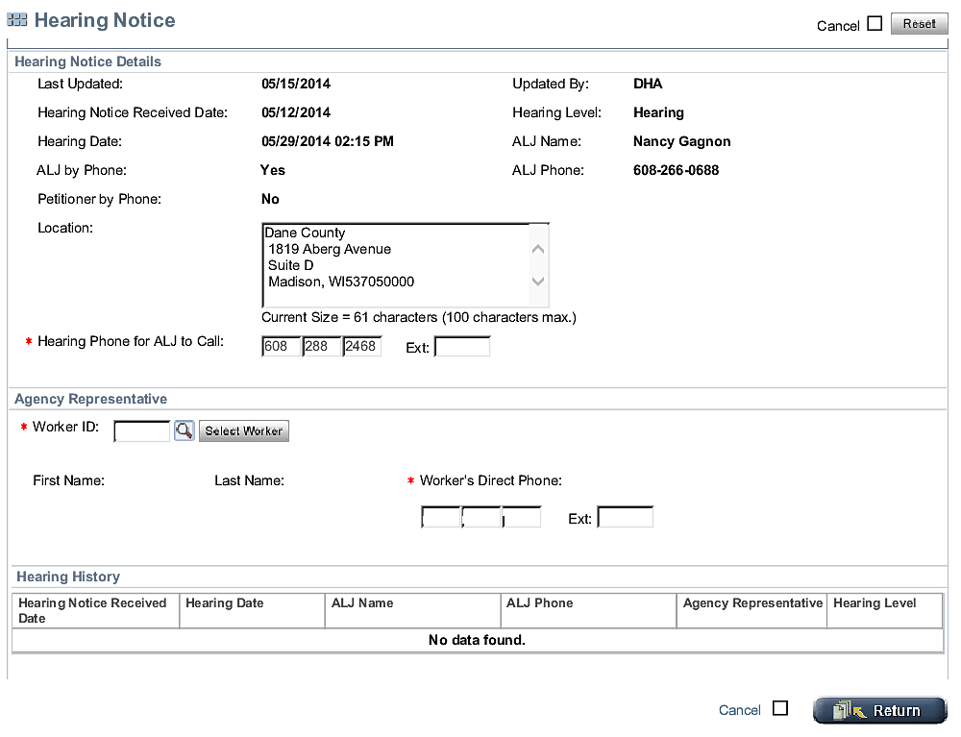
31

Slide 34

32
THE HEARING
Not all clients will appear in person. Some will provide their testimony by phone. Please watch the above notice closely. To see the Hearing Notice, go to the Appeal Information screen and click the Hearing Notice radio button. It will specify the manner in which the client will appear, as well as the hearing officer. The majority of the attorneys will conduct the hearing by telephone. You will occasionally have one appear in person. Be in the designated hearing room at the scheduled time. The ALJ will call at that time. There will be some situations when their previous hearing will run late.

Slide 35

33
The Hearing Officer will swear in all those present who are testifying. The county will present its testimony first. The client will make their statement. The county will have an opportunity to ask any questions and the client will. The Hearing Officer may ask questions at any time. The process will be recorded. No decision will be issued at that time.
The Hearing Decision will be issued by mail.

Slide 36
Take all documents and the detailed response letter to the hearing, in triplicate.
Have any related policy citations with you.
Know your case details. The hearing officer may ask unexpected questions.
Stay by the phone. Client has 15 minutes to show. Other hearings may run late. It’s up to the hearing officer to decide if they will deal with someone who is late.
34

Slide 37
The decision!
If the hearing officer dismisses the hearing or rules in favor of the county, the only thing left to do is to refer the case for an overpayment if we had restored benefits.
If the ALJ finds in the favor of the client, we will need to correct the benefits and complete the Certificate of Administrative Action.
Cynthia Flynn, Adams County Supervisor, compiles a hearing tracker for the consortium. Please e-mail her at Cynthia.Flynn@co.adams.wi.us with a copy of the remand form.
35

Slide 38
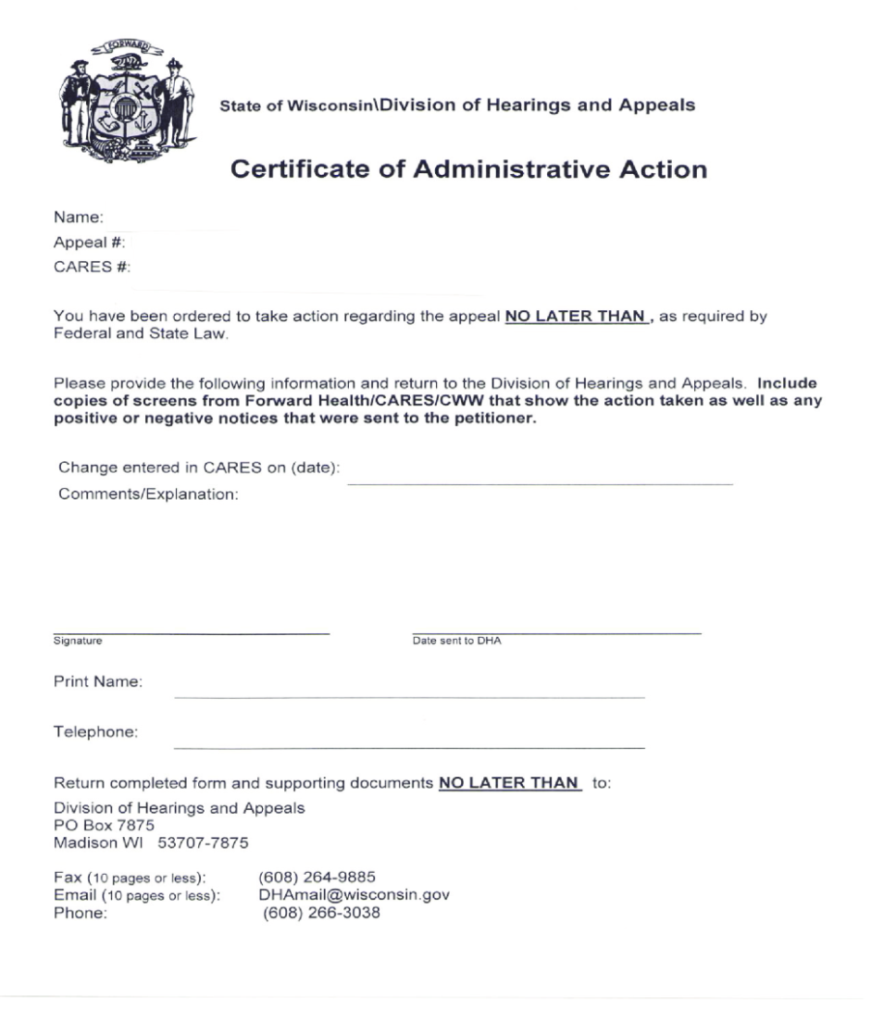
36
This form needs to be completed within ten days of the decision. The due date is monitored.
This form must either be uploaded to CARES or faxed to the Office of Hearings and Appeals.

Slide 39

37

