Slide 1


FoodShare
October 2020
Notes:
FoodShare
SNAP
Food Stamps
Quest
What you do is important. As you observe your coworkers, and read your curriculum, keep in mind why we do what we do. Remember how important it is to the people that we serve.
We’ve put this power point together to give you an idea of the type of information you will be reading. After watching this presentation, you will have a little foundation of information that you will be building on during training.
Thank you for being here, and thank you for your dedication to the people we serve.

Slide 2
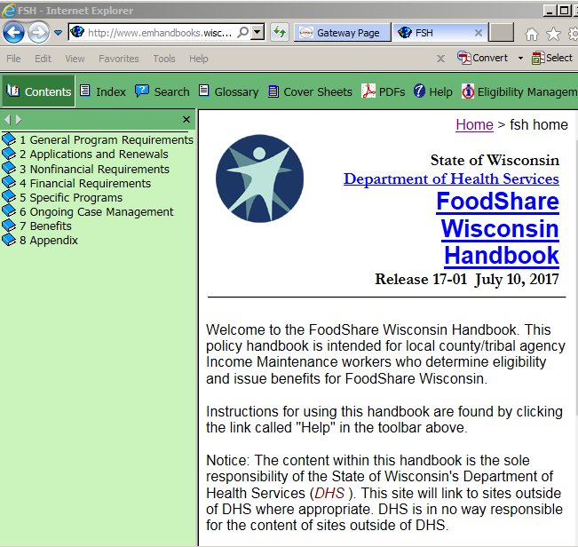
Your friendly fs handbook
Notes:
This is the online FS handbook. This is where many of your questions will be answered. All FS policies are located in this manual.

Slide 3
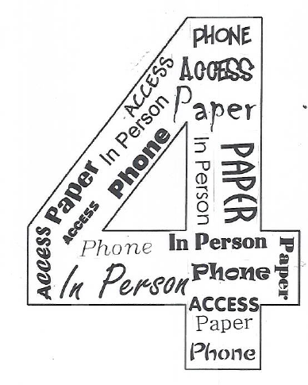
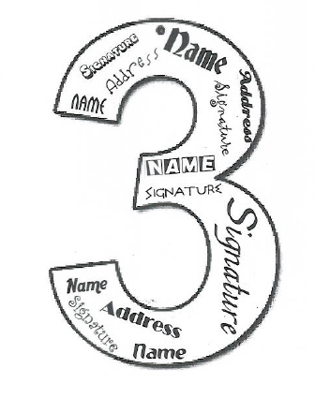
Application Process
4 ways to apply:
What you need to set filing date:
In person
Online
Phone
Mail
Name
Address
Signature
Notes:
If you forget everything else from this video, this is the one to remember!
Some day, someone is going to ask you these questions. I am hoping you will remember the correct answer. ☺

Slide 4

Quest card
A safe and easy way to use FoodShare benefits.
It is a plastic debit card with client’s name, card number and the QUEST logo on it
Used to buy groceries, at grocery stores, convenience stores, many farmers’ markets
Each month benefits will be added to your QUEST card account automatically, even on weekends or holidays
Notes:
FoodShare is issued on this Quest Card
Stores that accept Quest will have signage at the entrance of the store
When FS are issued the first time, customer will receive a big packet of information, called the Eligibility Benefits Brochure

Slide 5
Using the Quest card
What clients can buy
What can’t be bought
Breads and cereals
Fruits and vegetables
Meats, fish, and poultry
Dairy products
Seeds and plants that produce food for the household to eat
Nonfood items (such as pet foods, soaps, paper products, household supplies, grooming items, toothpaste, and cosmetics)
Beer, wine, liquor, cigarettes, or tobacco
Food that will be eaten in the store
Hot foods
Notes:
Listing of what people can and cannot buy with their quest card

Slide 6
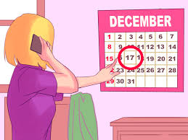
When BENEFITS ARE deposited
8th digit of your SSN | Benefits deposited on the
0 | 2nd
1 | 3rd
2 | 5th
3 | 6th
4 | 8th
5 | 9th
6 | 11th
7 | 12th
8 | 14th
9 | 15th
Initial allotment dates will vary
Auxiliary allotment dates will vary
Notes:
This chart is listed on the capital-im.com website, under desk aids / FS – good thing to print out and have handy when on CCA.
Many clients will already know what their date is, but you should be explaining how it works to newcomers.

Slide 7
What is Priority / Expedited Service?
Faster benefits if:
  Monthly gross income and assets are less than shelter expenses
  Gross monthly income < $150 and assets < $100
  Household contains migrant or seasonal farm worker
Benefits must be issued by 7th day after application is filed
Applications after the 15th of the month will receive month 1 and month 2 on the same day
Notes:
Read through the slide
Also stress just because someone is homeless does not make them eligible for priority / expedited benefits

Slide 8
Application Timeframes
Priority / Expedited Service 2.1.4
Non Priority Service 2.1.2
Benefits are issued to the FS group by the 7th day after the application date
The application process must be completed within 30 days of filing date.
If the 30th day falls on a weekend or postal holiday :
For denials - the action should be taken the next business day.
For approvals - the approval must be processed no later than the 30th day. Waiting until the next day is not allowed.

Slide 9
Verification Requirements
General Verification Guidelines
It is customer’s responsibility to provide verification, but if they request help, we must help them. If we are also unsuccessful, we may use best information available.
It is your job to accurately determine eligibility and issue correct benefits. Ask questions until you get all the information you need to do so.
All verification requests must be in writing (VCL)
Do not over-verify
Do not exclusively require one type of verification when other types are adequate and available
Collateral Contact (CC) is only for when you verbally verify something with a third party (Reference Process Help 50.1.3)

Slide 10
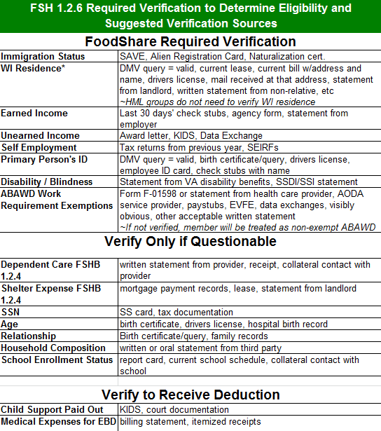
Mandatory Verification Items
Notes:
Point out that there are differences in required vs only if questionable vs to get a deduction.
Where to find this list in the handbook
This desk aid is available on the website

Slide 11
Late Verifications
Late Verifications
Applications are denied on day 30 if verification is not received
They have an additional 30 days from denial date, or 60 days from the filing date, to submit the required verification and open FS without requiring a new application or interview
Benefits should be prorated from the date all required verifications were submitted.

Slide 12
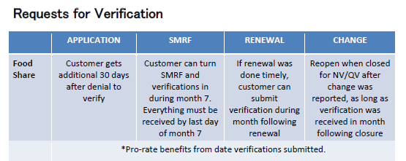
Available on the capital consortium website

Slide 13
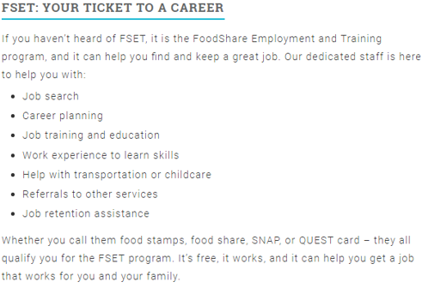
Foodshare employment & training (fset)
FoodShare recipients can receive FREE, individualized services to help gain financial stability
FREE JOB TRAINING and HELP FINDING A JOB!!!
1,108 FS recipients got jobs in 2019-2020 thru FSET
New workers will be scheduled to observe an FSET orientation to learn all about the program
Discuss, Promote and Refer clients to FSET

Slide 14
What have you learned so far?
You are 25% done! Let’s recap what we’ve learned.
  How to apply for FS.
  FS benefits go on a debit card called a Quest card.
  FS benefits can be spent on food only.
  When benefits are deposited.
  Definition of priority service / expedited benefits.
  Application timeframes
  Verification requirements
  And what to do if someone submits verification late.
  What FSET is
  What’s next?

Slide 15

Non-Financial Eligibility
Identity of Primary Person
WI Residence
Food Unit / Group / Relationships
Citizenship and Immigration
SSN Requirements
Student Eligibility
ABAWD (Able-Bodied Adult Without Dependents)
Drug Felon

Slide 16
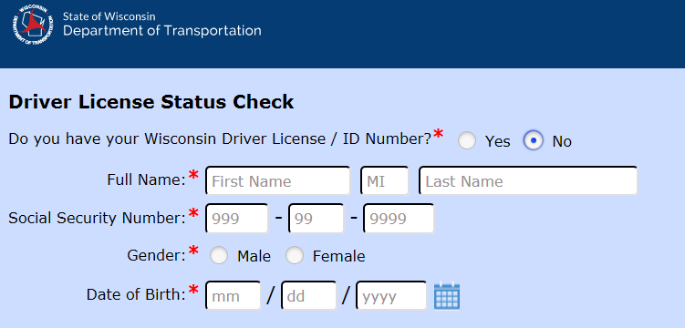
Identity of primary person
Birth Query / Birth Certificate
DMV data exchange (Process Help 44.2.2.6)
  Save this website to your favorites!
  https://trust.dot.state.wi.us/occsin/occsinservlet?whoami=statusp1
Immigration papers
Passport
Check stubs with name
Driver’s license
Data exchanges
**One time only item

Slide 17
Residence
Must reside in WI
WI residence must be verified (unless they are homeless)
Temporary Absence
  If someone is absent from the home for longer than 2 full consecutive calendar months, they must be removed from the group.
  See FSH 3.2.1.2 for more info
Shared custody of children – whichever parent is the child’s primary caretaker can receive FS for the child.

Slide 18
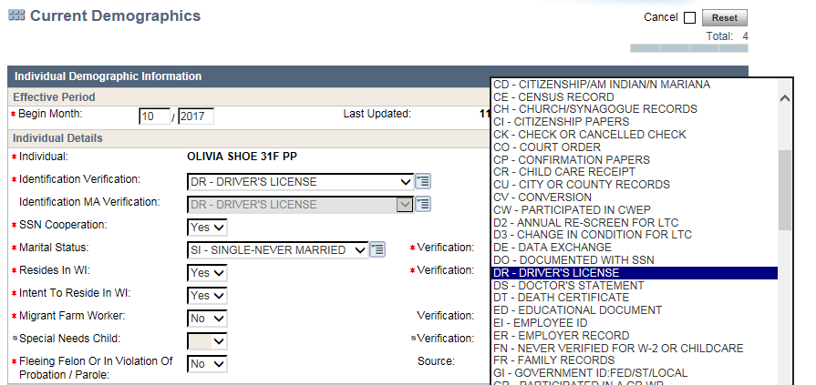
Verifying wi residence
Field in CWW defaults to NQ (Not Questionable) – workers must remember to update that field at intake
Error prone area
Can use DMV Data Exchange to verify

Slide 19
H.U.G.
Household: Everyone who lives at that address
Filter Out: Non-relatives who don’t share food
Unit: Required Relationship or Share Food
Filter Out: People determined ineligible due to student status, IPV sanctioned, immigration status, drug felony sanction, TLB, etc
Group: Who Ends Up Getting It

Slide 20


Maria and her husband Jeff apply for FS. They have two kids. They all live together.
They are in the same Household because they live together.
They are in the same Food Unit because they are married, and the kids are under 22.
Jeff is an ineligible student, so he is NOT part of the Food Group, and is ineligible for FS.
So, we end up with a Food Group of 3.

Slide 21
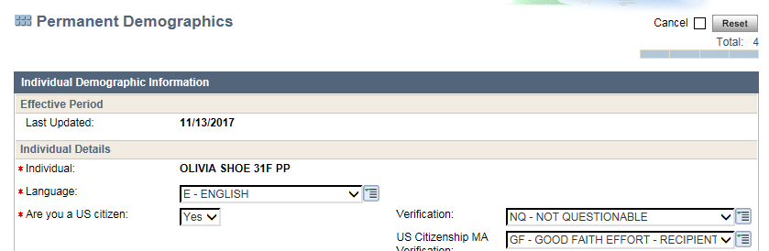
Citizenship and Immigration
FSH 3.12.1
For the FS program, citizenship is not questionable

Slide 22
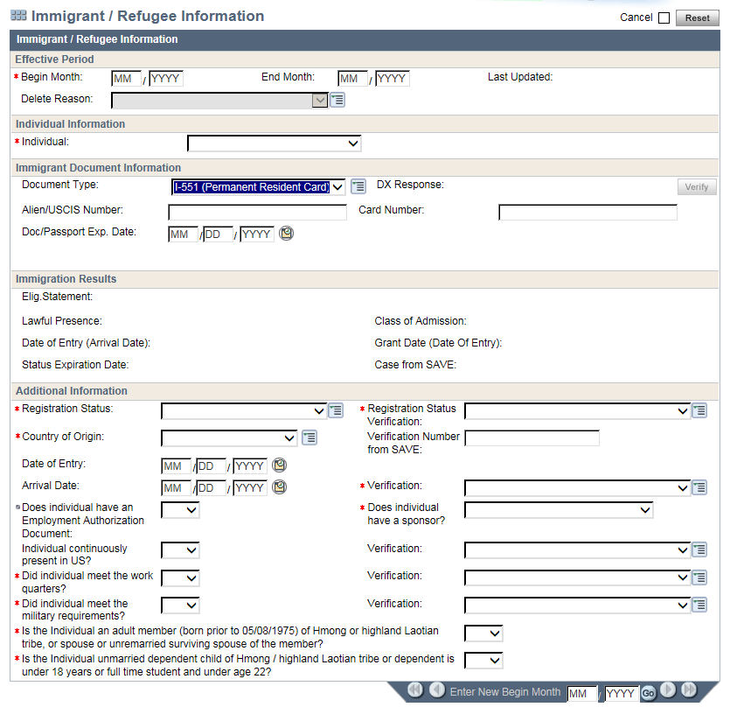
Non-citizens are eligible if they are….
Lawfully admitted permanently and have been here 5+ years
Refugee
Asylee
Cuban / Haitian Entrant
Trafficking victims
***Immigration status must be verified

Slide 23
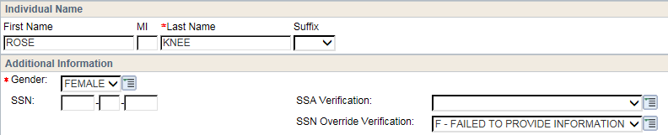
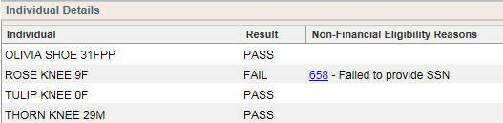
SSN Requirements
SSN must be provided for everyone requesting FS (or proof that SSN has been applied for)
If someone refuses to provide SSN, they will be excluded from the Food group
Exceptions: Newborns and religious reasons

Slide 24

Student Eligibility
Anyone, age 18-49, enrolled half time or more, post secondary education, is ineligible for FS, unless meets one of the criteria listed in FSH 3.15.1
  Here
  Here are a few examples:
    Employed 20 hours per week
    Caring for dependent child under 6
    Participating in work study
    School program designed to be completed in 2 years or less
Note: A student is enrolled as of the 1st day of the school term through normal scheduled class periods unless s/he:
  Graduates
  Drops out
  Doesn't intend to register for the next school term
So, if a student applies for FS in July, they are still ineligible, even though they’re not in school for the summer!

Slide 25
ABAWD
Able Bodied Adults Without Dependents
  Age 18 – 49
  Able to work
  No minor children in the home
  Limited to 3 months of FS benefits in a 3 year period
  Unless meeting a work requirement
    Working, FSET or volunteering 80 hours per month
See FSH 3.17.1.4 for more information

Slide 26
Non – ABAWD
Not limited to the 3 month time limit
Under age 18
Age 50 or older
Pregnant
Unable to work
  Physical, mental, chronic homelessness
Receive or apply for Unemployment
Participate in AODA treatment program (AA / NA not valid)
Eligible student
Primary caretaker of minor
Meet the work requirement through work, or volunteering
Residing in an unemployment exemption county, or the applicant or member is a tribal member living on tribal land that has an unemployment exemption

Slide 27
ABAWD – your responsibility
Client Education
  Your job is to explain ABAWD requirements to every FS applicant, and how it could affect their benefits.
  There is a script available on www.capital-im.com under Consortium procedures.
Case Comment
  Comment that you explained ABAWD rules.

Slide 28

Work registration
At application, we have to look back 30 days. If applicant has voluntarily quit a job, they may be ineligible for FS.
If a current recipient reports voluntarily quitting a job, they also may be ineligible for FS.
1st occurrence: 1 month
2nd occurrence: 3 months
3rd occurrence: 6 months
Exemptions from the Work Registration rules are listed in FSH 3.16.1.3

Slide 29
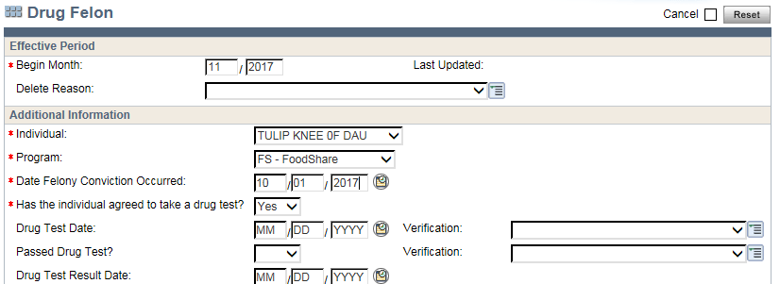
Drug Felon
Drug felony conviction date in last 5 years
Must agree to take a drug test
  We can issue benefits based on them agreeing to take the test. We don’t need to wait for them to take the test.
If they fail the drug test, they are sanctioned, and removed from the food group, for at least 12 months
If they refuse to take a drug test, they are removed from the food group until they agree to take a drug test

Slide 30
Ongoing case maintenance
Once people begin receiving FS, they have to have their eligibility re-determined periodically.
Six months later, recipients must submit a Six Month Report Form (SMRF) to let the agency know of any changes that may have occurred in the last six months.
Six months after that, recipients must complete a renewal – very similar to the intake, complete with interview and verification of income.

Slide 31
What have you learned so far?
You are 50% done! Let’s recap what we’ve learned about non-financial eligibility
  Identity of Primary Person
  WI Residence
  Food Unit / Group / Relationships
  Citizenship and Immigration
  SSN Requirements
  Student Eligibility
  ABAWD
  Work Registration
  Drug Felon
  What’s next?

Slide 32
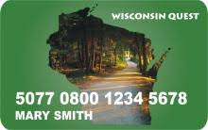

Financial eligibility
Why do we ask about income? Why do we ask about expenses?
As income goes up…..
The amount of FS benefits go down

Slide 33

Financial Eligibility
Prospective budgeting
Earned income
Self employment income
Unearned income
Assets
Deductions
Utility allowance
Deeming

Slide 34
Prospective Budgeting
As closely as possible, estimate the customer’s future income, based on the last 30 days
Pay period frequency
  Weekly
  Bi-weekly
  Semi-monthly
  Monthly
Conversion factor for FS
  Weekly x 4.3
  Bi-weekly x 2.15
  Semi-monthly x 2
  Monthly x 1
Both income and expenses need to be converted for FS

Slide 35
Earned Income
Counted Earned Income
(FSH 4.3.2.1)
Disregarded Earned Income
(FSH 4.3.2.2)
Wages, tips, salaries
Self employment earnings
Selling blood or plasma
Earned income of minor, under parental control, in HS
AmeriCorps / AmeriCorps VISTA
Work study

Slide 36
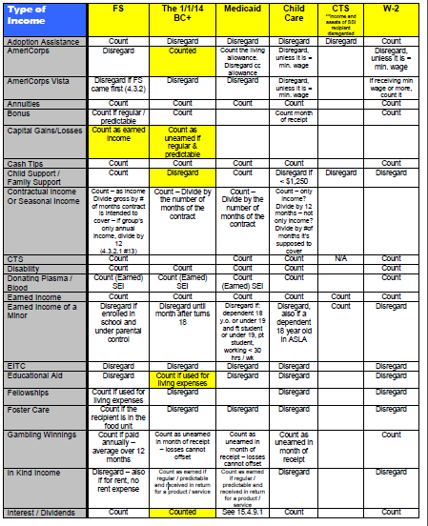
Available on the capital consortium website

Slide 37
Self Employment Income
FSH 4.3.3
Self-employment income is earned directly from one's own business rather than as an employee with a specified salary from an employer.
Self-employment income is reported to the IRS as farm, self-employment, rental, or royalty income.
All self-employment income is earned income, except royalty income and some rental income.
Verify self employment income using federal tax forms, or SEIRFs (Self Employment Income Report Form)
You will receive specific training on self employment

Slide 38
Unearned Income (FSH 4.3.4)
Counted Unearned Income
Disregarded Unearned Income
SSI
Social security (minus any overpayment repayments)
Unemployment
Worker’s Compensation
Disability / pension payments
CTS (Caretaker Supplement)
Child / Family Support
W-2
Kinship Care
Educational aid
Loans to the FS group
Reimbursements for medical or dependent care
Retroactive SSI
SSI-E
Capital gains from sale of personal asset
Some veterans benefits
Some tribal / Native American payments

Slide 39

Assets
The amount of available liquid assets must be reported at the point of initial application to determine eligibility for priority service and expedited issuance.
Assets are disregarded and are not required to be verified

Slide 40
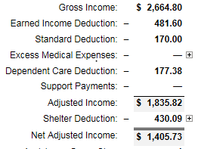
Deductions
Earned income deduction
Standard deduction
Medical expenses
Dependent care deduction
Child support payment
Shelter deduction

Slide 41
Standard Deduction
(8.1.3 FSH gives current amounts)
Group Size | Amount
1-3 People | $157
4 People | $168
5 People | $197
6+ People | $226 Eff 10/1/16
The standard deduction is subtracted from gross income in the FS FoodShare eligibility determination.
The standard deduction varies depending on FS group size

Slide 42
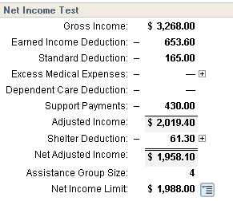
Earned Income Deduction
The earned income deduction is 20% of the gross monthly countable earned income.
This deduction is intended to offset work-related expenses such as taxes and social security withheld from wages.
Example: $3268 of gross earned income * 20% = $653.60 (the amount of the deduction in this budget)

Slide 43
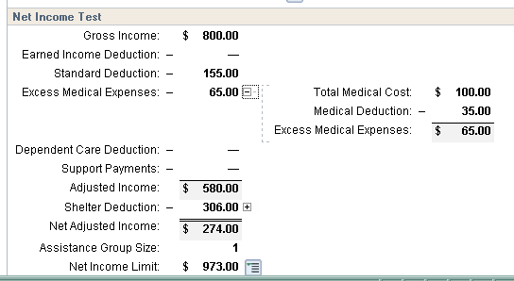
Medical Expenses
4.6.4
The out of pocket medical expense of an elderly (age 60+), blind or disabled group member
The amount spent over $35 per month is deduction
Example of someone with $100 monthly medical expenses
Remember, this is only for group members that are EBD (elderly, blind or disabled). If no one in the household is EBD, this is not a factor.

Slide 44
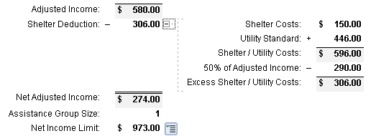
Utility Allowances
(8.1.3 FSH gives current amounts)
NOTE:
Utilities themselves are Not Questionable (NQ), meaning we don’t need to verify them
anyone receiving Energy Assistance in last 12 months (WHEAP or LIHEAP) automatically gets HSUA, but it needs to be verified
Utility Allowance Type | Nickname | Dollar Amount
Heat Standard | HSUA | $457
Limited | LUA | $307
Electric | EUA | $123
Phone | PUA | $29
Water and Sewer | WUA | $81
Cooking Fuel | FUA | $35
Garbage and Trash | TUA | $21

Slide 45
Deeming
When household members are excluded from the FS group due to ineligibility, how we treat their income and expenses depends on the reason for their ineligibility.
Treatment of Income for Food Unit Members that are Ineligible
No Deeming | Pro-Rated Deeming | Gross Deeming
Ineligible Student | Ineligible Immigrants Failed to Provide SSN Used 3 TLB | IPV Drug Felony Sanction

Slide 46
What have you learned so far?
You are 75% done! Let’s recap what we’ve learned about financial eligibility.
  Prospective budgeting
  Earned income
  Self employment income
  Unearned income
  Assets
  Deductions
  Deeming
  What’s next?

Slide 47
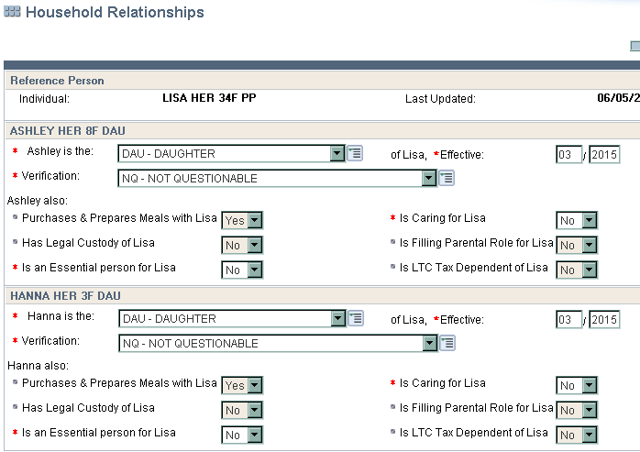
FS in CWW
Household Relationships

Slide 48
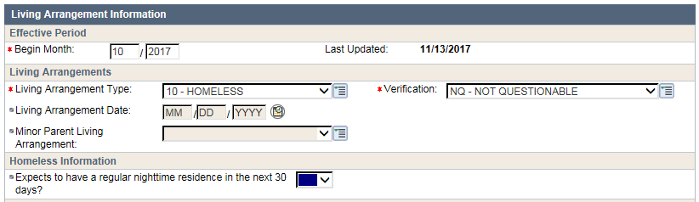
Living arrangement
Remember, homeless groups do not need to verify WI residence
Also, if someone is an ABAWD, we need to ask if they expect to have a regular nighttime residence in the next 30 days. If the answer is NO, they are exempt from the ABAWD rules.

Slide 49
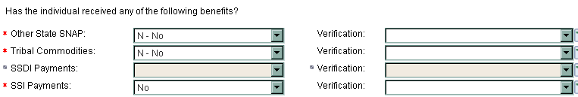
Benefits Received
Other State SNAP

Slide 50
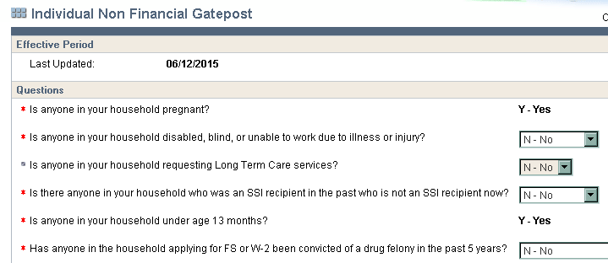
Individual Non Financial
Is anyone pregnant?
Is anyone disabled?
Has anyone been convicted of a drug felony in the past 5 years?

Slide 51
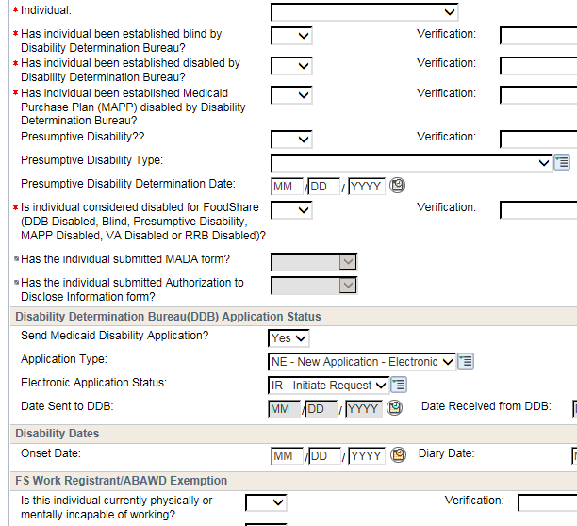
Disability page
Remember, if someone is unable to work, they are exempt from the ABAWD rules.
This can be a permanent or temporary disability. They don’t need a specific disability determination from DDB.
CWW gets that information from the Disability Page.

Slide 52
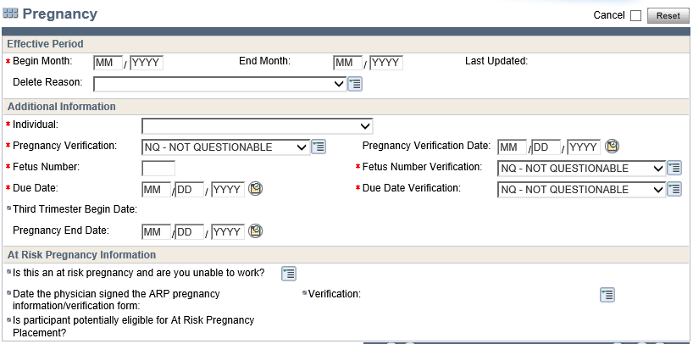
Pregnancy Page
Remember, if someone is pregnant, they are exempt from the ABAWD rules
CWW will update this screen to NQ, but will actually send a verification checklist if needed for Non-Abawd status

Slide 53
What have you learned so far?
You are 100% done! Let’s recap what CWW pages we’ve reviewed.
  Household relationships
  Living Arrangement
  Benefits Received
  Individual Non Financial
  Disability
  Pregnancy
  What’s next?

