Slide 1
Orientation to the Capital Consortium
Updated 10/29/2021

Slide 2
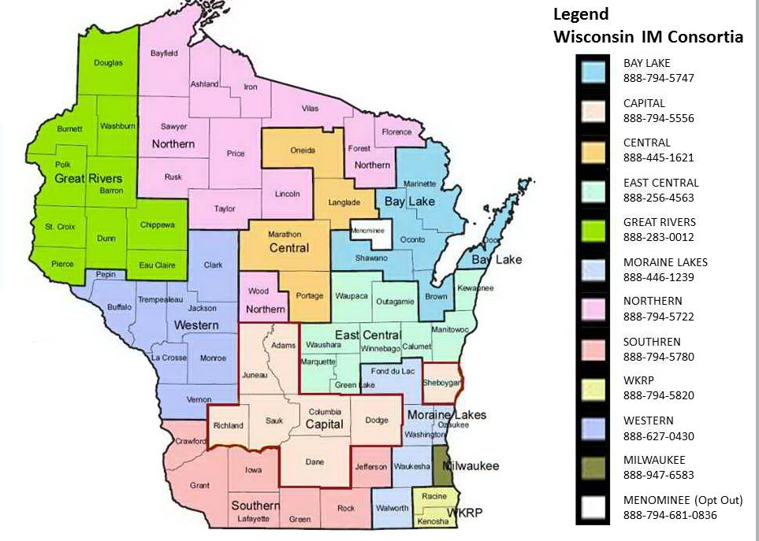
What is the Capital Consortium?

Slide 3
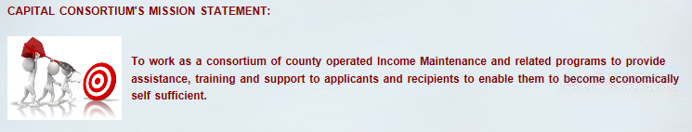
What does a consortium do?
A consortium is a group of counties that cooperate to administer IM programs for all the counties in the consortium
They operate a shared call center
They share some workload across the counties
They are managed by a group of supervisors from all of the counties in the consortium

Slide 4
How the consortium came to be
IM consortiums were formed as part of the State of WI 2011-2013 budget bill.
The consortiums were formed to adapt to changing technology and customer needs, provide better customer service, and provide cost savings to the state and county governments.
Consortiums were formed so that counties were in close proximity to each other, and caseloads would be approximately the same size.

Slide 5
See what can be accomplished when we work together?
Capital is the 2nd biggest consortium in WI (MILES [Milwaukee County] is the biggest)
Total cases in Capital - 83,135
Family cases in Capital - 59,581
Elderly, Blind, Disabled cases in Capital- 23,554
Calls in 2017- Capital answered 283,692 calls
 | Average per month: Calls Received | Average per month: Calls Answered | Average per month: Answer Rate
2017 | 26,981 | 23,641 | 87.71%

Slide 6
County vs. Consortium
While the Consortium strives to share the workload as much as possible, some work needs to be done at the county level.
What needs to be done at the county level?

Slide 7
County tasks
Child Care- applications, renewals, and authorizations need to be done by a worker in the county of residence
Federally Funded Marketplace (FFM) apps(Processed by Dane/Sheboygan only)
Long Term Care Health Care apps
Local duties like- Lobby services-vault cards, Homeless mail, drug testing, Good cause determinations, and other local services
Management/Supervision

Slide 8
Consortium tasks- what we can cooperate on
Call Center Anywhere (CCA)- some queues are county specific, but most calls come through general/EBD and are shared
Workload processing- FoodShare On Demand apps, documents, Six Month Report Forms, renewals, changes, Discrepancies, 10/30 day lists
Training- Training at Consortium Meetings, new worker training over Zoom
Fraud- Sheboygan, Dodge, and Richland do their own Fraud. Other counties share Dane Fraud Dept.
Worker assistance- Help Queue, Problem Resolution Team inbox, Lead coverage for absent workers

Slide 9
How is work assigned?
Individual level- Worker caseloads
Team level- supervisor unit- Team Day
County level- FFMs, CC apps, HC only apps
Consortium level- FSOD, Consortium projects

Slide 10
Who keeps track of all of this?
Your supervisor and lead worker
Workload manager
CCA monitoring team

Slide 11
Tracking at the county level
Local supervisors/leads track their county/unit through the CWW dashboard, CARES alerts, workload report, etc.

Slide 12
Tracking at the consortium level
The workload manager works with the CCA monitoring team to provide adequate staffing levels to the call center, get the workload that is due today completed, and to work ahead on consortium priorities.
Based on call volume, the workload manager will assign out work to be completed instead of being on CCA. Workers are rotated through workload assignments during Team/CCA time.

Slide 13
How are work assignments communicated?
FD/OCL schedule
FSOD assignment emails
Consortium project emails

Slide 14
How do we communicate with each other?
Supervisor meetings
Lead meetings
Weekly unit meetings, Monthly staff meetings, and all Consortium meetings
Daily Workload report
SharePoint/Daily CCA Schedule
Fair Hearing Tracker
Capital Website

Slide 15
Website
Home Page
County pages
Links
Forms
New Trainings calendar
Desk aids
Past Trainings
Consortium Procedures

Slide 16
Website Scavenger Hunt
Go to scavenger hunt:
https://capital-im.com/New%20Worker/Website%20Scavenger%20Hunt.pdf

