Slide 1
PIN LINKING
Best Practices
July 2020

Slide 2
Why do we want to keep the same PIN?
PINs track eligibility history in CARES, overpayments, SSI eligibility, and FS clocks for TLBs
Changing a PIN can cause systems to get out of synch, and information may not be updated accurately
Changing a PIN for the primary person on the case will cause a new EBT card to be issued and may cause other system errors
Child Care authorizations are PIN based
Multiple PINs create multiple MA ID numbers

Slide 3

Good Pin
The good PIN is usually the PIN that was original created, has the most
eligibility history on it, and may
or may not have the SSN
attached to it

Slide 4

Bad Pin
The bad PIN is any subsequent PIN
created after the original one and
usually has the least eligibility
history on it
The bad PIN may or may not
have the SSN assigned to it

Slide 5
Uncleared pin
A temporary PIN usually created before an RFA is processed that has not been cleared
Since these have not been cleared, they cannot be linked
No need to report uncleared PINs

Slide 6
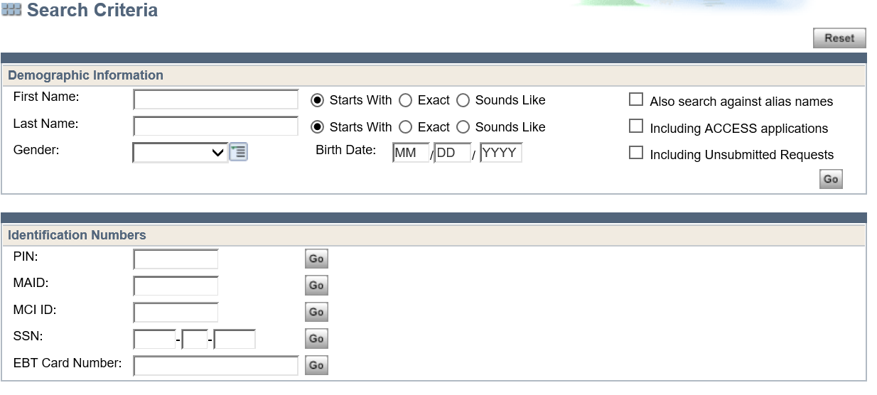
How can we prevent pin issues?
When processing an
application or doing a
person add, search for
the person by name
and SSN first to determine
if the person is
known to CWW

Slide 7
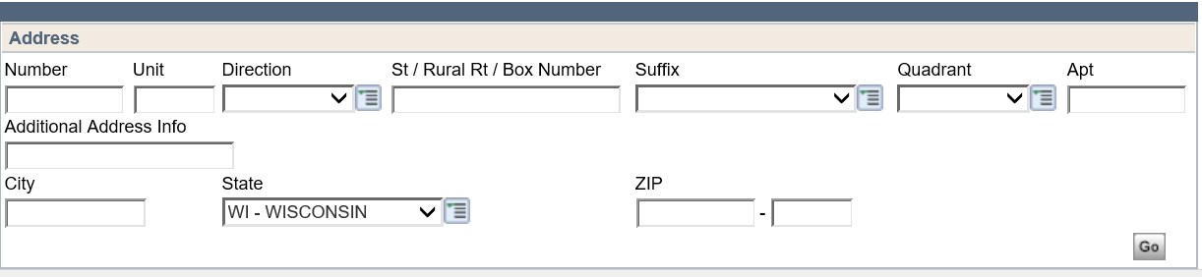
And what else can we do?
When missing information on an application, such as the Social Security Number or Date of Birth:
Do extra research
Can we find the SSN or DOB in CWW or KIDS?
Search the address to possibly find other cases with the person on it

Slide 8
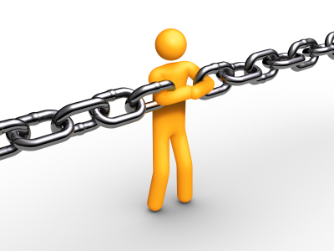
Requesting a pin link
Make sure the correct PIN is on the case:
Determine the good and bad PINs
Delete the individual with the bad PIN completely from the case
Add them back on the case, choosing the individual with the correct PIN at clearance
Email the PRT: Specify which is the good and bad PIN, and include relevant case numbers
PRT will forward the request to the
CARES Call Center for the PINs to be linked

Slide 9
Other things to consider…
When adding an old “good” PIN back to a case, make sure all NON-FINANCIAL AND FINANCIAL INFORMATION is updated on the PIN being added, then request the link
Linking these PINs will update Forward Health
interchange (iC) appropriately
Never delete one individual and add another individual as a one step process
First delete the person completely, then add the
correct person back on the case

Slide 10

And What else may cause issues?
Avoid saving SSNs or names in the alias field on the household members screen in CARES if they are not actual aliases
SSNs may be sent through other interfaces
The wrong SSN may be updated on the employment page
The primary person cannot be deleted from a case, and changing the primary person can have other negative impacts
Always contact the PRT prior to changing the PP on a case

Slide 11



