Slide 1
Quarterly Time Study Guide
Robyn Johnson
Jeremiah Cook

Slide 2
Overview
County receives funding from numerous sources to operate our programs
Time needs to be appropriately applied to the correct programs
Tracking is done through the Quarterly Time study tool on a quarterly basis
Accuracy in quarterly time reporting is vital --could potentially reach the budget limit prior to the end of the year if hours are over-reported in certain areas
Do not round hours when recording time, be specific
Notes:
Let think about where best to put the examples of multiple programs and how to divide it.

Slide 3
 |  |  |  |  |  |  |  |  |  |  |  |  | QUARTERLY TIME STUDY
Period Covered: |  |  |  |  |  |  |  |  |  |  |  |  | Tuesday | Wednesday | Thursday | Total
 |  |  |  |  |  | PROGRAM AREA
IMAA |  |  | 076 | IM Eligibility
 |  |  |  |  | All IM functions related to Food Share and/or Medical Assistance |  |  |  |  |  |  |  |  |  |  | 0.00
 |  |  | 150 | FSET
 |  |  |  |  | FSET Administration
 |  |  |  |  | Providing FSET program information
 |  |  |  |  | Work related to managing clocks and determing exemptions
 |  |  |  |  | FSET referral |  |  |  |  |  |  |  |  |  |  | 0.00
 |  |  | 360 | Marketplace Exchange
 |  |  |  |  | Assisting individuals with the process of enrolling in a Marketplace qualified health plan (QHP) |  |  |  |  |  |  |  |  |  |  | 0.00
 |  |  |  |  | Assisting individuals with Marketplace QHP selection. |  |  |  |  |  |  |  |  |  |  | 0.00
 |  |  |  |  | Completing Certified Application Counselor (CAC) training. |  |  |  |  |  |  |  |  |  |  | 0.00
CC | DCADM |  | 8850 | Child Care | Child Care Administration
 |  |  |  |  | Administrative staff time, monitoring, annual rate survey, all non-fraud overpayment recoveries for client, provider and admin error. |  |  |  |  |  |  |  |  |  |  | 0.00
 |  |  | 8831 |  | Child Care Certification
 |  |  |  |  | All time related to certification of child care providers and provider enforcements (denials, suspensions, revocations). |  |  |  |  |  |  |  |  |  |  | 0.00
 |  |  | 8832 |  | Child Care Eligibility and Authorizations
 |  |  |  |  | Eligibility and authorization activities including processing applications, verifying eligibility, and documenting child care needs. Includes time spent determining parental copayment amounts, entering authorization codes, processing ARFs,and responding to provider questions about ARF reporting, etc. Calculation of non-fraud related Child Care overpayments. |  |  |  |  |  |  |  |  |  |  | 0.00
 |  |  | 8834 |  | Child Care Hearings
 |  |  |  |  | Time spent preparing for or participating in administrative or judicial hearings. |  |  |  |  |  |  |  |  |  |  | 0.00
Prg. Int. |  |  | 58 |  | FoodShare Fraud Prevention and Investigation Reporting
 |  |  |  |  | Includes referral for FPI and fraud investigations, completing a FEV or fraud referral, claculating fraud related overpayments. |  |  |  |  |  |  |  |  |  |  | 0.00
 |  |  | 59 |  | Medical Assistance Fraud Prevention Reporting
 |  |  |  |  | Includes referral for FPI and fraud investigations, completing a FEV or fraud referral, calculating fraud related overpayments. |  |  |  |  |  |  |  |  |  |  | 0.00
 |  |  | 8841 |  | Child Care Fraud - Provider and Client
 |  |  |  |  | Time spent on fraud prevention, investigation, and enforcement. Includes time spent conducting front-end investigations for fraud purposes. Calculation of fraud related Child Care overpayments. Completing a fraud referral. Calculating fraud related overpayments. |  |  |  |  |  |  |  |  |  |  | 0.00
Other |  |  |  |  | Time spent in any program not accounted for in any other category. Please specify. |  |  |  |  |  |  |  |  |  |  | 0.00
Non- | Work | Time |  |  | Vacation, sick, comp time taken and/or leave without pay |  |  |  |  |  |  |  |  |  |  | 0.00
TOTAL |  |  |  |  |  |  |  |  |  |  |  |  | 0.00 | 0.00 | 0.00 | 0.00
(Add picture of quarterly time study form here)
Notes:
Need to add a complete picture. This one is cut off on bottom.

Slide 4
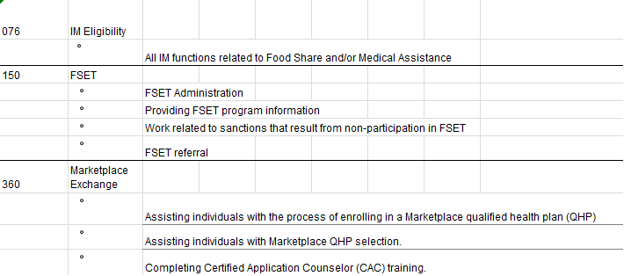
Income Maintenance

Slide 5
Section 1: Income Maintenance
076 IM Eligibility
Most hours should be allotted to this
category
150 FSET
Should be used by IM workers for providing program information and making a referral
Managing clocks, determining exceptions, etc should be under code 076
360 Marketplace
Not used by IM

Slide 6
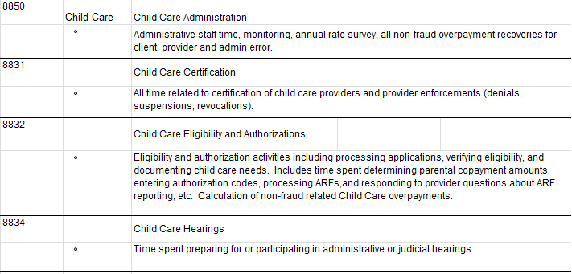
Childcare

Slide 7
Section 2: Childcare
8850 Administration
Use only for non-fraud overpayment recoveries, including BRITS referrals
8831 Certification
Not used by IM staff (Jessie Miller handles this)
8832 Eligibility and Authorizations
Childcare entries in CWW and CSAW
8834 Hearings
Including prep time

Slide 8
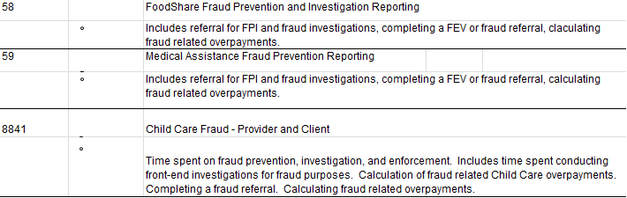
Program Integrity

Slide 9
Section 3: Program Integrity
58 FS Fraud Prevention
Count time used for FS fraud referrals in BRITS and associated time spent researching them
59 MA Fraud Prevention Reporting
Count time used for MA fraud referrals in BRITS and associated time spent researching
8841 Child Care Fraud
Includes completing a fraud referral in BRITS and associated time spent researching
Front End investigation, any activity related to over payment or fraud
**Time spent processing SWICAs belong to IM eligibility program code, not a program integrity code. For example, if you have a SWICA for FS that is non-fraud it would go under code 076, not 58
Notes:
8841 CC Fraud – make sure we include the paragraph from the QTS

Slide 10
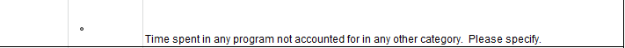
Other

Slide 11
Section 4: Other
Time spent in any other program
Only use this classification if specified by your supervisor
Clerical might use this code if scanning documents for W2

Slide 12
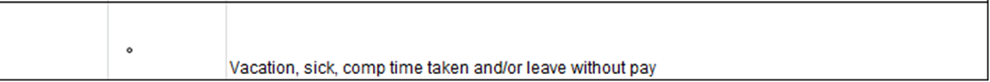
Non Work Time

Slide 13
Section 5: Non Work Time
Vacation, sick, comp time taken and/or leave without pay

Slide 14
Examples
Case involving a child care authorization that also has a SWICA match. (Using the one-touch approach, you work the SWICA as well as adding the authorization)
On your quarterly time report:
Time spent on the authorization:
8832 - Childcare Authorizations
Time spent on the SWICA:
8841- Child Care Fraud, if you suspect fraud
8850 -Child Care Administration, if you suspect it is client or agency error

Slide 15
Client on the phone needing a renewal for Childcare, Healthcare and FS. During the interview, you discover the 21 year old client has the same address as her mother, who is also on FS.
Enter the time spent on HC and FS under code 076-IM Eligibility
Enter the time spent on CC under code 8832-CC Eligibility
Enter the time spent on researching the living arrangement of the two cases under 056- FS Fraud Prevention
Budget the time according to your best estimate for each program involved.

Slide 16
Be Diligent!
Record time accurately to the correct category
Avoid future errors in time reporting throughout the fiscal year
Any ?’s, see your Lead or Supervisor.

Slide 17
Converting Minutes to Decimals on the Quarterly Time Sheet
6 minutes = .1 36 minutes = .6
12 minutes = .2 42 minutes = .7
15 minutes = .25 45 minutes = .75
18 minutes = .3 48 minutes = .8
24 minutes = .4 54 minutes = .9
30 minutes = .5

