Slide 1
SPECIAL STATUS MEDICAID
04/25/19

Slide 2
Course Objectives
To be able to identify when a case is a Special Status Medicaid case.
To understand the differences between 503, DAC and Widow/Widower cases.
To be able to set up the Prior SSI Screen.
To be able to calculate income disregards and enter them on the UI screens.

Slide 3
What is a Special Status MA Case?
A Special Status MA Case is a case where:
The client was on SSI but lost SSI at some point.
The client meets certain conditions regarding how SSI was lost.
Depending on what conditions are met, the client may qualify for certain income disregards.

Slide 4
What’s the big deal about Special Status Medicaid?
Because persons who qualify as a special-status Medicaid case are eligible for certain income disregards, they may not be found eligible for programs they are entitled to with the IM agency if the Prior SSI page is not completed in CWW and the income disregards not entered on the UI screens.
As a result, some clients go without MSP and/or Medicaid because these screens were omitted or filled out incorrectly.

Slide 5
The Key to the Three: Prior SSI
All three types of Special Status Medicaid have this in common:
They all received SSI payments and lost them at some point.
When an ESS worker becomes aware that a client has lost SSI on a case known to CWW, the worker should create a new Prior SSI Page.

Slide 6
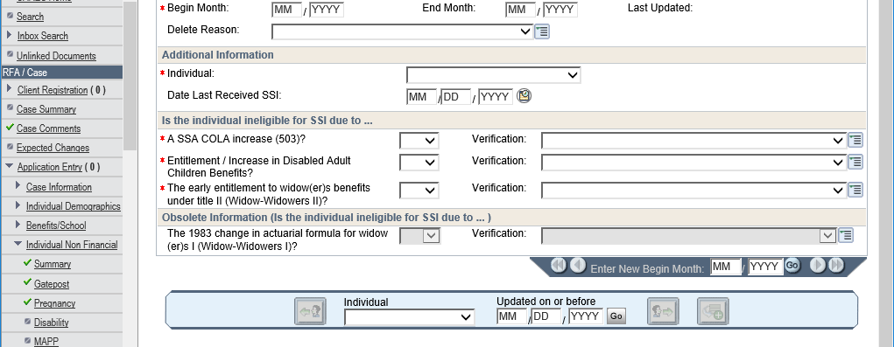
THE PRIOR SSI SCREEN
a.k.a.: Where the magic starts

Slide 7
Finding the date SSI was lost
The next step in this process is identifying when the SSI payment was lost.
Use Data Exchanges (Forward Health, SOLQ) to find the last month a regular monthly SSI payment was made.
If unable to determine the date on DE, contact SSA.
Enter this month and year in the “Date Last Received SSI” field.
Next, we test to see if the client met the criteria for any of the special status Medicaid categories.

Slide 8

What are the 3 categories of Special Status Medicaid?
DAC
Widow/Widower
503

Slide 9

Disabled Adult Child (DAC) Cases

Slide 10
What’s a DAC?
An adult disabled before the age of 22 may qualify for ‘Adult Child’ benefits with Social Security.
This is considered a ‘child’s’ benefit because it’s paid on a parent’s Social Security earnings record.
To qualify for this benefit, one of the disabled adult’s parents:
Must be receiving Social Security retirement or disability benefits; or
Must have died and have worked enough to qualify for Social Security

Slide 11
DAC’s Continued
For eligibility purposes, all of the following must be true for a client to be considered a DAC and be eligible for an unearned income disregard:
The client must have been at least 18 years old at the time SSI was lost
Must have been classified by SSA as disabled before the age of 22.
Received an OASDI payment based on the earnings of a parent who is disabled, retired or deceased.
Must have lost the SSI payment due to the OASDI payment, or increase in said payment.

Slide 12
DAC’s Continued, Again
If all three criteria from the previous slide are met, the client is entitled to an income disregard equal to the amount of the payment or the amount of the increase in the payment that caused them to lose SSI eligibility.

Slide 13
Hey, what about an example!
Harold was determined disabled from birth by the DDB. When he turned 27 this April, his father retired, making Harold eligible for an SSDC Payment of $1300. Then in May, Harold lost his SSI eligibility due to the SSDC payment he became eligible for.
Harold’s entire SSDC payment of $1300 will be disregarded for the purposes of eligibility for MSP and MA.

Slide 14
Hey, what about an(other) example!
Maude was determined disabled at age 21. She became eligible for an SSI payment of $200 and an SSDC payment of $540 at that time, due to her mother collecting disability payments of her own. Then, 10 years later, Maude’s mother dies, and as a result Maude’s SSDC payment increases to $1000, making her ineligible for further SSI payments.
Maude is eligible for an income disregard of $460, the amount of the increase that made her ineligible for SSI.

Slide 15
That’s great. But what does that have to do with what I put into CWW?
On the Prior SSI page, mark the “Entitlement/increase in disabled adult children benefits” as ‘yes’.
Mark ‘verification’ as DE.

Slide 16
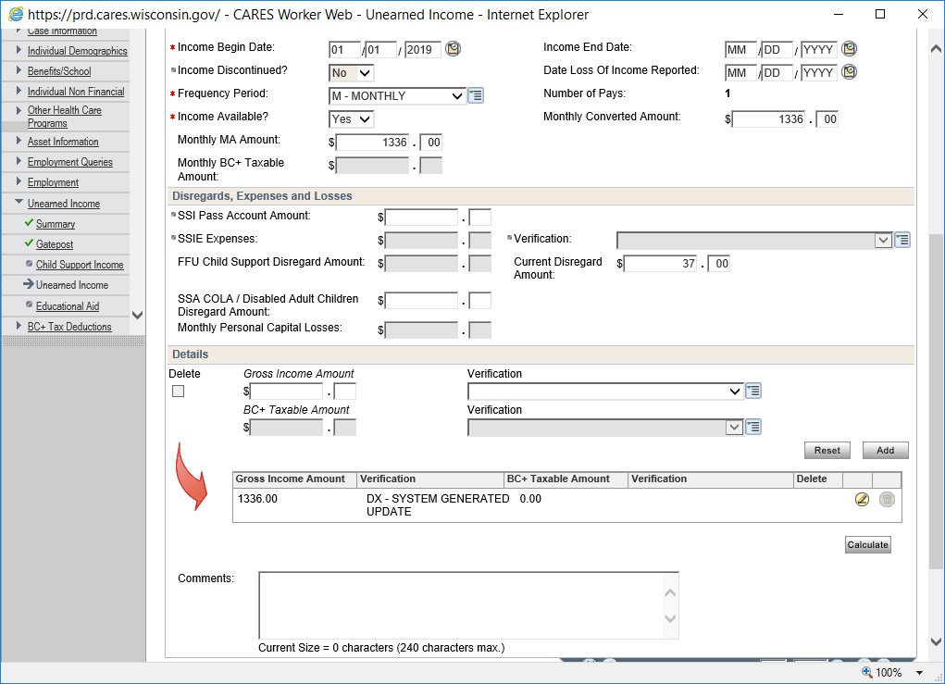
Anything else I need to do?
Enter the amount of the income disregard on the UI screen for the SSDC page in the SSA COLA / Disabled Adult Children Disregard Amount field as shown on the right.
Note that the disregard will not work if you have not entered a prior SSI page with ‘DAC’ checked ‘yes’.

Slide 17
What’s with that other field in white to the right? It says disregard, too!
This field is normally where SSA puts in the disregards for cases prior to when the system is adjusted in March for the new COLA’s to FPL’s.
It is usually auto-populated and can be left alone.

Slide 18
And the field that says “SSIE”?
*Sigh* This is going to be a long training, isn’t it.
This is a separate field not related to this presentation. It should only be entered for income type SSIE, and the amount is usually $95.99.

Slide 19
An Important Disclaimer for MAPP
Note that the disregards for Special Status cases do not apply to the MAPP program. If you have a special status case that applies for MAPP, you will have to remove the income disregards and case comment why you did so.

Slide 20

Widow/Widower Cases
How to determine them, how to enter them.

Slide 21
Okay, I know what a widow is. What’s it mean in the context of this training?
A Widow/Widower meets the following conditions:
Is considered elderly, blind, or disabled.
Is at least 50 years old.
Is receiving OASDI payments as a widow or widower (SSWW)
Received SSI or State SSI in the month preceding the month in which they started receiving SSWW.
Became ineligible for SSI due to the receipt of SSWW.
Would be eligible for SSI except for the receipt of SSWW.
Is not entitled to Medicare Part A.

Slide 22
That’s a lot of stuff. How often does this happen in practice?
Not often. The last condition, not being eligible for Medicare Part A, eliminates a lot of potential cases from the running.
Note that you may need to contact Social Security to determine when a case lost eligibility for SSI, and that they lost SSI directly because of their Widow/Widower benefit. But only do so if the client does not receive Medicare Part A.

Slide 23
I found a Widow/Widower case! Now what?
Mark the third box yes.
Mark verification as DE.

Slide 24
I think I know where this is going….
Enter the entire amount of the OASDI payments, much the same way as we did for the DAC example.

Slide 25
503 Cases
Are we done yet?

Slide 26
The Dirty Low Down on 503’s
The client was receiving any OASDI benefits (SSDI/SSRE/SSDC/SSWW/etc.)
The client was receiving SSI concurrently with OASDI but became ineligible for SSI for any reason.
The client is still receiving an OASDI payment
If the answer is yes to all three of these, the client is eligible for a Cost of Living Adjustment (COLA) to their income.

Slide 27
Calculating the COLA Disregard
Find the assistance group’s current gross OASDI income.
Include in this amount any Medicare premiums withheld for part A or Part B, unless the State is paying for these premiums through Medicare Premium Assistance.
Identify the last month the person was eligible for both OASDI payments and SSI payments, again using Data Exchanges or an award letter, or the local SSA office.
On the COLA Disregard Amount table (MEH 39.6) find the decimal figure that applies to this month.
Multiply the Gross OASDI payment by the decimal figure from 39.6.

Slide 28
You’re really starting to give me a headache.
Oh that’s nothing! To make matters worse, a case may be eligible for both a DAC income disregard and a COLA disregard if all requisite conditions apply.

Slide 29
An example of a 503
Newby's current gross OASDI income is $860. He is not currently receiving SSI benefits. The last month in which he was eligible for both OASDI and SSI and received benefits from both was April 2013. On the COLA Disregard Amount Table (see Section 39.6 Cost-of-Living Adjustment), April 2013 falls between January–December 2013.
The decimal figure that applies to April 2013 is 0.031247. Multiply 0.031247 by $860 to find Newby's COLA disregard amount of $26.87. Subtract the $26.87 disregard amount from the $860 OASDI. Newby’s income is then $833.13. This amount is below the EBD income limit of $854, which makes him eligible.

Slide 30
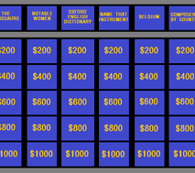
QUIZ

Slide 31
Question One
James Marsters is 38 years old and receives an SSDI payment of $1100. He was receiving SSI but lost it in May 2016 due to his accumulated assets being over the federal limit. He also receives SSDI in the month of May 2016. James receives Medicare Part A and B.
Is James a Special Status case?
Yes.
What status is he eligible for?
503
What needs to be done first?
Enter a prior SSI page.
What disregard is James eligible for?
A COLA disregard.

Slide 32
Question Two
Lawrence Fishburne is 65 years old. Lawrence receives Medicare Part A and B. He lost his wife 2 years ago and began receiving SSWW payments. As a result he lost his SSI payment.
Is Lawrence a Special Status case?
Yes.
What status is he eligible for?
503
Why isn’t Lawrence a Widow/Widower case?
He receives Medicare Part A.
What disregard is Lawrence eligible for?
A COLA disregard.

Slide 33
Question Three
Keanu is 40 years old, determined disabled when he was 16. 3 years ago his father died, increasing his SSDC payment from $800 to $1200. As a result of the increase, he lost his SSI.
Is Keanu a Special Status case?
Yes.
What status is he eligible for?
DAC
What is the amount of the disregard?
$400
Are there any other disregards Keanu is eligible for?
A COLA disregard.

