Slide 1

Social Security Benefits and Deductibles
By Jackie Benford

Slide 2

Social Security Income
There are different types of disability benefits:
SSDI - Social Security Disability / Wage Earner
SSDC – Social Security Disabled Child
SSWW – Social Security Widow(er) / Spouse
SSRE - Social Security Retirement
SSSP - Social Security Spouse
SSSC - Social Security Surviving Child
SSI – Federal Supplement Security Income
SSIS – State Supplemental Security Income
SSIE – State Supplement Income Exceptional

Slide 3

DEDUCTIBLES
24.2 Medicaid Deductible Introduction
24.3 Deductible Period
24.4 Choosing Not to Have a Deductible

Slide 4
24.2 Medicaid Deductible Introduction
When a Medicaid applicant (A person who has submitted a request for coverage for whom no decision has been made regarding eligibility) is ineligible for Medicaid solely because he or she has income that exceeds the Medicaid medically needy income limit, he or she can become eligible by meeting the Medicaid deductible. "Meeting the Medicaid deductible" means incurring medical costs that equal the dollar amount of the deductible.
The Medicaid deductible is the group's total excess monthly income over the 6 consecutive months of the Medicaid deductible period (See 24.3 Deductible Period).
"Excess monthly income" is the amount which is above the group's monthly medically needy income limit.
AGMD/AGMI PH 19

Slide 5
24.3 Deductible Period
The Medicaid deductible period is a period of six consecutive months. It is the length of time the group has for meeting the Medicaid deductible. It begins in the month which the applicant chooses, and it ends six months later. See 5.9.5 Eligibility for an exception to the 6 month deductible period for backdate periods after a formal disability (The law defines disability for Medicaid as "The inability to engage in any substantial gainful activity (SGA) by reason of any medically determinable physical or mental impairment(s) which can be expected to result in death or which has lasted or can be expected to last for a continuous period of not less than 12 months.) determination has been made for a member A recipient of Medicaid; formerly referred to as a "client." certified under a PD.
5.9.5 Eligibility - Medicaid coverage based on a presumptive disability determination begins on the date the individual is found presumptively disabled, as indicated by DDB or the receipt of written attestation from a medical profession. If the presumptive disability determination is made by the IM worker, Medicaid coverage should begin the date the complete Medicaid Presumptive Disability form (F-10130) was received by the agency, as long as all other eligibility requirements are met. The effective date should not be delayed based on the date the worker takes action to confirm the case.

Slide 6
24.4 Choosing Not to Have a Deductible
An applicant who is ineligible for excess income in some backdate months, but has no excess income in others, does not have to choose to have a Medicaid deductible. He or she can choose to be certified in the months he or she is eligible and to accept the ineligibility of the other months where he or she has excess income.

Slide 7

EXAMPLE #1
Horace applies for Medicaid in July. He has no income and does not expect any income in the future. He is financially eligible in July. He also wants Medicaid eligibility for April to cover some medical expenses he had in April. In April he would have been eligible because he had no income or assets. But in May and June he had excess income of $20 each month. He has 2 choices:
  Choose a Medicaid deductible period of April through September. After meeting the Medicaid deductible of $40 he would be certified for Medicaid from April through September.
  Not choose a Medicaid deductible period. He would not have to meet a Medicaid deductible. He could be certified immediately for April and July. But he would have to forego Medicaid for May and June because of the excess income in May and June.
  If the applicant has excess income in the month of application, but no excess income in the 3 months prior to the month of application, he or she does not have to include them in a deductible period. He or she can be certified for them immediately, and can begin the Medicaid deductible period with the month of application.

Slide 8

EXAMPLE #2
Roslyn applies for Medicaid in July. She is ineligible because she has excess income. She had no income in April, May, or June. She can be certified immediately for April, May, and June. She begins her Medicaid deductible period in July.

Slide 9
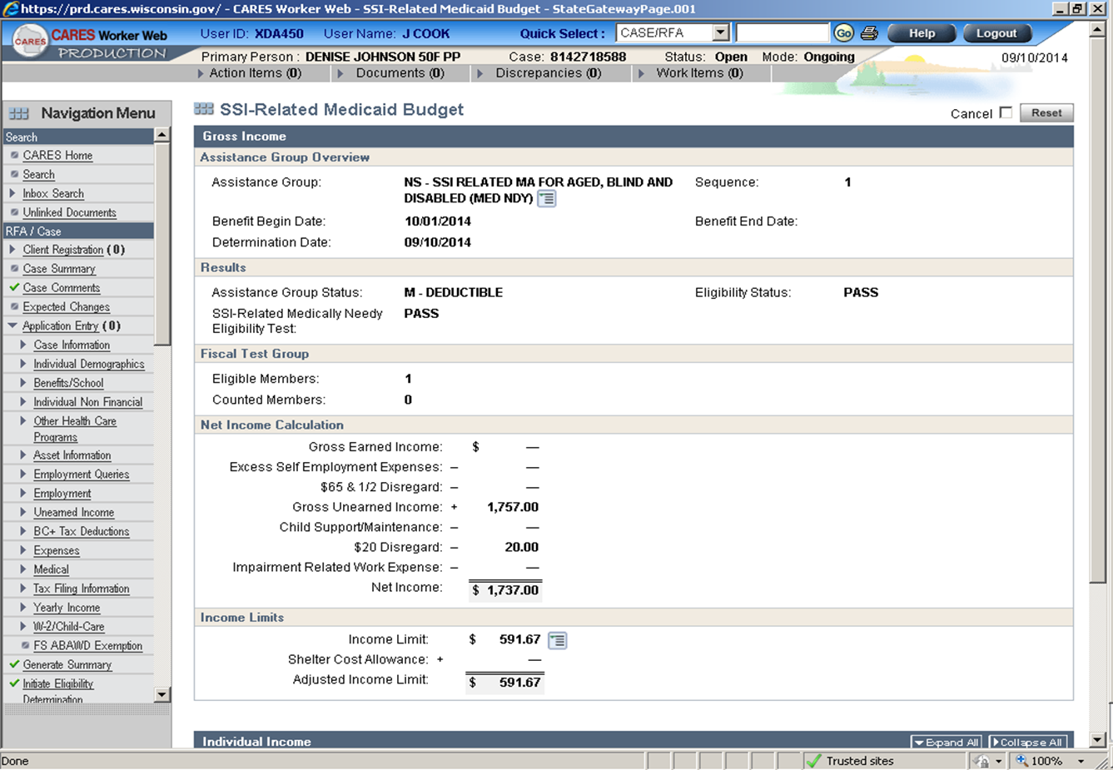
NS Budget Screen

Slide 10
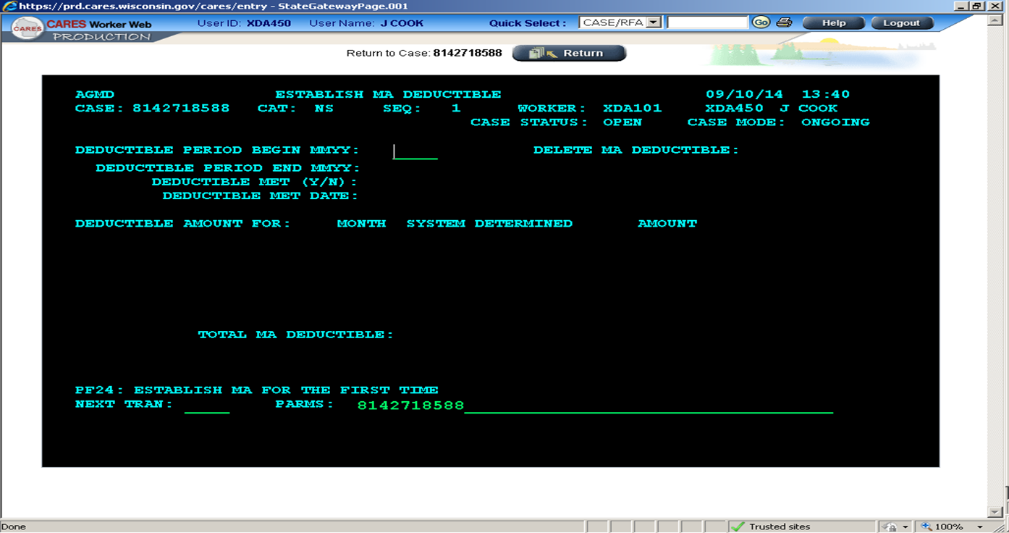
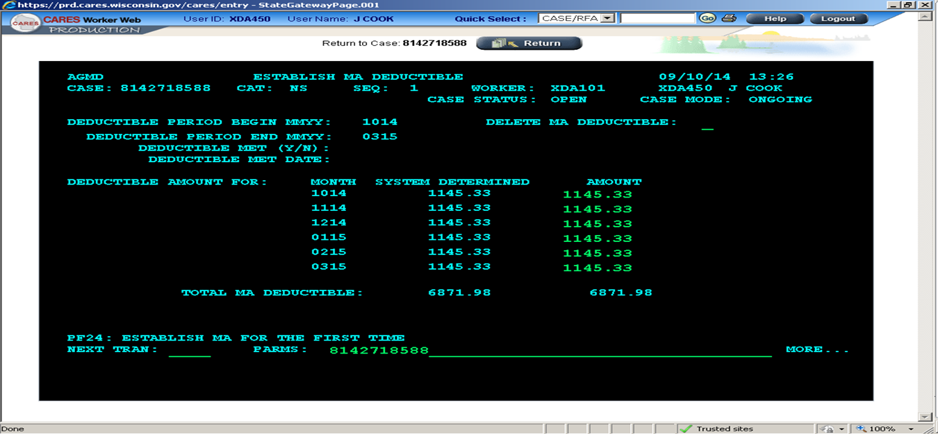
Example of Entering Deductible

Slide 11
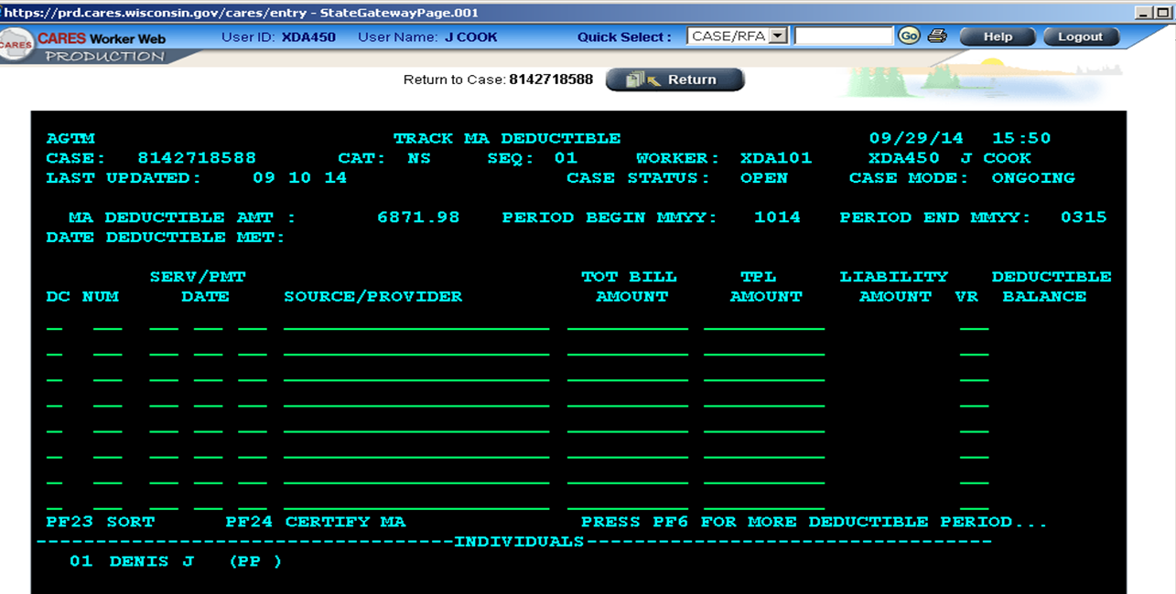
Continued…

Slide 12

AVS
Means Automated Verification System.
You will get the following responses:
  Initial AVS response – No data return
  Additional AVS Response
  AVS Request Failed – Incorrect VCL Sent

Slide 13

ANY QUESTIONS?

