Slide 1
BadgerCare Plus
Suspension vs Termination for Inmates
Overview of New Policy Starting 10.24.2020

Slide 2
Background
Under federal law, BadgerCare Plus and Medicaid may not pay for health services provided to incarcerated individuals, with the exception of someone who is outside of prison or jail for 24 hours or more (e.g., when admitted as an inpatient to a hospital).
Given this restriction, BadgerCare Plus and Medicaid have had a longstanding policy of terminating eligibility when someone is incarcerated and requiring a new application upon release.

Slide 3
Suspension of Eligibility
Provisions in the federal SUPPORT Act require states to “suspend” instead of terminate Medicaid eligibility for juveniles and Former Foster Care Youth who are incarcerated.
Effective October 24, 2020, DHS plans to suspend instead of terminate BadgerCare Plus, SSI-related Medicaid, and Well Woman Medicaid eligibility for any inmate, regardless of age.
DHS is also developing a data exchange with DOC to support a more streamlined process to suspend and reinstate eligibility for people incarcerated in DOC facilities.

Slide 4
Goals
Improve health outcomes for offenders who are released into the community. A report from DHS states that ensuring health coverage for individuals leaving jail can help to reduce homelessness and reduce barriers to employment.
Comply with federal requirements, specifically those in the federal SUPPORT Act
Simplify processes for individuals, IM agencies, and institutions

Slide 5
New Process Overview
When information becomes known to the IM agency, their eligibility will be suspended, or put “on hold”.
  For DOC inmates, we expect to receive this information automatically via data exchange.
  For inmates of local jails, we will continue to rely on direct reporting from members or jails.
During the time they have suspended benefits, BadgerCare Plus/Medicaid will only cover services received while the member is outside of jail or prison for 24 hours or more.

Slide 6
New Process Overview
Some forms of Medicaid will end because incarceration prevents the member from meeting basic program requirements. For example:
  MAPP
  Long-Term Care programs
Prior to disenrolling a member due to incarceration, CARES will look to see if the member is eligible for a form of BadgerCare Plus or Medicaid that can be suspended.

Slide 7
New Process Overview
Eligible members are subject to change reporting rules.
They are also required to complete an annual renewal, if it occurs while they are incarcerated, in order to maintain their benefits.
  In most cases, this will be an administrative renewal, which requires them to review information but not take action.
  There is no limit to how long someone’s benefits can be on hold, as long as they continue to meet program rules.

Slide 8
New Process Overview
Individuals whose health care is suspended are still considered eligible members with open cases.
  If they are part of a family enrolled in BadgerCare Plus or Medicaid, they can stay on the same case and be considered to be “temporarily absent” from the home.
  This temporary absence can last as long as the person is incarcerated. There is no time limit while the person is incarcerated.
  Members will be asked to indicate if the incarcerated individual is still part of the household so that workers know if they need to be kept or removed from the case.

Slide 9
Huber and Pregnant Women
Huber Law-Inmates released on Huber to care for family members are still eligible for full benefit BCP/Medicaid. Huber for any other reason will be eligible for suspended benefits.
Pregnant Inmates-still eligible for full benefit BCP. When pregnancy ends, may enter suspended BCP.

Slide 10
Three Month Grace Period
If the incarcerated member is the primary person on the case with no spouse or coparent in the household, and there are children receiving BadgerCare, the children will remain eligible for BCP for a three month grace period on the parent’s case.
This grace period will end before the three months if they open for health care on another case.

Slide 11
New Applications
New applications received after the project implementation from people who are already incarcerated may go right into a suspension if they are eligible.
  Example: Aaron is incarcerated and submits a new application on October 26, 2020. Aaron is eligible for suspended BadgerCare Plus starting October 1, 2020.

Slide 12
Existing Members
When an incarceration is reported for an existing member, the suspension will start the first of the month following the month in which the living arrangement change is processed in CWW.
Example: Olivia is open for full-benefit BadgerCare Plus. On October 26, 2020, IM receives a report that Olivia is incarcerated. The worker processes the change. Olivia’s BadgerCare Plus is suspended starting November 1, 2020.
Workers will need to run with dates if it is after adverse action in order to start the suspension the next month.

Slide 13
Existing Members
When an existing member moves into or out of a suspension, their renewal date remains the same.
For the first data exchange with DOC after implementation, we anticipate that IM may see a higher volume of members who are incarcerated in a DOC facility due to these members not previously reporting their incarceration to IM.

Slide 14
Redetermining Eligibility at Release
When someone is released and this information becomes known to the IM agency, eligibility can be reinstated without a new application for benefits.
  For DOC inmates, we expect to receive this information automatically via data exchange.
  For inmates of jails, we will continue to rely on direct reporting from members or jails.

Slide 15
Redetermining Eligibility at Release
If the member continues to be eligible, full benefits are reinstated the first of the month in which the member is released.
  Example: Cameron is incarcerated and enrolled in suspended BadgerCare Plus. Cameron is released on December 15. Cameron’s full benefit BadgerCare Plus starts December 1.

Slide 16
Impacts to IM Workers
The pre-release telephonic application process that is currently used will still exist. Inmates who are not enrolled in suspended health care benefits during their incarceration may use this telephonic application process to apply for health care prior to their release.
CARES will continue to receive Prisoner Match Data from SSA.
Worker will receive alert to run eligibility when release date is near.

Slide 17
CWW Changes
There will be changes to and pages generated on the Current Demographics screen when someone is coded as 26 Living Arrangement.
Pages will be generated regarding Huber or Jail/Prison information based on responses.
You will be asked to enter a release date if known.

Slide 18
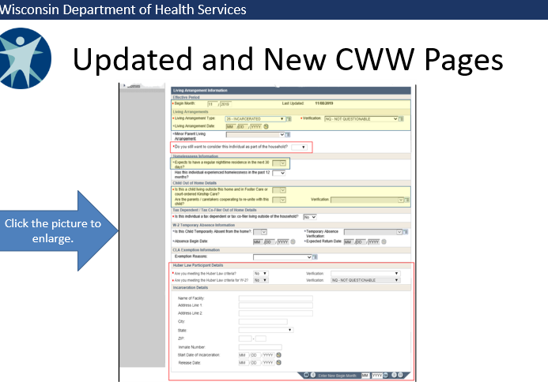
Current Demo Screen

Slide 19
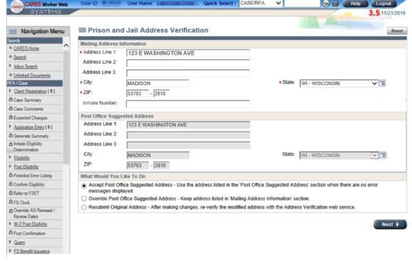
New Jail Address Screen

Slide 20
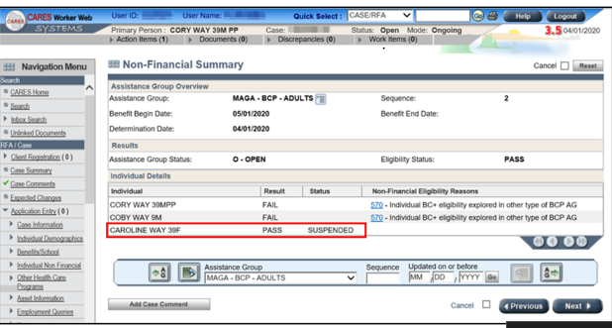
Non Financial Summary Page

Slide 21
Member Communications
The Notice of Decision will clearly state if a member is open for suspended BadgerCare Plus or Medicaid. It will also include information about what it means for the member to have their benefits “on hold.”
An informational letter will be sent to the incarcerated member at their jail or prison address if known. This letter will explain what it means for the member to have their benefits “on hold.”
A letter will also be generated close to the inmate’s release date with information on what to do next (call FH for a new card? Call HMO Enrollment? Apply for FS when they are out)

Slide 22
Questions?
Available Resources:
  Operations Memo 20-24
  DHS Training “Suspension of Health Care During Incarceration”
  Process Help-3.19 and 9.8

