Slide 1

THE KIDS SYSTEM
How to use the KIDS system to assist in Economic Support case work

Slide 2
Table of Contents
Page
3) Signing in to KIDS 34) List Check/EFT Details
6) Warning 35) Finding who is included in a case
7) Finding an individual/Main Menu 44) Finding a case worker
8) Inquiry Functions Menu
9) Participant Inquiry Submenu
10) Participant/Case Search
11) List Participants
12) Participant details/Inquire Participant
13) List Participant Address
14)Inquire Participant Address
15)Inquire Address Notes
16) List Participant Income/Employment
17) Finding a case/Case Inquiry Submenu
18) List Participant Cases
19) Event Search Options
20) List Events: View Option 1
21) List Noncooperation
23) Financial Inquiry Submenu
25) IV-D Case Account Statement
26) Select Case Subaccount
27) Display Subaccount Detail
28) CARES child support income screens/CARES Support Obligations/Payments
29) Budgeting Child Paid to the Household
30) CARES Child Support Income

Slide 3
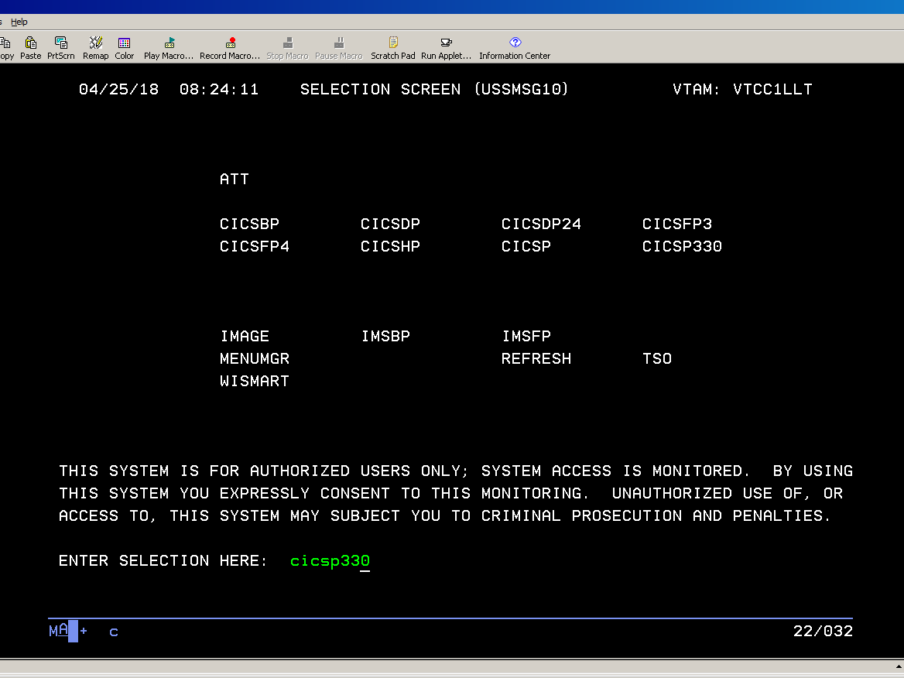
This is the mainframe sign-in screen with the code in green

Slide 4
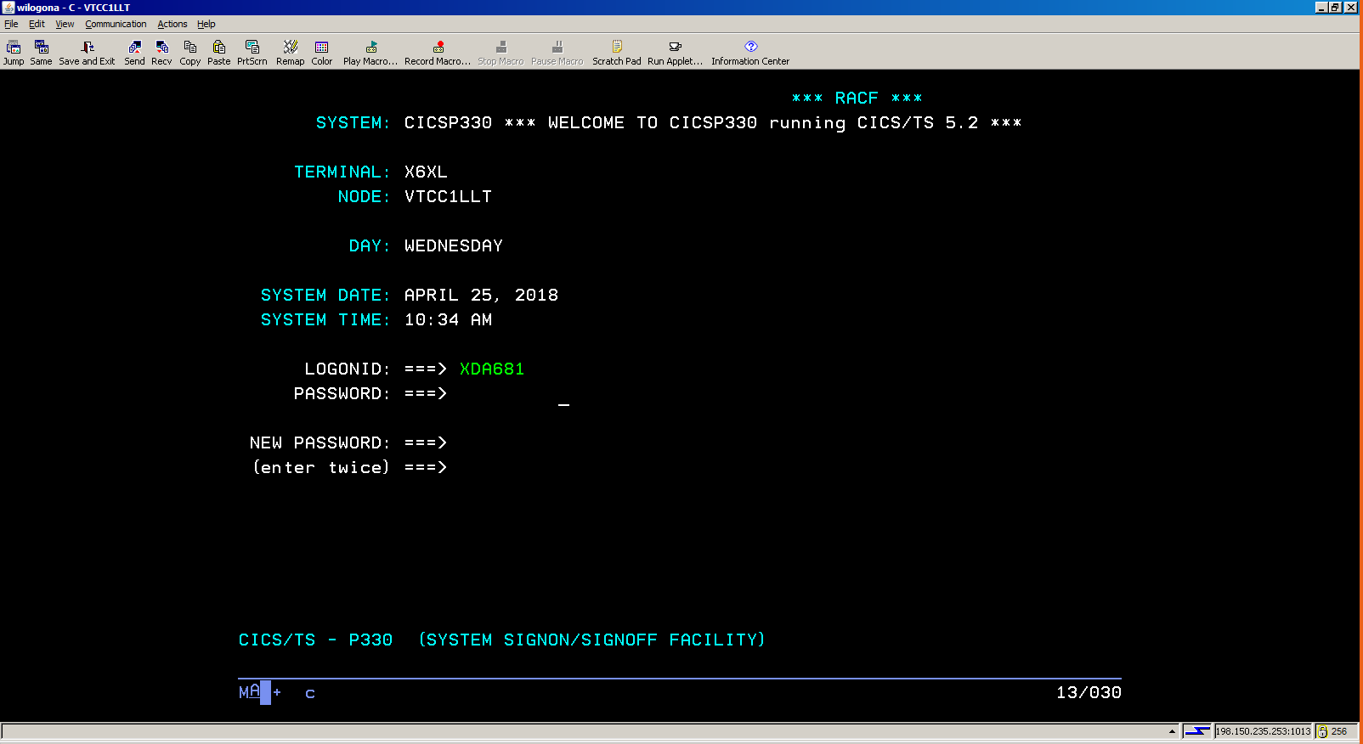
The sign-in screen
Enter your worker ID and your HOD password , then hit enter

Slide 5
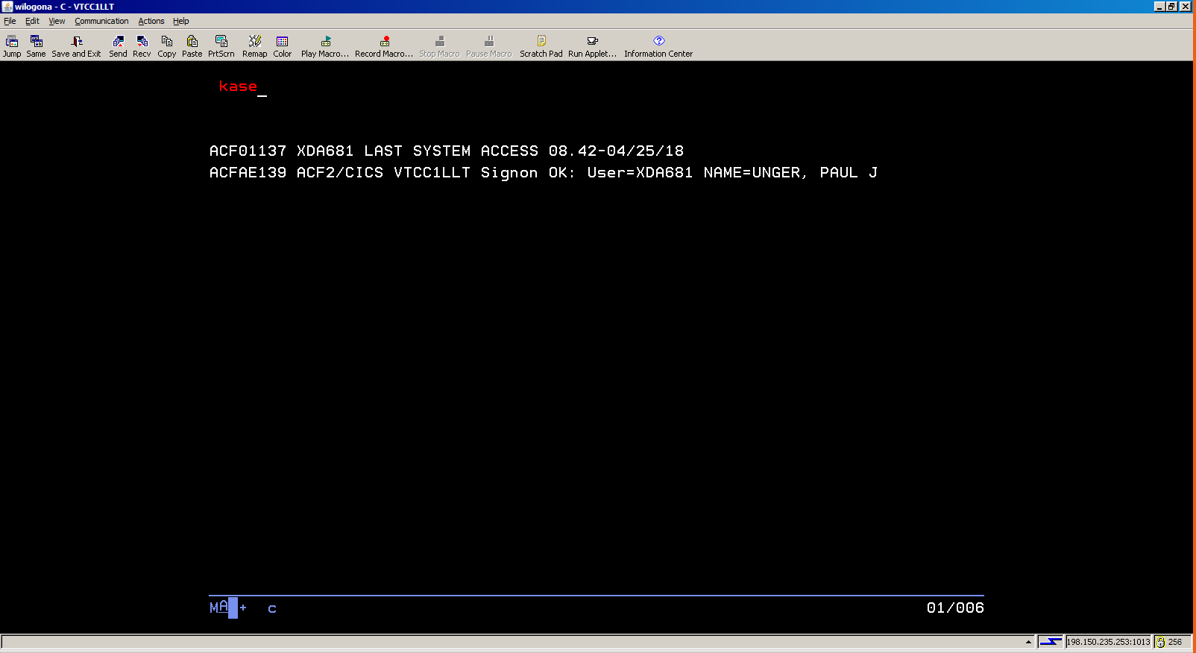
Type kase and hit enter

Slide 6
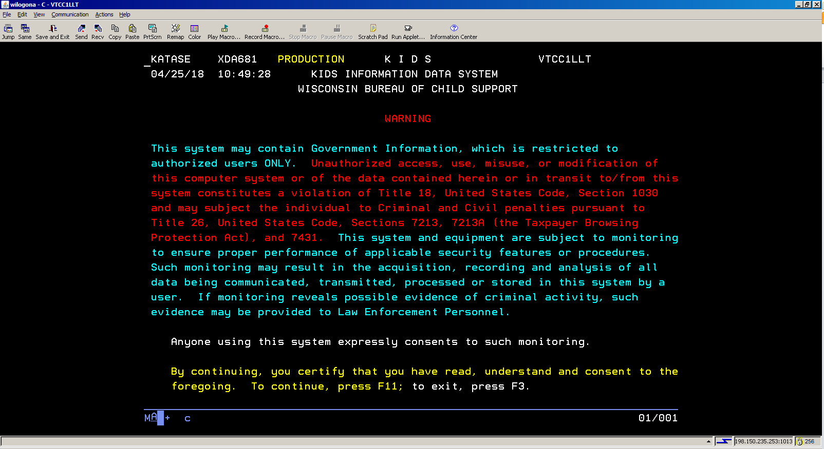
Warning
Hit F11 on the top of your keyboard to leave this screen

Slide 7
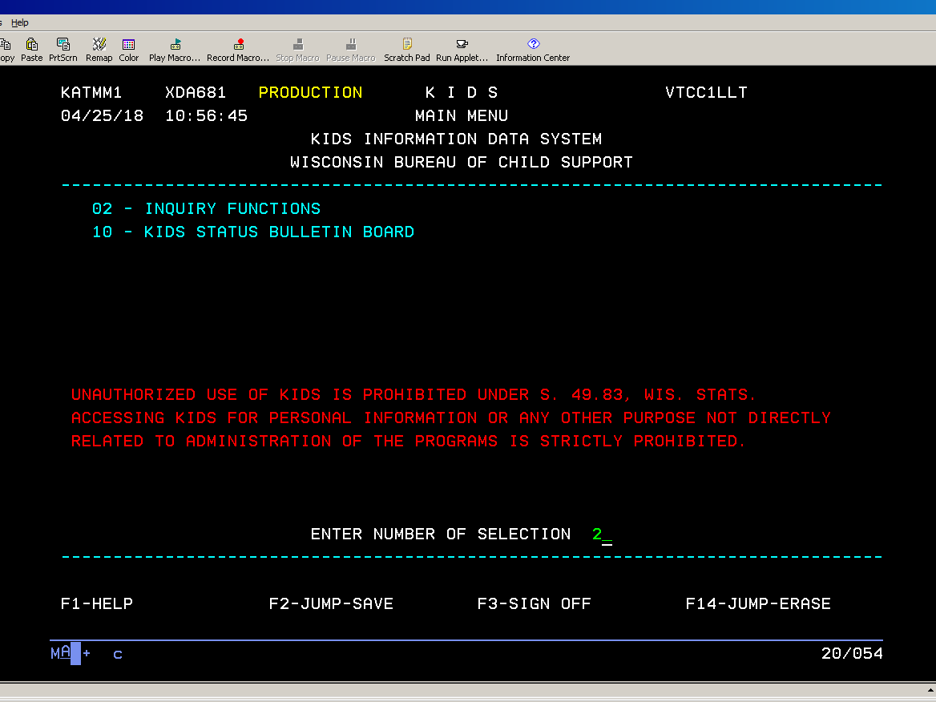
Finding an individual
This is the initial search screen. Enter 2 in the selection line and hit enter. Please note that 10 does not concern ESS, and is also essentially a dead link. One can return to this screen from any KIDS screen by selecting F3.

Slide 8
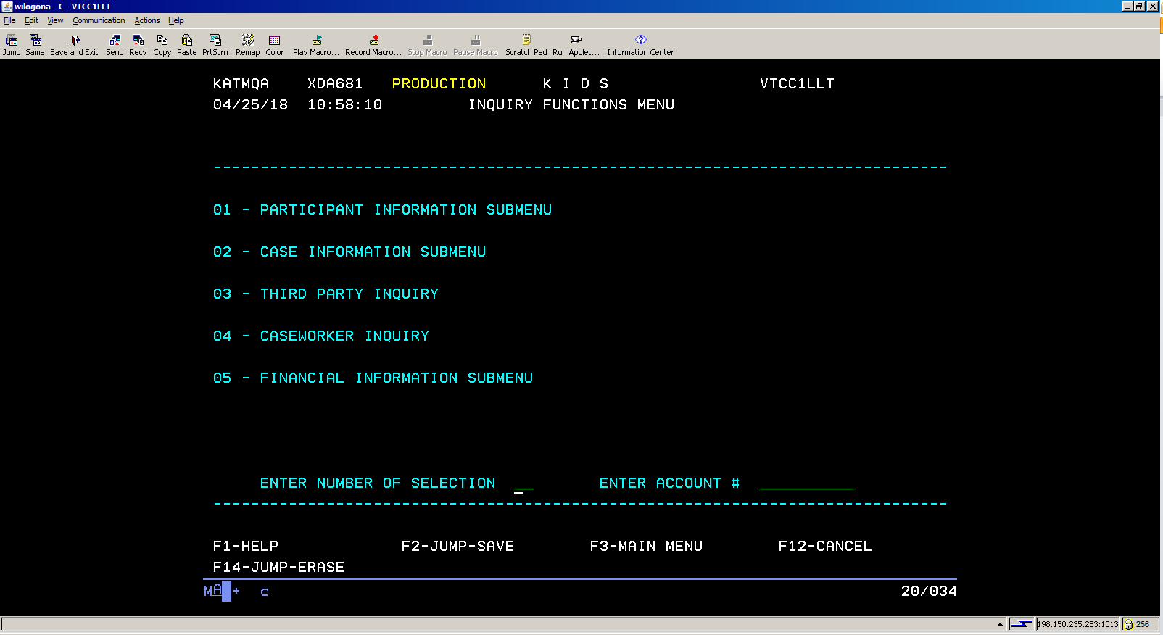

This is the starting point for your searches in KIDS.
You can reach it from any screen by hitting F4.

Slide 9
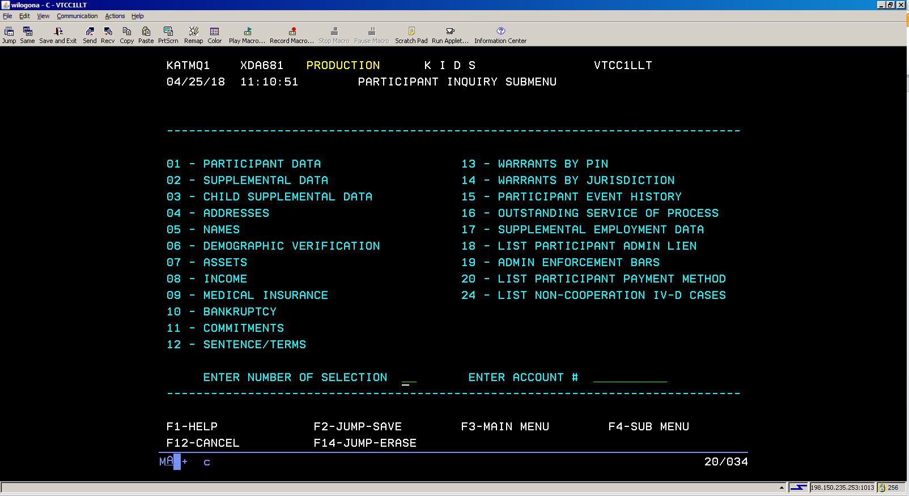
01 - PARTICIPANT INFORMATION SUBMENU
Selecting 01 on the prior page will bring you here. You can look up an individual, check addresses and see what income information KIDS has for a client.

Slide 10
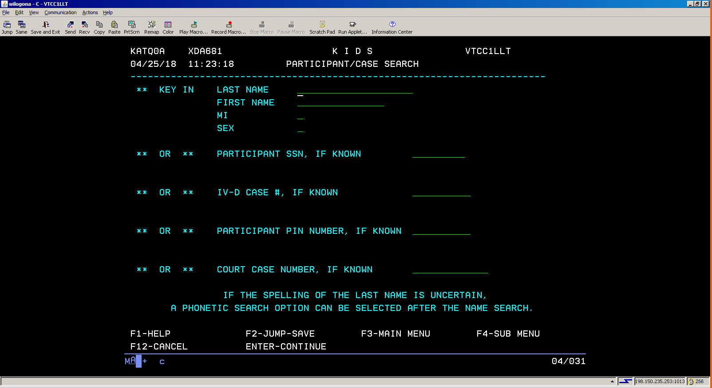
01 - PARTICIPANT DATA
Selecting 1 on the prior screen brings you to this search screen. You have a number of ways to search a case.

Slide 11
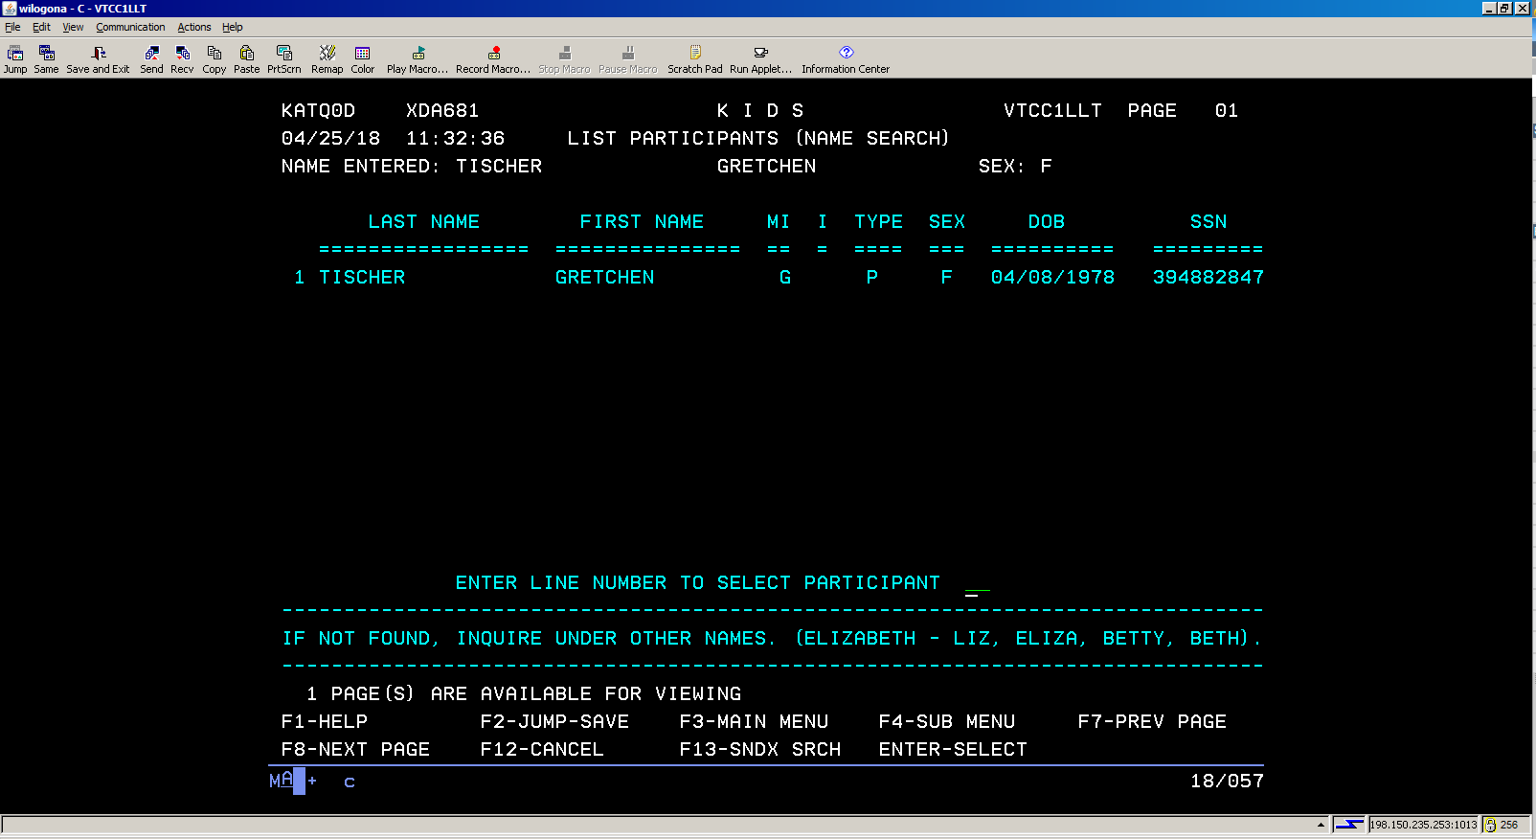
You may only have one hit if searching by name or you may have many. Select the individual that you want. A “P” under type tells you that this is the primary entry for someone. An “A” is alias.

Slide 12
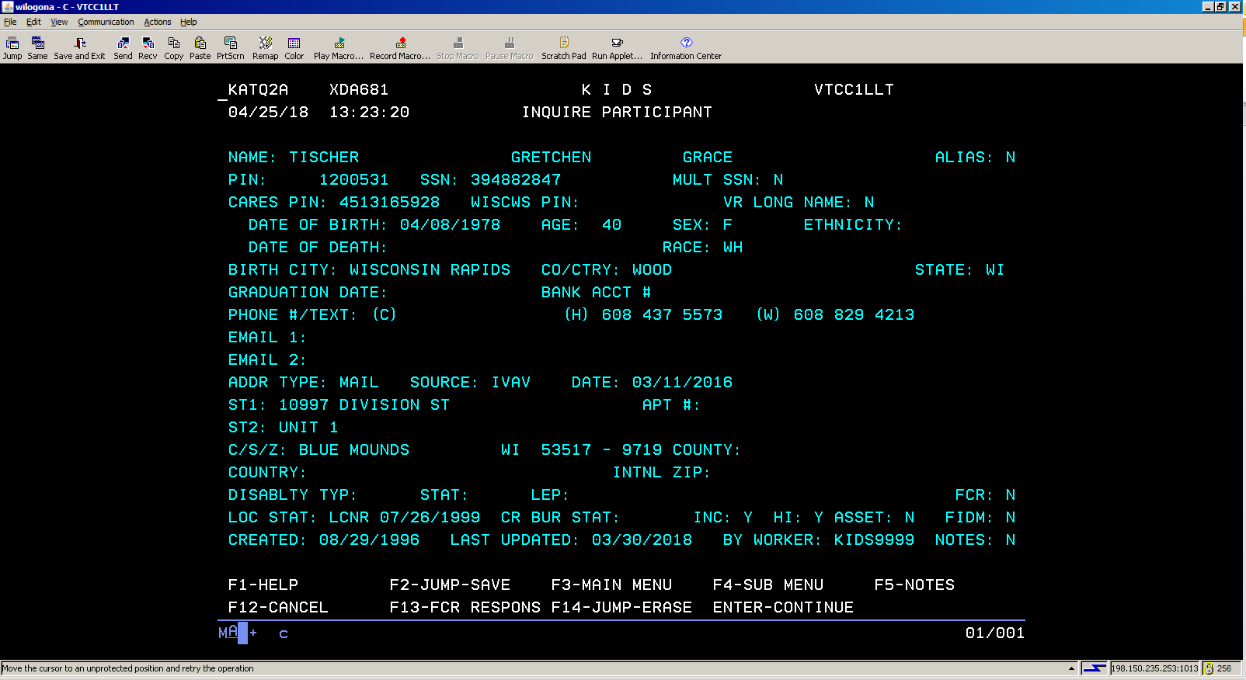
Participant details
Entering 1 in the selection will take you to this screen, which is a general information screen. It shows the person’s information and address.

Slide 13
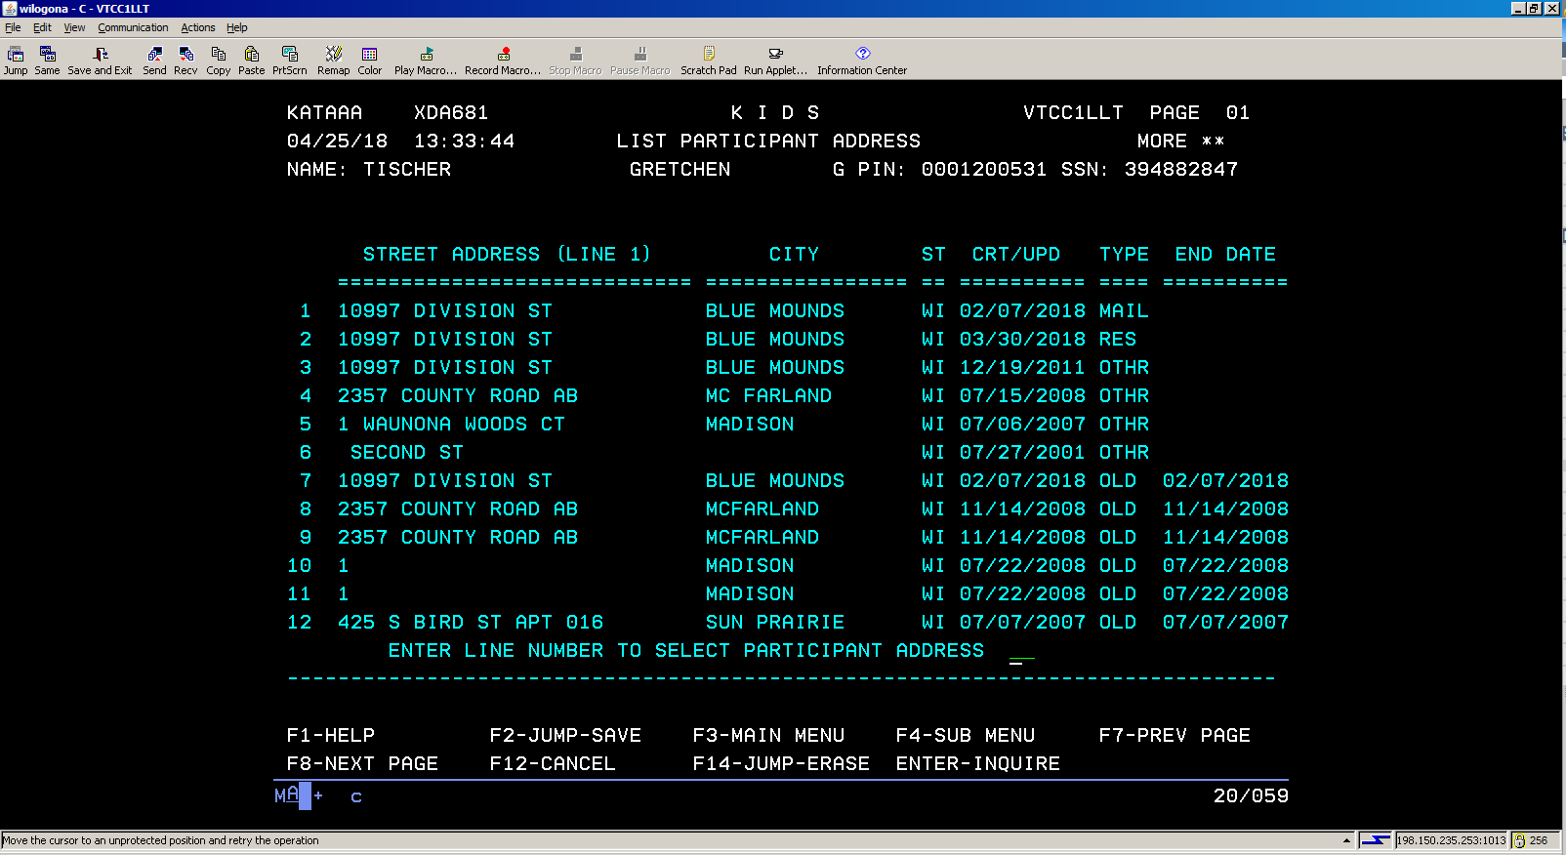
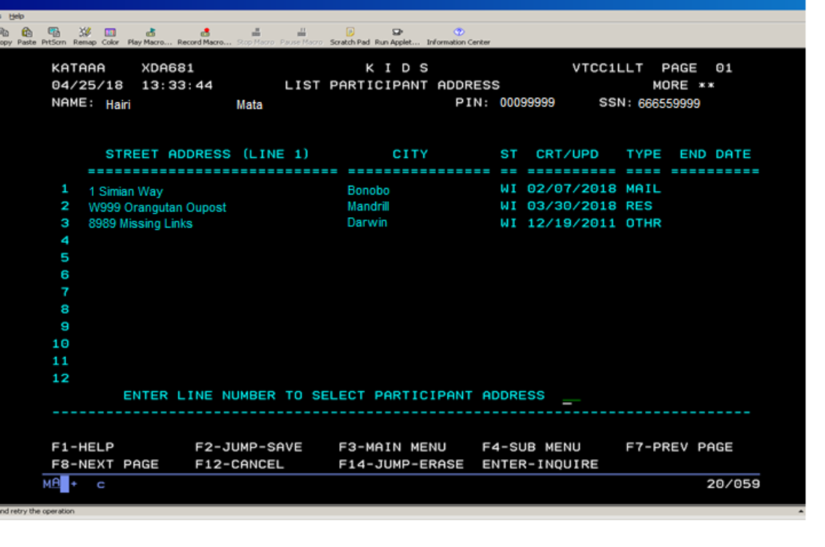
Hitting F4 on the prior page, then selecting 1, and then selecting 4 will take you to their address screen. This will show a history of the client’s various residential and mailing addresses, as reported to child support.

Slide 14
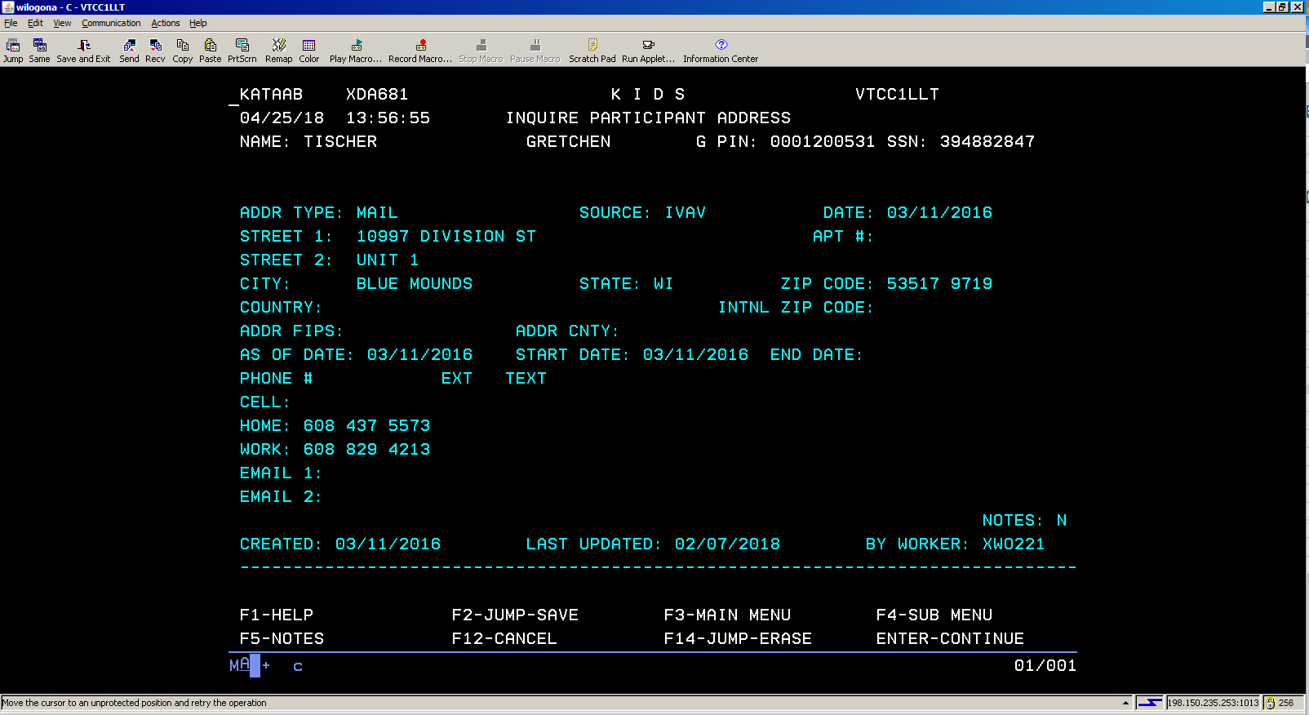
Selecting a line number will bring you to this screen, showing the address.
NOTES: IF THERE IS A Y ON THE NOTES LINE, HIT F5 TO SEE THE DETAILS. THIS IS COMMON FOR ALL KIDS SCREENS WITH NOTES.

Slide 15
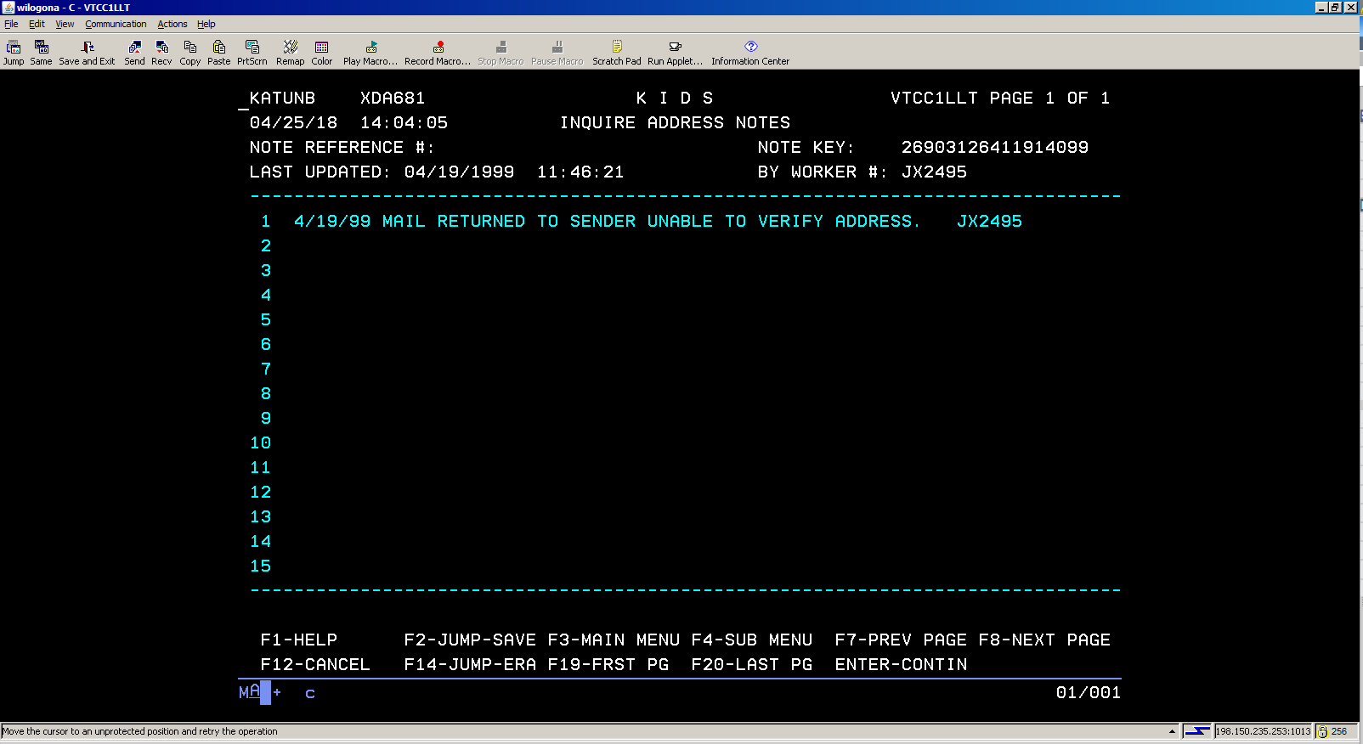
This is an example of a notes screen.

Slide 16
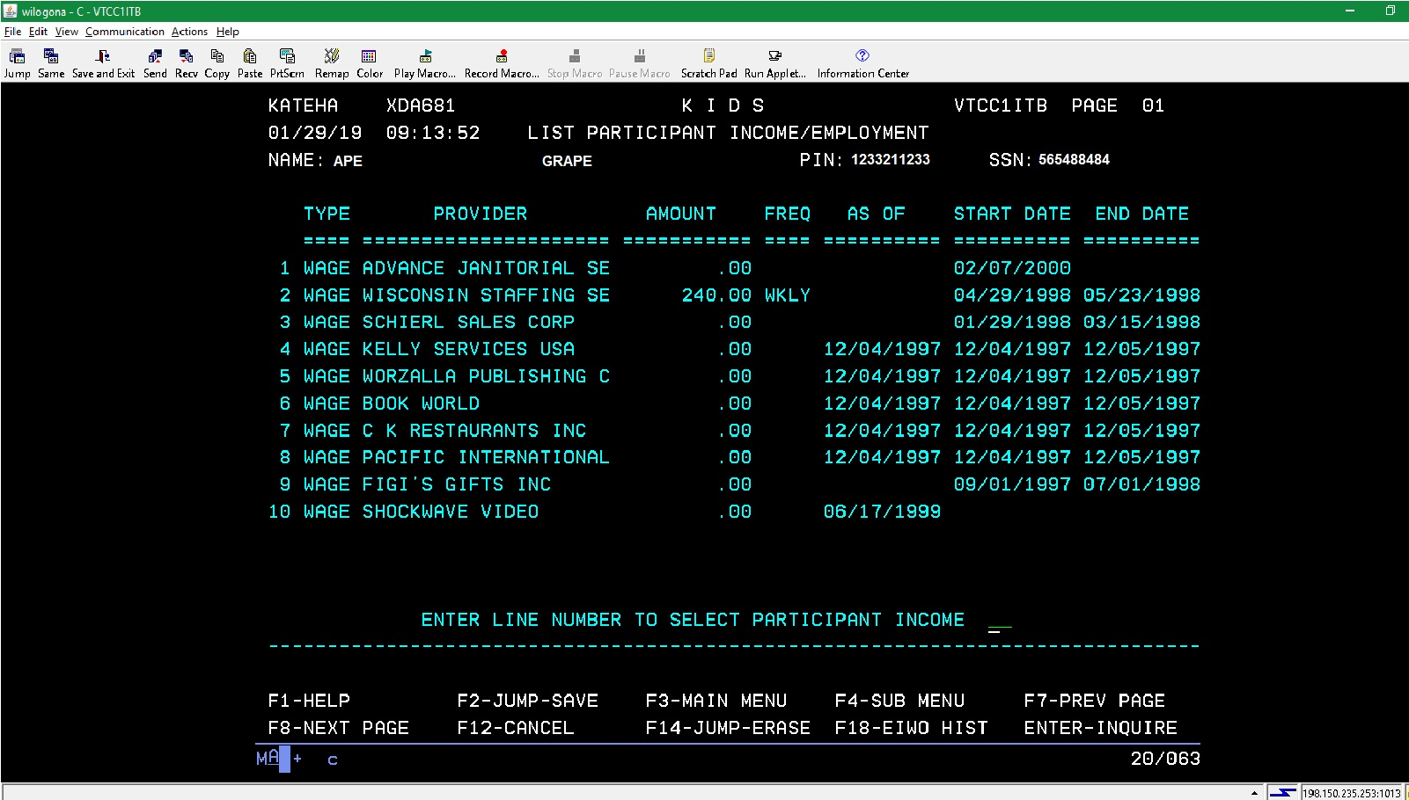
Clicking F4, selecting Participant Information Submenu and then Income will show you income sources reported for the person in question. This can be useful if you are adding an absent parent to a case.

Slide 17
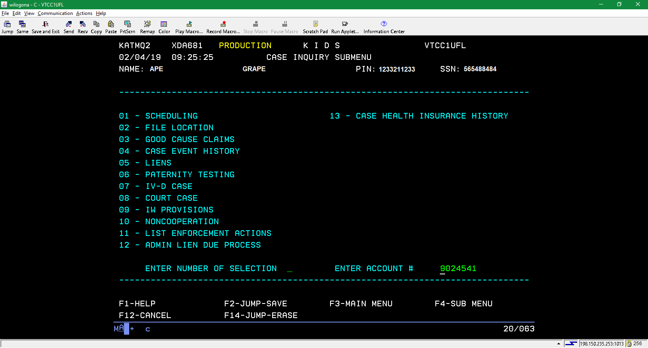
Case Information Submenu
Finding a case
Hitting F4 and then selecting Case Information Submenu will take you to this screen. There are two screens of use: case event history and noncooperation.

Slide 18
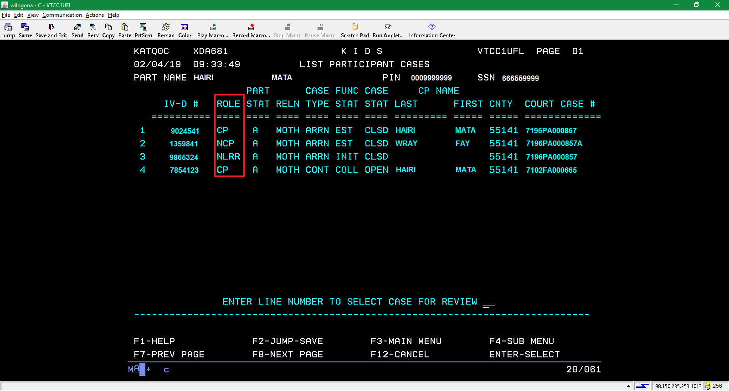
Selecting case event history from the prior screen will take you to this page, showing the various cases involving your person. Select one to see more. Please note the roles: CP (custodial parent), NCP (non-custodial parent) and NLRR (non-legally related relative). You may also see CHLD (child).

Slide 19
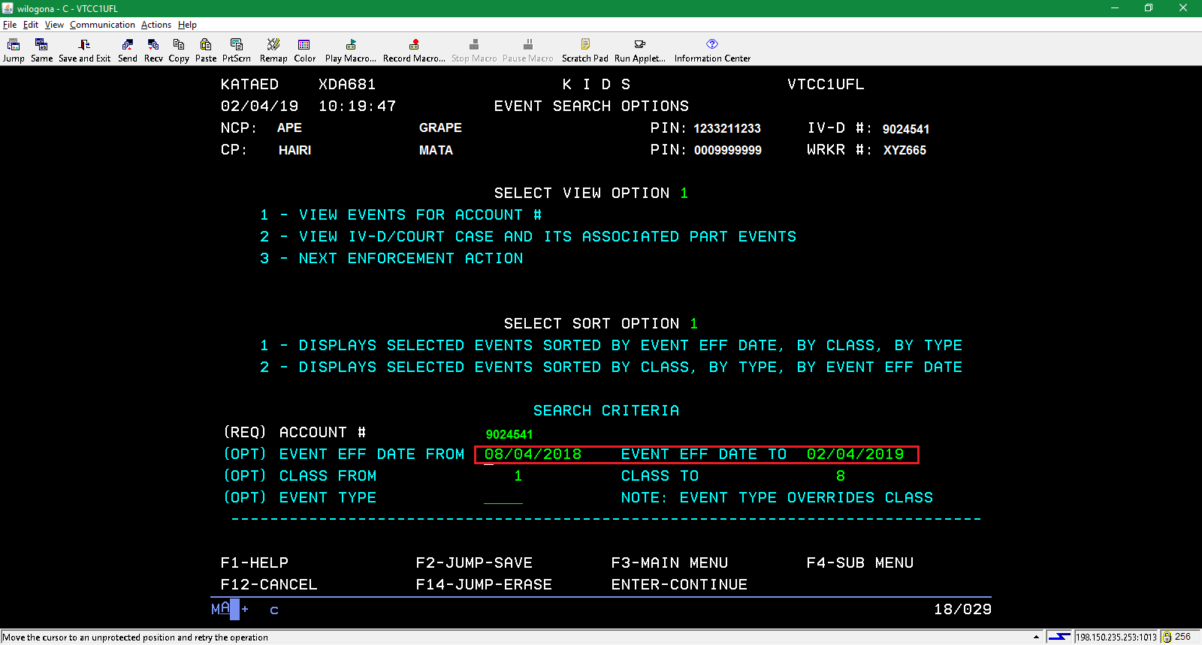
Selecting a line number will take you to this page. There are dates on the screen. Using these, you can refine the period you are researching.

Slide 20
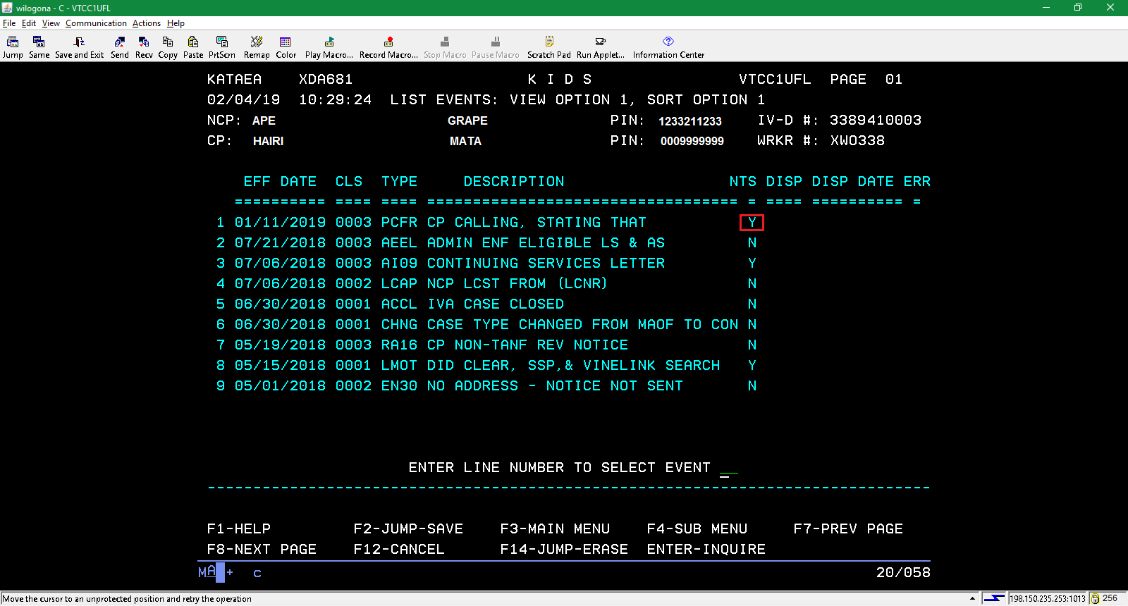
Most of the items under description will make more sense to child support than to us. However, some of these have notes (NTS).

Slide 21
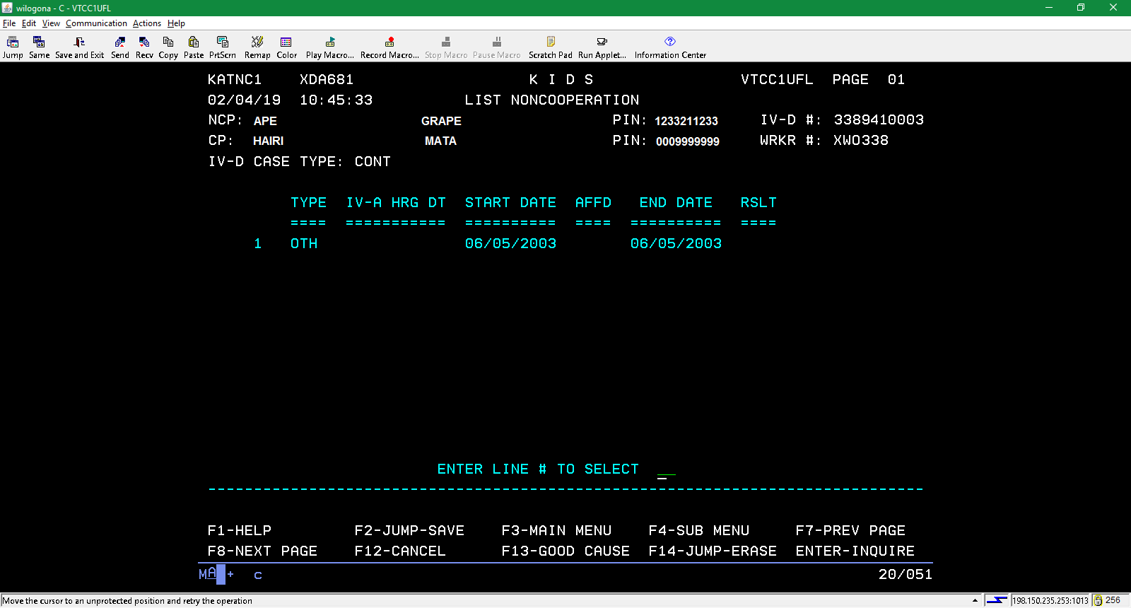
Hit F4, then select Case Information Submenu and then Noncooperation. It will take you to the list of cases, as seen on page 17. Select one of those pages and you may see what we have pictured above, showing a noncooperation.

Slide 22
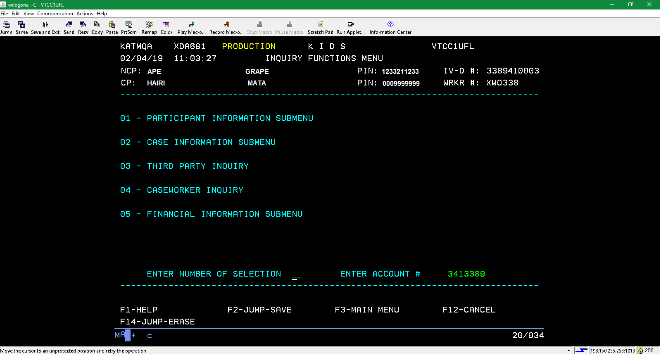
Financial Information Submenu
This page will be the springboard for looking up payments received by the custodial parent and made by the absent parent.

Slide 23
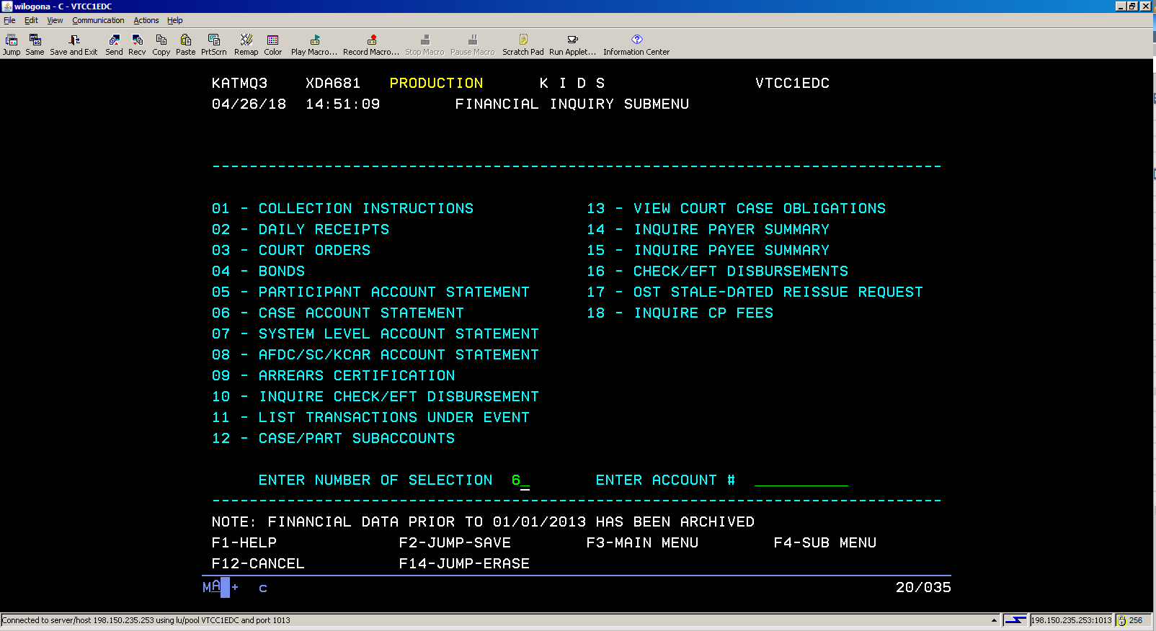
After selecting line 5 on the previous page, you will come to this page. Pick line 6 and hit enter.

Slide 24
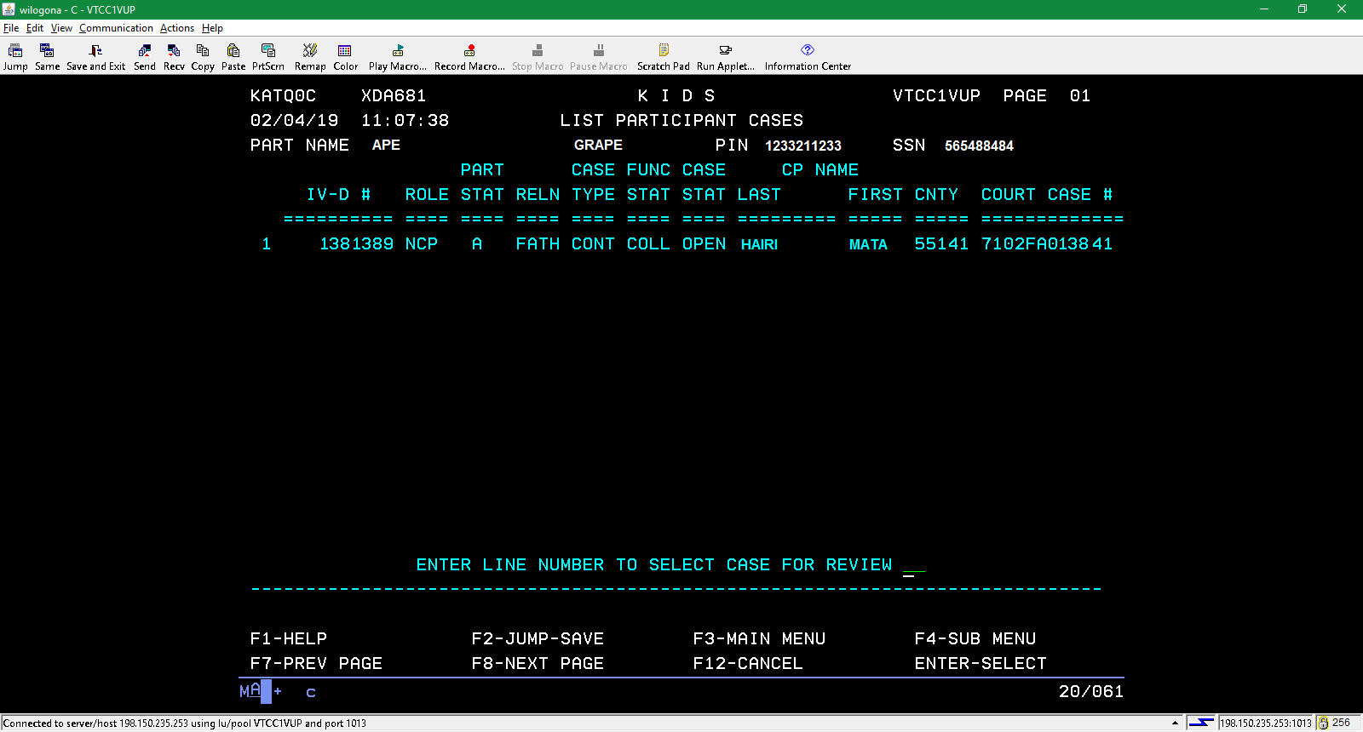
You will again get a list of the cases involving an individual. Select a case and hit enter. Cases marked Open under Case Stat(us) will be more likely to have the information you want. Select the line number of the case you want to see and hit enter.

Slide 25
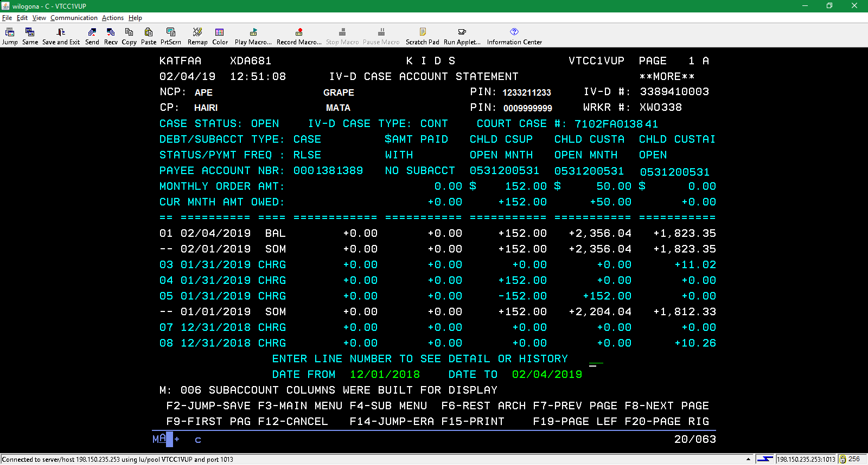
This screen shows money that has been paid by the absent parent. Enter the line number for BAL and hit enter to see details about the payments.

Slide 26
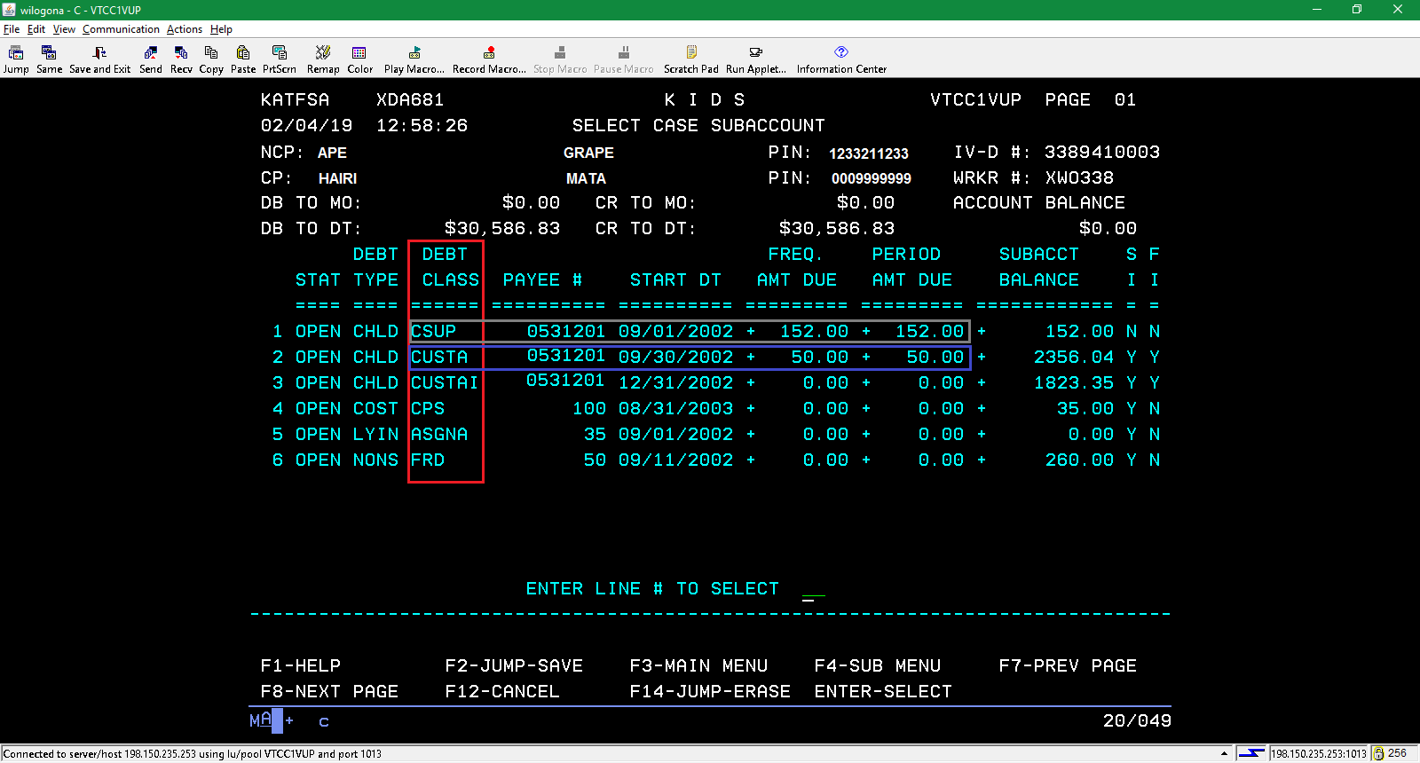
The Debt Class column shows the various types of orders that are being collected. CSUP is current support. CUSTA is arrears. ASGNA is lying in assignment. This screen shows that the client owes $152 in current support in May 2018 and $50 for arrears.

Slide 27
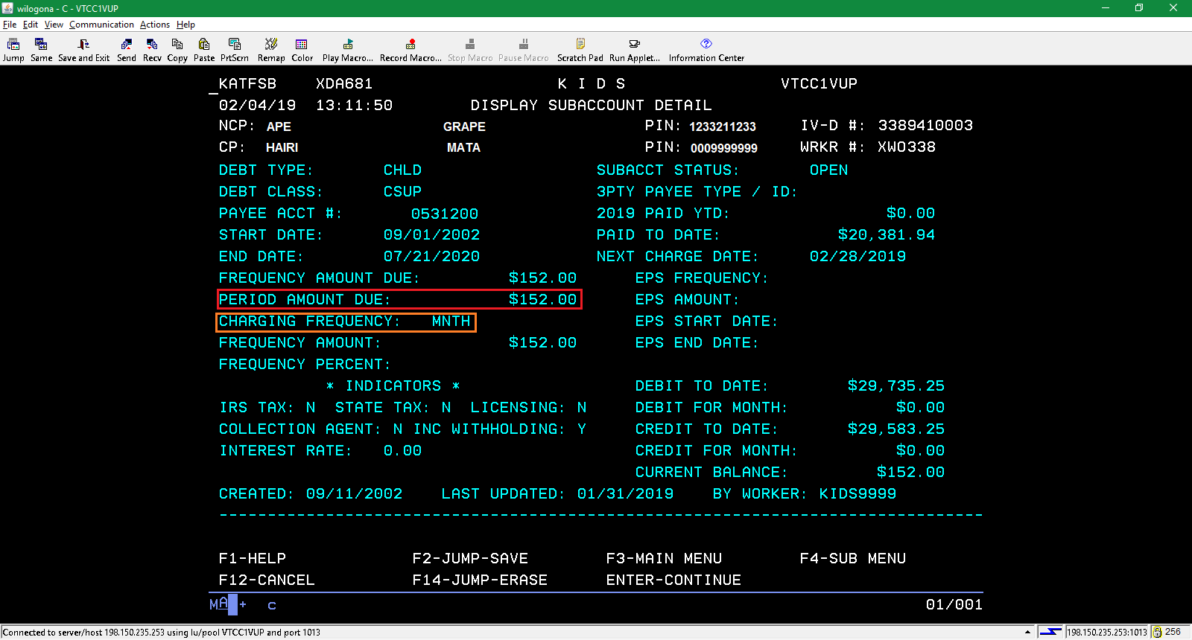
Selecting the CSUP line from the previous screen brings you to this screen. It shows that he is ordered to pay $152.00 per month.

Slide 28
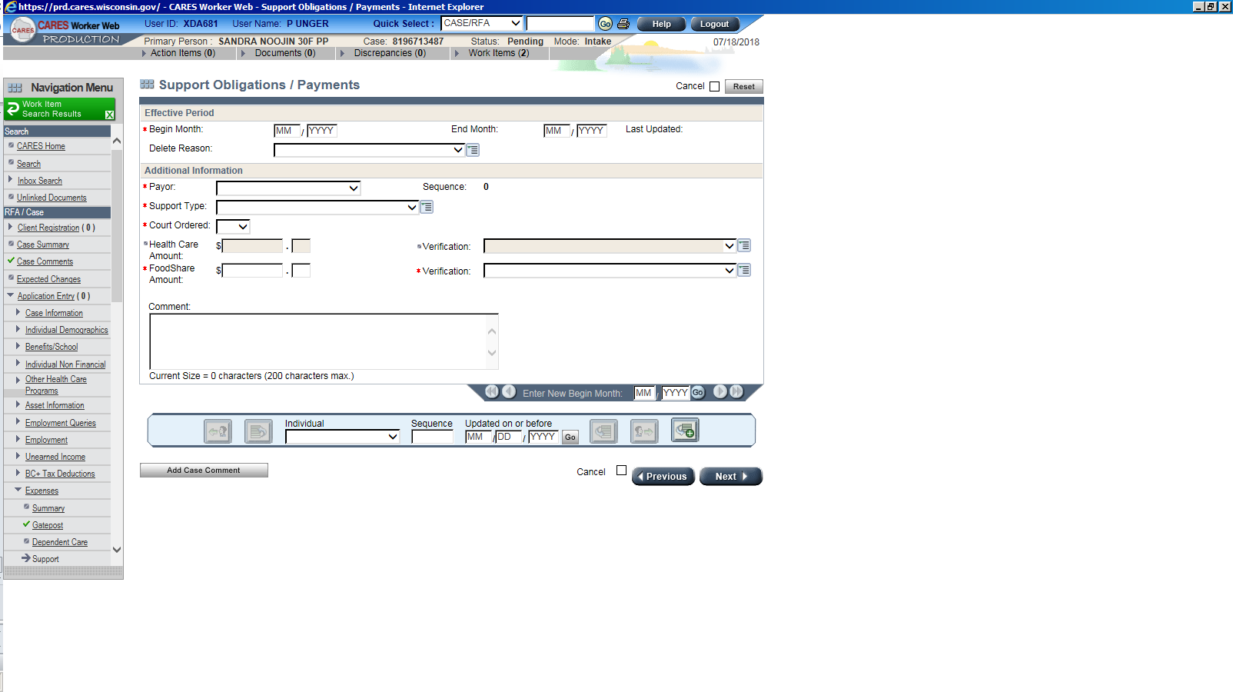
CARES child support income screens
When entering
Enter the average of the last three months on this CARES screen. If the payor has not paid recently, but is reporting a new job, and states that s/he will be making payments, you may enter the ordered amount, converting the income if needed.

Slide 29

Budgeting Child Support paid to the household
Please remember that one should use the CARES Worker Web Child Support Income Screen when entering child support paid to the household. Payments should be averaged over the past three months and divided among the children included in the support order. Only go to KIDS for the average if you receive a soft stop (yellow banner) or a hard stop (red banner). There may be cases where the average between the two sources differs. Always use the CARES average unless told to do otherwise. Case comment if that happens.

Slide 30
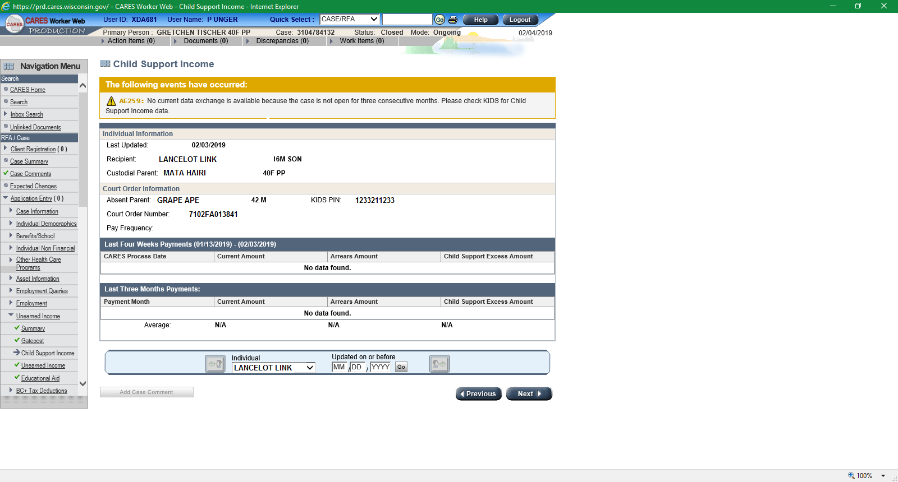
Finding Child Support Income
The CARES Child Support Income screen is the first place to look for support payments. If the screen has no yellow or red banners, you should use the average calculated. However, if there is a soft or a hard stop, one must go to KIDS to determine the amount to budget.

Slide 31
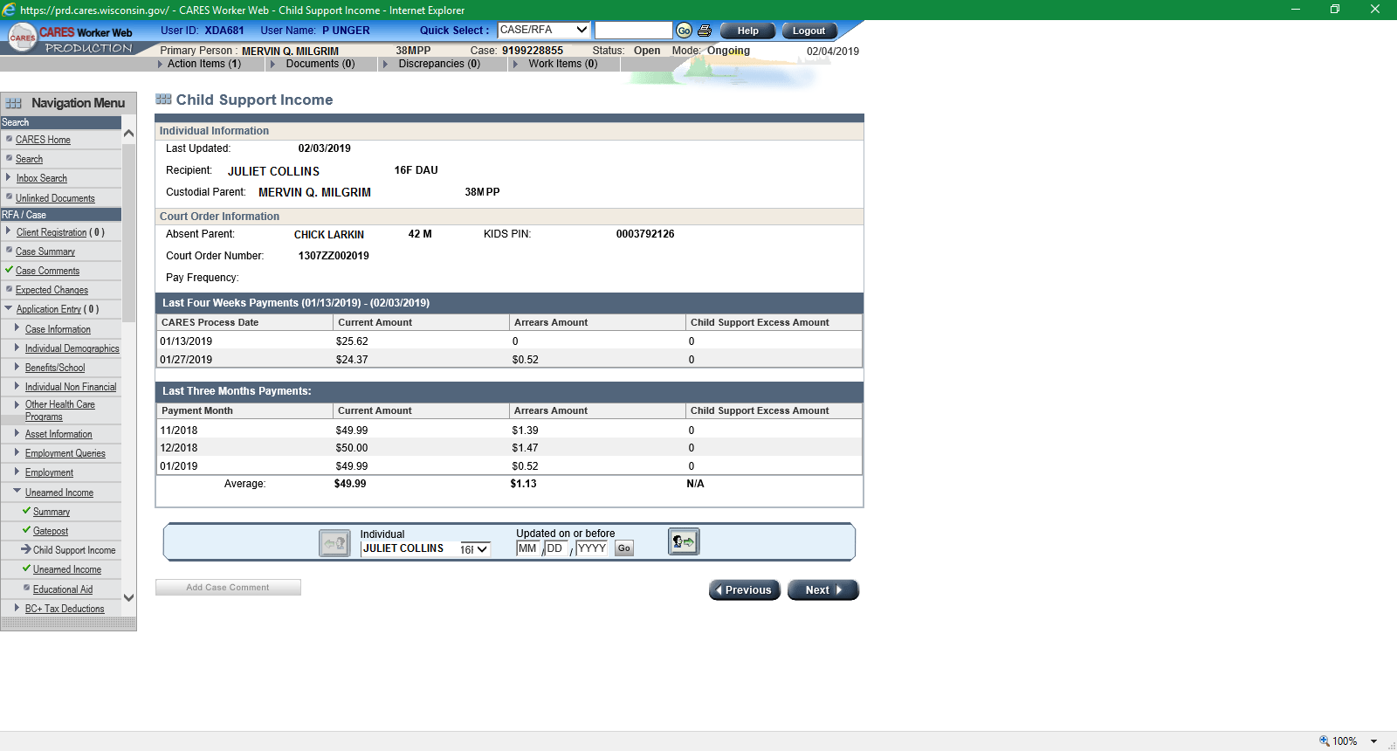
Above is a screen print of a “normal” support screen. CARES creates the average for you and simply update the Unearned Income screen. This should be the first screen that you check for support…every time. However, if you receive a yellow banner (soft stop) or a red banner (hard stop), you should go to KIDS to calculate an average.

Slide 32
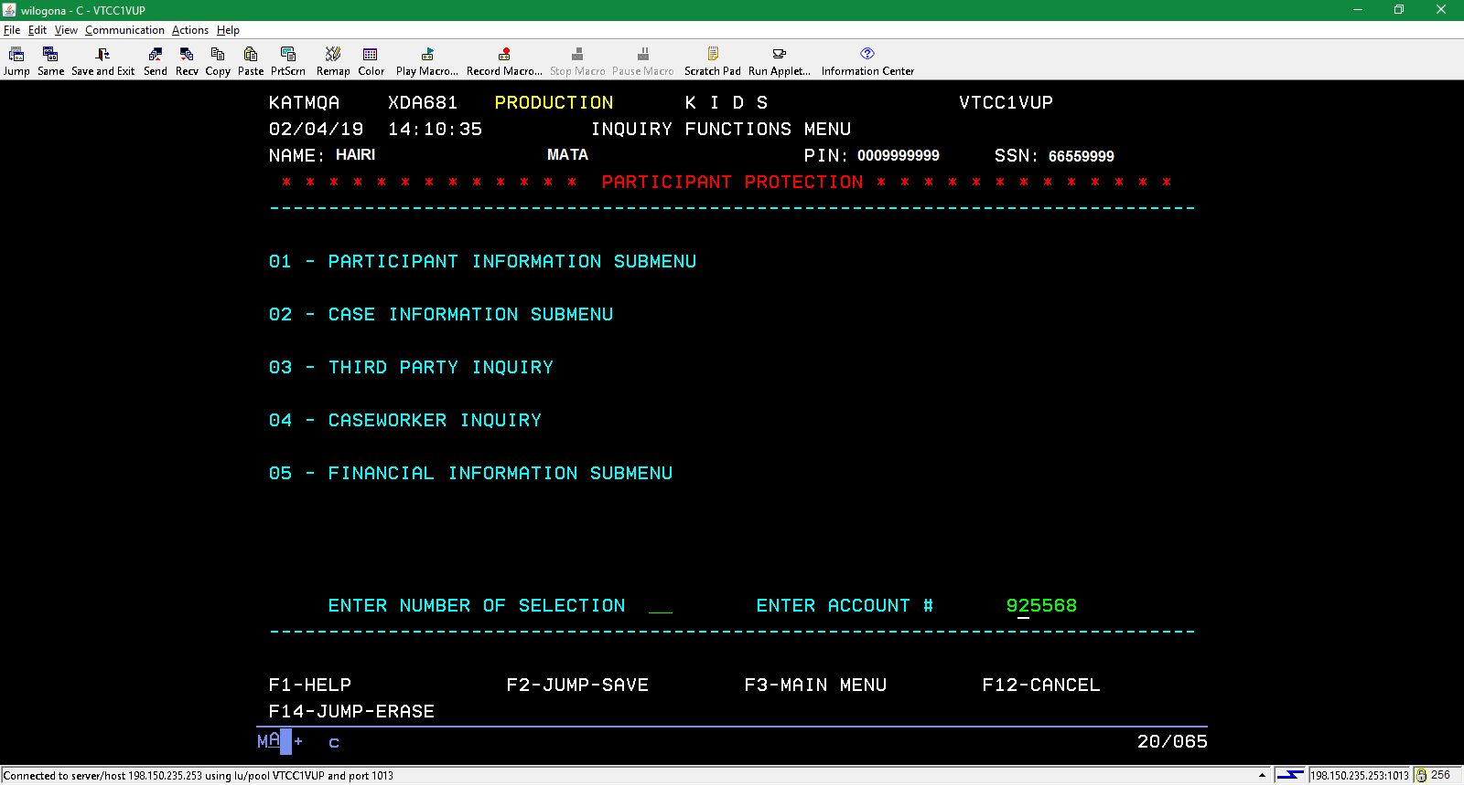
Finding Support payments
From the main menu, select “Financial Information Submenu.” Please also note that this client has “Participant Protection” notation. This does not affect anything we do here in Economic Support, but applies to the child support workers. We should continue to exercise our usual precautions and respect confidentiality.

Slide 33
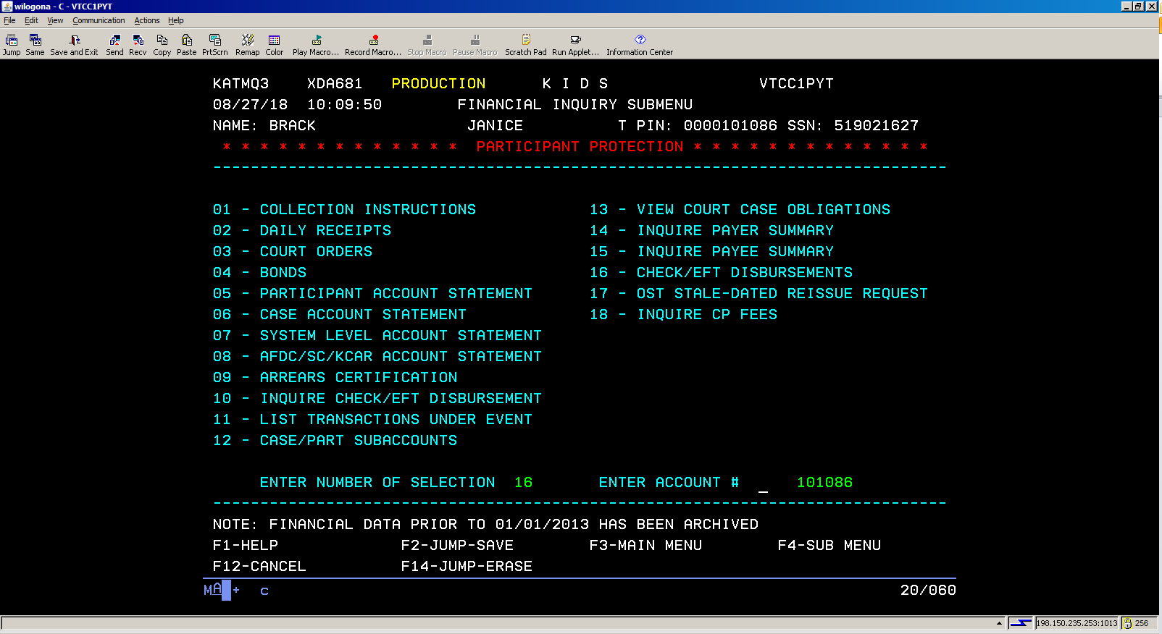
Select Financial Information Submenu from the previous menu and then Check EFT/Disbursements from this list to see payments made to the custodial parent.

Slide 34
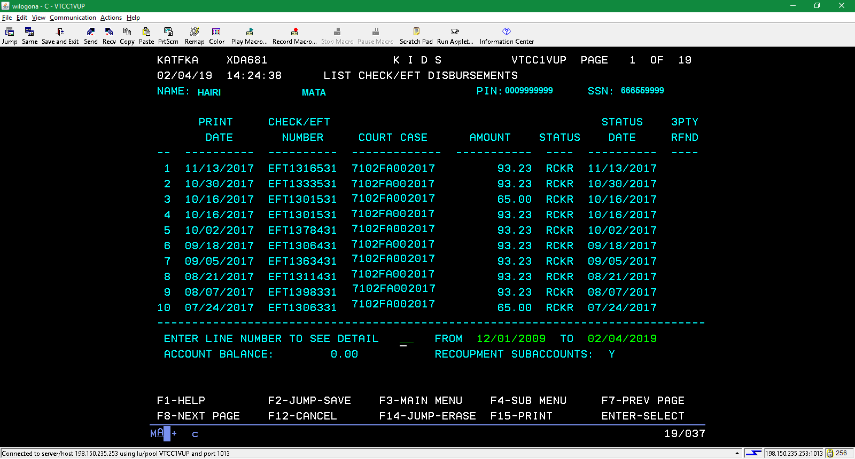
Above is a list of child support payments made to a client. If one needs to change the time period that one is checking, one may adjust to the “to” and “from” dates in green. This case has only payor. One can see that there are multiple payors by looking at the list of court cases. Please be careful when averaging payments on cases with multiple absent parents.

Slide 35
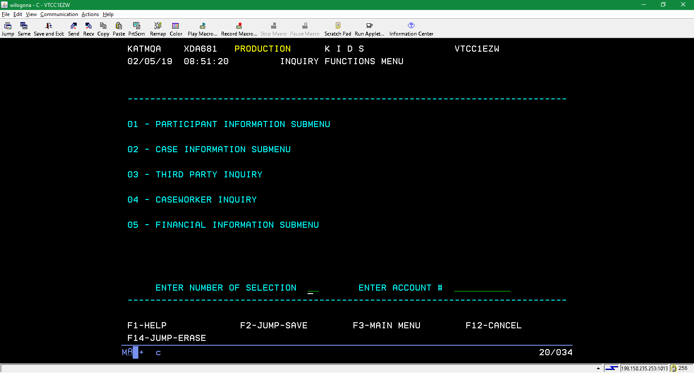
Finding who is included on a case
Select Participant Information Submenu.

Slide 36
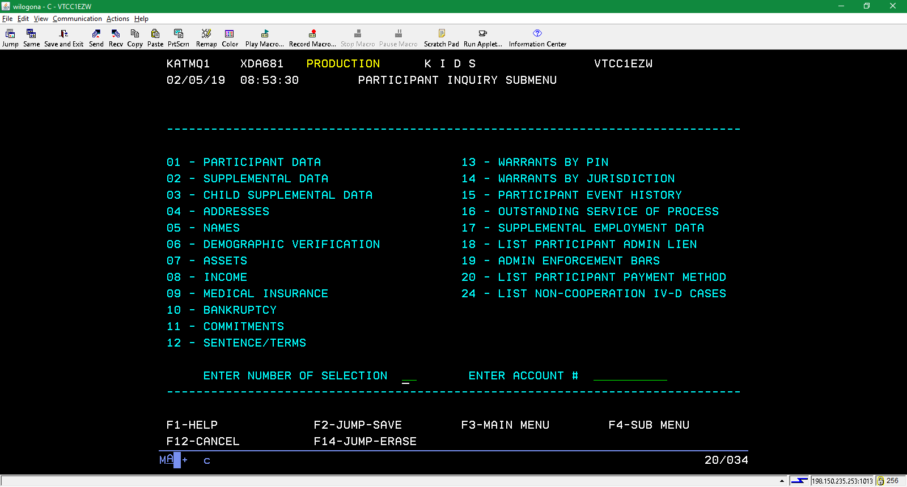
Select Participant Data.

Slide 37
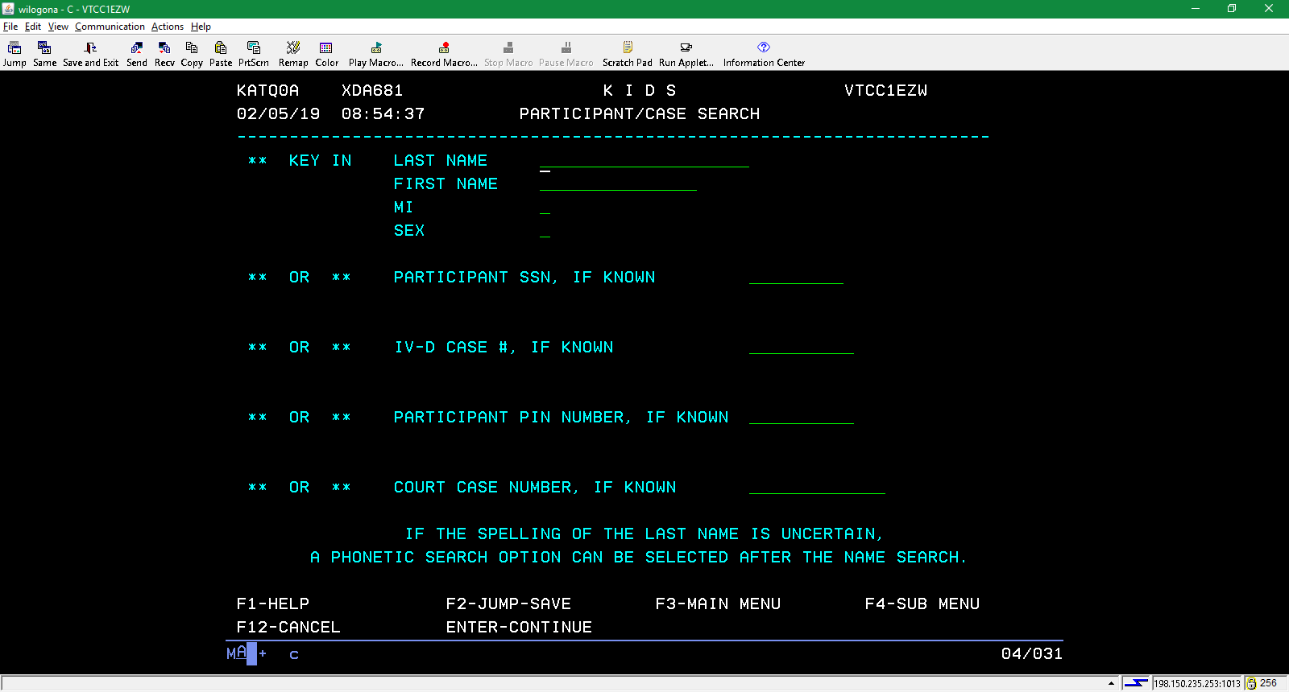
A worker has three options from this screen. The search can be started using the client’s name, social security number or KIDS (participant) pin. The second is with the IV-D case number. Finally, one can use the court case number, which can be found in KIDS or CARES, on the Child Support Income line from the menu.

Slide 38
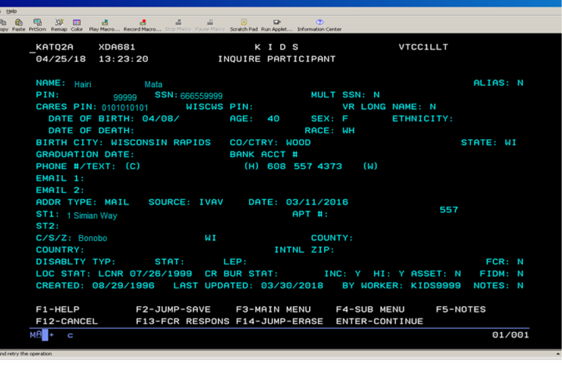
Using the name, KIDS pin or the client’s SSN will take you to this page. Select F4, which will take you back to the Inquiry Functions Menu.

Slide 39
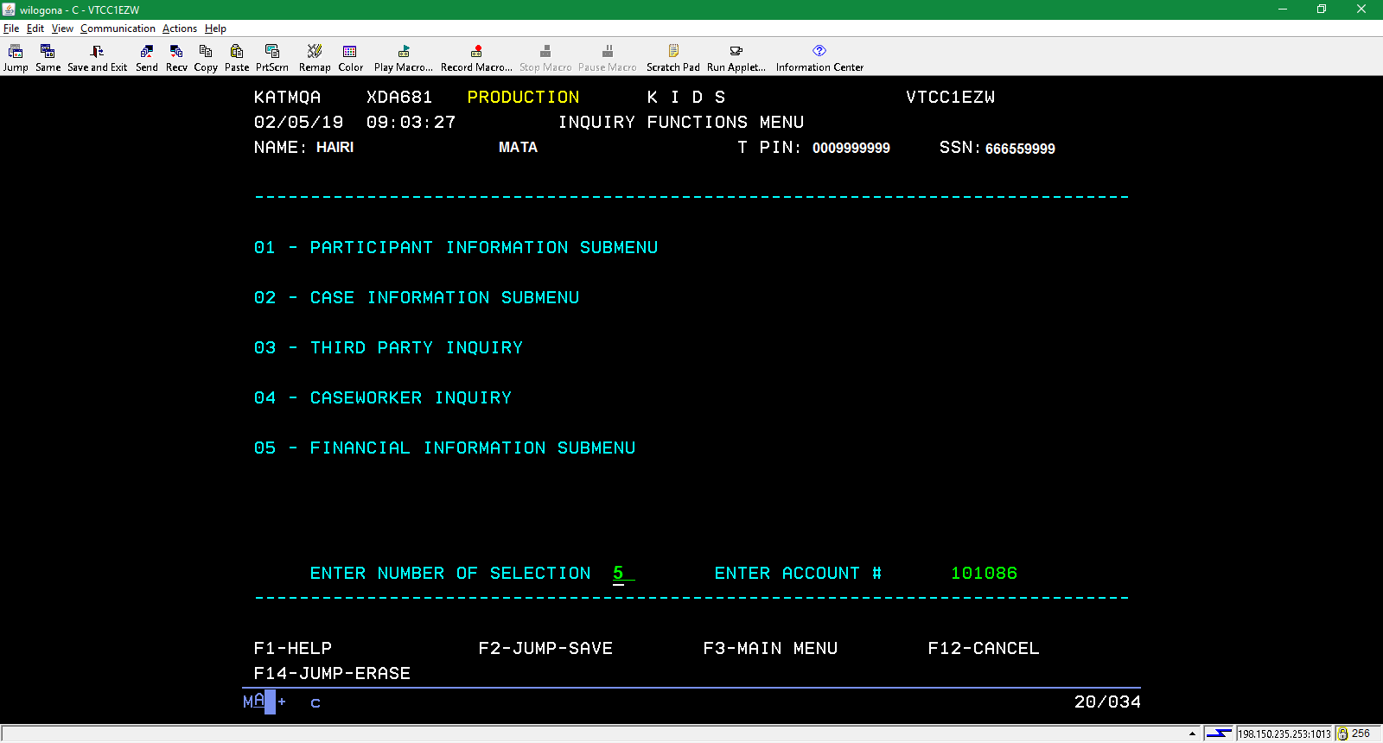
Select Financial Information Submenu and hit enter.

Slide 40
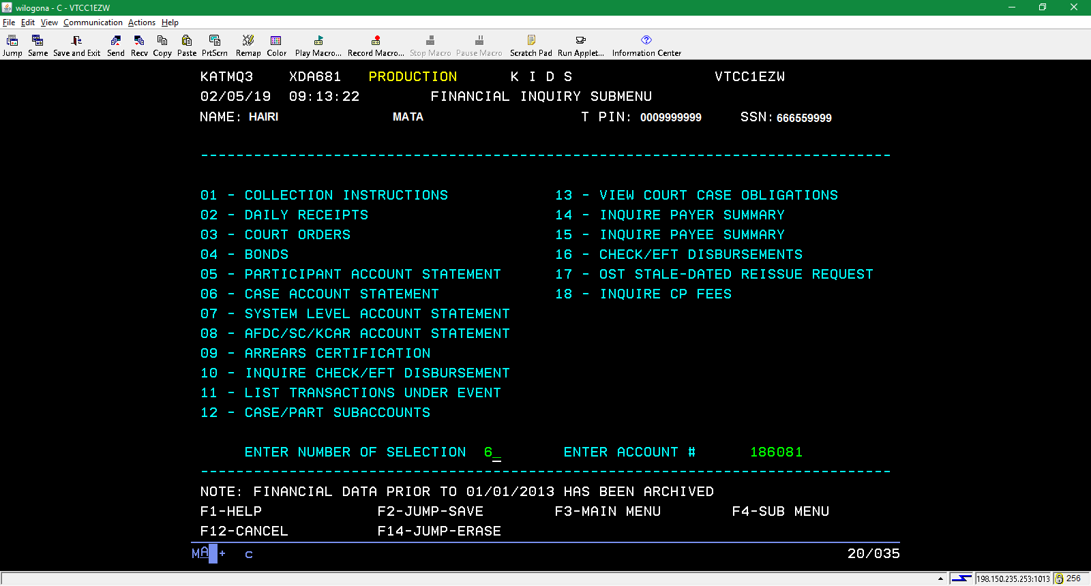
Select Case Account Statement from this screen.

Slide 41
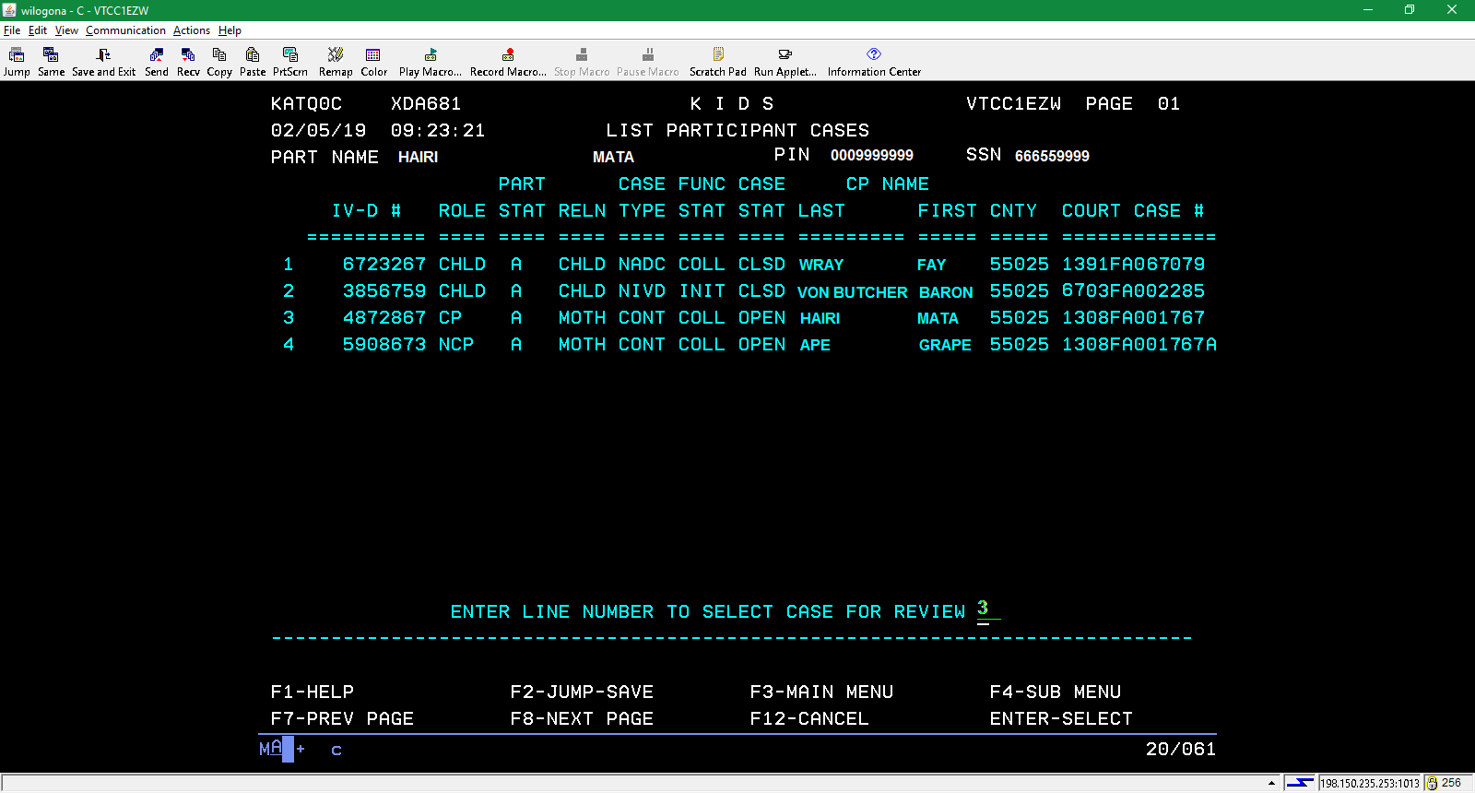
Selecting a case here will take you to the IV-D CASE ACCOUNT STATEMENT. PLEASE NOTE THAT YOU HAVE THE IV-D # and THE COURT CASE NUMBER # available here if you wish to go to the PARTICIPANT/CASE SEARCH MENU to search for case members.

Slide 42
After selecting a case from the LIST PARTICIPANT CASES MENU, you will see this screen. Press F4, select PARTICIPANT INFORMATION SUBMENU, and finally, PARTICIPANT DATA.

Slide 43
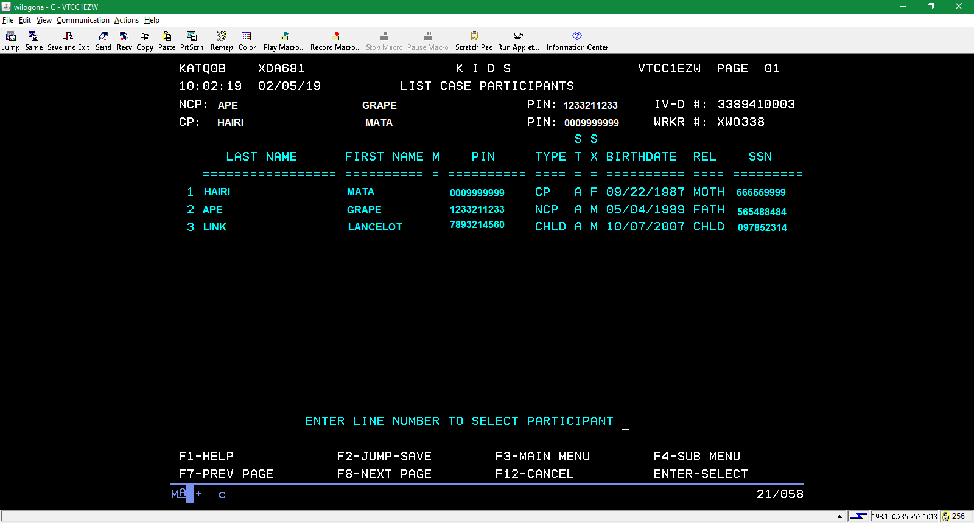
…and here are your individuals associated with a case. The highlighted box above shows the various roles on a case: CP is custodial parent, NCP is non-custodial parent and CHLD is child. One may also see POTF, for potential father, in situations where an adjudication has not been entered.

Slide 44
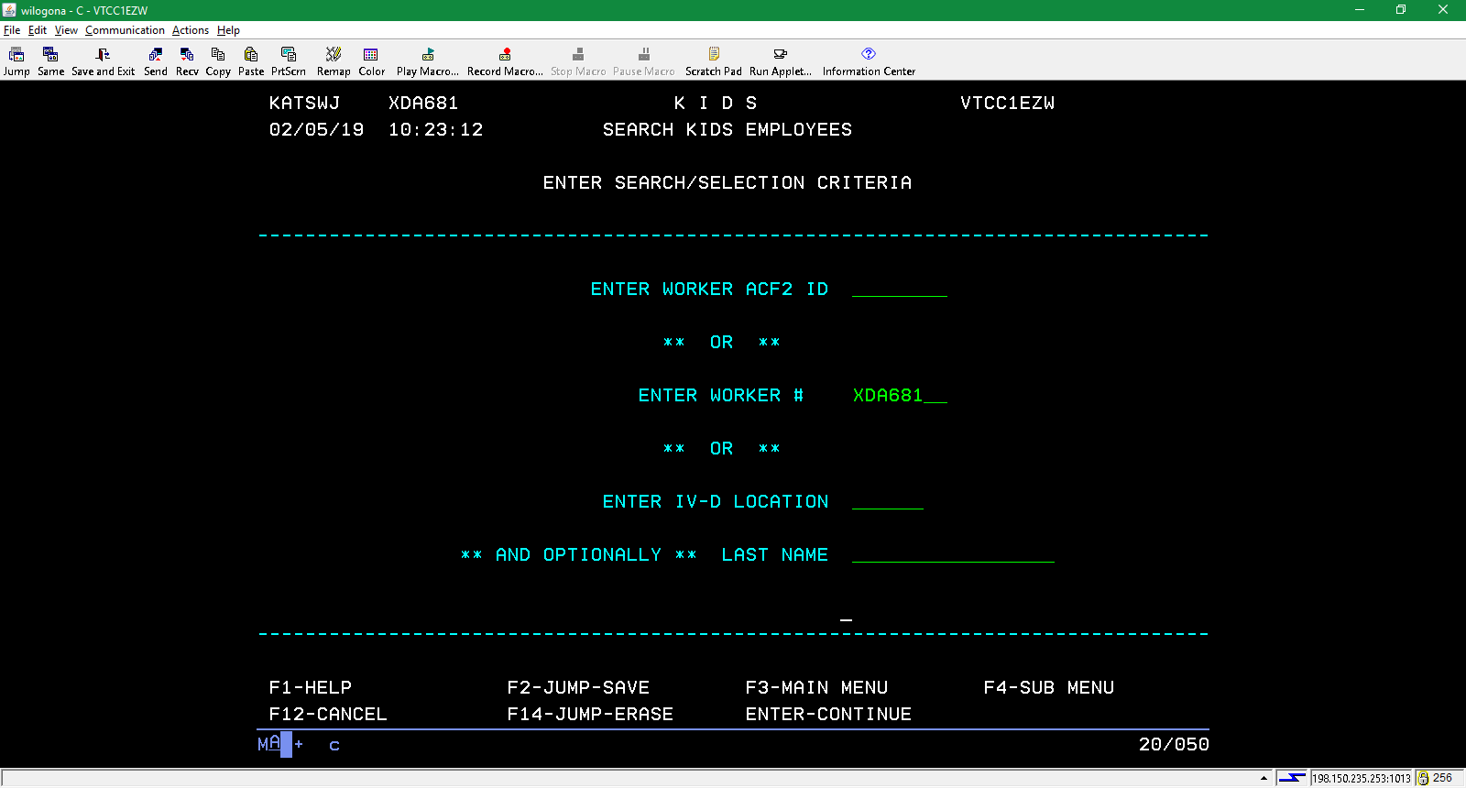
Finding a case worker
From the INQUIRY FUNCTIONS MENU found on page 38 of this packet, select CASEWORKER INQUIRY. This will take you to the page above. Enter the worker number and hit enter to see…

Slide 45
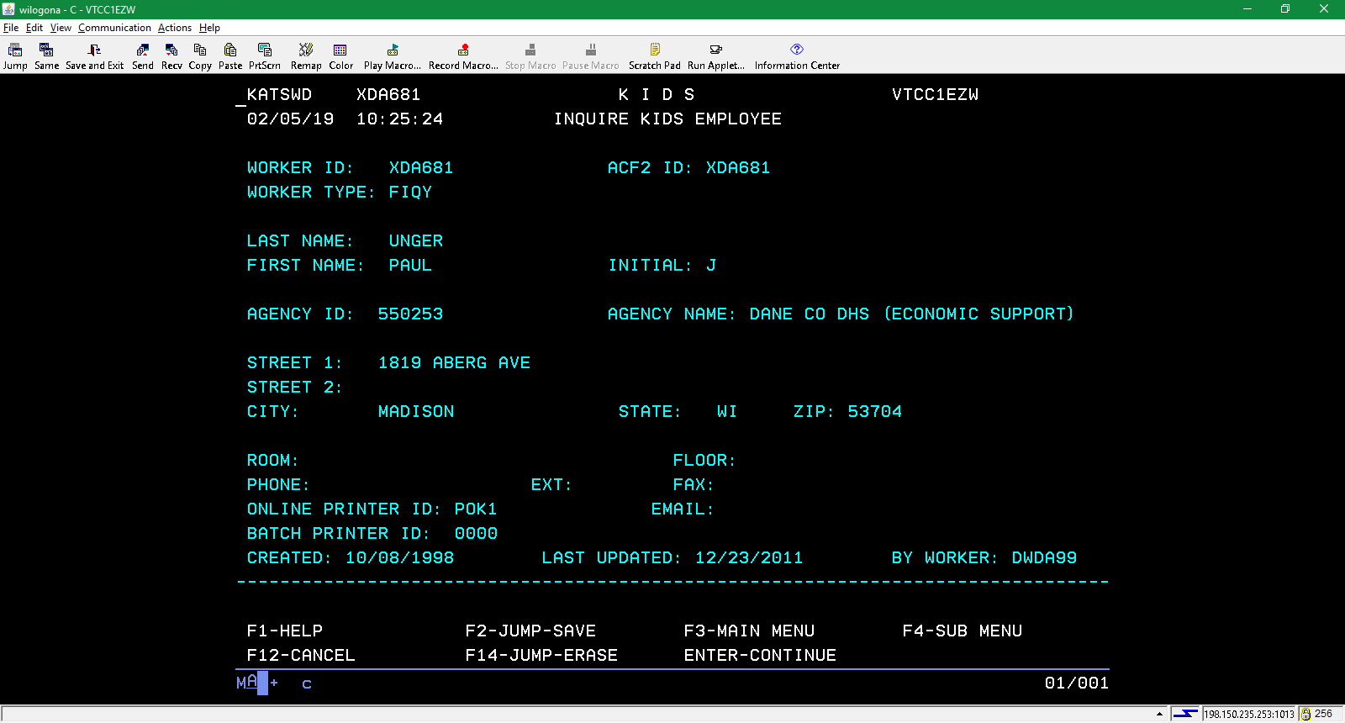
One can also find worker information in the CARES Mainframe by entering SMUM in the transaction line with the worker number in the Parameter line.

Slide 46
