Slide 1

Time Management
October 2019

Slide 2
What is Time Management?
The process of organizing and planning how to divide time between specific activities
Exercising conscious control of time spent
Increasing effectiveness, efficiency, and productivity

Slide 3
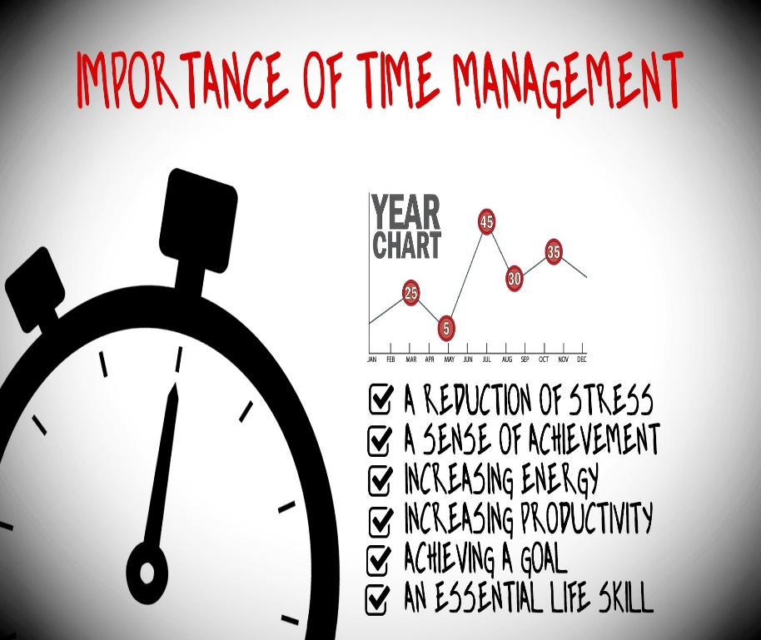
Why is Good Time Management Important?
Accomplish more in a shorter amount of time
Helps create focus, leading to higher levels of career and agency success
Most important,
top priority work gets done
Less re-work for yourself and
co-workers
Lowers stress in the workplace

Slide 4
Skills
Making a schedule or a plan
Prioritizing according to deadlines
Goal setting
Communication
Self-awareness and Self-care
Coping mechanisms/Stress management
Managing barriers and interruptions
Organizing and utilizing resources

Slide 5

Schedule and Plan
Set a plan for the day: what do you need to accomplish to be productive and successful?
Be realistic about how much can be included in the day’s plan
Schedule meetings, trainings, or other events on your calendar and set reminders
Manage your day hour by hour or in
specific blocks of time
Be willing to make changes to your
schedule or plan if necessary

Slide 6

Setting Goals and Prioritizing
Identify and think about your specific goals at the beginning of each day
Determine the order of importance or priority for each goal

Slide 7

Setting Goals and Prioritizing
Be aware that all goals may not be able to be completed due to unexpected issues that may arise during any workday
Identify goals that could wait
until the following day and
place them at the end of your
priority list

Slide 8
Communication
Ask questions to ensure accuracy of work
Utilize resources when needed: Help queue, PRT, Handbooks, Operations Memos
Inform Lead Worker or Supervisor when
falling behind or unable to complete
priority tasks

Slide 9

Communication
**Do not be afraid to ask for help**

Slide 10
Self Awareness
Be aware of your strengths and use them to your advantage to increase output and productivity
Be aware of your weaknesses and the areas you are not as strong in
Do not focus or dwell on comparing yourself to other workers
There are many different work styles that can be successful

Slide 11

Self Awareness
Ask yourself:
What is the high point of my day?
When am I at my best?
Tackle the tough stuff during that time!

Slide 12
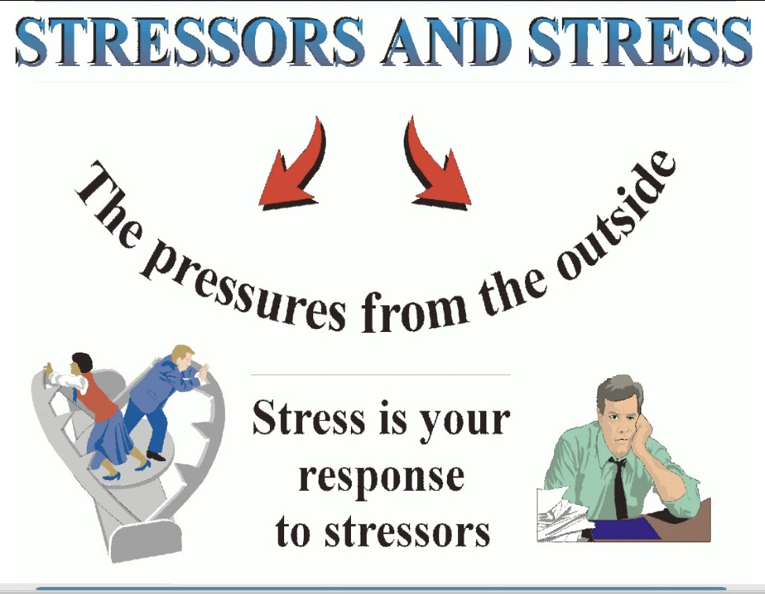
Coping with Stress
Take your allowed breaks and leave your work station
Have a support system and talk to co-workers, lead workers, or supervisors
Do not over commit yourself
and only take on extra work
that you can handle
If a case or task feels
overwhelming, focus on one
step at a time

Slide 13

Coping with Stress
Keep a positive attitude, since negative thinking will only drain your energy and motivation
Do not try to control things that are beyond your control, focus on what you can control
Set realistic goals and aim to do your best, not to be perfect

Slide 14
Managing Barriers and Interruptions
Effective communication with co-workers, supervisors, managers
Available and unavailable time: politely let interrupters know if you are not available during that time
Urgent, valid interruptions may have to be dealt with and schedules or plans changed accordingly
Track the most common interruptions and barriers that affect you daily and think of ways to possibly decrease or eliminate those occurrences

Slide 15

Organizing and Utilizing Resources
Have desk aids easily accessible
Create a binder, email folders, or desktop folders to store policy or other information
Keep sites open that may need to be used often: Capital Consortium website, Forward Health, ECF
**Establish a system that works and makes sense for you, and use it every day**

Slide 16
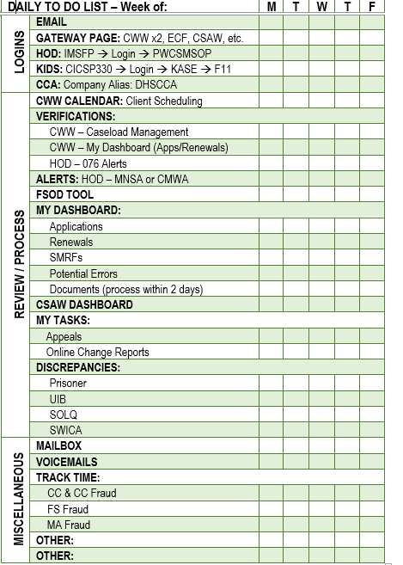
Daily To Do List Sample

Slide 17

Review Your Workday
What things did you do today that helped make the day successful?
What helps you stay focused?
Where did you get
distracted during the day
and what caused this?
What skills can you work
on to be even more
productive tomorrow?

Slide 18


Questions or Comments?

