Slide 1
Work Registration
November 2019

Slide 2

The Policy
Non-Financial Eligibility
All FS applicants / members must comply with work requirements.
  Register for work at time of application, and annually
  Not quit a job of 30 hours or more per week or reduce hours to under 30 per week without good cause, 30 days prior to application, or after
  Not refuse a suitable job offer
    Pay is min wage or higher, job matches abilities
  Continue to comply with Unemployment compensation program
  Continue to comply with W-2 program work requirement.

Slide 3
Exemptions from the Work Requirement
Under age 16, or age 60 or older
16 -18 year old enrolled in high school
Students of higher education at least half time
Physically or mentally incapable for employment
W-2 participants
Caring for dependent child under age 6, or incapacitated person
Applied for, or receiving Unemployment
Regular participation in AODA program
Employed / self-employed at least 30 hours per week (or earning the equivalent of min wage x 30 hrs per week - $935.25))
Applied for SSI simultaneously, until DDB decision has been made

Slide 4
The Sanction
A FS applicant or member, not exempt from these requirements, will be sanctioned if they have….
  Quit a job of 30 hours per week or more
  Reduced their hours to under 30 hours per week (or below $935.25 per month)
  Turned down a suitable job offer
  W-2 closed for failing to meet the W2 work requirement
  Failing to meet the unemployment work requirement
What’s that you say?

Slide 5

The Sanction Period
At Application
  If a VQT occurred within 30 days of application, that individual is sanctioned for 30 days
Example: John applies for himself, and his 3 kids (ages 13, 11, and 9) March 2. On February 20, he had voluntarily reduced his work hours, to 15 per week. He will be sanctioned from March 2, through March 31 (30 days). His kids will be eligible beginning March 2, and John is a gross deemer.
These puppies need some chow!
Notes:
How would this look different, if one of his kids was under 6? Or if he had a good cause reason to reduce his hours?

Slide 6
The Sanction Period
Ongoing
  1st occurrence – one month
  2nd occurrence – three months
  3rd occurrence – six months
The sanction begins the 1st of the month following the month of notice.
Sanctioned individual will be gross deemer
If VQT is during final month of cert. period, the sanction begins the next month, regardless of whether the person continues receiving FS

Slide 7
Good Cause
Not suitable employment
They were fired, or resigned at employer’s demand
Discrimination by employer
Unreasonable work demands
Accepted another job offer
Reduced hours under 30, but wage is still at least $935.25
Enrolled at least half time in school
Changes in residence impacted current job
Quit due to health reasons
Resignation of someone <60, employer deems retirement
Quit in the natural pattern of employment (migrant)
Hours were reduced
Quit to join volunteer program such as Americorps
Transportation unavailable
Inadequate child care for kid under 12
Self employment ended
Other circumstances, agency discretion
Request verification only if questionable

Slide 8
Ending a VQT
When the sanction period ends, a re-request for FS must be made prior to adding person back into the food unit.
They will be added in the first of the month following the month the sanction ended, and the re-request was made.
A sanction period may end early only if the person becomes exempt from meeting work requirements.

Slide 9
Work registration status is determined automatically at application, renewal, and whenever a Loss of Employment page is created
Employment Gatepost Page has been changed to ask “Has anyone in your household recently refused employment, lost employment, or voluntarily reduced work hours?” Answering Yes or ? Will schedule the Loss of Employment Page

Slide 10
Loss of Employment Page
The worker is required to enter in the following fields:
  Begin Month
  Individual
  Change Type (type of employment change)
  Change Event Date
  Verification
  Good Cause

Slide 11
Loss of Employment Page
CWW will determine the sanction sequence and begin / end date after you run eligibility

Slide 12
Employment Page
Loss of Employment Page will also be scheduled when workers enter an Employment End date on the Employment Page

Slide 13
FS Work Registrant / ABAWD Exemption Page
Existing ABAWD exemption page has been updated with new headers and layout
Answers on this page will determine work registrant status

Slide 14
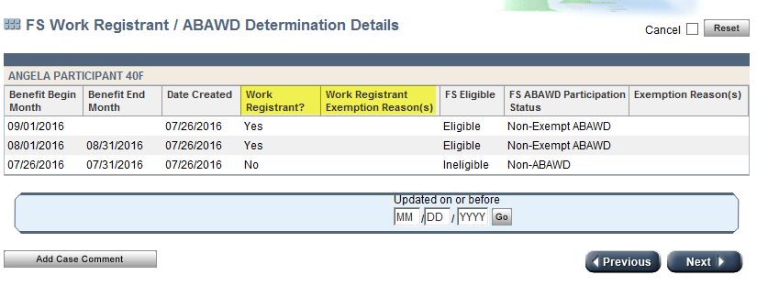
FS Work Registrant / ABAWD Determination Details Page
The ABAWD Determination Details page has been renamed to include Work Registrant status

Slide 15
What it Means to You….
At FS intakes, renewals, changes, you will have to ask some more questions, and have some more data entry

Slide 16
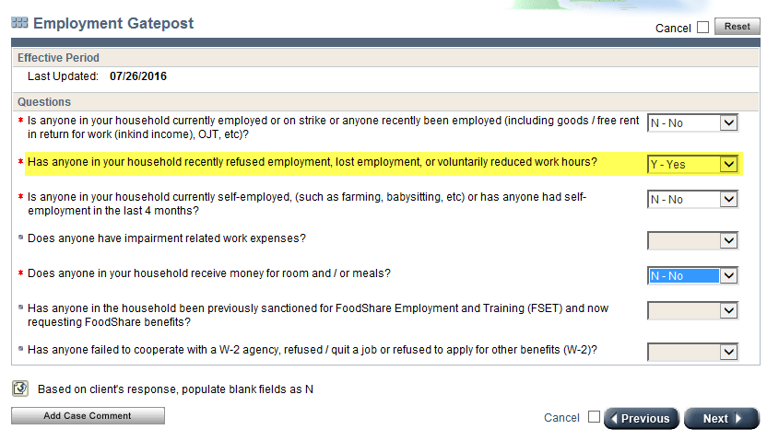
What to do if someone says YES
You must ask this question in the FS driver flow.
If someone says yes, you will get directed to the Loss of Employment page, and you will complete that.
You’ll have to start asking WHY their job ended.
Remember who is a mandatory work registrant, and who is not.

Slide 17
Exemptions from the Work Requirement
Under age 16, or age 60 or older
16 -18 year old enrolled in high school
Students of higher education at least half time
Physically or mentally incapable of employment
W-2 participants
Caring for dependent child under age 6, or incapacitated person
Applied for, or receiving Unemployment
Regular participation in AODA program
Employed / self-employed at least 30 hours per week (or earning the equivalent of min wage x 30 hrs per week)
Applied for SSI simultaneously, until DDB decision has been made

Slide 18

Wait, isn’t that the same as ABAWD?
Great observation, Harley!
It’s close, but not quite the same as ABAWD.

Slide 19
Work Registration Exemptions
ABAWD
Under age 16, or 60+
Student enrolled ½ time
Unable to work
W-2 participant
Caring for dependent child under 6 or incapacitated person
Unemployment – application or receiving
AODA participant
SSI application
Employed / self-employed at least 30 hours per week (or $935.25 monthly)
Non-ABAWD
  Under age 18, or 50+
  Unable to work
  Food unit with minor
  Pregnant
Exempt ABAWD
  Unable to work
  Chronic homelessness
  Unemployment – application or receiving
  AODA participant
  Eligible student
  Other work program
  Transitional FS
  Primary caregiver for dependent under 6 or incapacitated person

Slide 20
Loss of Employment Page
If your applicant has quit a job in the last 30 days (aka VQT), and they have no exemptions, they will be sanctioned.

Slide 21

Just remember….
Work registration is tied to the Employment Gatepost, or Employment Page
It is a part of non-financial eligibility.
If someone has refused, reduced, or quit, FoodShare they don’t git!

